Slide 1
iHEA Pre-Congress Session, Basel 14.07.2019 Session organizer: Siddharth Srivastava, Health Financing Specialist Swiss Tropical and Public Health Institute
Value of Health Insurance Data from a Public Health perspective
2th of July, 2019

Slide 2
Objective of the Workshop
To explore ways in which data from health insurance systems have been/can be used to provide insights for health system improvements in various settings.
→ we want to turn these into requirements for an open source analytics module for openIMIS.

Slide 3
Background: what is openIMIS?
open source software: free to download and use
helps to manage health financing processes, e.g. for a health insurance
integrates the key stakeholders in theses processes: beneficiaries, payers and providers
Functionalities
Enrolment; patient verification
Benefit packages (services and prices)
Contracted providers
Claims submission and review
Monitoring and reporting
supported by an international community

Slide 4
Background: openIMIS Initiative
Group of partners supporting and extending the reach of openIMIS globally
Funded by the Swiss and German development cooperations
Community of users, donors, implementers, and developers
Work towards the shared goal of improving health financing operations
Continuously engaged in openIMIS product development and its existing implementations through technical expertise, knowledge sharing, and financial contributions
One of current developments: integration with DHIS2 for monitoring and reporting purposes

Slide 5
Relevance of these Discussions to the Initiative - I
CoP is important for us
A way to engage different groups is through thematic areas (data analytics)
Virtual and in person consultation rounds
Examples coming from such consultations:
S.No. | Use case | Why? | Challenges /Limitations
1. | Tracking of infectious diseases/ Triggering disease outbreak investigations | Demographics on individuals are useful for picking out disease patterns Claims data including diagnosis is relevant and an insurer actively scrutinizing leads to the claim data having better quality diagnosis reported Any new data sources from health facilities that is of good quality/is reliable is very valuable Claims payment mechanism requires facilities to report claims regularly (daily or even monthly), it could be a source of real time information The system could provide flags to disease surveillance teams to track abnormal patterns. | Quality of diagnosis made might be low Provider payment mechanism might influence reporting behaviour Tracking is not appropriate for highly infectious "Notifiable Diseases" (for eg. Ebola outbreaks) which require dedicated structures and systems in place

Slide 6
Relevance of these Discussions to the Initiative - II
All discussions are captured here: https://openimis.atlassian.net/wiki/spaces/OP/pages/822673472/Data+Analytics
If you would like to continue this discussion beyond this room (contribute further or see inputs of others) – please share your contacts of visiting cards and use the link above to follow this discussion

Slide 7
Format of the Workshop: Modified World Café
World Café is a method designed to collect as many ideas and comments as possible from a large group of participants within a relatively short time. This is how it works:
We’ll have two rounds of discussions in small groups of six people
At the beginning of the workshop, each group chooses a “host”, who will write down the results of the discussion on the table cloth provided
After the first round, all participants change table and form new groups, except for the host, who stays at the table and fills in the new discussants on what happened in the first round
After the second round, the groups pick two top insights from their table to present in the plenary

Slide 8
World Café: These are the Questions
Round 1: What are potential use cases of using health insurance data for health system improvements? Why?
Round 2: What are potential challenges, limitations or disadvantages of the suggested use cases?

Slide 9
World Café: This is the Timing
Round 1: 30 minutes, including 5 minutes at the beginning to get to know each other within your group
Round 2: 20 minutes, including 5 minutes to get to know each other within your new group and get filled in by your host about what has been discussed at your table in the first round

Slide 10
World Café: These are the Questions
Round 1: What are potential use cases of using health insurance data for health system improvements? Why?
Round 2: What are potential challenges, limitations or disadvantages of the suggested use cases?

Slide 11
openIMIS Community Resources
Implementations currently in 5 countries
Dedicated development teams
Implementation support teams
across Asia, Africa and Europe!
www.openimis.org - Home of the openIMIS Initiative
Strategic direction given by a Steering Group
Technical directions guided by a Technical Advisory Group
openIMIS wiki - Read more about openIMIS
www.github.com/openimis - Download software and source code
openIMIS Demo: demo.openimis.org - use the demo now !
openIMIS Service Desk- report issues, bugs, or feature requests !

Slide 12
Thank you!

Slide 13
Top 2 insights - I
S.No. | Round 1: What are potential use cases of using health insurance data for health system improvements? Why? | Round 2: What are potential challenges, limitations or disadvantages of the suggested use cases?
Table 1
1 | Outcome measures, epidemiological studies, Post marketing surveillence (monitoring impact of drugs after approval and introduction into market) | Quality of diagnosis made and representation of the dataset would pose challenges
2 | Understanding provider behaviour, resource allocation and health inequities | Insurance databases dont talk to each other and population sub groups split across different systems would pose problems
Table 2
1 | Disease based costing, measuring effects of changes to Health Policy (eg. OOP expend. By HH or uptake of services by area, diseases, etc.) | Who owns the data, how is access to data governed and how do researchers access such data are hurdles
2 | Checking adherence to treatment guidelines as well understanding practiced treatment pathways to update/improve guidelines. | In complete and non representative data set (if whole population is not in the system) could impact results

Slide 14
Top 2 insights - II
S.No. | Round 1: What are potential use cases of using health insurance data for health system improvements? Why? | Round 2: What are potential challenges, limitations or disadvantages of the suggested use cases?
Table 3
1 | Inequities across population sub groups, geographical differences, Immigration status, etc. | Lack of standardization (records not provided with the same structure) and regularization (timeliness of submission) of data
2 | Understanding outcomes (prescribing behaviour, moral hazard, etc.) including through capture of additional data (eg. feedback could include capturing informal payments, similarly other data capturing opportunities (enrol or renewal) to capture more information to complement outcome parameters) | Additional data capturing requires more thought in order to keep it representative, meaningful and practical
Table 4
1 | Understanding differences between private and public sector service provision | Data is fragmented and not linked, Inefficiences in collection and sharing causes hurdles, Ownership of data, infrastructure to make it work, lack of standards and common data elements, lack of human capital (IT and non IT), lack of timely reporting and low quality of data are hurdles
2 | Excess use of drugs

Slide 15
Discussion summary – Table 1

Slide 16
Discussion summary – Table 2

Slide 17
Discussion summary – Table 3

Slide 18
Discussion summary – Table 4

Slide 19
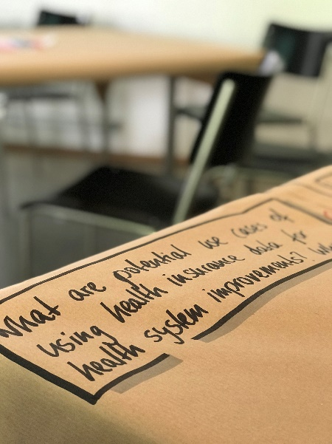
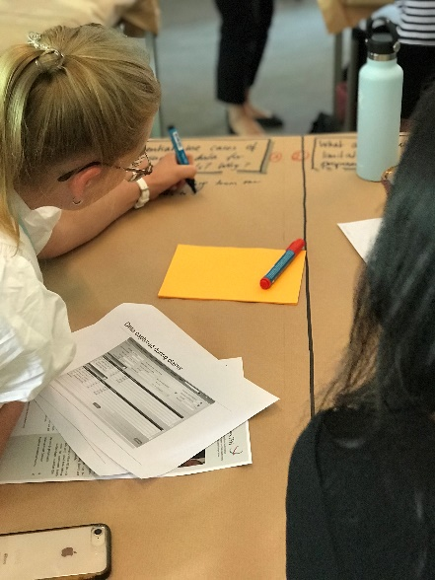
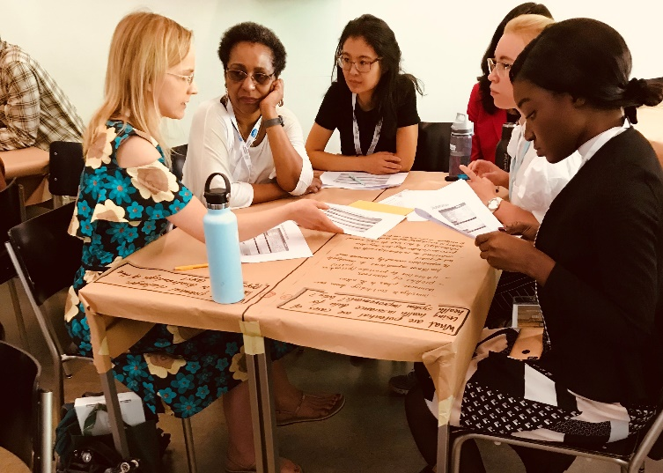
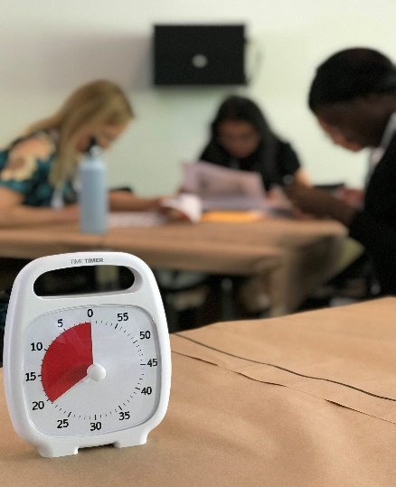
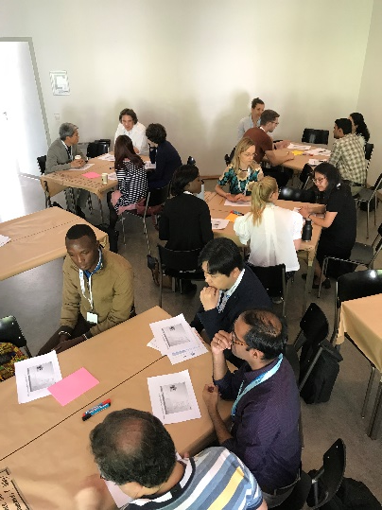
Glimpses from the session

