Slide 1






A global good for health financing operations
Uwe Wahser @ OpenHIE Community Meeting, Addis Abeba, 06.11.2019

Slide 2
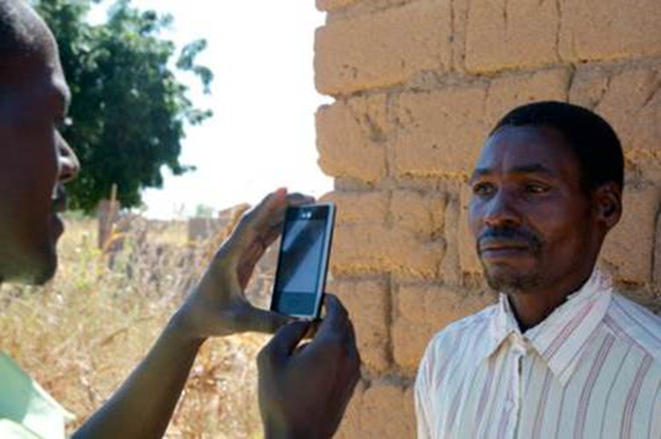

What is openIMIS?
openIMIS is an
open source software for improving health financing operations by digitalizing the link between patients, providers and payers
Based on a
community of developers, users and implementers
With the joint mission to
increase and improve universal health coverage (UHC)

Slide 3
From MS IMIS to openIMIS
Modular Architecture Transformation & Community Building
IMIS for Tanzania CHF
by SwissTPH,
Exact Software,
MicroInsurance Academie
IMIS Customization for Nepal
openIMIS Master Version
(TZ+CM+NP)
2012
2014
2017
2019
2013
2016
2018
2020
openIMIS Initiative
(SDC & GDC)
openIMIS Community
Pilots in DRC, Chad
Various country assessments among them Cameroon, Rwanda
IMIS Customization for Cameroon
Continuous development & community Building

Slide 4
Slow Transition (Current Roadmap)
Framework
openIMIS
MS IMIS
Claiming
Facility Registry
(Module Y)
openHIE Integration
Indicator Dashboard
Claims Adjudication - AI
(Formal Sector Schemes)
Releases:
April 2019
October 2019
April 2020

Slide 5
Teams in Developers Committee
Continuity
Re-Architecture
Interoperability
Maintenance & Support
Modular Transformation
Digital Square Notice C1
HISP India
SwissTPH
SwissTPH
BlueSquare
SolDevelo
SolDevelo
Possible Health
Coordination Desk
GIZ

Slide 6
Integration into OpenHIE
DHIS2
BAHMNI
Odoo
OpenELIS
openIMIS
OpenMRS
OpenMRS
OpenHIM
BlueSquare
SolDevelo
Possible Health
HISP India

Slide 7

Vision: Integrated Workflows (e.g. Claiming)
Insurance Mgmt
Client Registry:
Medic CR
Insurance Adjudication
openIMIS
3
5
2
FHIR Data Store:
Hearth
Interop Layer:
OpenHIM
1
EMR:
OpenMRS
Source: Carl Leitner @ AEHIN Conference 2018
Notes:
Missing:
- Payment notification

