Slide 1






A global good for health financing operations
openIMIS @ OpenHIE *-a-thon,
Addis Abeba, 06.11.2019

Slide 2
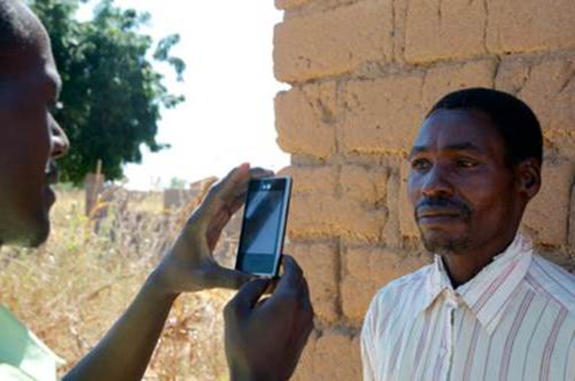
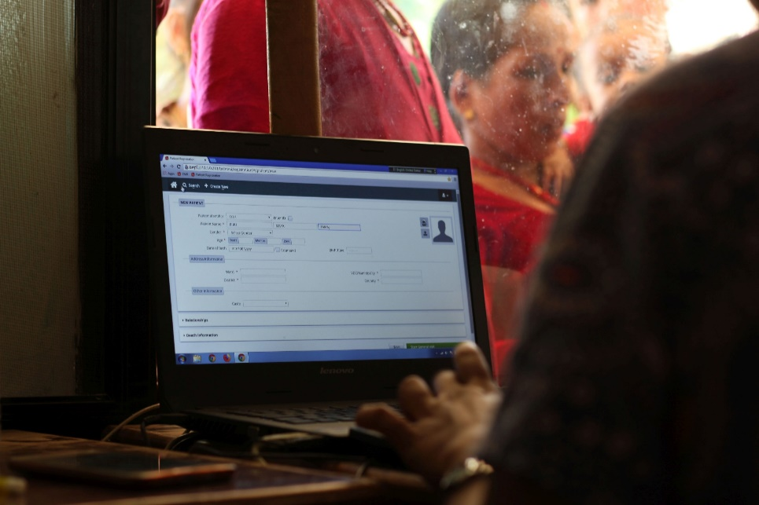
What is openIMIS?
openIMIS is an
open source software for improving health financing operations by digitalizing the link between patients, providers and payers
Based on a
community of developers, users and implementers
With the joint mission to
increase and improve universal health coverage (UHC)

Slide 3
Teams in Developers Committee
Continuity
Re-Architecture
Interoperability
Maintenance & Support
Modular Transformation
Digital Square Notice C1
HISP India
SwissTPH
SwissTPH
BlueSquare
SolDevelo
SolDevelo
Possible Health
Coordination Desk
GIZ

Slide 4
Integration into OpenHIE
DHIS2
BAHMNI
Odoo
OpenELIS
openIMIS
OpenMRS
OpenMRS
OpenHIM
BlueSquare
SolDevelo
Possible Health
HISP India

Slide 5

Vision: Integrated Workflows (e.g. Claiming)
Insurance Mgmt
Client Registry:
Medic CR
Insurance Adjudication
openIMIS
3
5
2
FHIR Data Store:
Hearth
Interop Layer:
OpenHIM
1
EMR:
OpenMRS
Source: Carl Leitner @ AEHIN Conference 2018
Notes:
Missing:
- Payment notification

Slide 6
Goals for today
Digital Square Teams (connectity):
Level 1:
  Do the peer-to-peer connections work?
Level 2:
  Can we set this up with OpenHIM?
Architecture Teams:
How do we develop a messaging plugin in openIMIS to push messages to OpenHIM?
Anyone:
Feel free to join any of the openIMIS members
We all have VMs with complete development environments on our machines.

