Slide 1
openIMIS Demo – Offline version
(shortened version)
02.10.2019
Introduction -
openIMIS system characteristics & data captured

Slide 2

Overview
openIMIS
Data flow 1
Access to the system 2
Data captured 3
Beneficiary related 3a
Claims related 3b
Configuration related data 3c
Reporting and data analysis 3d

Slide 3
Overview
openIMIS
Data flow 1
Access to the system 2
Data captured 3
Beneficiary related 3a
Claims related 3b
Configuration related data 3c
Reporting and data analysis 3d

Slide 4




Communication within openIMIS
Central Server
Internet
Internet
Physical transport
online
mobile
offline

Slide 5
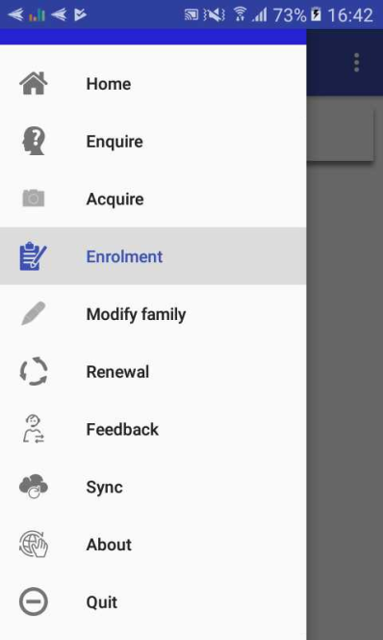
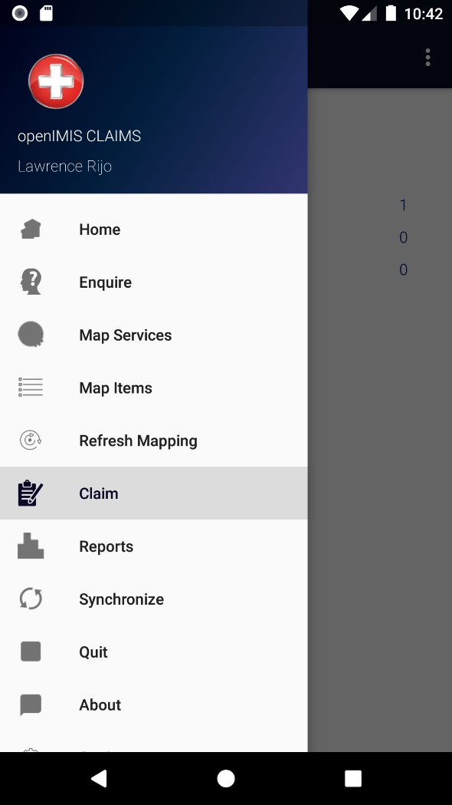
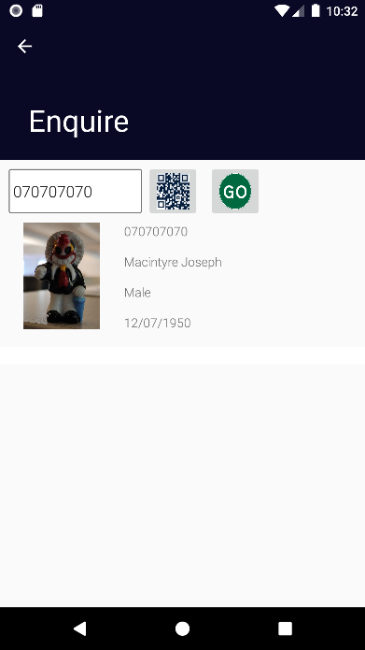
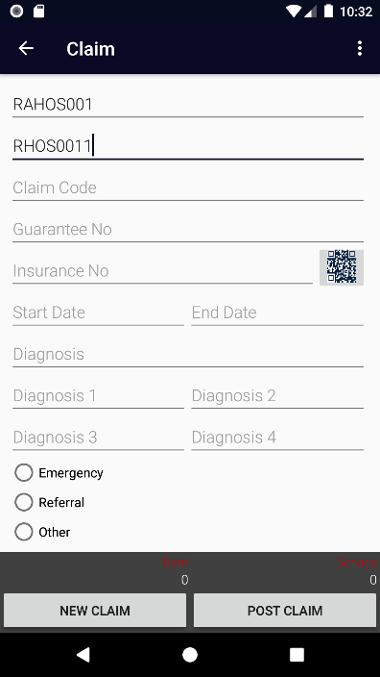
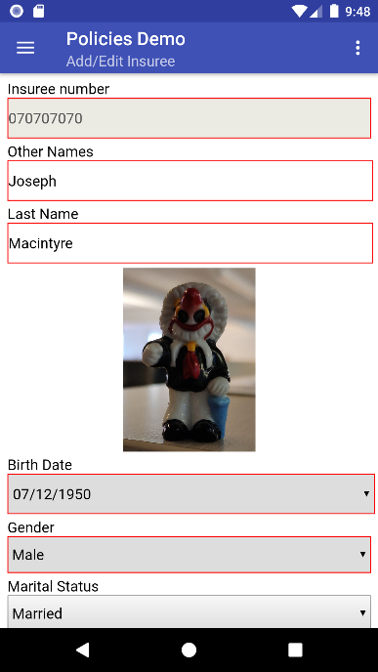
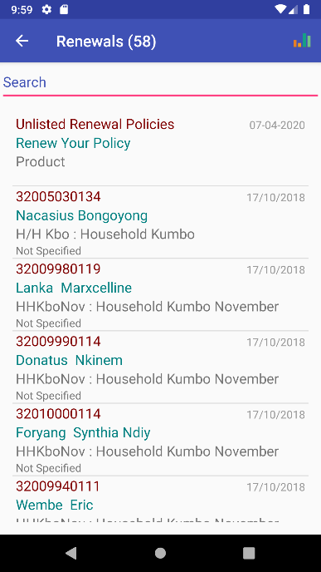
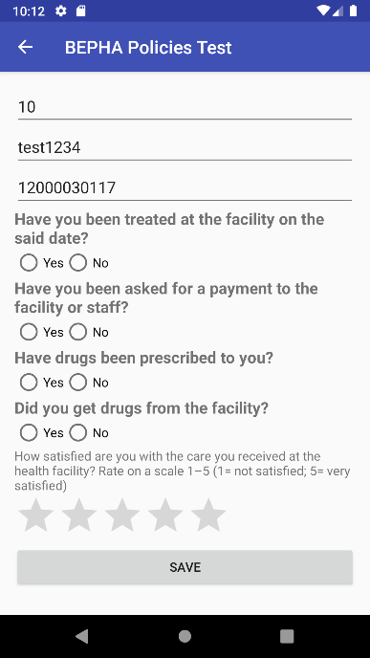
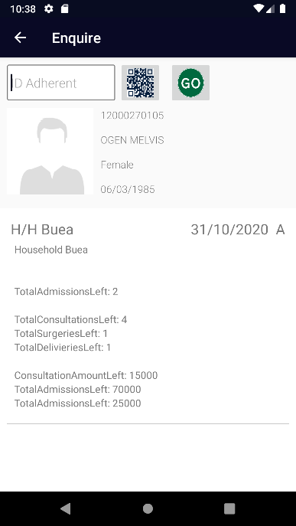
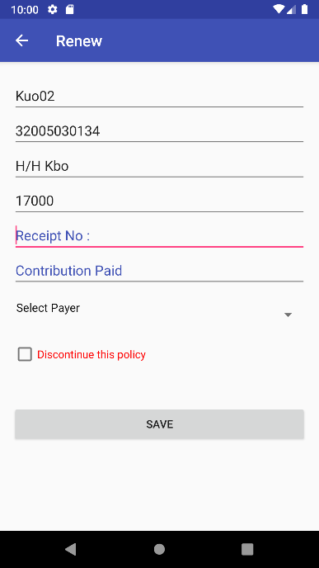
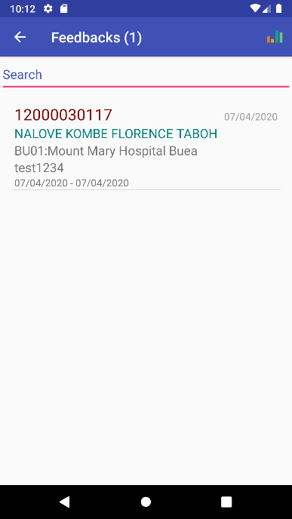

Mobile phone applications
Insurance Agent
Server
Health Facility Staff
Mobile network
Acquiring of
Photos & Data
Renewal
of a policy
Acquiring
of feedbacks
Retrieving
of coverage
Submission of claims

Slide 6

Data flow with mobile apps
Central Server
Internet
Extract
Upload
(Login credentials)
Upload
(Login credentials)
Master Data
Extract
EO/CA Code
Data entry
Extract

Slide 7

Data flow with offline components
Central Server
Internet
1. Downloading of data extract from server
2. Uploading of data extract
3.Data entry on offline client
Physical transport
Online client
5. Uploading of entered data
Offline client
4. Downloading of entered data

Slide 8
Overview
openIMIS
Data flow 1
Access to the system 2
Data captured 3
Beneficiary related 3a
Claims related 3b
Configuration related data 3c
Reporting and data analysis 3d

Slide 9
Access to the system
Based on Role and Location which in openIMIS is configured through:
Location – Levels
Profiles (to define roles)
User account creation and allocation of role and location

Slide 10
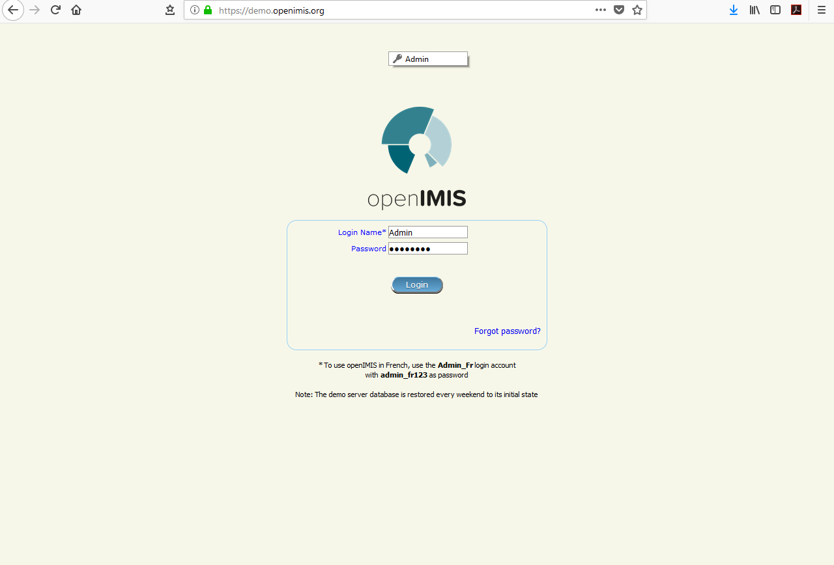
Login Screen

Slide 11
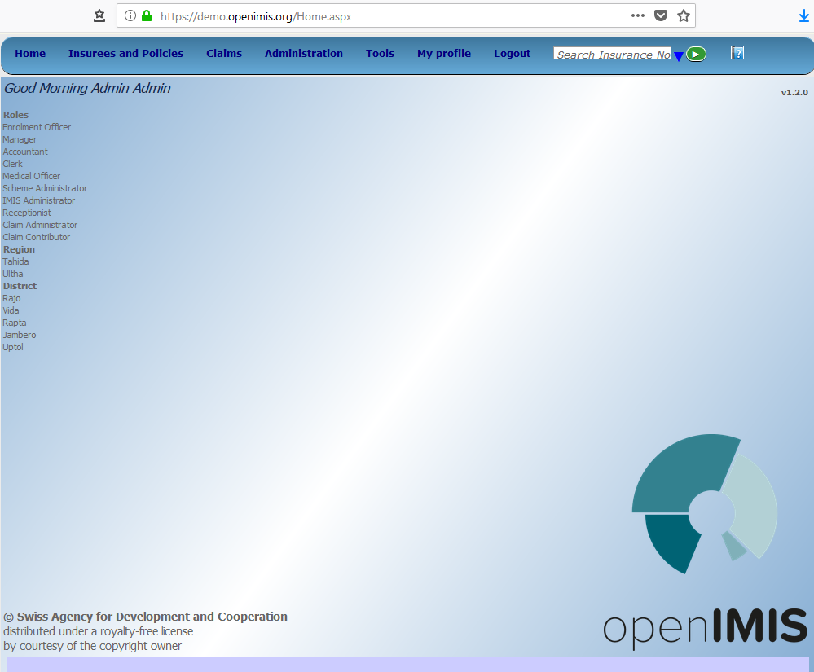
Home page

Slide 12
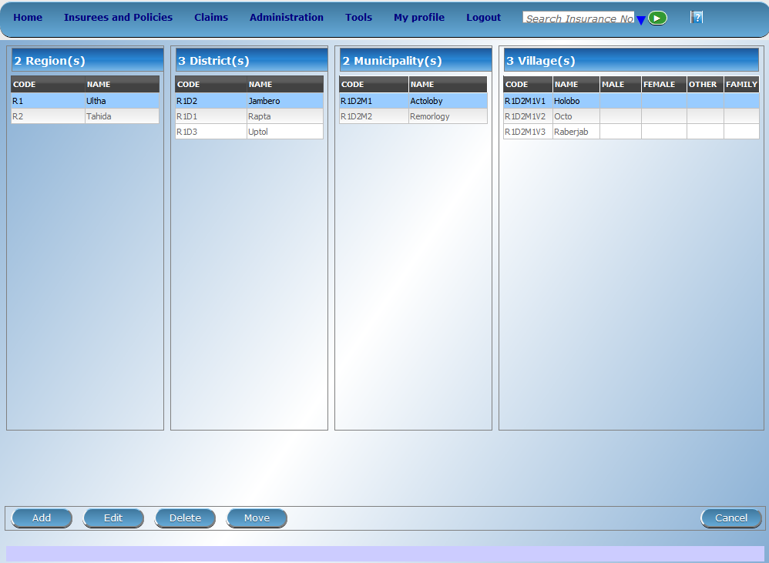
Locations

Slide 13
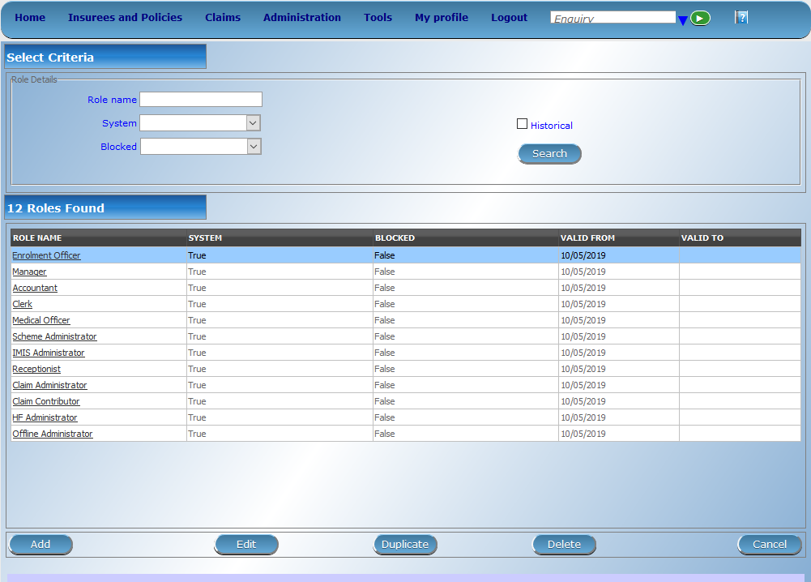
Profiles – I

Slide 14
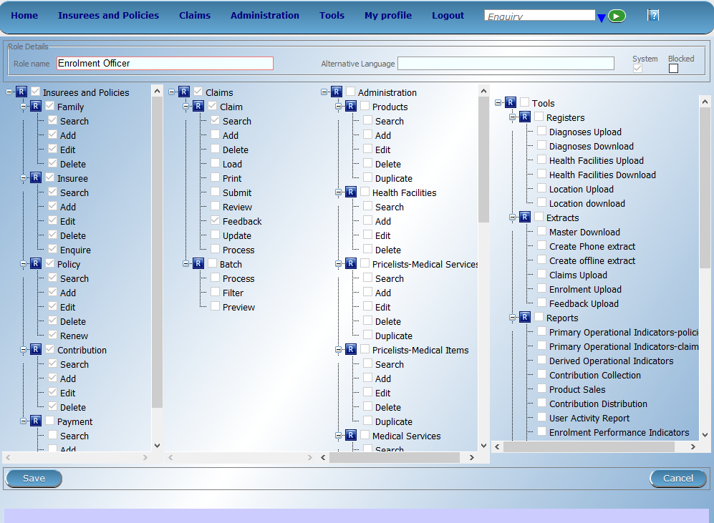
Profiles - II

Slide 15
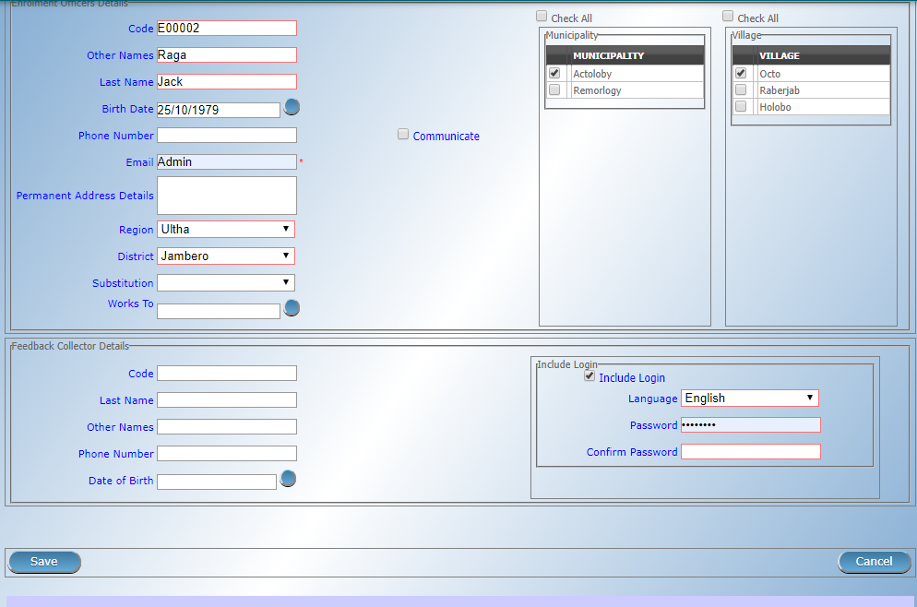
User account: Enrolment Officers

Slide 16
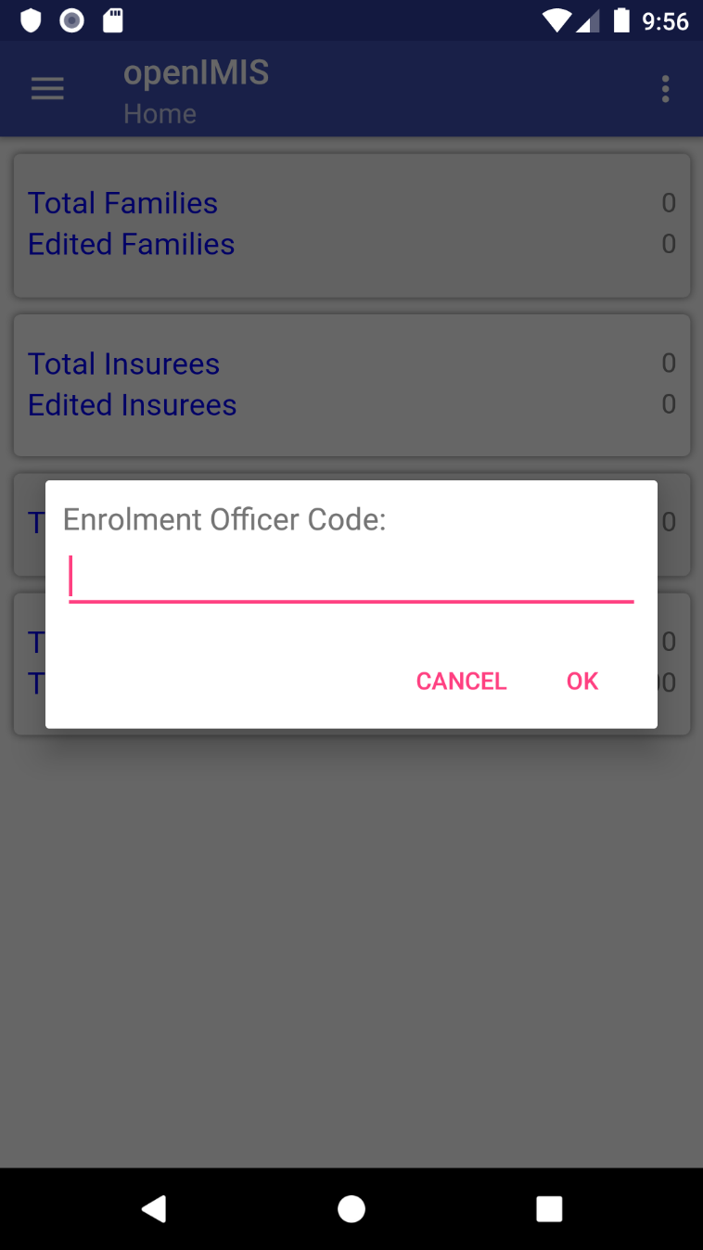
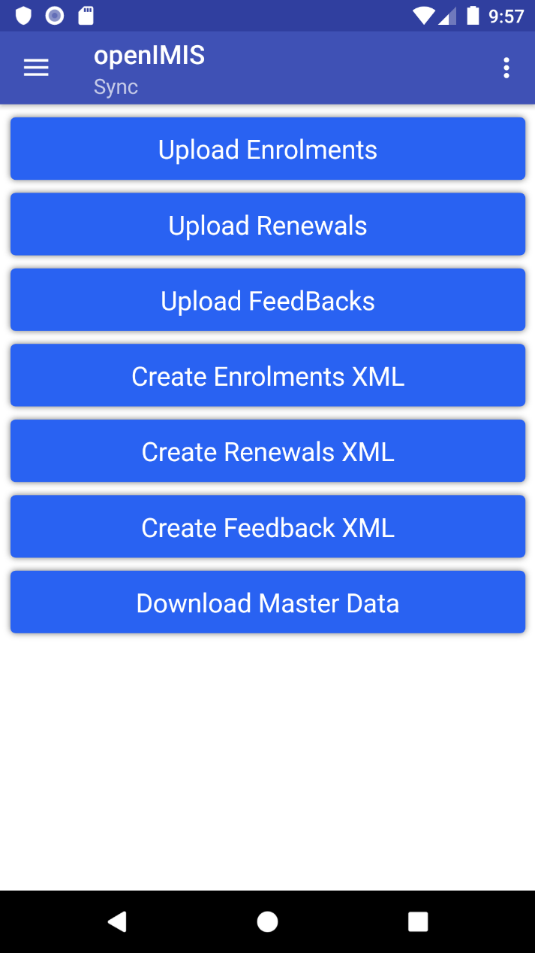
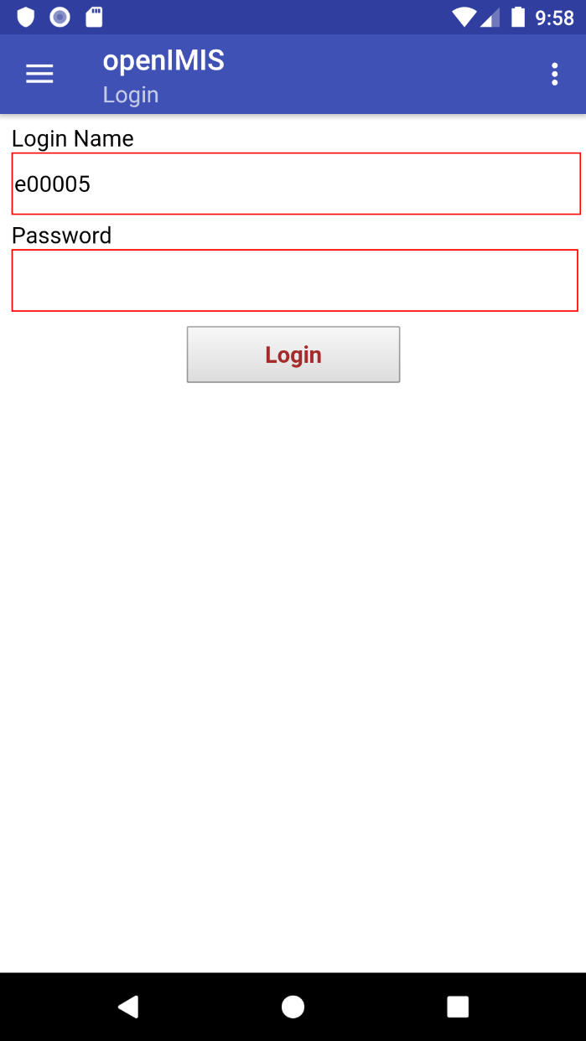
User account in apps: Enrolment Officers

Slide 17
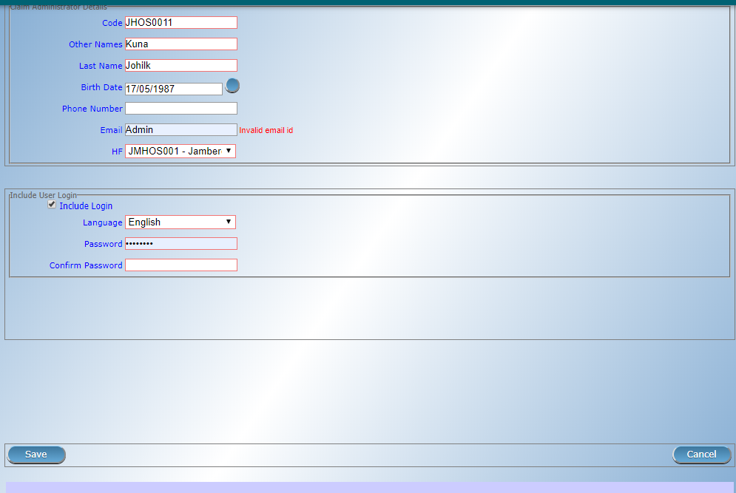
User account: Claim administrators

Slide 18
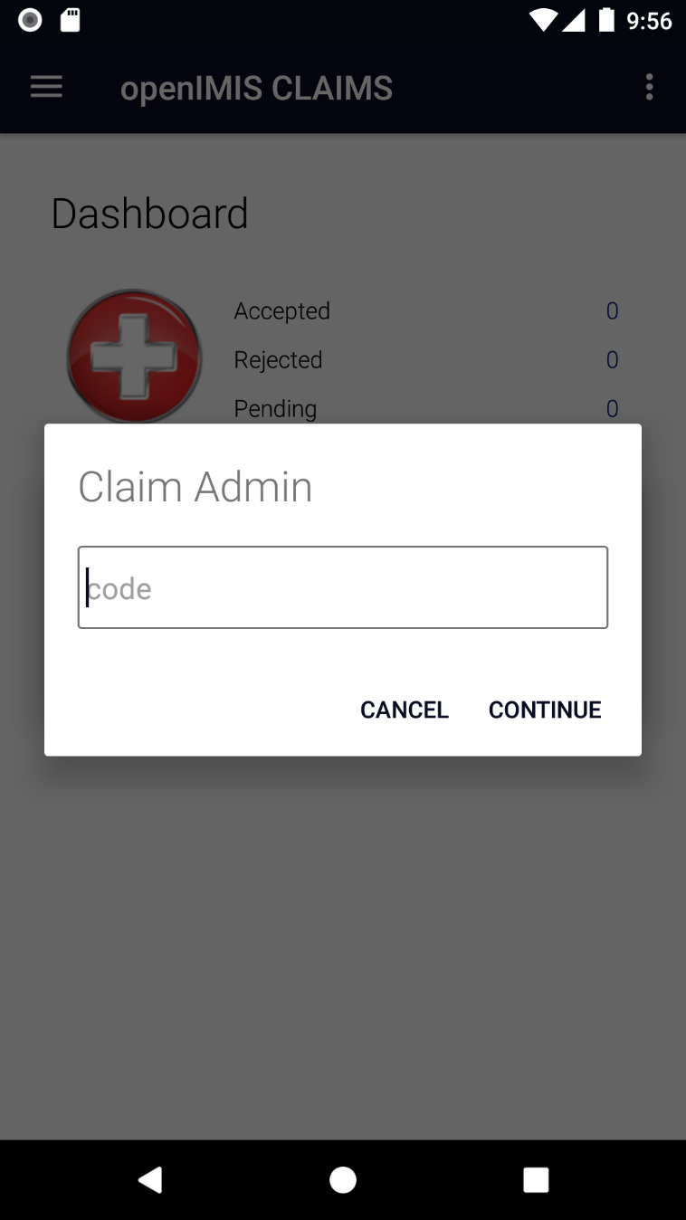
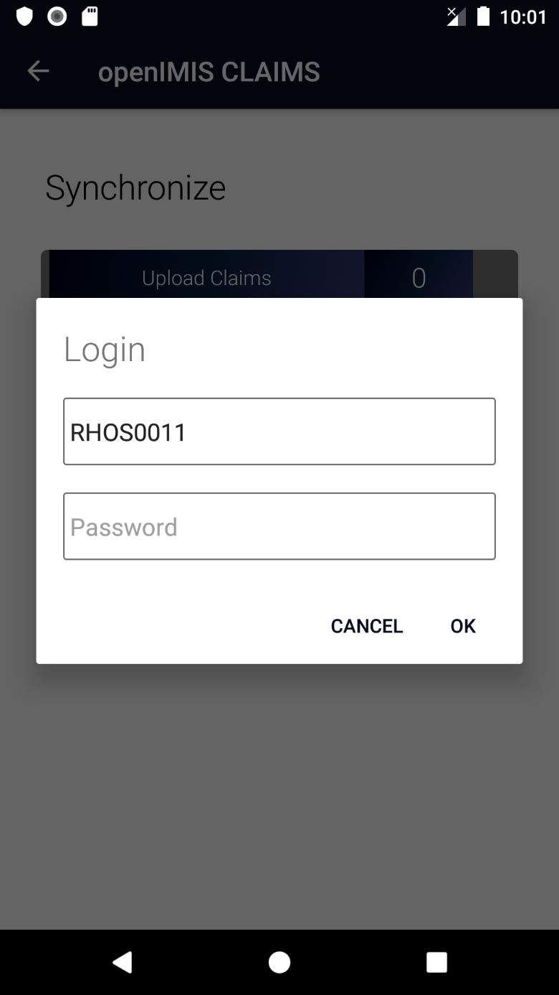
User account in apps: Claim admin

Slide 19
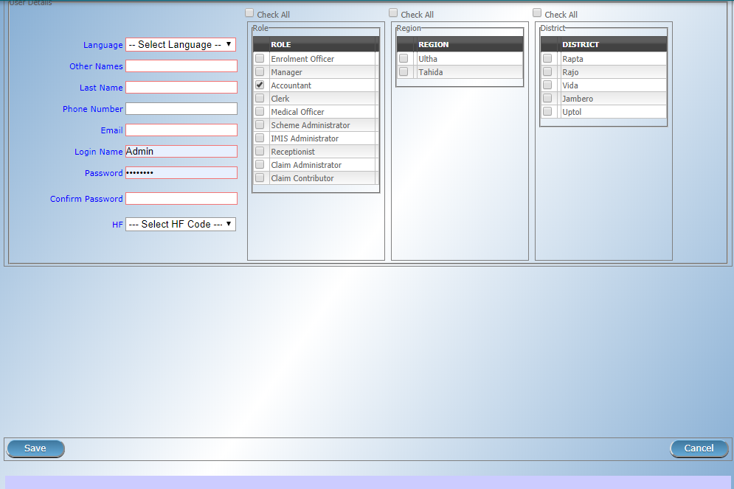
User account: Other Users

Slide 20
Overview
openIMIS
Data flow 1
Access to the system 2
Data captured 3
Beneficiary related 3a
Claims related 3b
Configuration related data 3c
Reporting and data analysis 3d

Slide 21
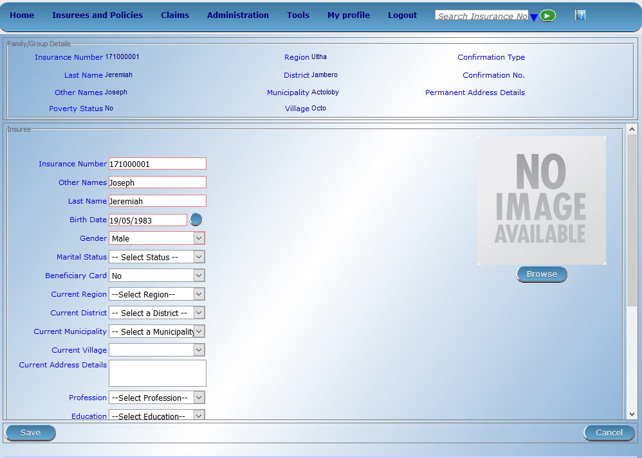

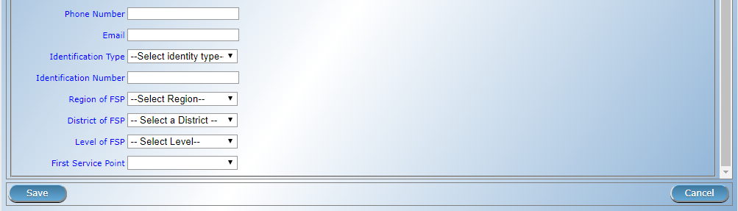
Beneficiary data - I

Slide 22
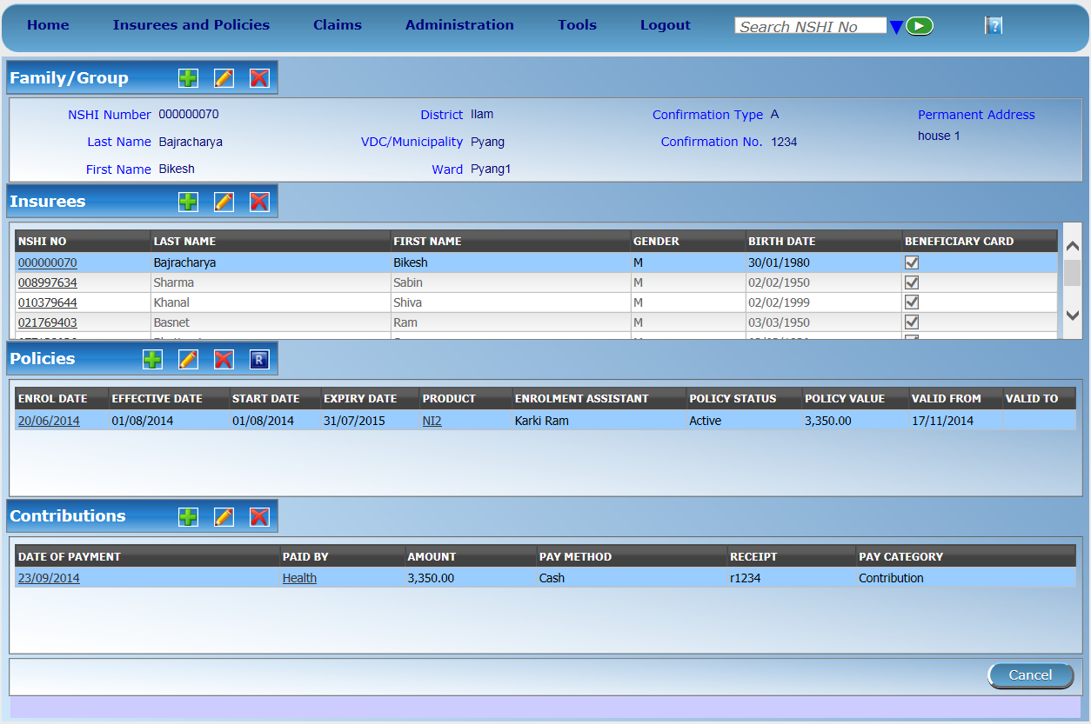
Beneficiary data - II

Slide 23
Overview
openIMIS
Data flow 1
Access to the system 2
Data captured 3
Beneficiary related 3a
Claims related 3b
Configuration related data 3c
Reporting and data analysis 3d

Slide 24
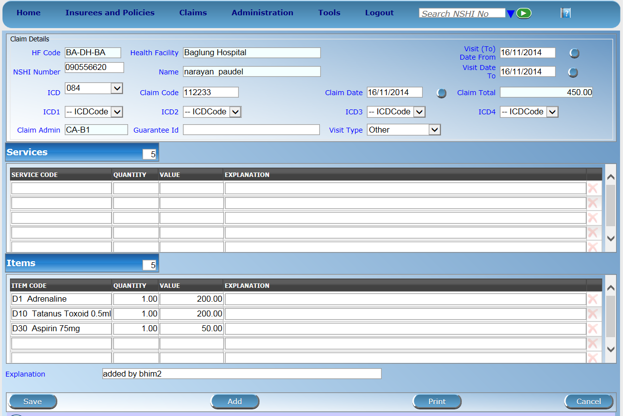
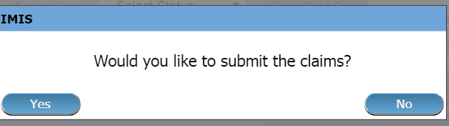
Claim entry page

Slide 25
SECTION 2

Slide 26
Overview
openIMIS
Data flow 1
Access to the system 2
Data captured 3
Beneficiary related 3a
Claims related 3b
Configuration related data 3c
Reporting and data analysis 3d

Slide 27








Construction of a scheme I
Purchaser
Provider
Type of facility
Services/Items
Price Lists
Contract
Contract
Client

Slide 28






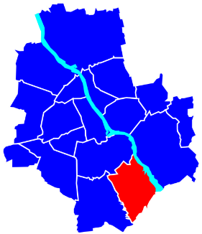
Construction of a scheme II
General definition of registers:
User Profiles
Diagnosis List
Users
Medical services
Products
Enrolment officers
Claim Administrators
Medical Items
Health facilities
Payers
Price lists
Locations

Slide 29
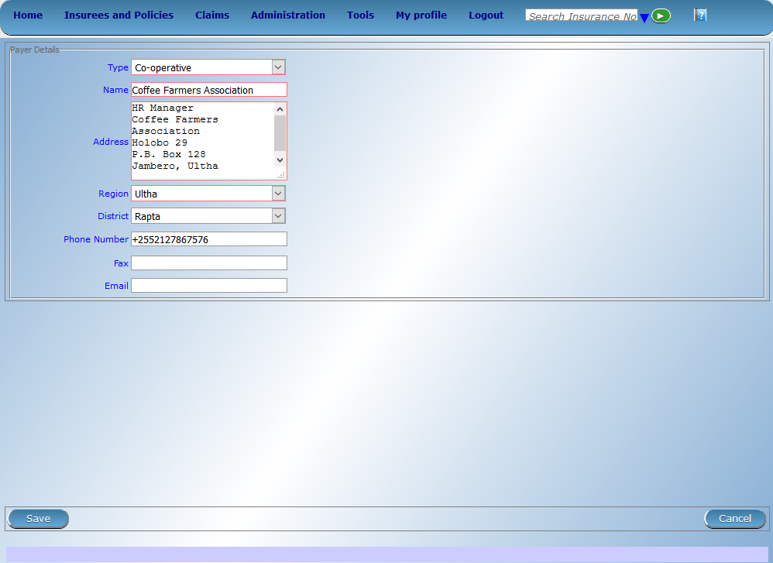
Payers

Slide 30
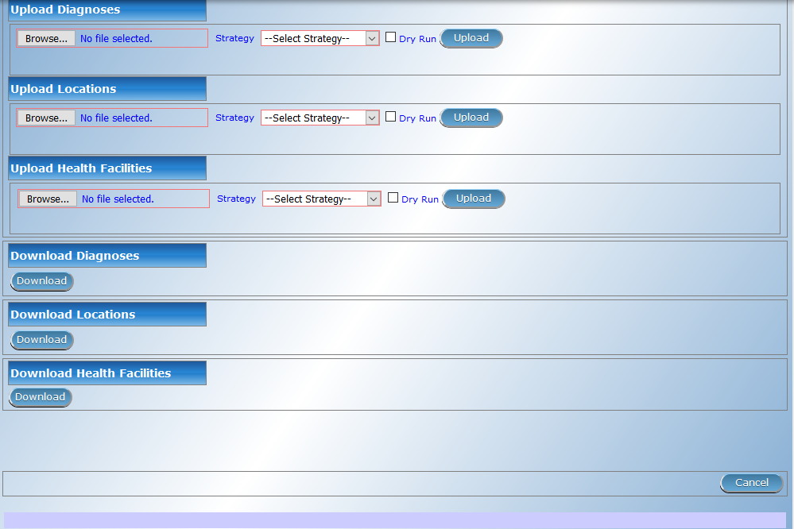
Diagnosis List

Slide 31
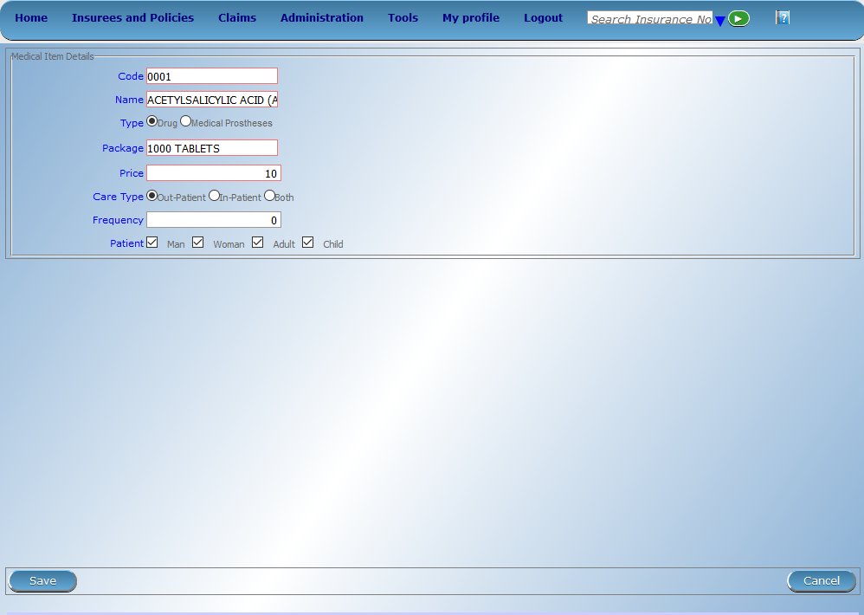
Medical Items

Slide 32

Medical Services

Slide 33
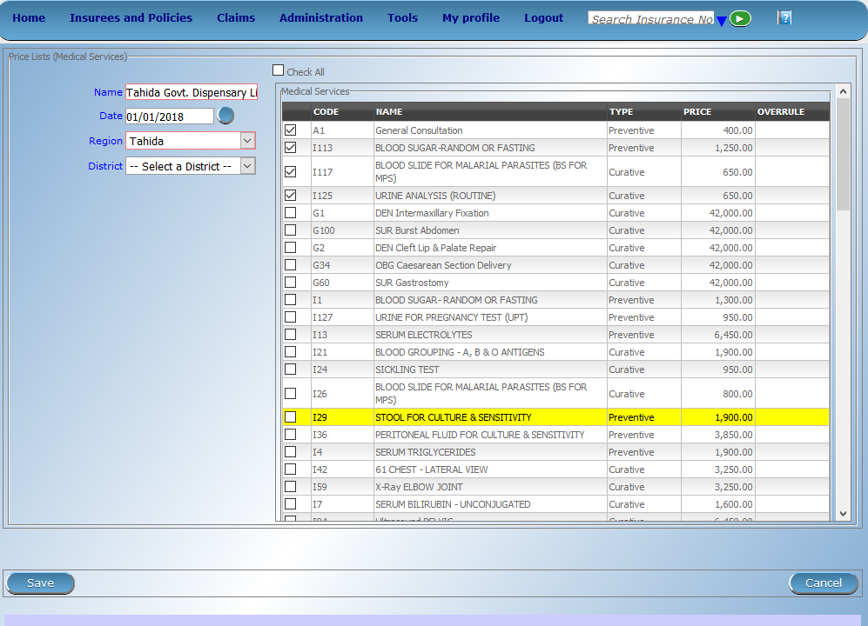
Price List -> Medical Services

Slide 34

Price List -> Medical Items

Slide 35
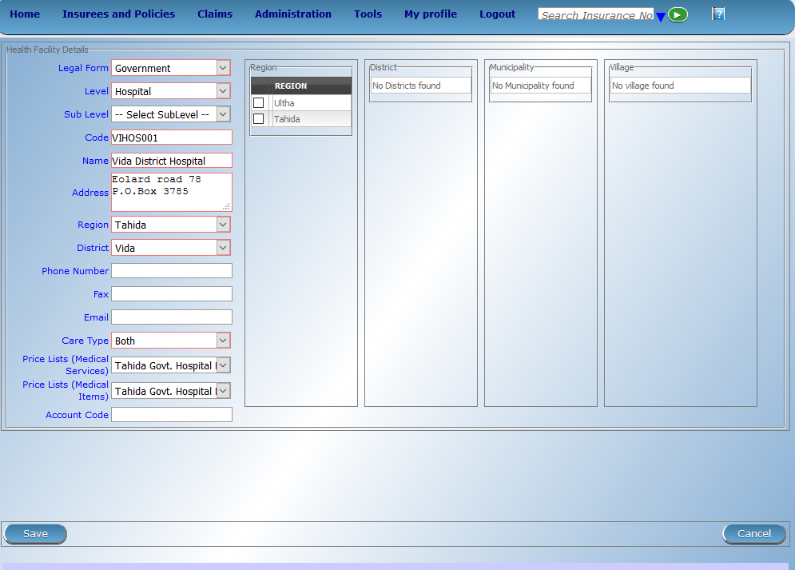
Health Facilities

Slide 36
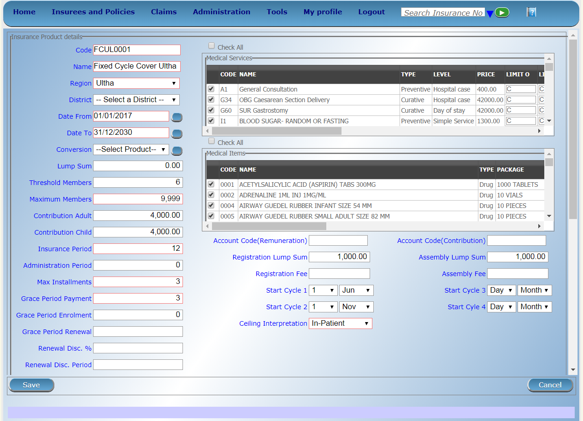
Products – I

Slide 37
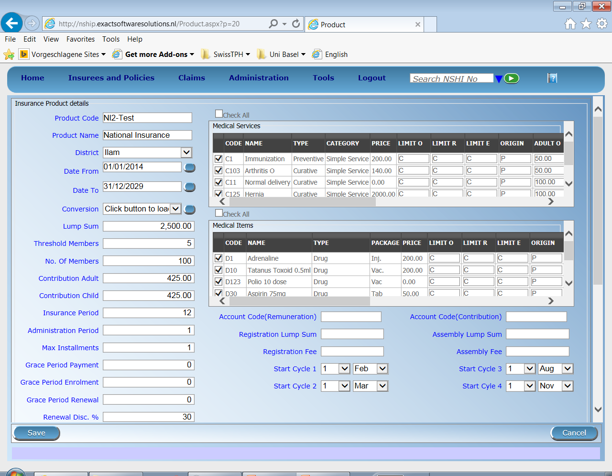
Products – II

Slide 38
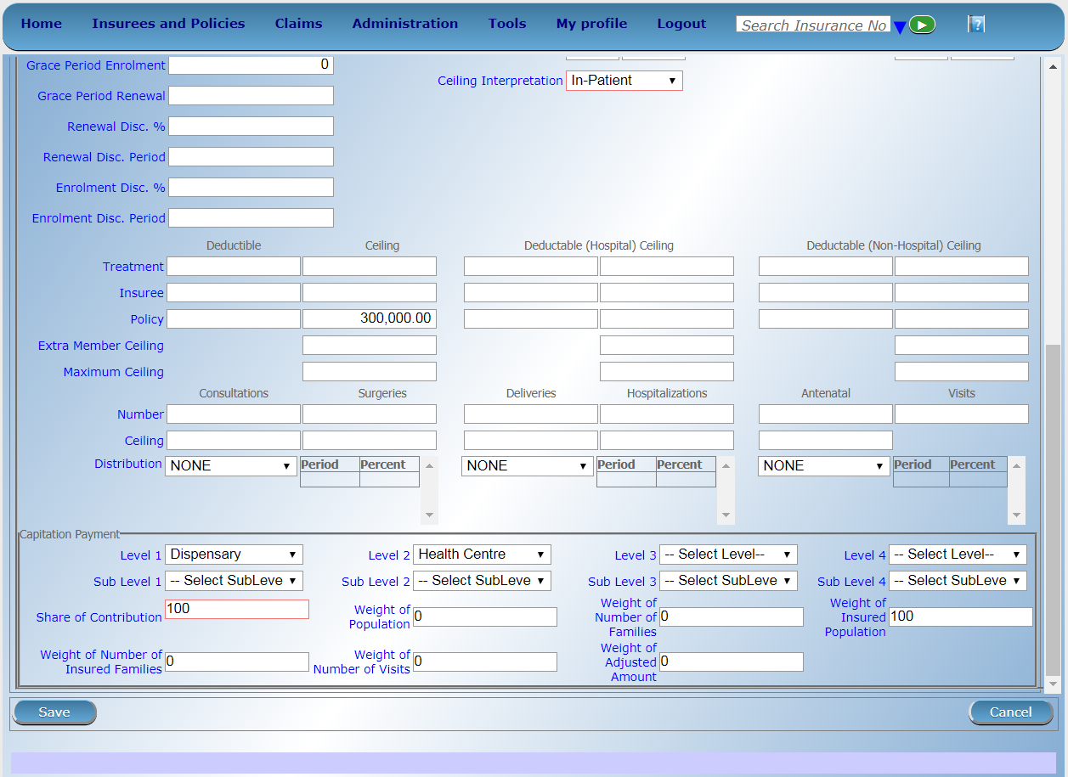
Products – III

Slide 39
SECTION 3

Slide 40
Overview
openIMIS
Data flow 1
Access to the system 2
Data captured 3
Beneficiary related 3a
Claims related 3b
Configuration related data 3c
Reporting and data analysis 3d

Slide 41
Types of reports
Standard operational reports
Customizable reporting options

Slide 42
Standard operational reports
Reports on management of families, insurees, policies, premiums, claims:
Primary Operational Indicators-policies & claims
Derived Operational Indicators
Contribution Collection
Product Sales
Contribution Distribution
User Activity Report
Enrolment Performance Indicators
Status of registers
Insurees without photos
Matching Funds
Claim Overview
Percentage of Referrals
Families and Insurees Overview
Pending Insurees
Renewals
Capitation Payment
Rejected Photos

Slide 43
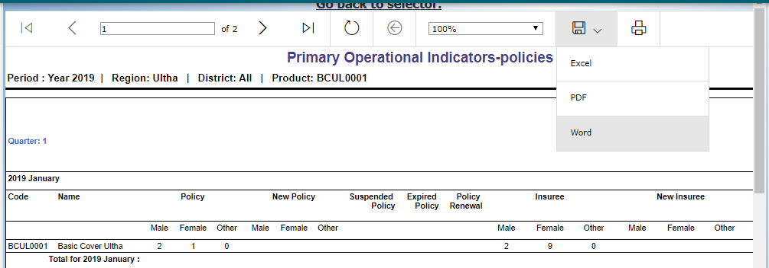
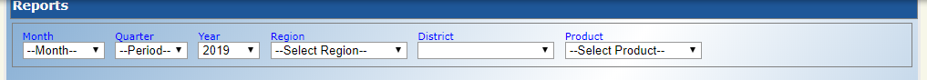
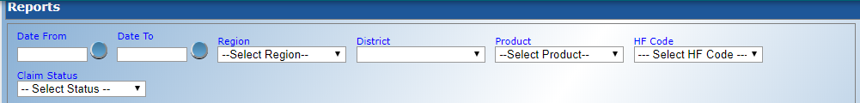
Generation of standard reports

Slide 44
Customizable reporting options – DHIS 2
Server
FHIR Server/FHIR Reference Module
DHIS 2 FHIR Adapter
Operational database of openIMIS
mobile
DHIS 2 Tracker
online client
Aggregation
DHIS 2
offline client
Dashboards

Slide 45
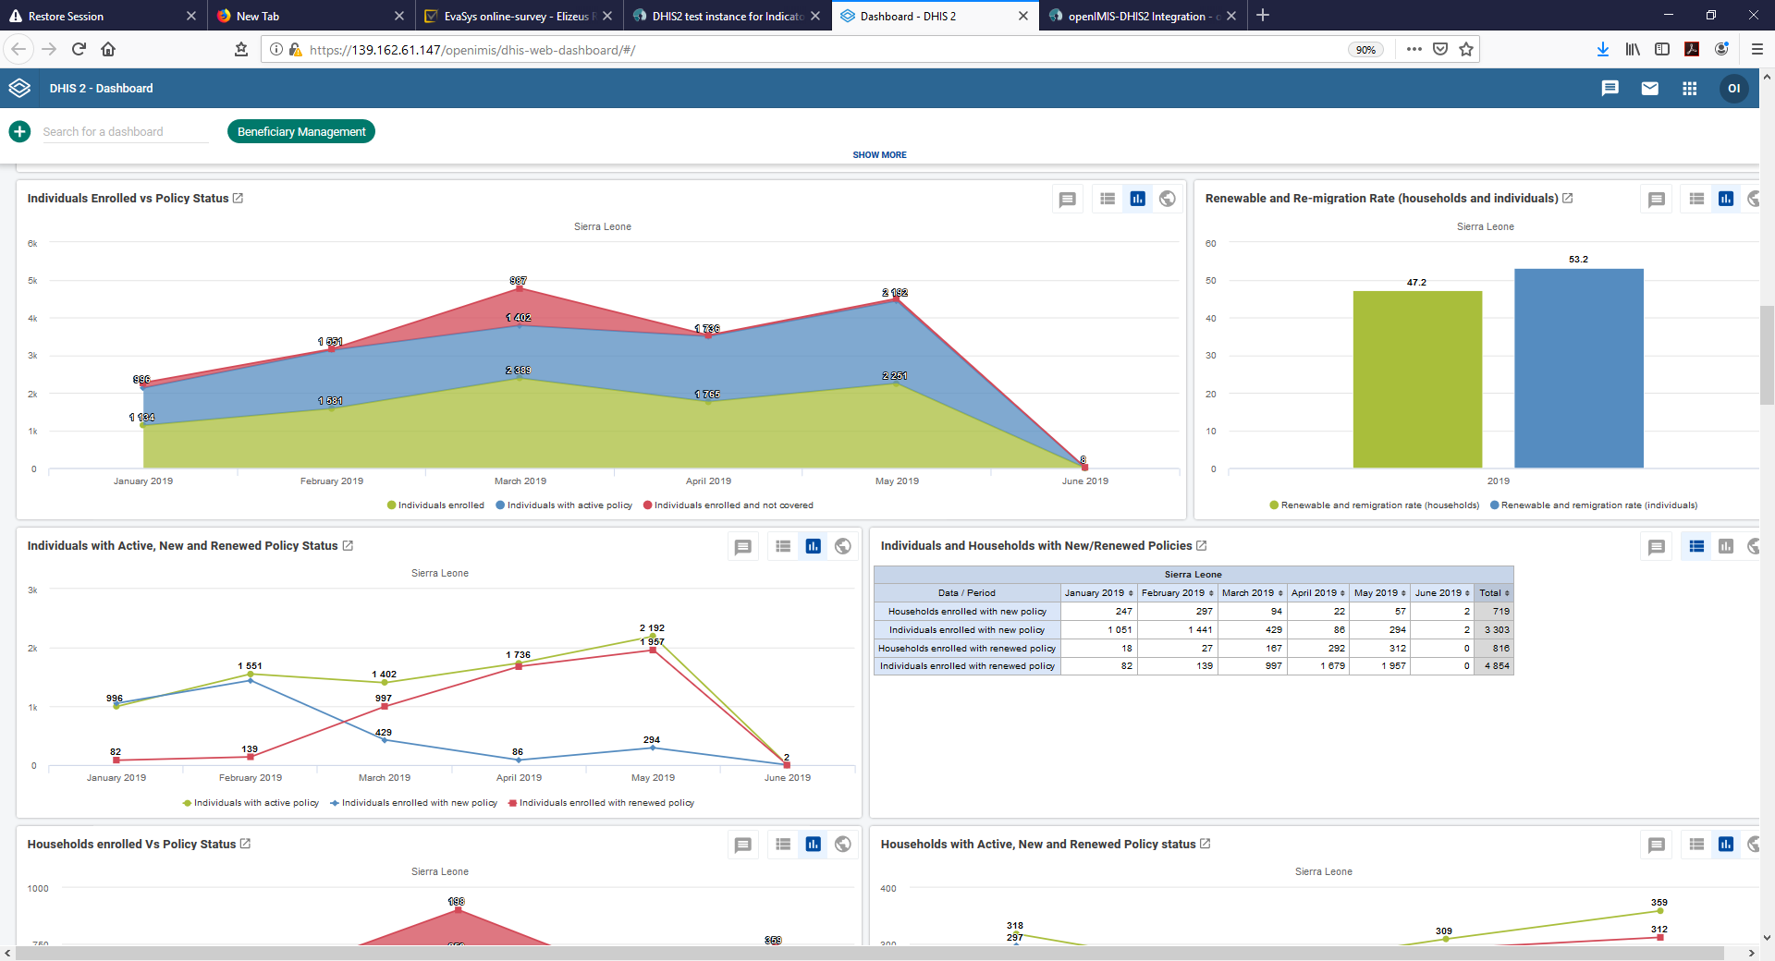
Customizable reporting options – dashboards

Slide 46
Attributions for icons
Creative Commons CC BY 3.0 license applies to all icons:
Payment by Loki Ba / CC BY 3.0
Hospital by ibrandify / CC BY 3.0
Hospital by Vectors Point / CC BY 3.0
Pharmacy by Eucalyp / CC BY 3.0
Medication by sahua d / CC BY 3.0
Network by Creative Stall / CC BY 3.0
Worker by Nikita Kozin / CC BY 3.0
Contract by Adrien Coquet / CC BY 3.0
Family by Gan Khoon Lay / CC BY 3.0

Slide 47



Thank you!
Except where otherwise noted, this work is licensed under
https://creativecommons.org/licenses/by-sa/4.0/legalcode

