Slide 1
Introduction - openIMIS system characteristics & data captured

Slide 2
Overview
Data flow
Access to the system
Data captured
  Beneficiary related
  Claims related
  Configuration related data
  Reporting and data analysis
Notes:
Configuration
Split by process
Reporting

Slide 3

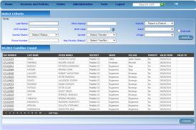





Communication within openIMIS
central server
Internet
Internet
Internet
physical
transport
on-line
mobile
off-line

Slide 4


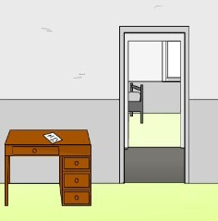
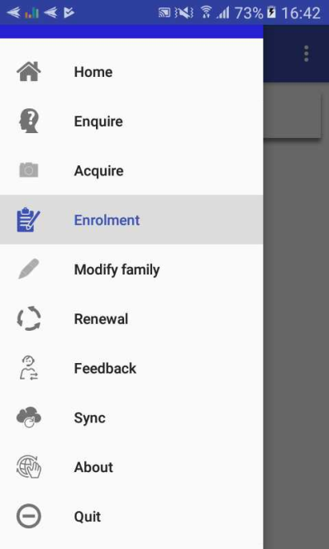
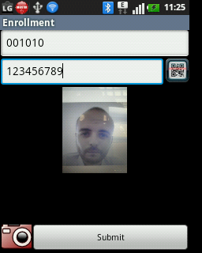
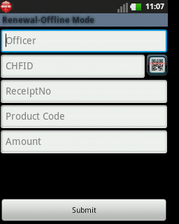
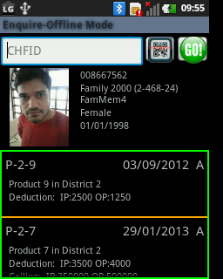
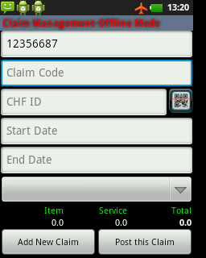
Mobile phone applications
server
mobile
network
acquiring of
Photos & data
renewal
of a policy
acquiring
of feedbacks
retrieving
of coverage
submission
of bills

Slide 5
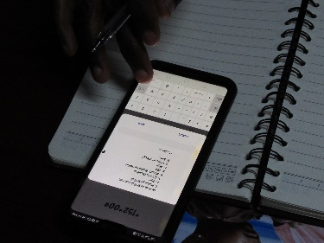
Data flow with mobile apps
central server
Extract
Master Data
Upload
(Login credentials)
Upload
(Login credentials)
Data entry
EO/CA Code
Extract
Extract

Slide 6
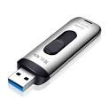

Data flow with offline components
Internet
network
central server
2. Uploading of data extract
3.Data entry on offline client
1. Downloading of data extract from server
on-line
client
5. Uploading of entered data
off-line
client
4. Downloading of entered data
Notes:
Scope of Off-line clients:
For households, adherents, policies:
BEPHA off-line client
For claims
Health facility off-line client

Slide 7
Overview
Data flow
Access to the system
Data captured
  Beneficiary related
  Claims related
  Configuration related data
  Reporting and data analysis
Notes:
Configuration
Split by process
Reporting

Slide 8
Access to the system
Based on Role and Location which in openIMIS is configured through:
Location – Levels
Profiles (to define roles)
User account creation and allocation of role and location

Slide 9
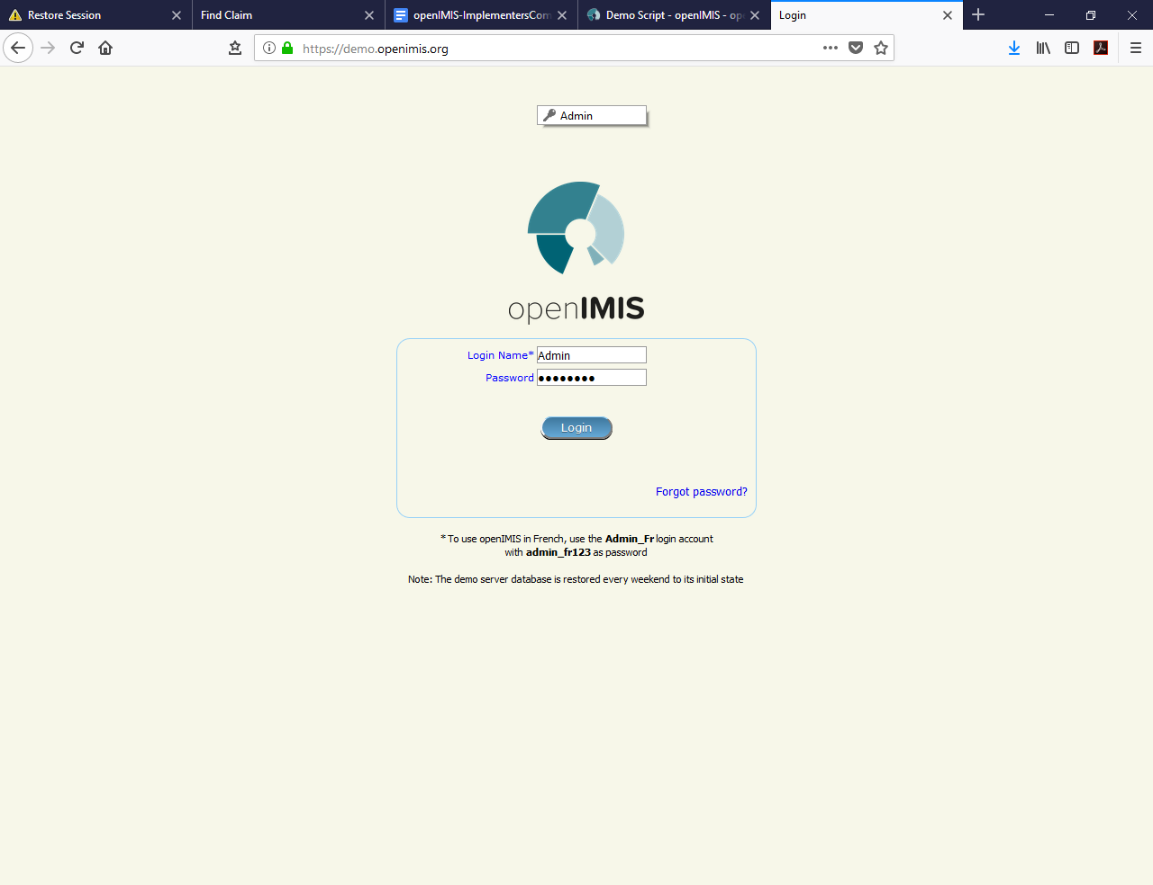
Login Screen

Slide 10
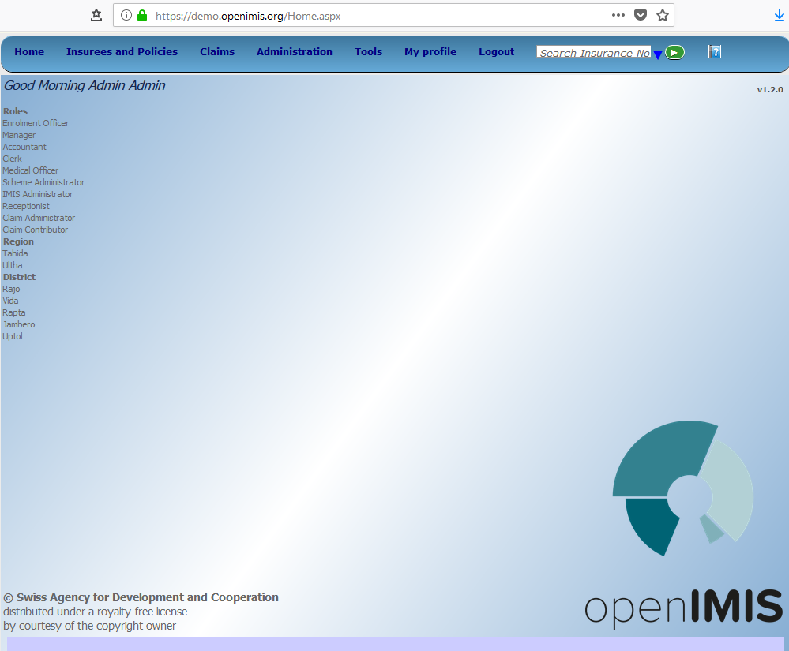
Home page

Slide 11
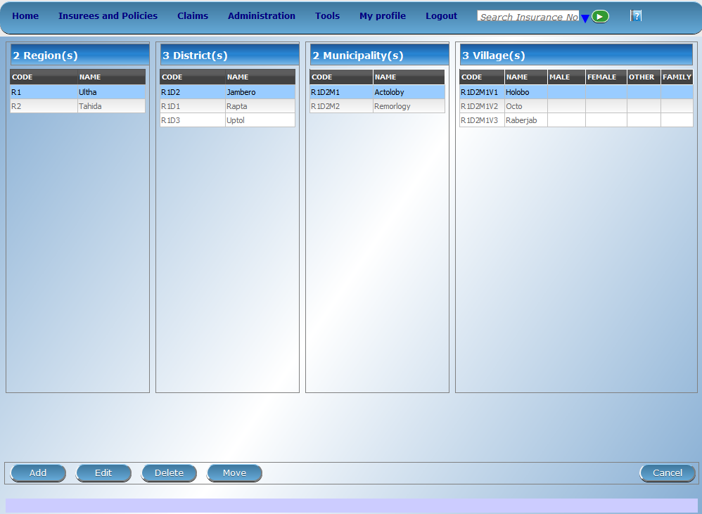
Locations

Slide 12
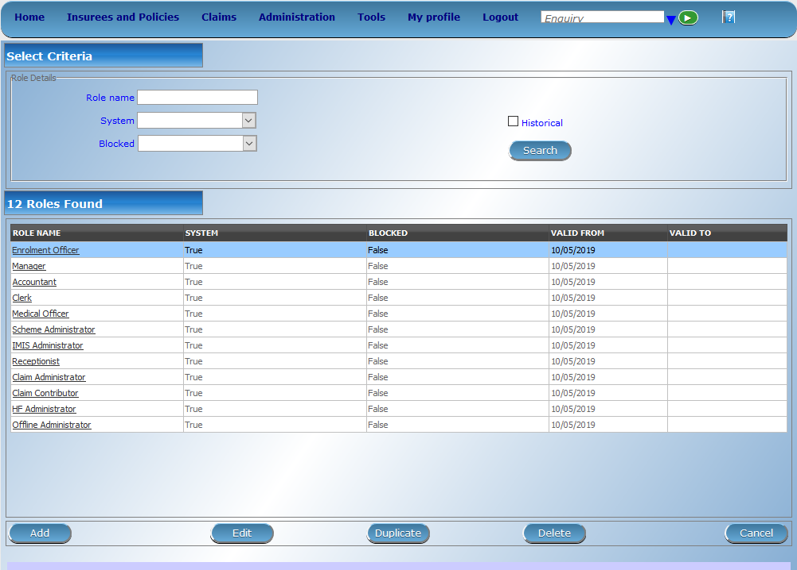
Profiles – I

Slide 13
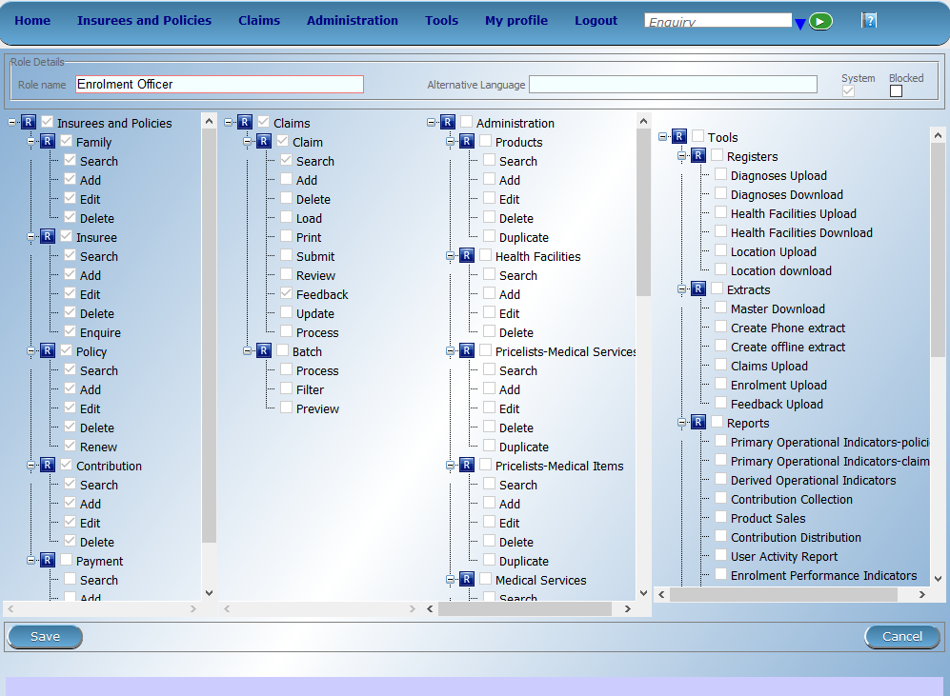
Profiles - II

Slide 14
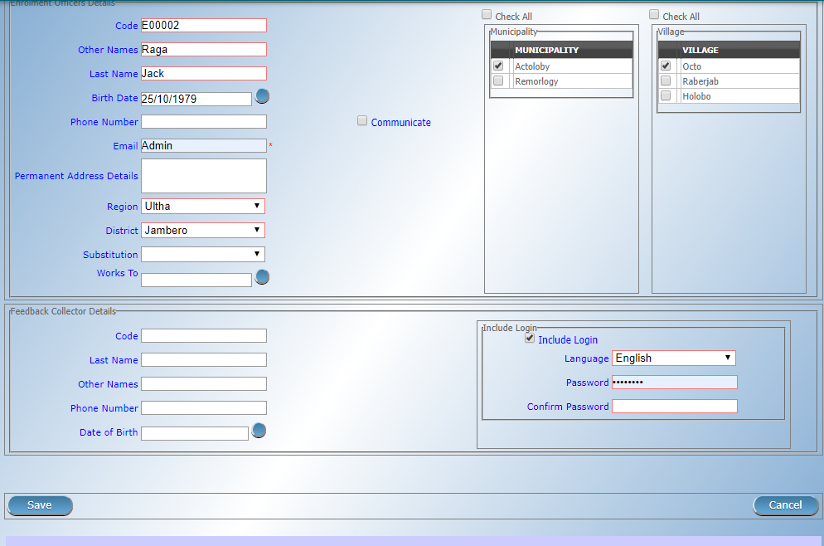
User account: Enrolment Officers

Slide 15
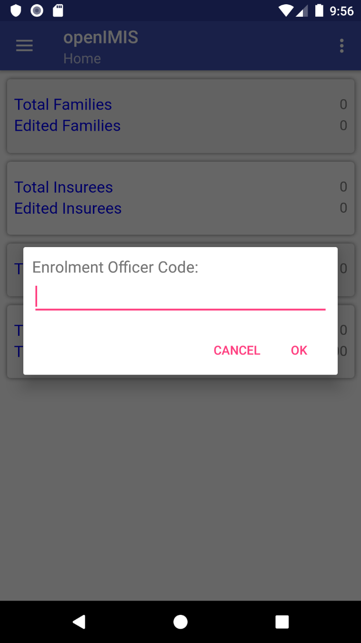
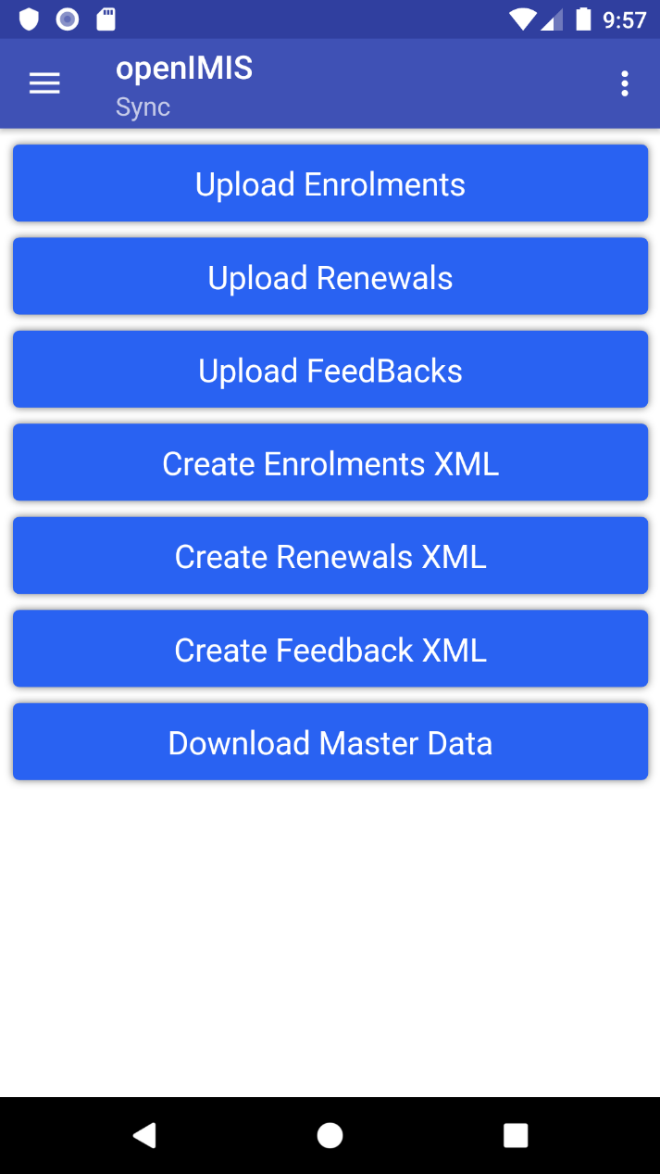
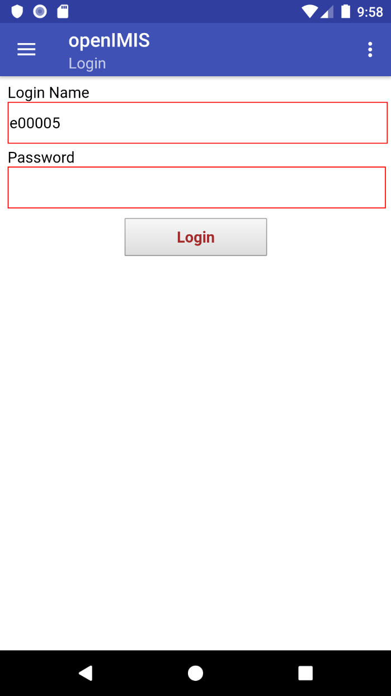
User account in apps: Enrolment Officers

Slide 16
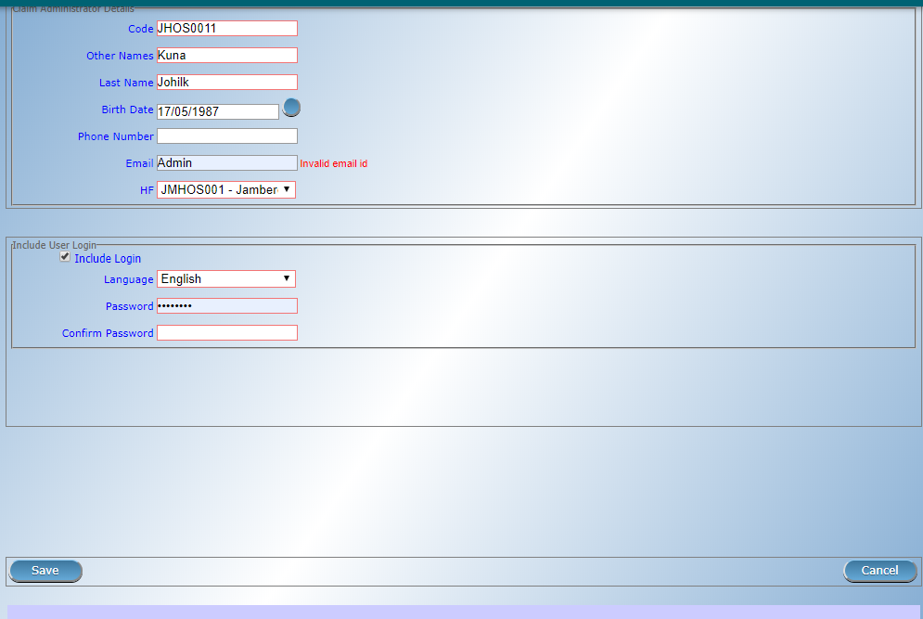
User account: Claim administrators

Slide 17
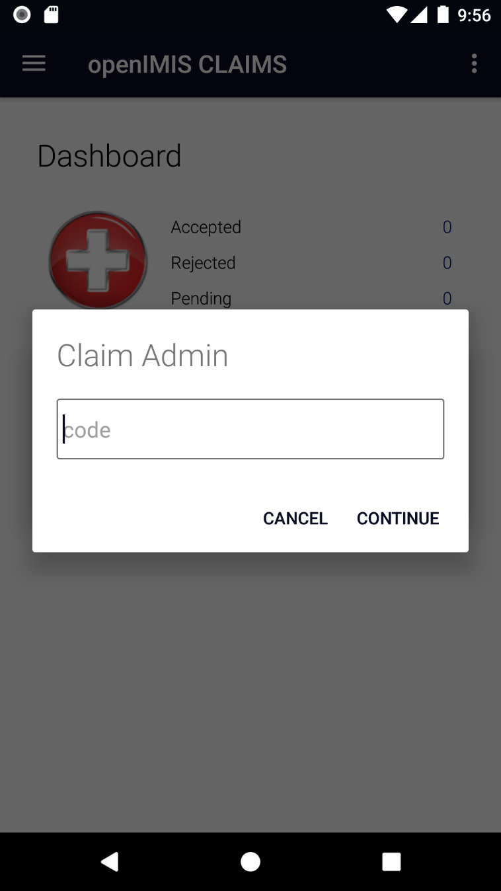
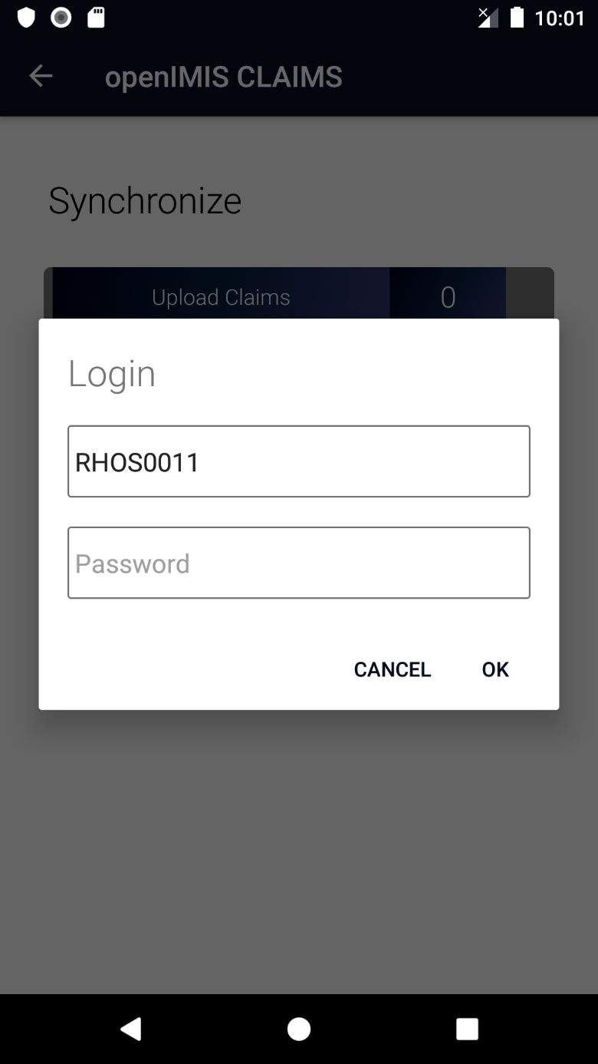
User account in apps: Claim admin

Slide 18
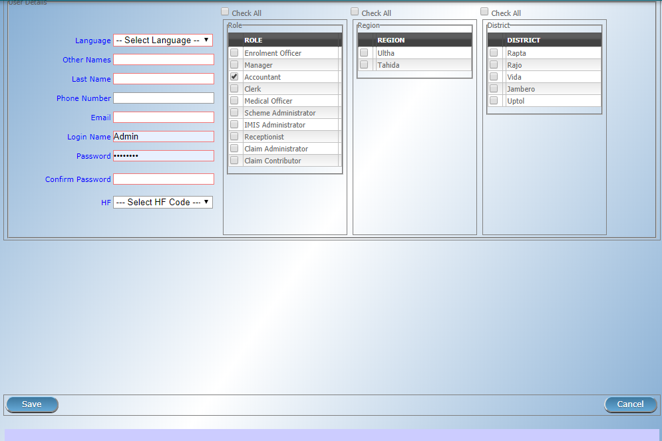
User account: Other Users

Slide 19
Overview
Data flow
Access to the system
Data captured
  Beneficiary related
  Claims related
  Configuration related data
  Reporting and data analysis
Notes:
Configuration
Split by process
Reporting

Slide 20
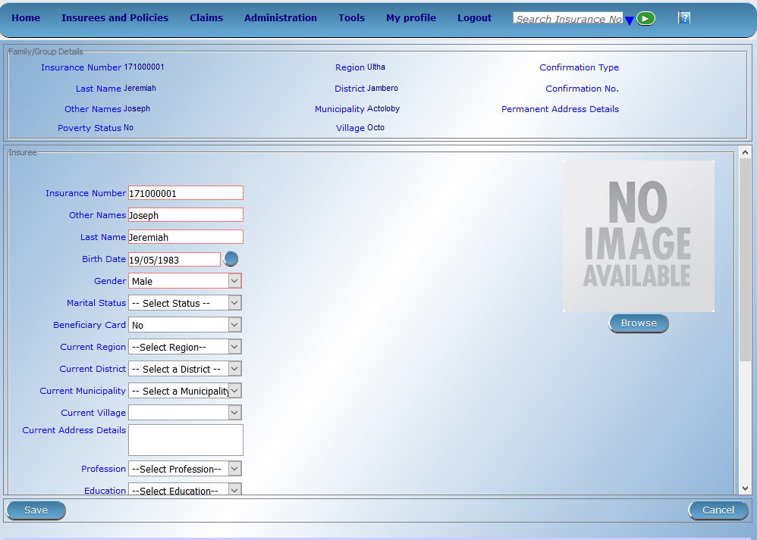

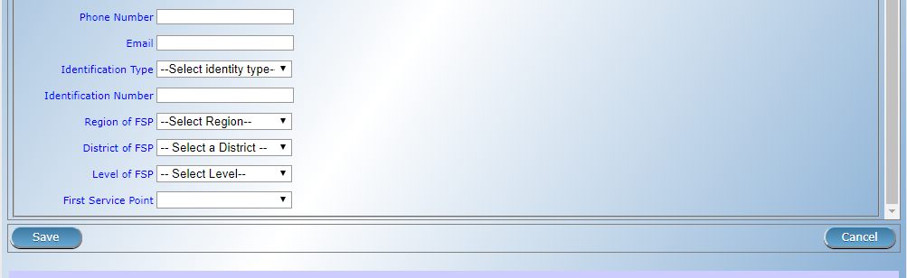
Beneficiary data - I

Slide 21
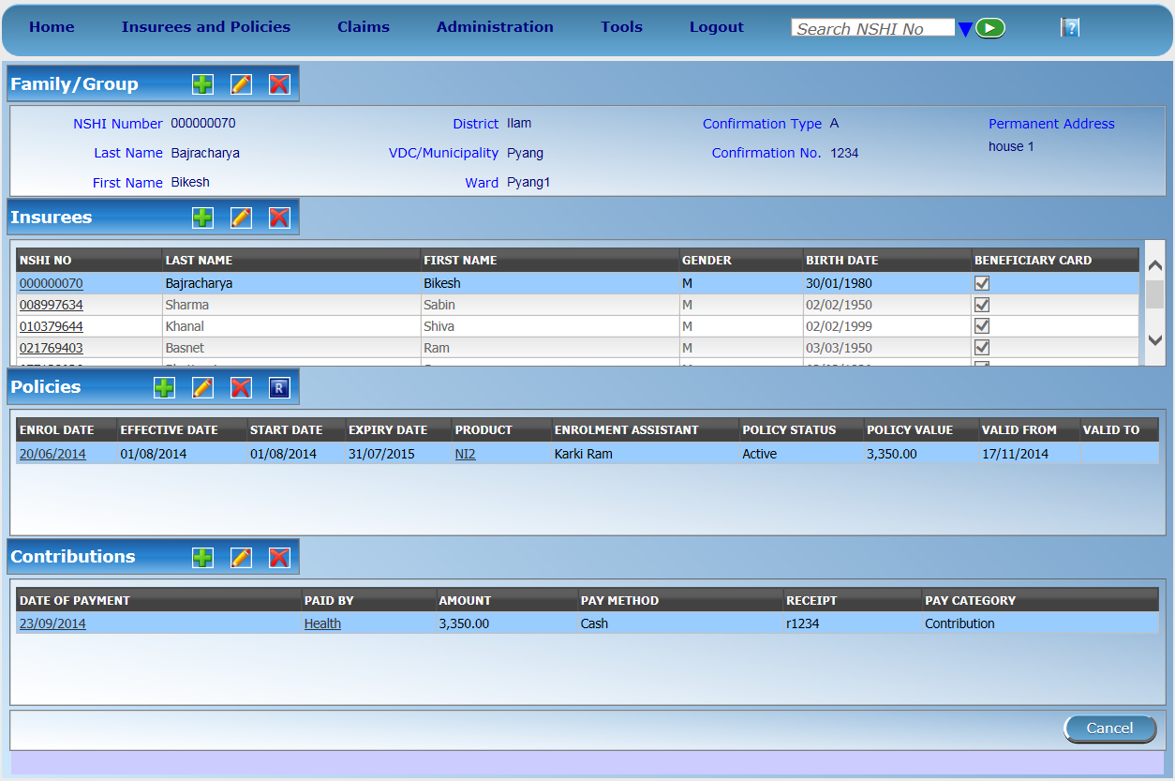
Beneficiary data - II

Slide 22
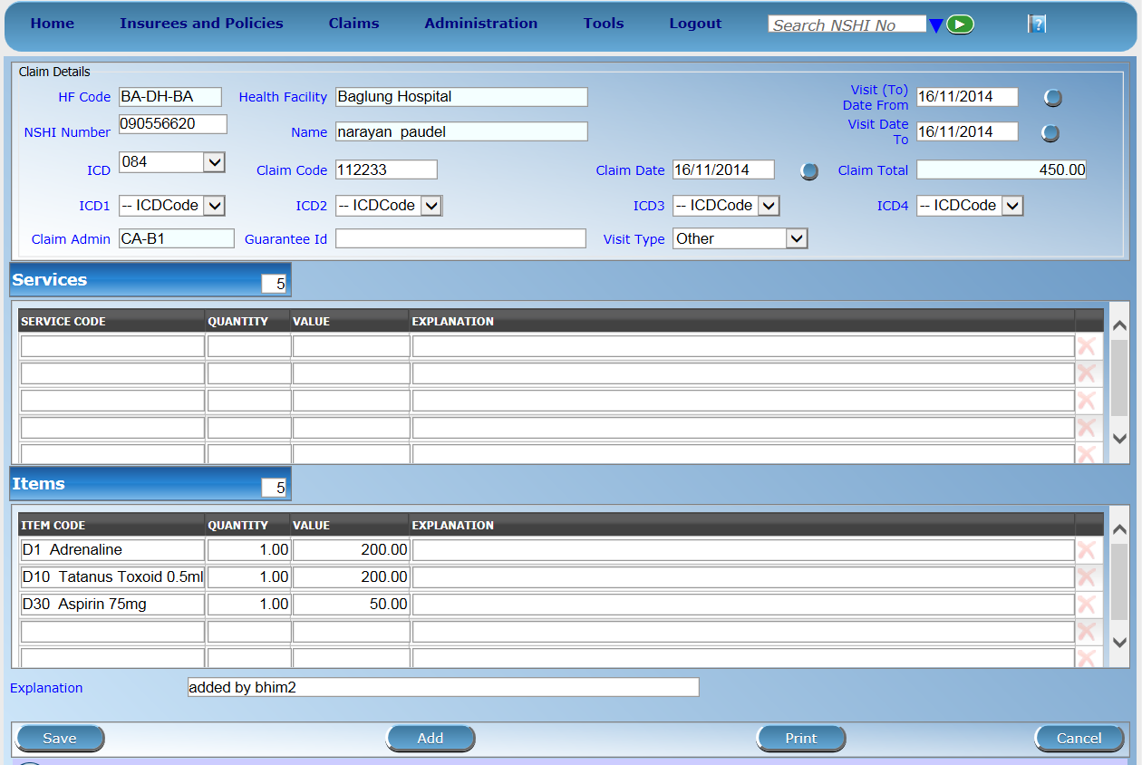
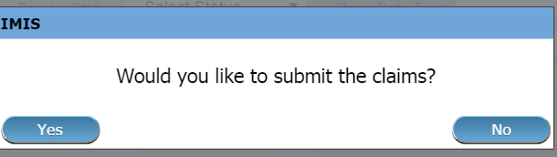
Claim entry page

Slide 23
SECTION 2

Slide 24
Overview
Data flow
Access to the system
Data captured
  Beneficiary related
  Claims related
  Configuration related data
  Reporting and data analysis
Notes:
Configuration
Split by process
Reporting

Slide 25
Configuration related data

Slide 26





















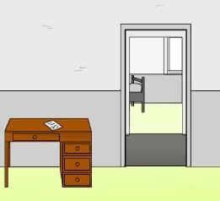

Construction of a scheme - I

Slide 27


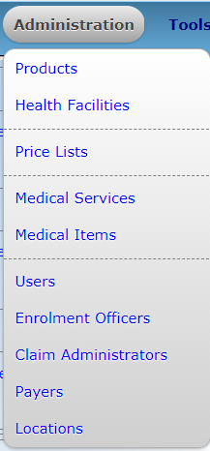




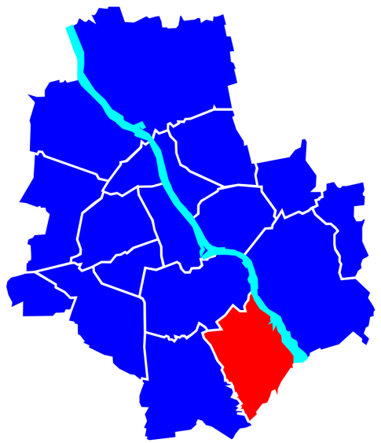


Construction of a scheme - II
Is someone paying on behalf on the insured family/group?

Slide 28
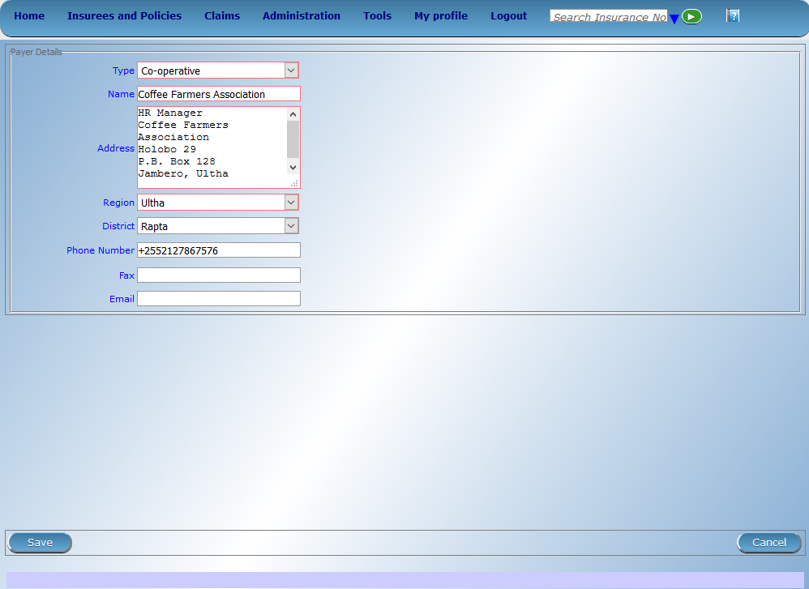
Payers

Slide 29
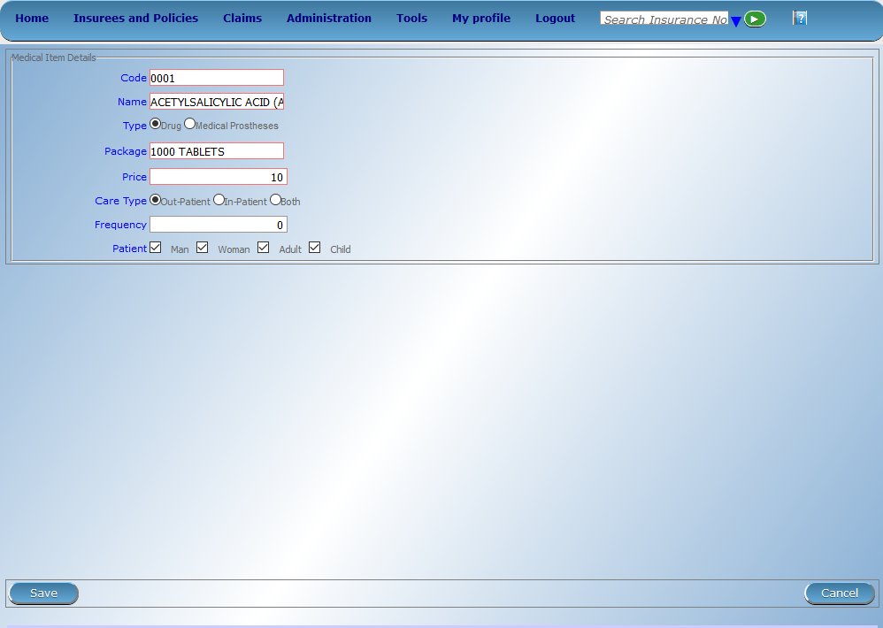
Medical Items

Slide 30

Medical Services

Slide 31
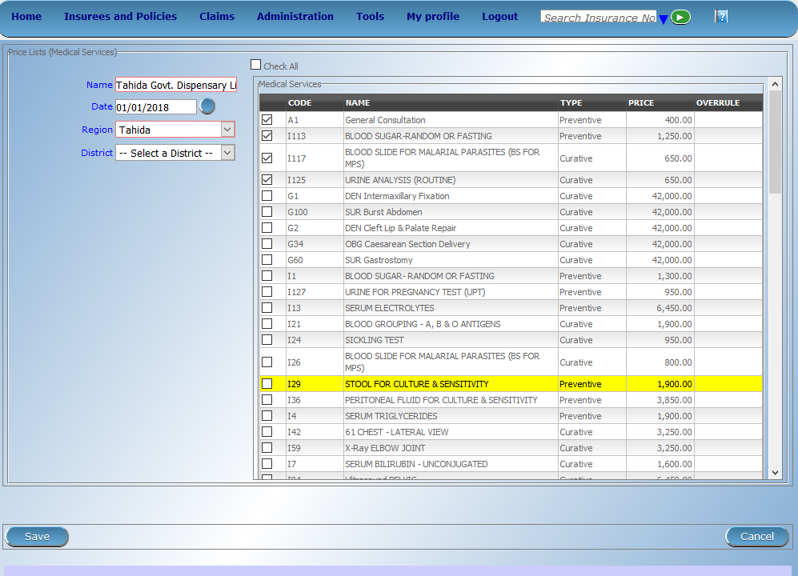
Price List -> Medical Services

Slide 32

Price List -> Medical Items

Slide 33
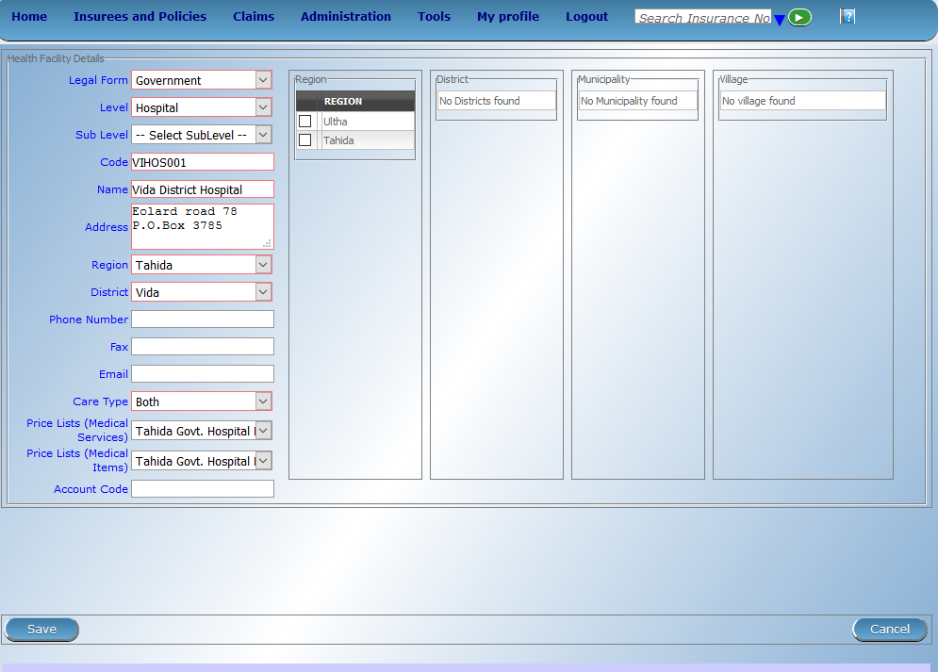
Health Facilities

Slide 34
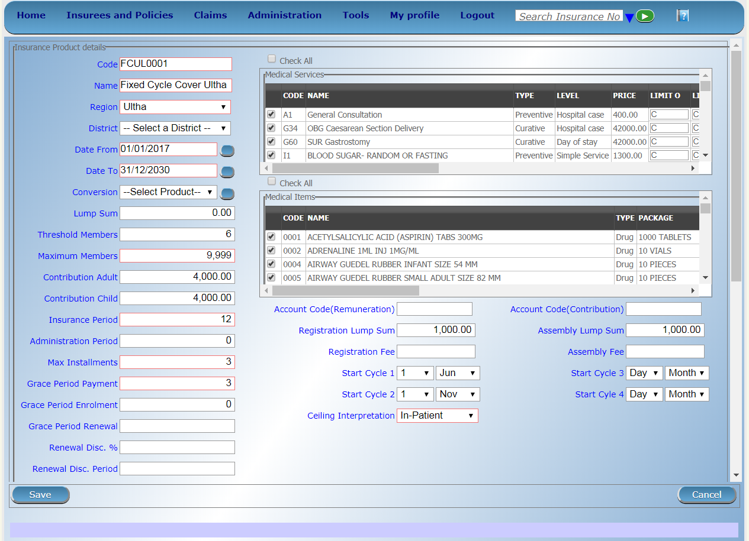
Products – I

Slide 35
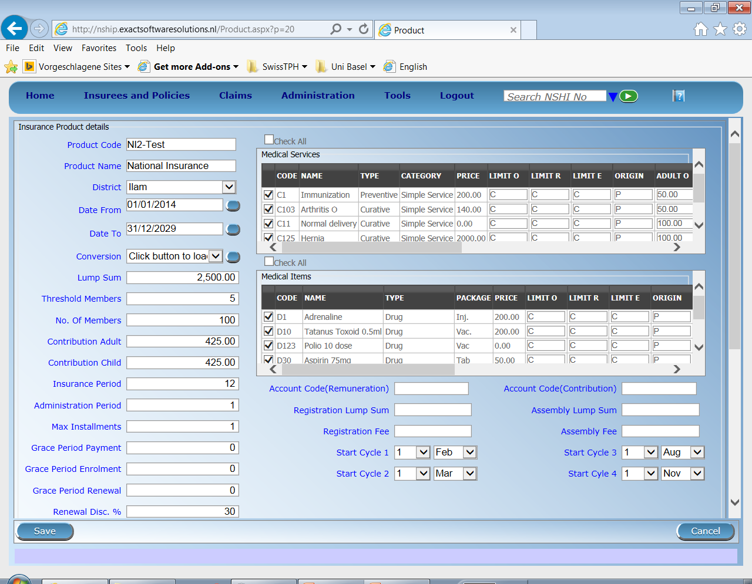
Products – II

Slide 36
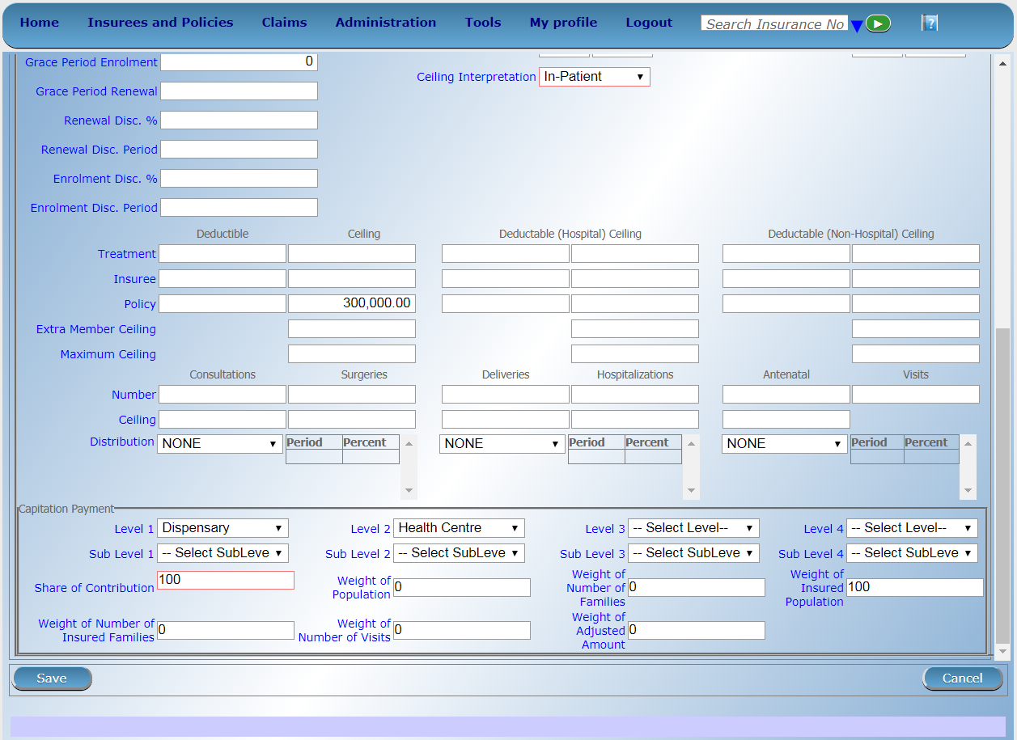
Products – III

Slide 37
SECTION 3

Slide 38
Overview
Data flow
Access to the system
Data captured
  Beneficiary related
  Claims related
  Configuration related data
  Reporting and data analysis
Notes:
Configuration
Split by process
Reporting

Slide 39
Types of reports
Standard operational reports
Customizable reporting options

Slide 40
Standard operational reports
Reports on management of families, insurees, policies, premiums:
Primary Operational Indicators-policies & claims
Derived Operational Indicators
Contribution Collection
Product Sales
Contribution Distribution
User Activity Report
Enrolment Performance Indicators
Status of registers
Insurees without photos
Matching Funds
Claim Overview
Percentage of Referrals
Families and Insurees Overview
Pending Insurees
Renewals
Capitation Payment
Rejected Photos

Slide 41
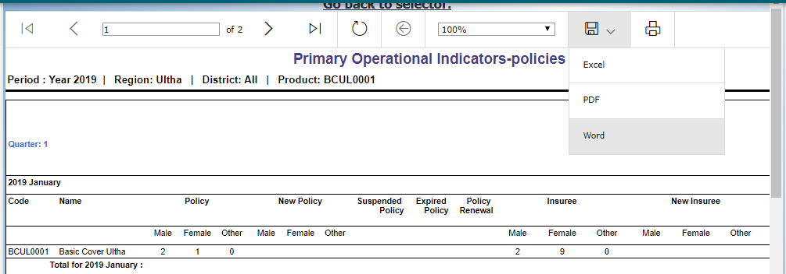
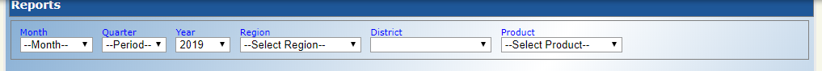
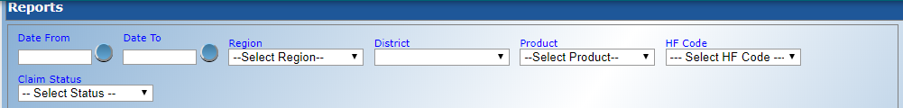
Generation of standard reports

Slide 42
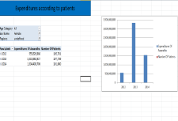


Customizable reporting options – DHIS 2
mobile
network
Front-end (Excel)
server
Operational database of IMIS
Check with HISP India and update diagram
IMIS Data Warehouse
ETL
mobile phone clients
AR-IMIS
External data sources (eg. DHIS)
on-line
(thin) clients
off-line
(thick) clients
42

Slide 43
Customizable reporting options – DHIS 2 - dashboards
Check with HISP India and update slide

Slide 44
Thank you!

