Slide 1
Running an openIMIS Demo

Slide 2
Pre requisites
Prepare before hand data that you need to give the demo:
Accounts
Registers
Mobile apps (demo server)
Web application (demo server)
Solution to demonstrate mobile screen
Paper forms (if needed)
Customized process flows (if needed)

Slide 3
Product Presentation Overview
Overview of data flow
Construction of a scheme
Processes
  Enrolment process
  Health Service Utilization
  Claims process
  Renewal Process
Notes:
Configuration
Split by process
Reporting

Slide 4

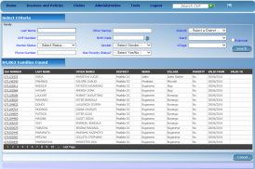





Communication within openIMIS
central server
Internet
Internet
Internet
physical
transport
on-line
mobile
off-line

Slide 5
Product Presentation Overview
Overview of data flow
Construction of a scheme
Processes
  Enrolment process
  Health Service Utilization
  Claims process
  Renewal Process
Notes:
Configuration
Split by process
Reporting

Slide 6
Building of registers
Go down to up (Administration ->Locations up to Products; Tools -> Registers)
Demonstrate what you think is relevant in your context – have already created products, facilities, price lists, users beforehand to make things faster
Images (next slide) are provided to help visualize how some key registers are connected in the overall context of the scheme – use if needed!
Go through all screens in different time blocks: Block 1 – diagnosis, locations, payers; Block 2 – Claim Administrators, Enrolment Officers, Users, User Profiles; Block 3 - Medical Items, Medical Services, Price lists, Health facility; Block 4 – Products

Slide 7





















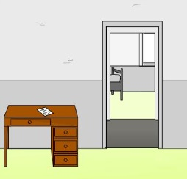
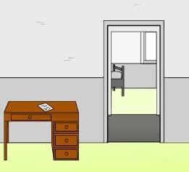

Construction of a scheme - I

Slide 8



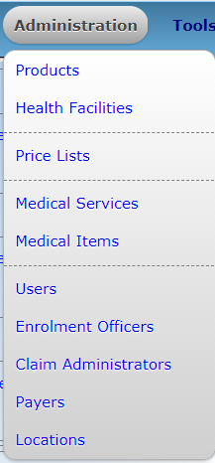




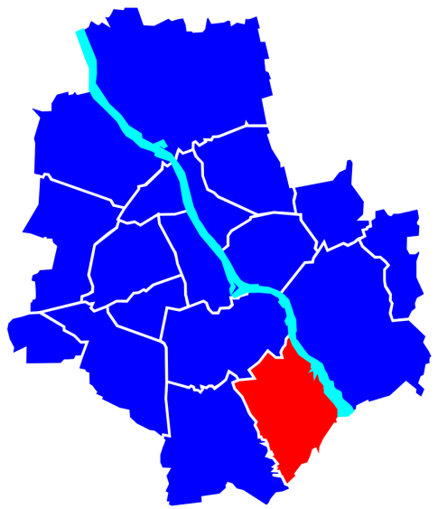


Construction of a scheme - II
Is someone paying on behalf on the insured family/group?

Slide 9
Product Presentation Overview
Overview of data flow
Construction of a scheme
Processes
  Enrolment process
  Health Service Utilization
  Claims process
  Renewal Process
Notes:
Configuration
Split by process
Reporting

Slide 10
Enrolment Process
Based on audience decide whether to use a visualization diagram (example in next slide) to show how a general process flows and how openIMIS fits within it/what is the role of the system
Ideally try to draft this in a way the audience can relate to
To make the demo faster have a housheold enrolled already and show that to demonstrate info captured
Based on available time decide whether to show mobile phone (or only show mobile phone – mandatory fields) – keep it simple by not switching across too often
Go through all screens in different time blocks: Block 1 – enrolment of HHH, HH members; Block 2 - Policies & Contributions; Block 3 – Mobile app

Slide 11
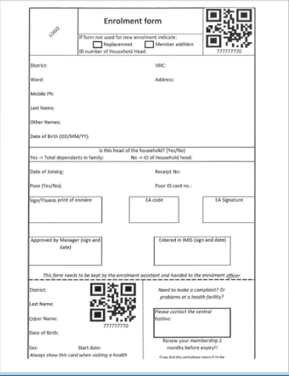
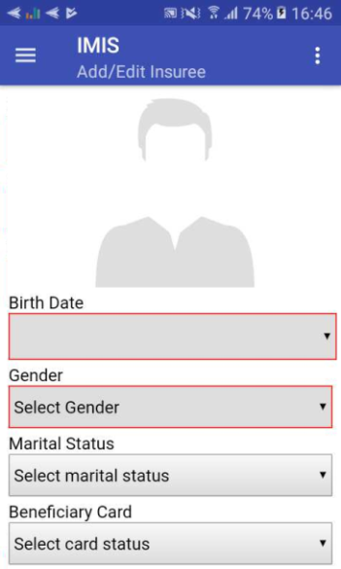
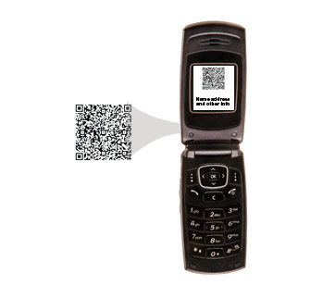


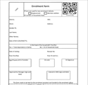


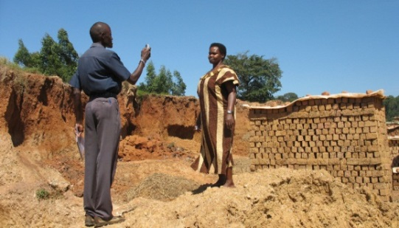
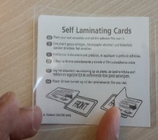
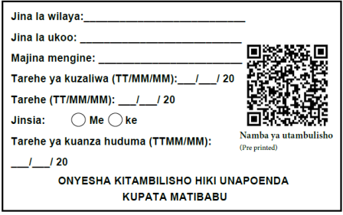
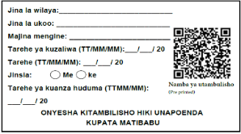
Enrolment – I (Sample Process)
Collect contribution

Slide 12
Product Presentation Overview
Overview of data flow
Construction of a scheme
Processes
  Enrolment process
  Health Service Utilization
  Claims process
  Renewal Process
Notes:
Configuration
Split by process
Reporting

Slide 13
Health Service Utilization
Based on audience decide whether to use a visualization diagram (example in next slide) to show how a general process flows and how openIMIS fits within it/what is the role of the system
Ideally try to draft this in a way the audience can relate to
To make the demo faster use an already enrolled person to demonstrate
Based on available time decide whether to show mobile phone (or only show mobile phone – mandatory fields) – keep it simple by not switching across too often
Go through all screens in one time block – querying through web application & querying through phone

Slide 14
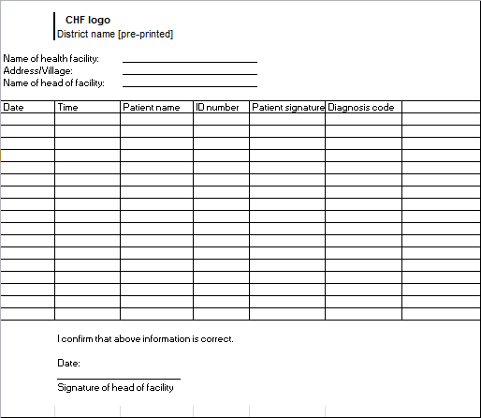

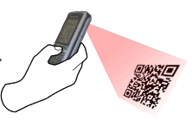

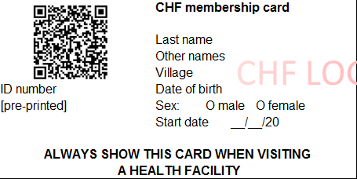
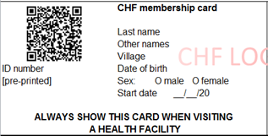

Health Service Utilization (Sample Process)
Reception1st registers patient in OPD/IPD register
Receptionist scans card with phone (offline & online) connectivity OK
EXPIRED
Send patient for treatment

Slide 15
Product Presentation Overview
Overview of data flow
Construction of a scheme
Processes
  Enrolment process
  Health Service Utilization
  Claims process
  Renewal Process
Notes:
Configuration
Split by process
Reporting

Slide 16
Claims Process
Based on audience decide whether to use a visualization diagram (example in next slide) to show how a general process flows and how openIMIS fits within it/what is the role of the system
Ideally try to draft this in a way the audience can relate to
To make the demo faster have a claim already in each of the different stages to demonstrate
Based on available time decide whether to show mobile phone (focus on mandatory fields) – keep it simple by not switching across too often
Go through all screens in different time blocks: Block 1 – claim entry through web application; Block 2 - claim entry through phone app; Block 3 – Medical Review; Block 4 – Batch run

Slide 17
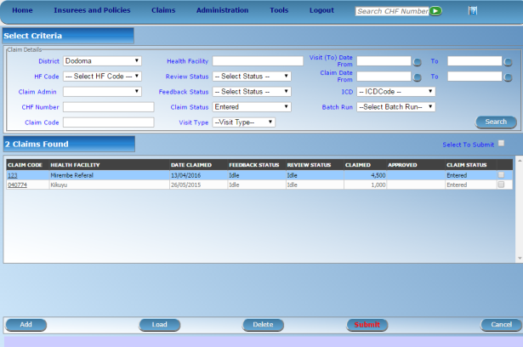




Claims Process – I (Sample Process)
server
mobile
network
health facility
Internet
network
mobile client
on-line client
Internal claims processing in IMIS
CHF office
off-line client
Automated Checking (client status, price lists, etc.)
Review by a Medical Advisor
Automated final claim calculations (remaining limits, etc.)
Generating consolidated claims report
paper forms
on-line client

Slide 18
Product Presentation Overview
Overview of data flow
Construction of a scheme
Processes
  Enrolment process
  Health Service Utilization
  Claims process
  Renewal Process
Notes:
Configuration
Split by process
Reporting

Slide 19
Renewal Process
Based on audience decide whether to use a visualization diagram (example in next slide) to show how a general process flows and how openIMIS fits within it/what is the role of the system
Ideally try to draft this in a way the audience can relate to
To make the demo faster have a household already linked to the EO you will use to demonstrate a renewal case
Based on available time decide whether to show web application or not and otherwise only focus on mobile phone app– keep it simple by not switching across too often
Go through all screens in different time blocks: Block 1 – renewal on web application; Block 2 – renewal through mobile phone application;

Slide 20
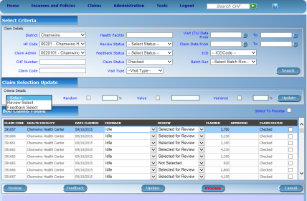
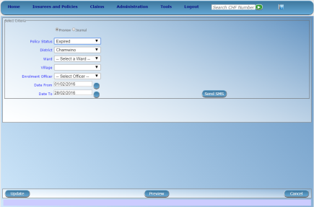





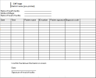
Renewal process flow
server
mobile
Network - sms
mobile
Network – data transfer
Renewal trigger
Print out of
generated
Renewal list OR
offline file to be
uploaded to
mobile phone
CHF office

Slide 21
Additional resources
www.openimis.org - Home of the openIMIS Initiative
Strategic direction given by a Steering Group
Technical directions guided by a Technical Advisory Group
openIMIS wiki - Read more about openIMIS
www.github.com/openimis - Download software and source code
openIMIS Demo: demo.openimis.org - use the demo now !
openIMIS Service Desk- report issues, bugs, or feature requests !
Notes:
Configuration
Split by process
Reporting

