Slide 1
Running an openIMIS Demo

Slide 2
Pre requisites
Prepare before hand data that you need to give the demo:
Accounts
Registers
Mobile apps (demo server)
Web application (demo server)
Solution to demonstrate mobile screen
Paper forms (if needed)
Customized process flows (if needed)

Slide 3
Overview
openIMIS
Overview of data flow 1
Construction of a scheme 2
Processes 3
Enrolment Processes 3a
Health service Utilization 3b
Claims processes 3c
Renewal processes 3d

Slide 4
Overview
openIMIS
Overview of data flow 1
Construction of a scheme 2
Processes 3
Enrolment Processes 3a
Health service Utilization 3b
Claims processes 3c
Renewal processes 3d
Notes:
Configuration
Split by process
Reporting

Slide 5
Communication within openIMIS
Central Server
Internet
Internet
Physical transport
online
mobile
offline

Slide 6
Overview
openIMIS
Overview of data flow 1
Construction of a scheme 2
Processes 3
Enrolment Processes 3a
Health service Utilization 3b
Claims processes 3c
Renewal processes 3d

Slide 7
Building of registers
Go down to up (Administration ->Locations up to Products; Tools -> Registers)
Demonstrate what you think is relevant in your context – have already created products, facilities, price lists, users beforehand to make things faster
Images (next slide) are provided to help visualize how some key registers are connected in the overall context of the scheme – use if needed!
Go through all screens in different time blocks: Block 1 – diagnosis, locations, payers; Block 2 – Claim Administrators, Enrolment Officers, Users, User Profiles; Block 3 - Medical Items, Medical Services, Price lists, Health facility; Block 4 – Products

Slide 8
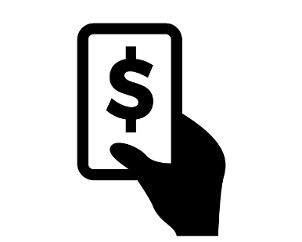
Construction of a scheme I
Purchaser
Provider
Type of facility
Services/Items
Price Lists
Contract
Contract
Client

Slide 9
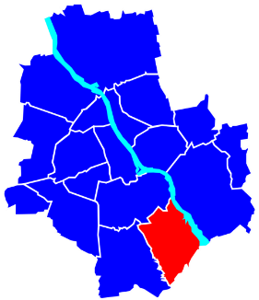
Construction of a scheme II
General definition of registers:
User Profiles
Diagnosis List
Users
Medical services
Products
Enrolment officers
Claim Administrators
Medical Items
Health facilities
Payers
Price lists
Locations

Slide 10
Overview
openIMIS
Overview of data flow 1
Construction of a scheme 2
Processes 3
Enrolment Processes 3a
Health service Utilization 3b
Claims processes 3c
Renewal processes 3d

Slide 11
Enrolment Process
Based on audience decide whether to use a visualization diagram (example in next slide) to show how a general process flows and how openIMIS fits within it/what is the role of the system
Ideally try to draft this in a way the audience can relate to
To make the demo faster have a housheold enrolled already and show that to demonstrate info captured
Based on available time decide whether to show mobile phone (or only show mobile phone – mandatory fields) – keep it simple by not switching across too often
Go through all screens in different time blocks: Block 1 – enrolment of HHH, HH members; Block 2 - Policies & Contributions; Block 3 – Mobile app

Slide 12
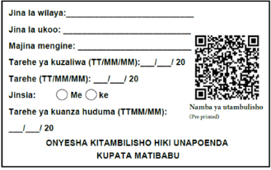
Enrolment Process I – e.g. Voluntary schemes/informal sector
Visit household
Inform, advise and convince
Collect contribution amount (mobile payment), personal data and capture photo)
Central Server
ID card issued on the spot with pre printed unique ID no. (bar code)
Policy & other relevant information
Insurer
Transfer all information & money collected to insurer
Notes:
Approaching clients and enrolling
A key question – when is policy activated/coverage started?
Financial transaction – norm, accounting requirement

Slide 13
Overview
openIMIS
Overview of data flow 1
Construction of a scheme 2
Processes 3
Enrolment Processes 3a
Health service Utilization 3b
Claims processes 3c
Renewal processes 3d

Slide 14
Health Service Utilization
Based on audience decide whether to use a visualization diagram (example in next slide) to show how a general process flows and how openIMIS fits within it/what is the role of the system
Ideally try to draft this in a way the audience can relate to
To make the demo faster use an already enrolled person to demonstrate
Based on available time decide whether to show mobile phone (or only show mobile phone – mandatory fields) – keep it simple by not switching across too often
Go through all screens in one time block – querying through web application & querying through phone

Slide 15
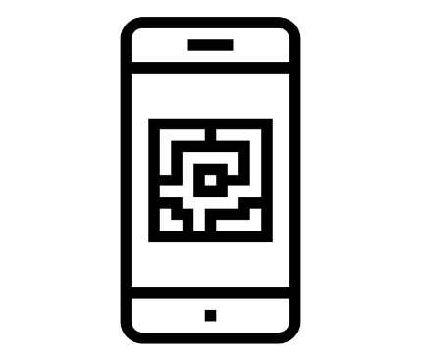
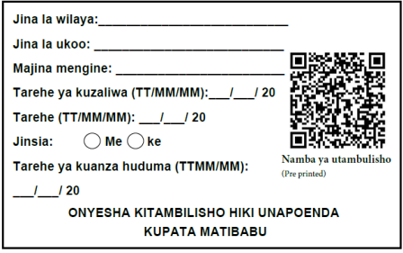
Client Service Utilization Process – Health Facility
Verify membership through openIMIS
Member visits health facility
Member shows insurance card
Valid card
Invalid card
No card
Treated as insured person
Treated as an uninsured client

Slide 16
Overview
openIMIS
Overview of data flow 1
Construction of a scheme 2
Processes 3
Enrolment Processes 3a
Health service Utilization 3b
Claims processes 3c
Renewal processes 3d

Slide 17
Claims Process
Based on audience decide whether to use a visualization diagram (example in next slide) to show how a general process flows and how openIMIS fits within it/what is the role of the system
Ideally try to draft this in a way the audience can relate to
To make the demo faster have a claim already in each of the different stages to demonstrate
Based on available time decide whether to show mobile phone (focus on mandatory fields) – keep it simple by not switching across too often
Go through all screens in different time blocks: Block 1 – claim entry through web application; Block 2 - claim entry through phone app; Block 3 – Medical Review; Block 4 – Batch run

Slide 18
Claims Process – I (Sample Process)
Server
Health facility
mobile client
Internet
online client
offline client
Purchaser office
Physical transport
paper forms
online client

Slide 19
Internal claims processing in IMIS
Claims Process – II
Automated Checking (client status, price lists, etc.)
Review by a Medical Advisor
Automated final claim calculations (remaining limits, etc.)
Generating consolidated claims report

Slide 20
Overview
openIMIS
Overview of data flow 1
Construction of a scheme 2
Processes 3
Enrolment Processes 3a
Health service Utilization 3b
Claims processes 3c
Renewal processes 3d

Slide 21
Renewal Process
Based on audience decide whether to use a visualization diagram (example in next slide) to show how a general process flows and how openIMIS fits within it/what is the role of the system
Ideally try to draft this in a way the audience can relate to
To make the demo faster have a household already linked to the EO you will use to demonstrate a renewal case
Based on available time decide whether to show web application or not and otherwise only focus on mobile phone app– keep it simple by not switching across too often
Go through all screens in different time blocks: Block 1 – renewal on web application; Block 2 – renewal through mobile phone application;

Slide 22
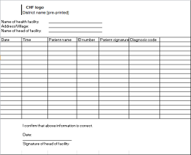
Renewal Process Flow -I (Sample Process)
Mobile network - SMS
Server sends renewal list:
Client
Mobile network – data transfer
Renewal trigger
Print out of generated renewal list
Central Server
Alternatively
Offline file to be uploaded to mobile phone
Insurer
Enrolment officer receives renewal list

Slide 23
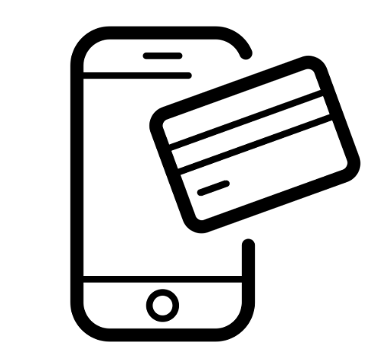
Renewal Process – II (Sample process – self renewal)
Full payment
Central Server
Clients receive SMS from server
SMS provides details to renew using USSD code
Make a payment e.g. using mobile money
Policy activation confirmed through sms

Slide 24
Additional resources
www.openimis.org - Home of the openIMIS Initiative
Strategic direction given by a Steering Group
Technical directions guided by a Technical Advisory Group
openIMIS wiki - Read more about openIMIS
www.github.com/openimis - Download software and source code
openIMIS Demo: demo.openimis.org - use the demo now !
openIMIS Service Desk- report issues, bugs, or feature requests !
Notes:
Configuration
Split by process
Reporting

Slide 25
Attributions for icons
Creative Commons CC BY 3.0 license applies to all icons:
Payment by Loki Ba / CC BY 3.0
Hospital by ibrandify / CC BY 3.0
Hospital by Vectors Point / CC BY 3.0
Pharmacy by Eucalyp / CC BY 3.0
Medication by sahua d / CC BY 3.0
Network by Creative Stall / CC BY 3.0
Worker by Nikita Kozin / CC BY 3.0
Contract by Adrien Coquet / CC BY 3.0

Slide 26
Attributions for icons
Creative Commons CC BY 3.0 license applies to all icons:
Family by Gan Khoon Lay / CC BY 3.0
Medical service by andrewcaliber / CC BY 3.0
medical insurance by Creative Mania / CC BY 3.0
officer by Eucalyp / CC BY 3.0
QrCode Scan by Ninejipjip / CC BY 3.0
portrait by Bakunetsu Kaito / CC BY 3.0
Smartphone by Danil Polshin / CC BY 3.0
recipt by stolkramaker / CC BY 3.0

Slide 27
Attributions for icons
Creative Commons CC BY 3.0 license applies to all icons:
write document by kiddo / CC BY 3.0
flyer by Graphic Tigers / CC BY 3.0
Card by Stephen JB Thomas / CC BY 3.0
person by Yamini Ahluwalia / CC BY 3.0

Slide 28
Thank you!
Except where otherwise noted, this work is licensed under
https://creativecommons.org/licenses/by-sa/4.0/legalcode

