Slide 1
Running an openIMIS Demo

Slide 2
Pre requisites
Prepare before hand data that you need to give the demo:
Accounts
Registers
Mobile apps (demo server)
Web application (demo server)
Solution to demonstrate mobile screen
Paper forms (if needed)
Customized process flows (if needed)

Slide 3
Overview
openIMIS
Overview of data flow 1
Construction of a scheme 2
Processes 3
Enrolment Processes 3a
Health service Utilization 3b
Claims processes 3c
Renewal processes 3d

Slide 4
Overview
openIMIS
Overview of data flow 1
Construction of a scheme 2
Processes 3
Enrolment Processes 3a
Health service Utilization 3b
Claims processes 3c
Renewal processes 3d
Notes:
Configuration
Split by process
Reporting

Slide 5
Communication within openIMIS
Central Server
Internet
Internet
Physical transport
online
mobile
offline

Slide 6
Overview
openIMIS
Overview of data flow 1
Construction of a scheme 2
Processes 3
Enrolment Processes 3a
Health service Utilization 3b
Claims processes 3c
Renewal processes 3d

Slide 7
Building of registers
Go down to up (Administration ->Locations up to Products; Tools -> Registers)
Demonstrate what you think is relevant in your context – have already created products, facilities, price lists, users beforehand to make things faster
Images (next slide) are provided to help visualize how some key registers are connected in the overall context of the scheme – use if needed!
Go through all screens in different time blocks: Block 1 – diagnosis, locations, payers; Block 2 – Claim Administrators, Enrolment Officers, Users, User Profiles; Block 3 - Medical Items, Medical Services, Price lists, Health facility; Block 4 – Products

Slide 8
Construction of a scheme II
Purchaser
Provider
Type of facility
Medication
Price Lists
Contract
Client

Slide 9
Construction of a scheme I
General definition of:
Users
(Definitions will be specificied later for the specific schemes, packages,etc.)
Medical services
Enrolment officers
Products
Medical Items
Claim Administrators
Health facilities
Payers
Price lists
Locations

Slide 10
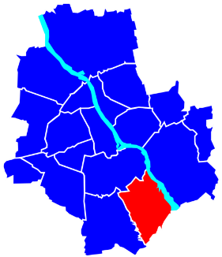
Construction of a scheme I
General definition of:
Users
(Definitions will be specificied later for the specific schemes, packages,etc.)
Medical services
Enrolment officers
Products
Claim Administrators
Medical Items
Health facilities
Payers
Price lists
Locations

Slide 11
Overview
openIMIS
Overview of data flow 1
Construction of a scheme 2
Processes 3
Enrolment Processes 3a
Health service Utilization 3b
Claims processes 3c
Renewal processes 3d

Slide 12
Enrolment Process
Based on audience decide whether to use a visualization diagram (example in next slide) to show how a general process flows and how openIMIS fits within it/what is the role of the system
Ideally try to draft this in a way the audience can relate to
To make the demo faster have a housheold enrolled already and show that to demonstrate info captured
Based on available time decide whether to show mobile phone (or only show mobile phone – mandatory fields) – keep it simple by not switching across too often
Go through all screens in different time blocks: Block 1 – enrolment of HHH, HH members; Block 2 - Policies & Contributions; Block 3 – Mobile app

Slide 13
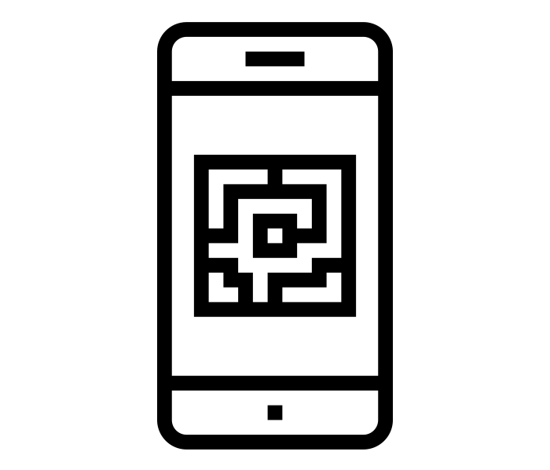
Enrolment I – Sample processes
Collect contribution
Provide receipt
Fill Enrolment Form
With the app, scann QR code of Enrolment Form

Slide 14
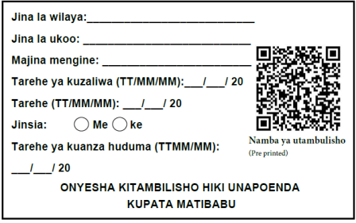
Enrolment I – Sample processes
(Take photo)*
Centralized or decentralized storage
Distribute membership ID and flyer on scheme
*not necessary

Slide 15
Overview
openIMIS
Overview of data flow 1
Construction of a scheme 2
Processes 3
Enrolment Processes 3a
Health service Utilization 3b
Claims processes 3c
Renewal processes 3d

Slide 16
Health Service Utilization
Based on audience decide whether to use a visualization diagram (example in next slide) to show how a general process flows and how openIMIS fits within it/what is the role of the system
Ideally try to draft this in a way the audience can relate to
To make the demo faster use an already enrolled person to demonstrate
Based on available time decide whether to show mobile phone (or only show mobile phone – mandatory fields) – keep it simple by not switching across too often
Go through all screens in one time block – querying through web application & querying through phone

Slide 17
Client Service Utilization Process – Health Facility
Verify membership through IMIS
Member visits health facility
Member shows insurance card
Is person a member?
Yes
No
Treated as insured person
Treated as an uninsured client

Slide 18
Overview
openIMIS
Overview of data flow 1
Construction of a scheme 2
Processes 3
Enrolment Processes 3a
Health service Utilization 3b
Claims processes 3c
Renewal processes 3d

Slide 19
Claims Process
Based on audience decide whether to use a visualization diagram (example in next slide) to show how a general process flows and how openIMIS fits within it/what is the role of the system
Ideally try to draft this in a way the audience can relate to
To make the demo faster have a claim already in each of the different stages to demonstrate
Based on available time decide whether to show mobile phone (focus on mandatory fields) – keep it simple by not switching across too often
Go through all screens in different time blocks: Block 1 – claim entry through web application; Block 2 - claim entry through phone app; Block 3 – Medical Review; Block 4 – Batch run

Slide 20
Claims Process – I (Sample Process)
Server
Health facility
mobile client
online client
offline client
CHF office
paper forms
online client

Slide 21
Internal claims processing in IMIS
Claims Process – I (Sample Process)
Automated Checking (client status, price lists, etc.)
Review by a Medical Advisor
Automated final claim calculations (remaining limits, etc.)
Generating consolidated claims report

Slide 22
Overview
openIMIS
Overview of data flow 1
Construction of a scheme 2
Processes 3
Enrolment Processes 3a
Health service Utilization 3b
Claims processes 3c
Renewal processes 3d

Slide 23
Renewal Process
Based on audience decide whether to use a visualization diagram (example in next slide) to show how a general process flows and how openIMIS fits within it/what is the role of the system
Ideally try to draft this in a way the audience can relate to
To make the demo faster have a household already linked to the EO you will use to demonstrate a renewal case
Based on available time decide whether to show web application or not and otherwise only focus on mobile phone app– keep it simple by not switching across too often
Go through all screens in different time blocks: Block 1 – renewal on web application; Block 2 – renewal through mobile phone application;

Slide 24
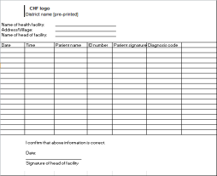
Renewal + Modification Process Flow
Mobile network - SMS
Server sends renewal list:
Mobile network – data transfer
Renewal trigger
Enrolment officer receives renewal list on the app
Print out of generated renewal list
Alternatively
Offline file to be uploaded to mobile phone

Slide 25
Additional resources
www.openimis.org - Home of the openIMIS Initiative
Strategic direction given by a Steering Group
Technical directions guided by a Technical Advisory Group
openIMIS wiki - Read more about openIMIS
www.github.com/openimis - Download software and source code
openIMIS Demo: demo.openimis.org - use the demo now !
openIMIS Service Desk- report issues, bugs, or feature requests !
Notes:
Configuration
Split by process
Reporting

Slide 26
Attributions for icons
Creative Commons CC BY 3.0 license applies to all icons:
Payment by Loki Ba / CC BY 3.0
Hospital by ibrandify / CC BY 3.0
Hospital by Vectors Point / CC BY 3.0
Pharmacy by Eucalyp / CC BY 3.0
Medication by sahua d / CC BY 3.0
Network by Creative Stall / CC BY 3.0
Worker by Nikita Kozin / CC BY 3.0
Contract by Adrien Coquet / CC BY 3.0

Slide 27
Attributions for icons
Creative Commons CC BY 3.0 license applies to all icons:
Family by Gan Khoon Lay / CC BY 3.0
Medical service by andrewcaliber / CC BY 3.0
medical insurance by Creative Mania / CC BY 3.0
officer by Eucalyp / CC BY 3.0
QrCode Scan by Ninejipjip / CC BY 3.0
portrait by Bakunetsu Kaito / CC BY 3.0
Smartphone by Danil Polshin / CC BY 3.0
recipt by stolkramaker / CC BY 3.0

Slide 28
Attributions for icons
Creative Commons CC BY 3.0 license applies to all icons:
write document by kiddo / CC BY 3.0
flyer by Graphic Tigers / CC BY 3.0
Card by Stephen JB Thomas / CC BY 3.0
person by Yamini Ahluwalia / CC BY 3.0

Slide 29
Thank you!
Except where otherwise noted, this work is licensed under
https://creativecommons.org/licenses/by-sa/4.0/legalcode

