Slide 1
Introduction - Health Financing Mechanisms and Insurance Processes

Slide 2
Overview – key health financing concepts
Health system building blocks
Universal Health Coverage dimensions
Role of health financing
Health financing mechanisms
Transactions in health insurance system

Slide 3
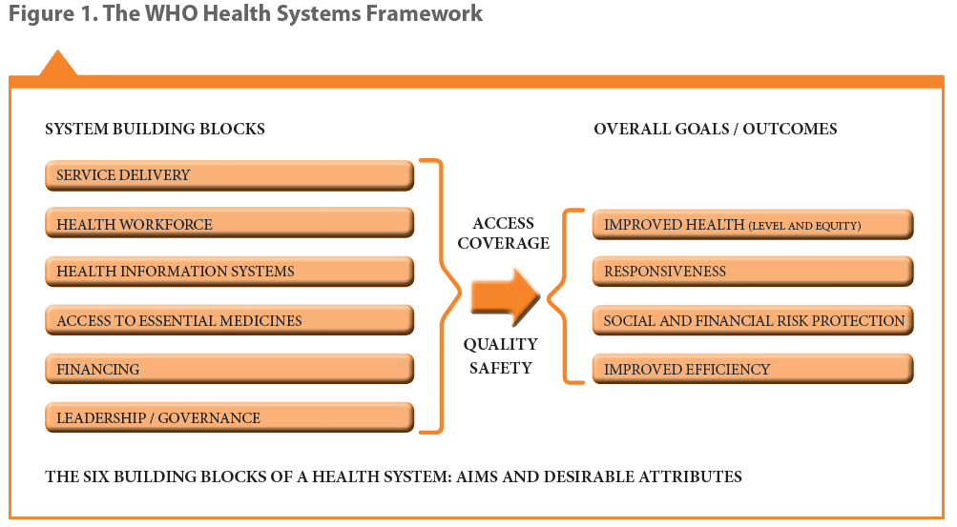
Health system building blocks

Slide 4
Universal Health Coverage – UHC Cube

Slide 5
Health financing strategy key functions

Slide 6
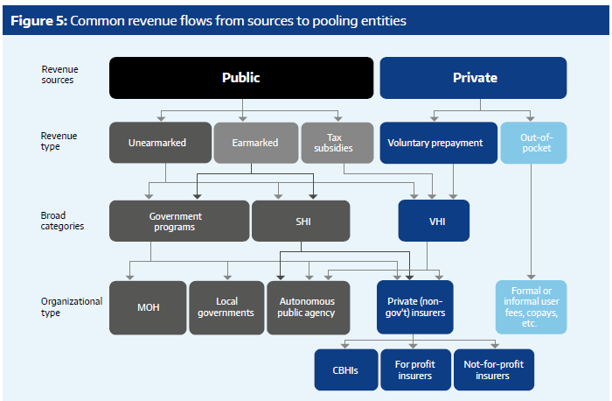
Examples of health financing mechanisms: Tanzania setting
Multiple: companies – local/regional
National Health Insurance Fund
Single National Health Insurer
Voucher Programme
Church based, Charitable health facilities, etc.
Community Health Funds
NGO based, savings groups, etc.

Slide 7
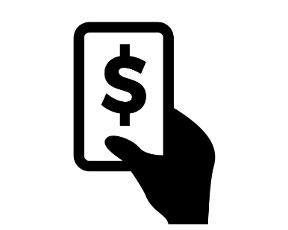
Transactions in health insurance systems
Purchaser
Provider
Type of facility
Services/Items
Price Lists
Contract
Contract
Client
Notes:
Flows should be differentiated:
Eg. Client to Purchaser (flow of money – contributions etc); Provider to Purchaser (flow of claims and money for reimbursement), Client to Provider (physical flow of patient)

Slide 8
Overview - Processes
Enrolment/Beneficiary Management
Health Service Utilization by insured clients
Claims processing (submission + scrutiny and payment)
Renewals (and/or modifications)

Slide 9
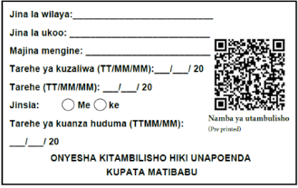
Enrolment Process I – e.g. Voluntary schemes/informal sector
Visit household
Inform, advise and convince
Collect contribution amount, personal data and capture identifier (photo, biometrics, etc.)
Provided
to client
Centralized or localized storage of individual information – link through ID no.
Policy & other relevant information
Insurer
Transfer all information & money collected to insurer
Notes:
Approaching clients and enrolling
A key question – when is policy activated/coverage started?
Financial transaction – norm, accounting requirement

Slide 10
Enrolment Process II – Existing lists eg. Company
Provide ID card & capture remaining data
Provide information to scheme (full or partial) on potential members
Transfer back to insurer additional data
Transfer issued ID card (ID no.) & reqd. data
Visit household
Insurer
Notes:
A key question – when is policy activated/coverage started?
Enrolment of existing employees (whose info is already available), or list of identified poor to be enrolled.
Some key considerations
Who are the actors involved and their specific roles
Choice of identification mechanism (centralized Vs decentralized storage, cost, available infrastructure, etc.)
Information to allow identification, location, etc.
Information on contribution/premium (based on “product”) and who pays
Information to establish benefit package eligibility
Conditions for activating a HH
Point at which data is digitized

Slide 11
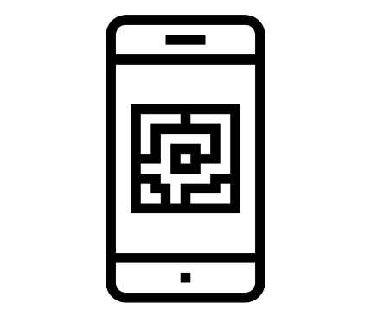
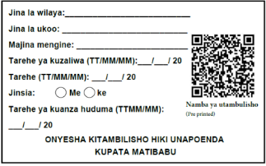
Health Service Utilization Process – Health Facility
Verification of membership
Member visits health facility
Member shows insurance card
Valid card
Invalid card
No card
Treated as insured person
Treated as an uninsured client
Notes:
Identity and eligibility check

Slide 12
Health Service Utilization Process II – Pre facility check
Insurance office (designated personnel) with equipment checks info stored on card or central server / or self check
Central Server
Notes:
Mainly eligibility check
Client need to know where to go and what benefits eligible for or validity of insurance coverage (expired or not)

Slide 13
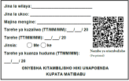
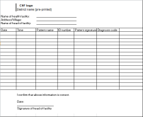
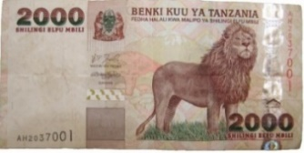
Claims Processing I: Submission (cashless or pre authorization)
central server
Insurer
Lab & Imaging
Billing
Doctor
Pharmacy
Notes:
Centralized billing
Apart from cashless method, Preauthorization (can also occur here), and or co pay.
Decentralized (separate departments) billing
Updation of remaining eligibility

Slide 14
Claims Processing I: Submission (reimbursement)
central server
Insurer
Lab & Imaging
Billing
Doctor
Pharmacy
Notes:
Reimbursement, - payment direct to facility and reimbursed later – perhaps the concept also for other benefit being paid directly to individual instead of health facility.

Slide 15
Claims Processing II: Claims scrutiny and payment
Submission
Automatic checks
Manual review
Resubmit/ Reopen rejected claim
Final calculation of payment to be made
Claim Payment
Notes:
Claim payment is then to providers or clients (reimbursement)
Some key considerations:
Renumeration mechanism to health facilities
Rules defined for payment of claims applied to facilities and clients
Claim submission point (automated at facility, insurance scheme office or intermediary level) – claims details + billing (prices), including payments made directly by client at point of care (depending on whether reimbursement or cashless or outside eligibility - co pay, amount above defined ceiling, exclusions, etc.)
Definition of stages of processing - automated checking & manual checking (including a medical review)
Processing of individual claims or grouping of claims while scrutinizing – criteria based on defined benefit package offered to clients and package negotiated with providers
Post scrutiny - compilation of due payment to respective service providers
Accounting by external system or insurance system?
External accounting system then’
Process of initiation of payment

Slide 16
Renewal + Modification Process – I (client initiated)
Collect ID card collected if needed
Updated or new ID card (if needed)
Updated in the system
Policy & other relevant information provided
Insurer
Insurer

Slide 17
Renewal Process – II (Insurer initiated)
ID card if needed
Policy is activated
Policy & other relevant information provided
Insurer
Notes:
Renewals
Triggering renewals and reaching out to clients (informing directly or via extension reaching out individually or through group follow ups)
Modification of household details (if any)
What completes renewals (with payment – full or part or without?)
Data update for identification mechanism
Policy Modification
Allowing modification of client data - As per business rules modification of HH/indv. details and impending effect on insurance processing – eg. new born entry or through marriage etc. might result in additional payment as well as benefit package changes like limits. Shifting of members between insured families, etc.

Slide 18
Attributions for icons
Creative Commons CC BY 3.0 license applies to all icons:
Family protection by Dilon Choudhury / CC BY 3.0
Payment by Loki Ba / CC BY 3.0
Hospital by ibrandify / CC BY 3.0
Hospital by Vectors Point / CC BY 3.0
Pharmacy by Eucalyp / CC BY 3.0
Medication by sahua d / CC BY 3.0
Upload by Hare Krishna / CC BY 4.0
Network by Creative Stall / CC BY 3.0
Worker by Nikita Kozin / CC BY 3.0

Slide 19
Attributions for icons
Creative Commons CC BY 3.0 license applies to all icons:
Contract by Adrien Coquet / CC BY 3.0
write document by kiddo / CC BY 3.0
Smartphone by Danil Polshin / CC BY 3.0
portrait by Bakunetsu Kaito / CC BY 3.0
flyer by Graphic Tigers / CC BY 3.0
id by Mr. Minuvi / CC BY 3.0
person and house by Rflor / CC BY 3.0
recipt by stolkramaker / CC BY 3.0
Doctor by zidney / CC BY 3.0
Card by Stephen JB Thomas / CC BY 3.0

Slide 20
Attributions for icons
Creative Commons CC BY 3.0 license applies to all icons:
computer-check list by Komkrit Noenpoempisut / CC BY 3.0
like by i cons / CC BY 3.0
Dislike by Numero Uno / CC BY 3.0
help by Rainbow Designs / CC BY 3.0
bullet list by Aneeque Ahmed / CC BY 3.0
QrCode Scan by Ninejipjip / CC BY 3.0
Family by Gan Khoon Lay / CC BY 3.0
person by Yamini Ahluwalia / CC BY 3.0
networking by Becris / CC BY 3.0
edit by Gregor Cresnar / CC BY 3.0
Scanner by Eucalyp / CC BY 3.0

Slide 21
Thank you!
Except where otherwise noted, this work is licensed under
https://creativecommons.org/licenses/by-sa/4.0/legalcode

