Slide 1
Introduction - Health Financing Mechanisms and Insurance Processes

Slide 2
Overview – key health financing concepts
Health system building blocks
Universal Health Coverage dimensions
Role of health financing
Health financing mechanisms
Transactions in insurance system

Slide 3
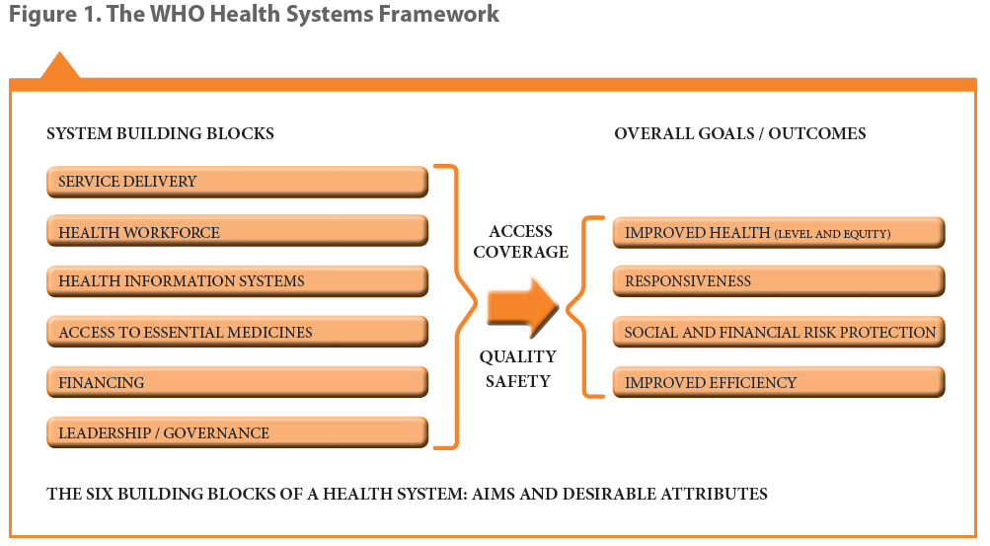
Health system building blocks

Slide 4
Universal Health Coverage – UHC Cube

Slide 5
Health financing strategy key functions

Slide 6
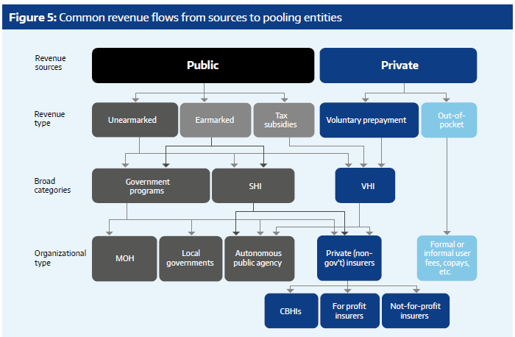
Examples of health financing mechanisms: Tanzania setting
Multiple: companies – local/regional
National Health Insurance Fund
Single National Health Insurer
Voucher Programme
Church based, Charitable health facilities, etc.
Community Health Funds
NGO based, savings groups, etc.

Slide 7
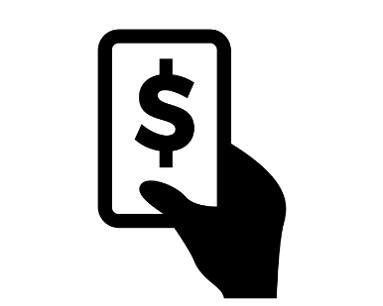
Transactions in health insurance systems
Purchaser
Provider
Type of facility
Medication
Price Lists
Contract
Client

Slide 8
Overview - Processes
Enrolment/Beneficiary Management
Client Service Utilization
Claims processing (submission + scrutiny and payment)
Renewals (modifications)

Slide 9
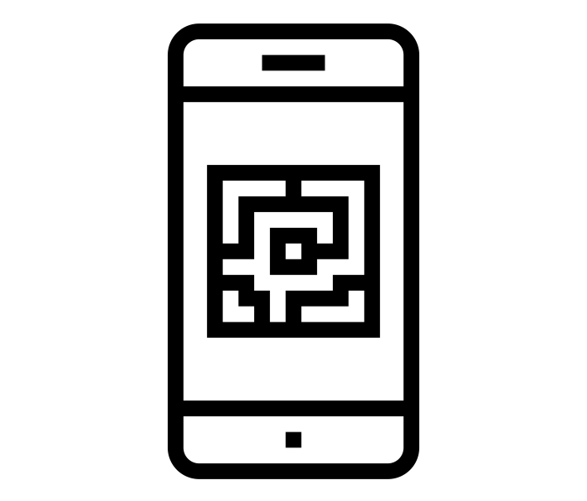
Enrolment I – e.g. Voluntary schemes/informal sector
For the informal sector, there is a door to door enrolment
Visit household
Inform, advise and convince
Fill Enrolment Form
Centralized or decentralized storage
With the app, scann QR code of Enrolment Form
(Take photo)*
*not necessary

Slide 10
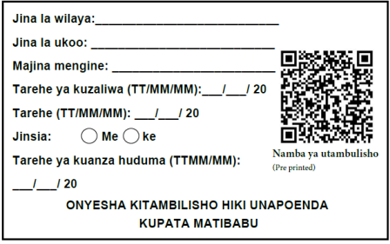
Enrolment I – e.g. Voluntary schemes/informal sector
Collect contribution
Provide receipt
Distribute membership ID and flyer on scheme

Slide 11
Enrolment Process II – Existing lists e.g. Company
Insurer has full or partial information
Provide information on scheme to potential members
Ask for ID no/ policy no.
(Take photo)*
Provide membership card
Submit through App
*not necessary

Slide 12
Client Service Utilization Process – Health Facility
Verify membership through IMIS
Member visits health facility
Member shows insurance card
Is person a member?
Yes
No
Treated as insured person
Treated as an uninsured client

Slide 13
Client Service Utilization Process – Health Facility
Server
Doctor examines member
Receives medicine and or does tests*
Health facility enter information into IMIS
Infomation stored in the server
*if applicable

Slide 14
Claims Processing I: Submission
Insurance side
Medical audit of randomly selected % of claims
Insurance personell starts processing
Automatic and manual checks of claims are done
Approve
Clarify with health facility
Disapprove
→Reimbursment

Slide 15
Claims Processing II: Claims scrutiny and payment
Submission
Automatic checks
Manual review
Final calculation of payment to be made
Claim Payment
Notes:
Claim payment is then to providers or clients (reimbursement)
Some key considerations:
Renumeration mechanism to health facilities
Rules defined for payment of claims applied to facilities and clients
Claim submission point (automated at facility, insurance scheme office or intermediary level) – claims details + billing (prices), including payments made directly by client at point of care (depending on whether reimbursement or cashless or outside eligibility - co pay, amount above defined ceiling, exclusions, etc.)
Definition of stages of processing - automated checking & manual checking (including a medical review)
Processing of individual claims or grouping of claims while scrutinizing – criteria based on defined benefit package offered to clients and package negotiated with providers
Post scrutiny - compilation of due payment to respective service providers
Accounting by external system or insurance system?
External accounting system then’
Process of initiation of payment

Slide 16
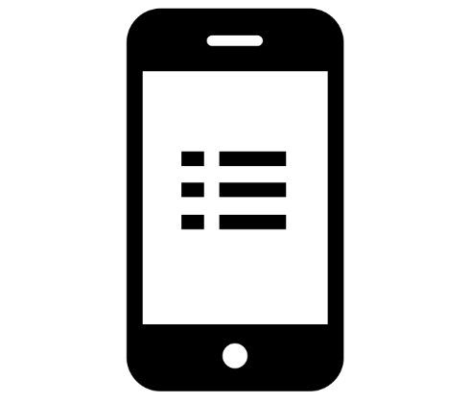
Renewal + Modification Process – I (client initiated)
Servers sends information to enrolment officers
List with people that need to renew their contracts is sent to app
Collect contribution
Provide receipt
Update or new ID card and give flyer on scheme
→Information updated in the server

Slide 17
Renewal Process – II (Insurer initiated)
Insurer
Provide information on scheme to potential members
(Take photo)*
Collect information from individual/family members
Submit through App
Ask for ID no/ policy no.

Slide 18
Renewal Process – II (Insurer initiated)
Collect contribution
Provide receipt
Distribute membership ID and flyer on scheme
→Policy is activated

Slide 19
Attributions for icons
Creative Commons CC BY 3.0 license applies to all icons:
Family protection by Dilon Choudhury / CC BY 3.0
Payment by Loki Ba / CC BY 3.0
Hospital by ibrandify / CC BY 3.0
Hospital by Vectors Point / CC BY 3.0
Pharmacy by Eucalyp / CC BY 3.0
Medication by sahua d / CC BY 3.0
Upload by Hare Krishna / CC BY 4.0
Network by Creative Stall / CC BY 3.0
Worker by Nikita Kozin / CC BY 3.0

Slide 20
Attributions for icons
Creative Commons CC BY 3.0 license applies to all icons:
Contract by Adrien Coquet / CC BY 3.0
write document by kiddo / CC BY 3.0
Smartphone by Danil Polshin / CC BY 3.0
portrait by Bakunetsu Kaito / CC BY 3.0
Smart Card by Vectors Point / CC BY 3.0
flyer by Graphic Tigers / CC BY 3.0
id by Mr. Minuvi / CC BY 3.0
person and house by Rflor / CC BY 3.0
recipt by stolkramaker / CC BY 3.0

Slide 21
Attributions for icons
Creative Commons CC BY 3.0 license applies to all icons:
Doctor by zidney / CC BY 3.0
Card by Stephen JB Thomas / CC BY 3.0
computer-check list by Komkrit Noenpoempisut / CC BY 3.0
like by i cons / CC BY 3.0
Dislike by Numero Uno / CC BY 3.0
help by Rainbow Designs / CC BY 3.0
bullet list by Aneeque Ahmed / CC BY 3.0
QrCode Scan by Ninejipjip / CC BY 3.0
Family by Gan Khoon Lay / CC BY 3.0
person by Yamini Ahluwalia / CC BY 3.0

Slide 22
Thank you!
Except where otherwise noted, this work is licensed under
https://creativecommons.org/licenses/by-sa/4.0/legalcode

