Slide 1
Introduction -
Health Financing Mechanisms and Insurance Processes

Slide 2
Overview – key health financing concepts
Health system building blocks
Universal Health Coverage dimensions
Role of health financing
Health financing mechanisms
Transactions in insurance system

Slide 3
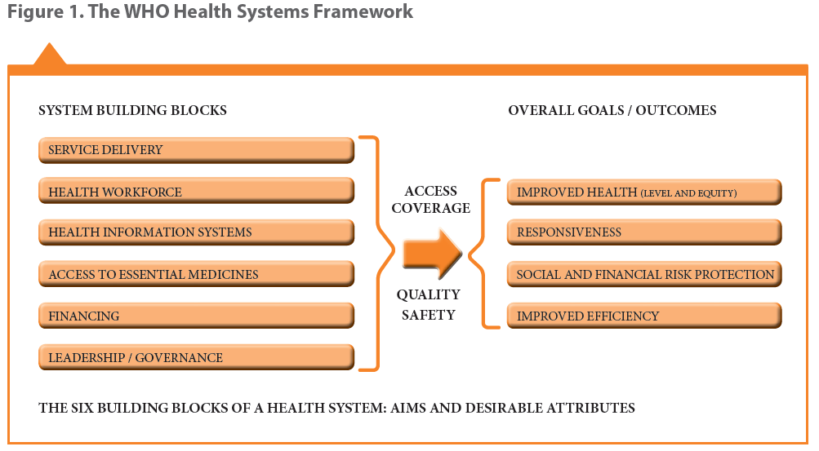
Health system building blocks

Slide 4
Universal Health Coverage – UHC Cube

Slide 5
Health financing strategy key functions

Slide 6
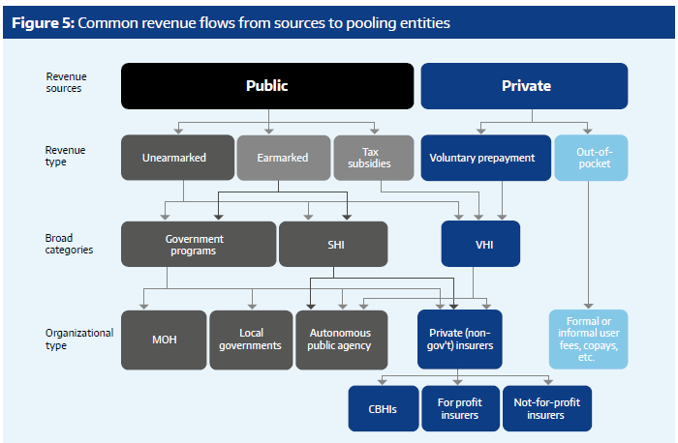
Examples of health financing mechanisms: Tanzania setting
Multiple: companies – local/regional
National Health Insurance Fund
Single National Health Insurer
Voucher Programme
Church based, Charitable health facilities, etc.
Community Health Funds
NGO based, savings groups, etc.

Slide 7






















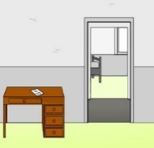

Transactions in health insurance systems
Purchaser
Provider
Client

Slide 8
Overview - Processes
Enrolment/Beneficiary Management
Client Service Utilization
Claims processing (submission + scrutiny and payment)
Renewals (modifications)

Slide 9



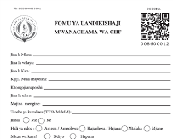



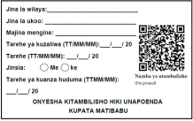









Enrolment Process I – e.g. Voluntary schemes/informal sector
ID no./Policy no. & card
Centralized or decentralized storage
Insurer
Notes:
Approaching clients and enrolling
A key question – when is policy activated/coverage started?
Financial transaction – norm, accounting requirement

Slide 10



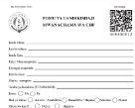
Enrolment Process II – Existing lists eg. Company
Info is Full or partial
ID no./Policy no. & card
Insurer
Notes:
A key question – when is policy activated/coverage started?
Enrolment of existing employees (whose info is already available), or list of identified poor to be enrolled.
Some key considerations
Who are the actors involved and their specific roles
Choice of identification mechanism (centralized Vs decentralized storage, cost, available infrastructure, etc.)
Information to allow identification, location, etc.
Information on contribution/premium (based on “product”) and who pays
Information to establish benefit package eligibility
Conditions for activating a HH
Point at which data is digitized

Slide 11


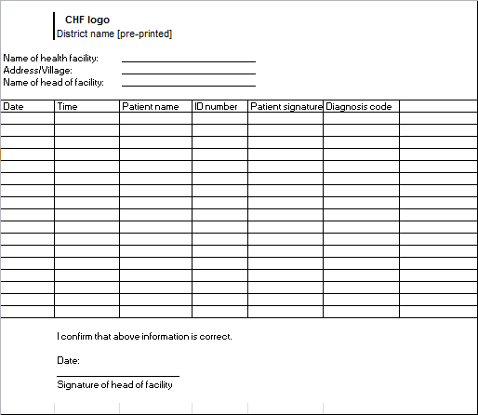
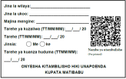








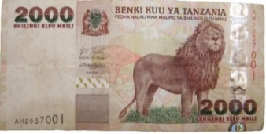
Client Service Utilization Process I – Health Facility
Central Server
Reception
EXPIRED
Send patient for treatment
Notes:
Identity and eligibility check

Slide 12



Client Service Utilization Process II – Pre facility check
Insurance office or designated person
central server
Notes:
Mainly eligibility check
Pre – Authorization
Client need to know where to go and what benefits eligible for or validity of insurance coverage (expired or not)

Slide 13






Claims Processing I: Submission
central server
Insurer
Notes:
preauthorization (can also occur here), cashless and or co pay. For reimbursement then ofcourse a mechanism for client to submit bills and insurer to pay client.

Slide 14
Claims Processing I: Submission (reimbursement)
central server
Insurer
Notes:
Reimbursement, - payment direct to facility and reimbursed later – perhaps the concept also for other benefit being paid directly to individual instead of health facility.

Slide 15
Claims Processing II: Claims scrutiny and payment
Submission
Automatic checks
Manual review
Final calculation of payment to be made
Claim Payment
Notes:
Claim payment is then to providers or clients (reimbursement)
Some key considerations:
Renumeration mechanism to health facilities
Rules defined for payment of claims applied to facilities and clients
Claim submission point (automated at facility, insurance scheme office or intermediary level) – claims details + billing (prices), including payments made directly by client at point of care (depending on whether reimbursement or cashless or outside eligibility - co pay, amount above defined ceiling, exclusions, etc.)
Definition of stages of processing - automated checking & manual checking (including a medical review)
Processing of individual claims or grouping of claims while scrutinizing – criteria based on defined benefit package offered to clients and package negotiated with providers
Post scrutiny - compilation of due payment to respective service providers
Accounting by external system or insurance system?
External accounting system then’
Process of initiation of payment

Slide 16


Renewal + Modification Process – I (client initiated)
ID card
Updated or new ID card
Updated in the system
Insurer

Slide 17
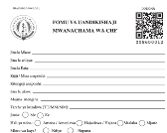
Renewal Process – II (Insurer initiated)
ID card
Policy is activated
Insurer
Notes:
Renewals
Triggering renewals and reaching out to clients (informing directly or via extension reaching out individually or through group follow ups)
Modification of household details (if any)
What completes renewals (with payment – full or part or without?)
Data update for identification mechanism
Policy Modification
Allowing modification of client data - As per business rules modification of HH/indv. details and impending effect on insurance processing – eg. new born entry or through marriage etc. might result in additional payment as well as benefit package changes like limits. Shifting of members between insured families, etc.

Slide 18
Thank you!

