Slide 1
openIMIS Demo – Offline version
16.04.2019

Slide 2
Product Presentation Overview
Overview of data flow
Construction of a scheme
Processes
  Enrolment process
  Health Service Utilization
  Claims process
  Renewal Process
  Reporting
Notes:
Configuration
Split by process
Reporting

Slide 3

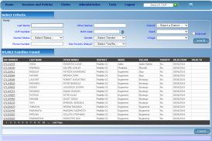





Communication within openIMIS
central server
Internet
Internet
Internet
physical
transport
on-line
mobile
off-line

Slide 4


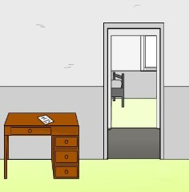
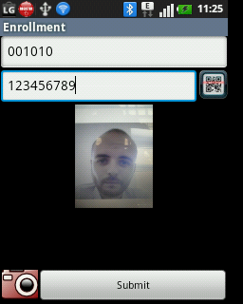
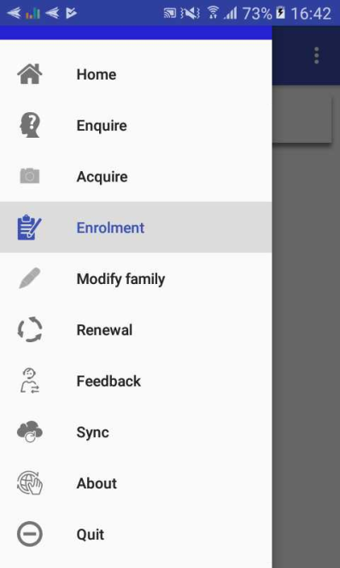
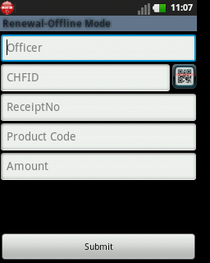
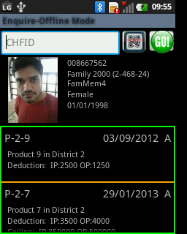
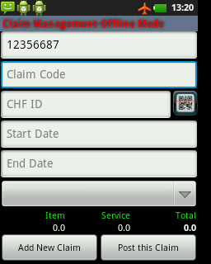
Data transfer in insurance system using mobile phone
server
mobile
network
acquiring of
photos
renewal
of a policy
acquiring
of feedbacks
retrieving
of coverage
submission
of bills

Slide 5
Product Presentation Overview
Overview of data flow
Construction of a scheme
Processes
  Enrolment process
  Health Service Utilization
  Claims process
  Renewal Process
  Reporting
Notes:
Configuration
Split by process
Reporting

Slide 6





















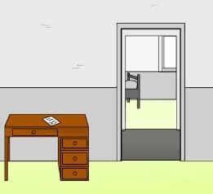

Construction of a scheme - I

Slide 7
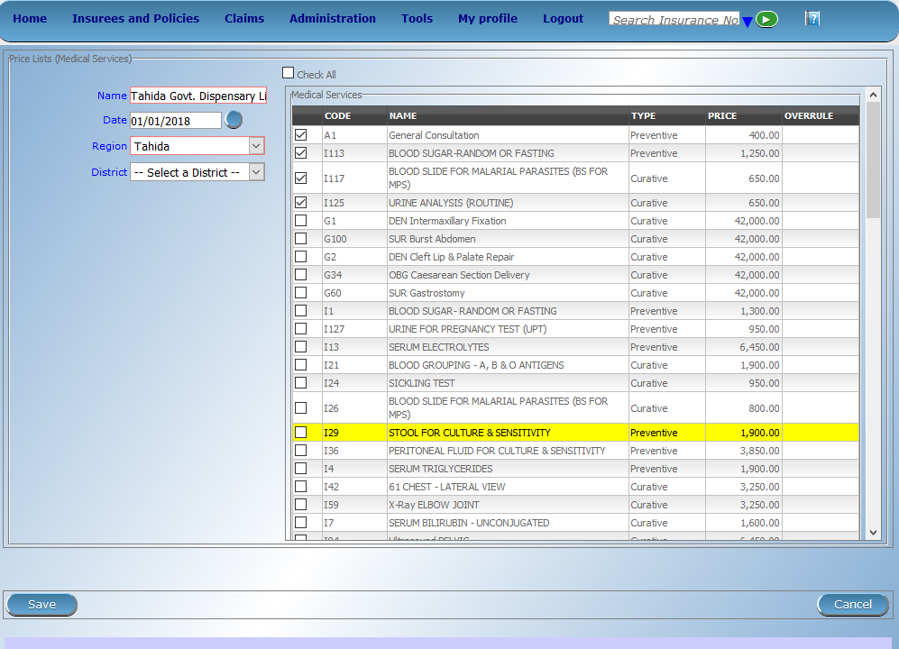
Price List -> Medical Services

Slide 8

Price List -> Medical Items

Slide 9
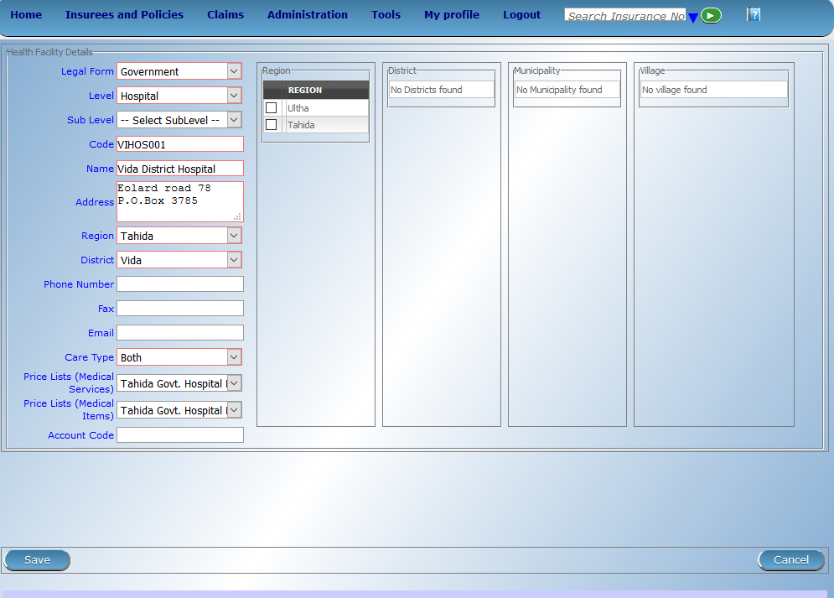
Health Facilities

Slide 10
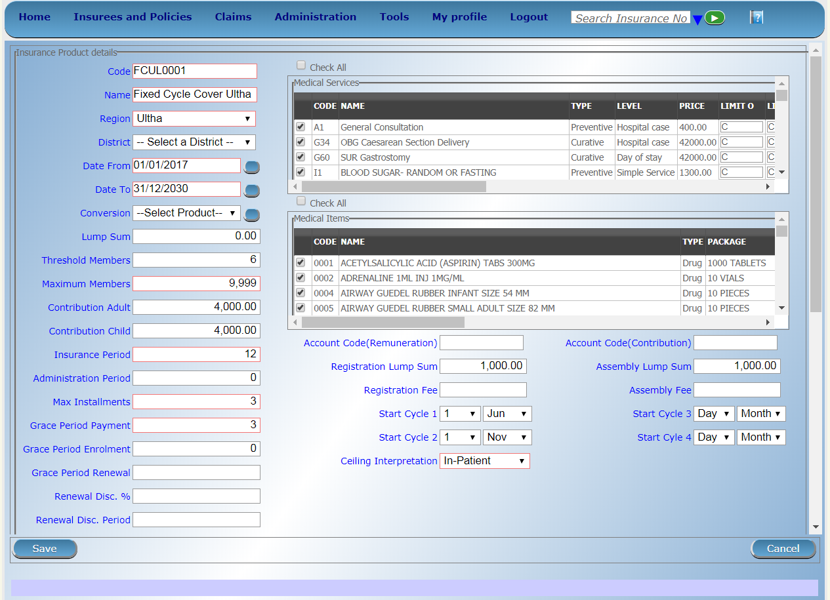
Products – I

Slide 11
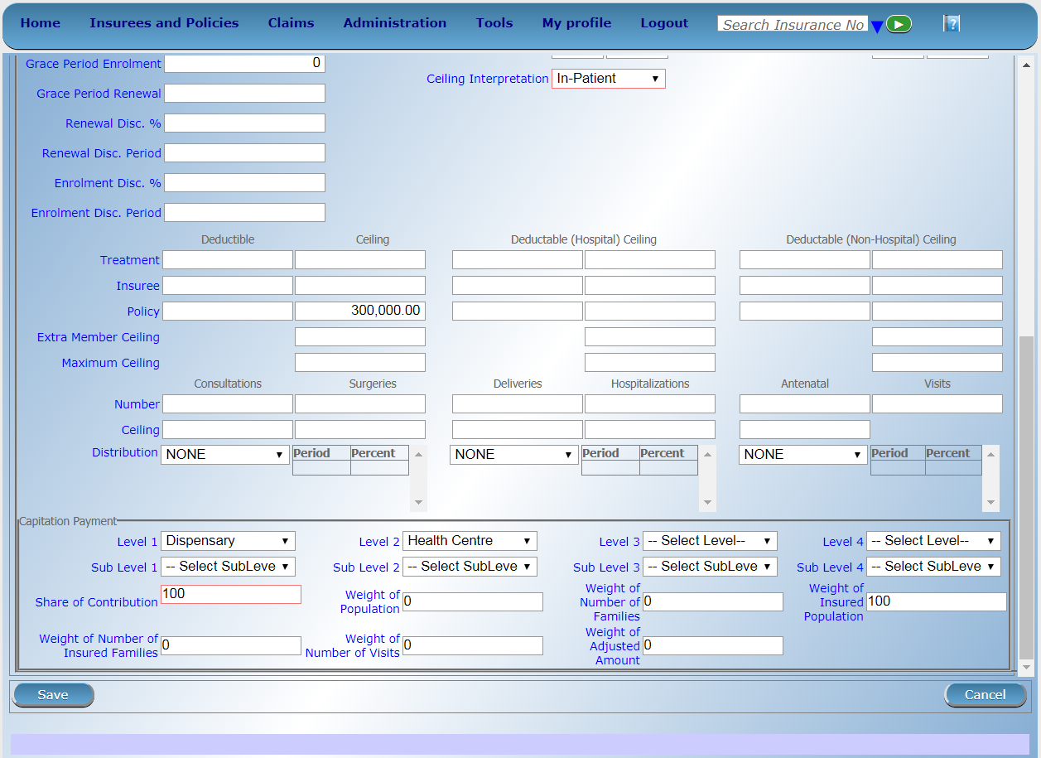
Products – II

Slide 12
Product Presentation Overview
Overview of data flow
Construction of a scheme
Processes
  Enrolment process
  Health Service Utilization
  Claims process
  Renewal Process
  Reporting
Notes:
Configuration
Split by process
Reporting

Slide 13
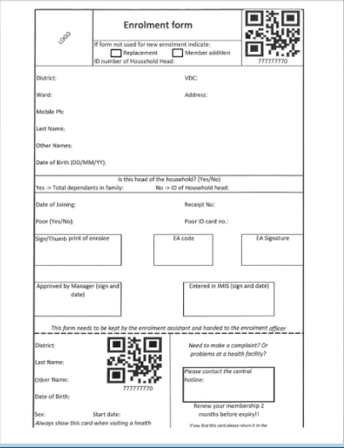
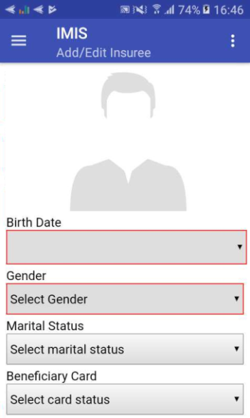
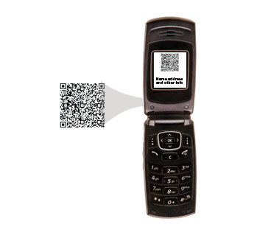


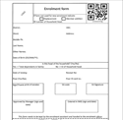



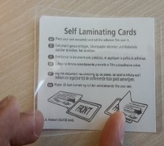
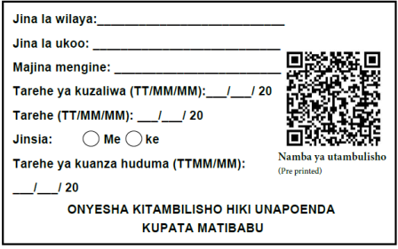
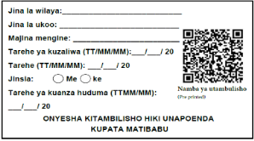
Enrolment – I (Sample Process)
Collect contribution

Slide 14
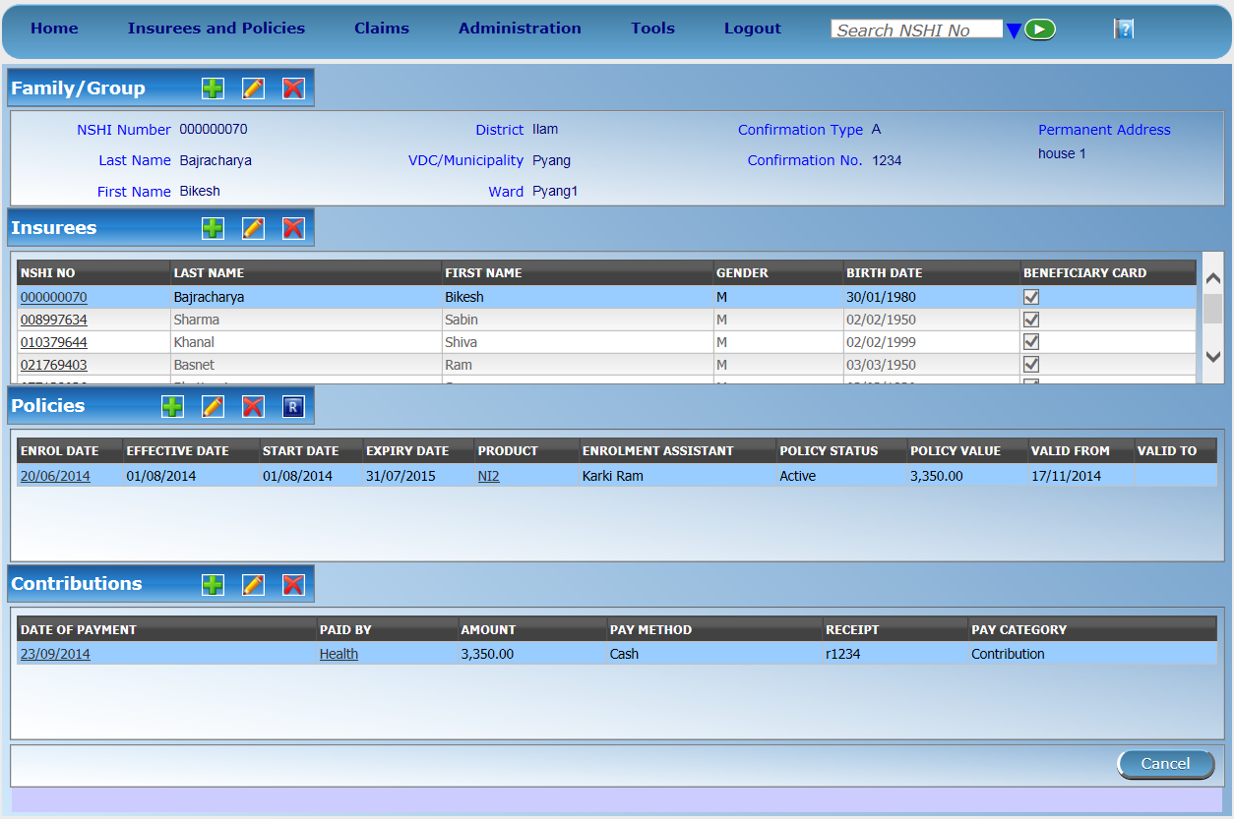
Enrolment of other members in the household

Slide 15
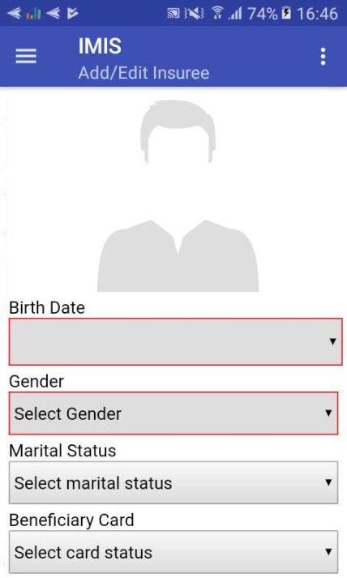

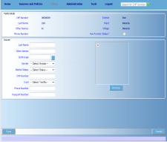

Mobile phone applications- Enrolment
1.acquiring of a photo of an insuree
by a mobile phone
3.assigning it to
the record of the insuree
(automatically)
2.sending it on
the central server
15

Slide 16
Product Presentation Overview
Overview of data flow
Construction of a scheme
Processes
  Enrolment process
  Health Service Utilization
  Claims process
  Renewal Process
  Reporting
Notes:
Configuration
Split by process
Reporting

Slide 17
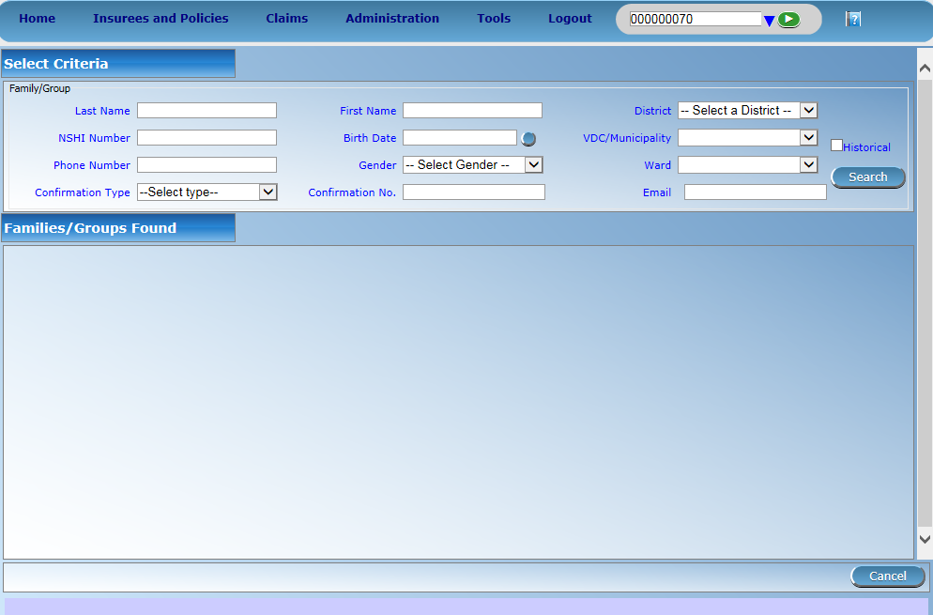
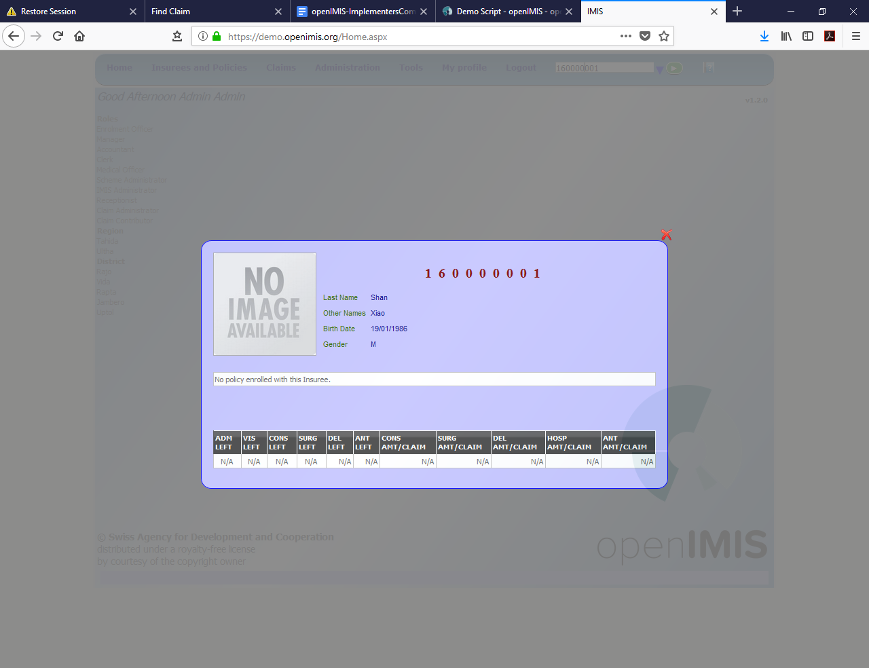

Online/Offline querying of clients

Slide 18
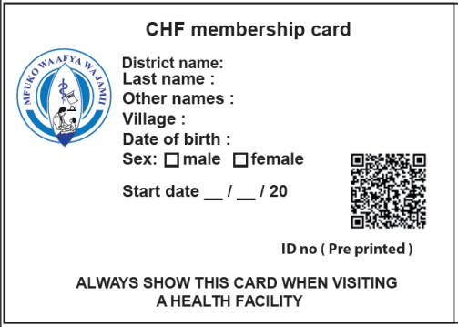


Use of mobile application
1. insuree’s ID number read by phone through QR code
3.retrieving photo and information
on coverage
2.send it to
the central server

Slide 19
Product Presentation Overview
Overview of data flow
Construction of a scheme
Processes
  Enrolment process
  Health Service Utilization
  Claims process
  Renewal Process
  Reporting
Notes:
Configuration
Split by process
Reporting

Slide 20
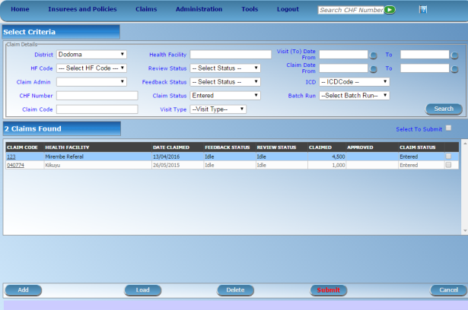


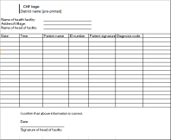

Claims Process – I (Sample Process)
server
mobile
network
health facility
Internet
network
mobile client
on-line client
Internal claims processing in IMIS
CHF office
off-line client
Automated Checking (client status, price lists, etc.)
Review by a Medical Advisor
Automated final claim calculations (remaining limits, etc.)
Generating consolidated claims report
paper forms
on-line client

Slide 21
Use of mobile application – claim submission
1. insuree’s ID number read by phone through QR code
2. claim details entered
3. send it to the
central server

Slide 22
Product Presentation Overview
Overview of data flow
Construction of a scheme
Processes
  Enrolment process
  Health Service Utilization
  Claims process
  Renewal Process
  Reporting
Notes:
Configuration
Split by process
Reporting

Slide 23
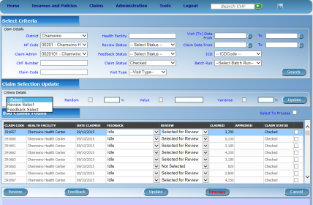
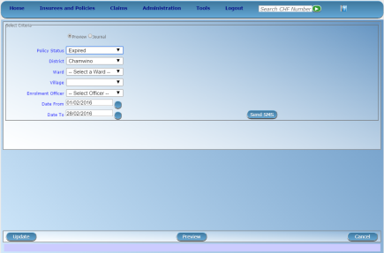





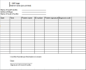

Renewal and Feedback – I (Standard Process)
Feedback trigger
mobile
Network - sms
server
mobile
Network – data transfer
Renewal trigger
CHF office
Print out of
generated
Renewal list OR
offline file to be
uploaded to
mobile phone

Slide 24

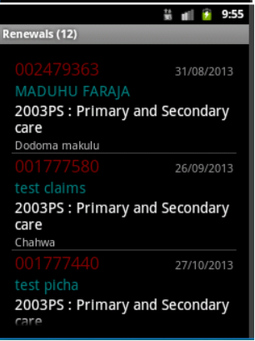
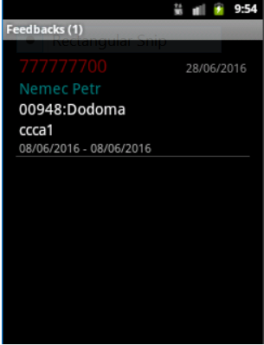
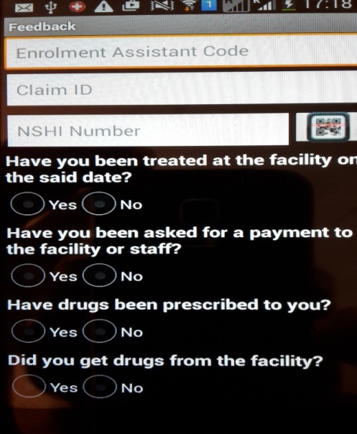
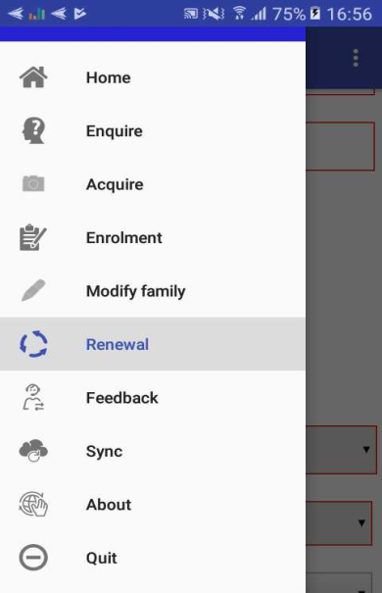
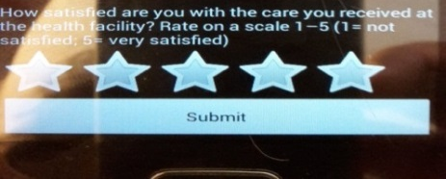
Renewal and Feedback – II (Mobile phone supported)
server

Slide 25
Product Presentation Overview
Overview of data flow
Construction of a scheme
Processes
  Enrolment process
  Health Service Utilization
  Claims process
  Renewal Process
  Reporting
Notes:
Configuration
Split by process
Reporting

Slide 26
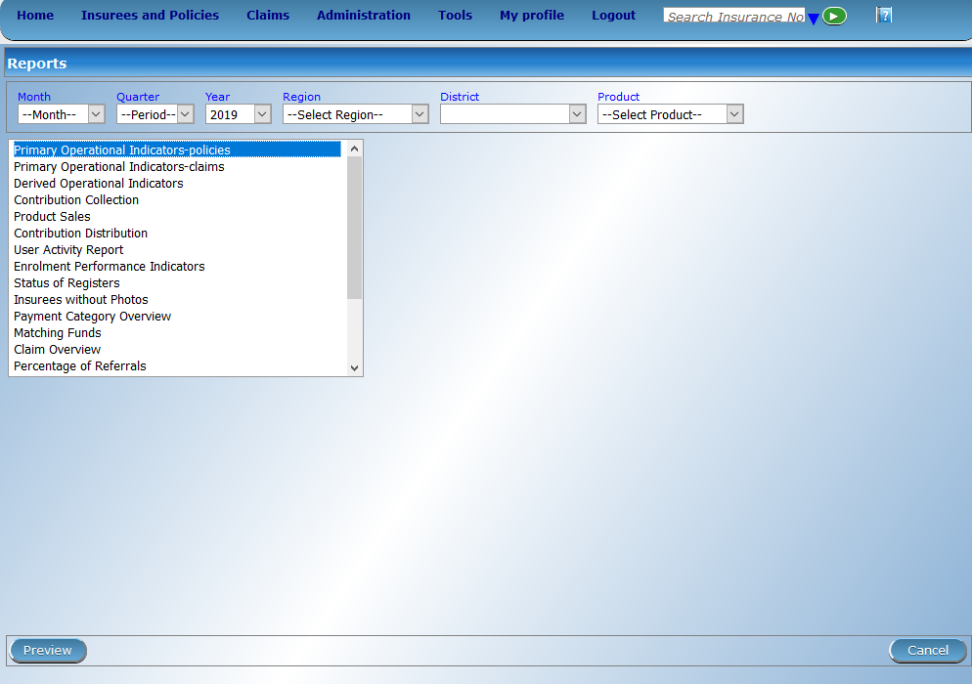
Generating pre configured reports

Slide 27
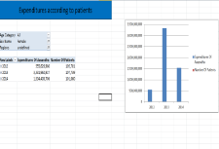


Customizable reporting – AR IMIS
mobile
network
Front-end (Excel)
server
Operational database of IMIS
IMIS Data Warehouse
ETL
mobile phone clients
AR-IMIS
External data sources (eg. DHIS)
on-line
(thin) clients
off-line
(thick) clients
27

Slide 28
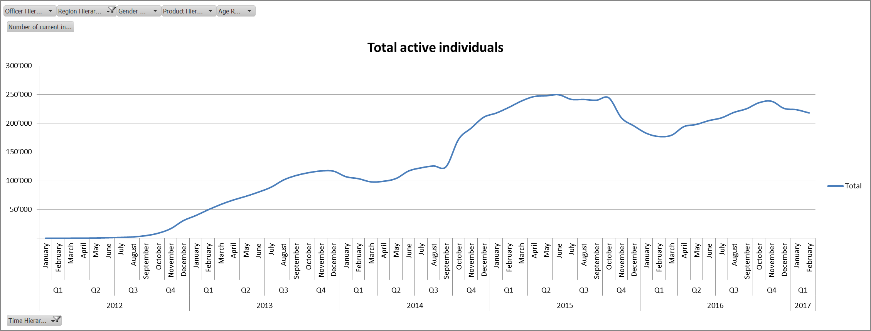
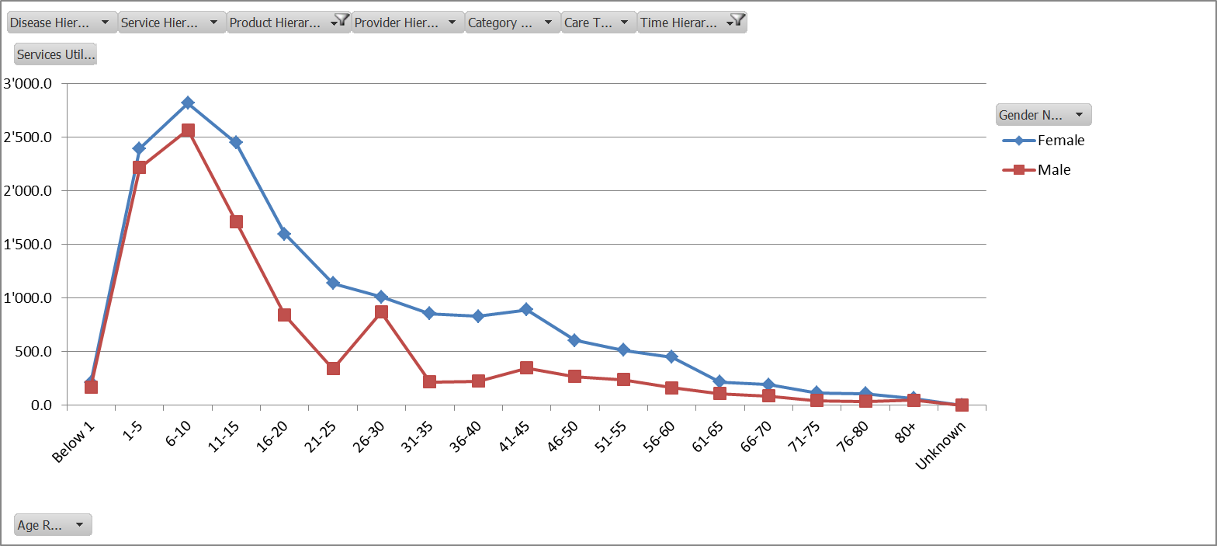
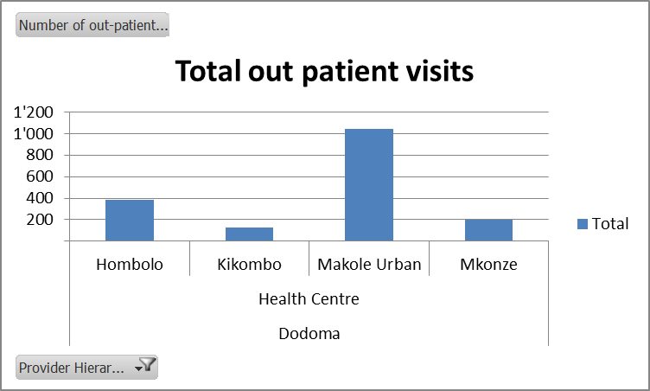
Excel front end

Slide 29
Additional resources
www.openimis.org - Home of the openIMIS Initiative
Strategic direction given by a Steering Group
Technical directions guided by a Technical Advisory Group
openIMIS wiki - Read more about openIMIS
www.github.com/openimis - Download software and source code
openIMIS Demo: demo.openimis.org - use the demo now !
openIMIS Service Desk- report issues, bugs, or feature requests !
Notes:
Configuration
Split by process
Reporting

