Slide 1
openIMIS Demo – Offline version
16.04.2019

Slide 2
Product Presentation Overview
Overview of data flow
Construction of a scheme
Processes
  Enrolment process
  Health Service Utilization
  Claims process
  Renewal Process
  Reporting
Notes:
Configuration
Split by process
Reporting

Slide 3

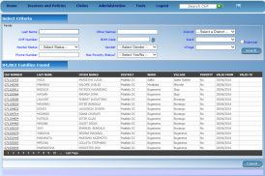





Communication within openIMIS
central server
Internet
Internet
Internet
physical
transport
on-line
mobile
off-line

Slide 4


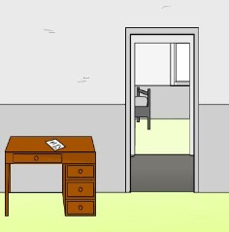
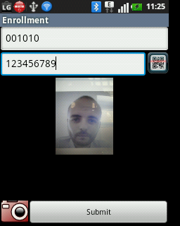
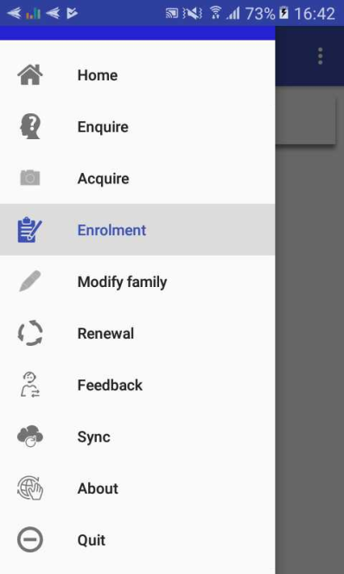
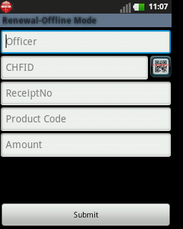
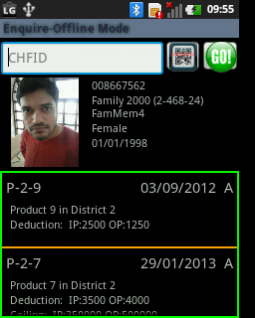
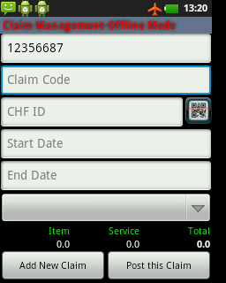
Data transfer in insurance system using mobile phone
server
mobile
network
acquiring of
photos
renewal
of a policy
acquiring
of feedbacks
retrieving
of coverage
submission
of bills

Slide 5
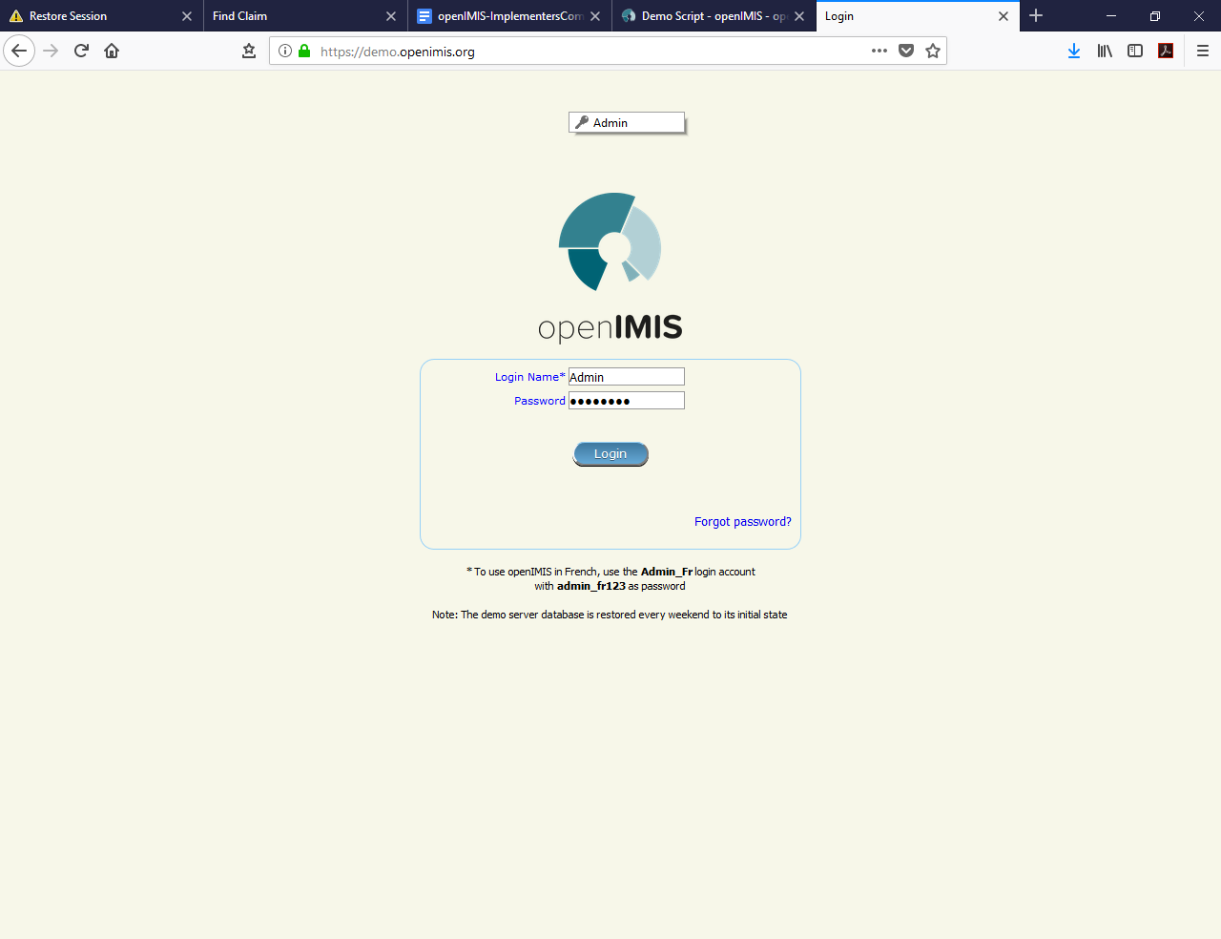
Login Screen

Slide 6
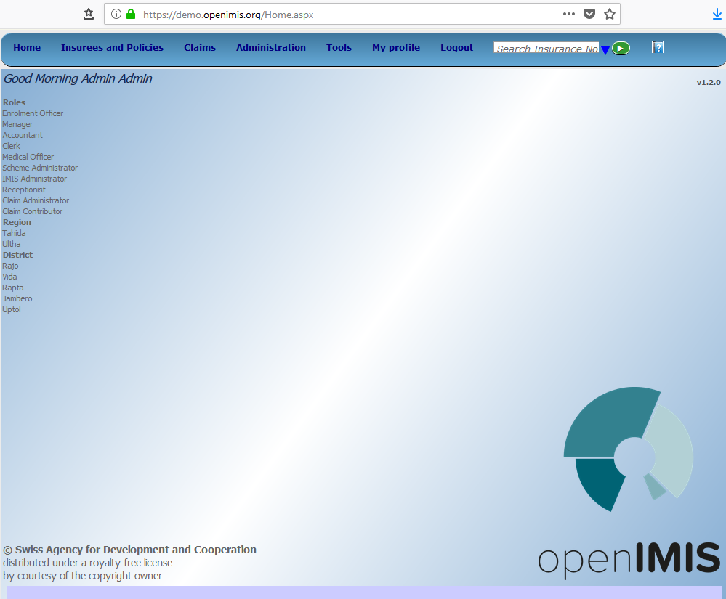
Home page

Slide 7
Product Presentation Overview
Overview of data flow
Construction of a scheme
Processes
  Enrolment process
  Health Service Utilization
  Claims process
  Renewal Process
  Reporting
Notes:
Configuration
Split by process
Reporting

Slide 8





















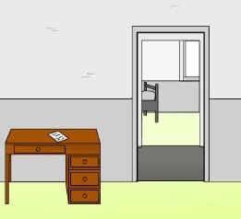

Construction of a scheme - I

Slide 9


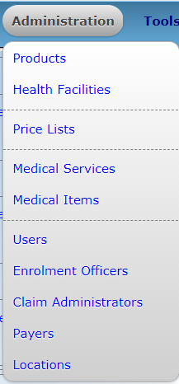




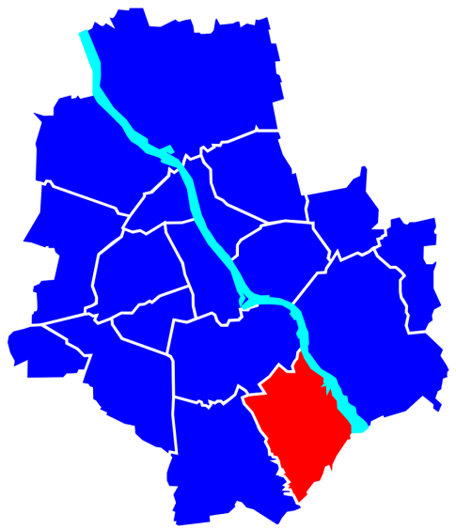


Construction of a scheme - II
Is someone paying on behalf on the insured family/group?

Slide 10
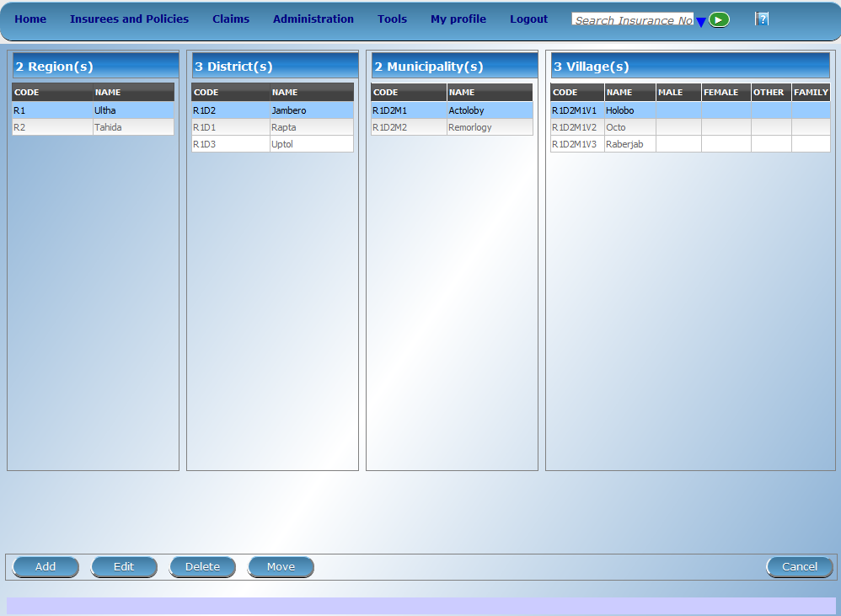
Locations

Slide 11
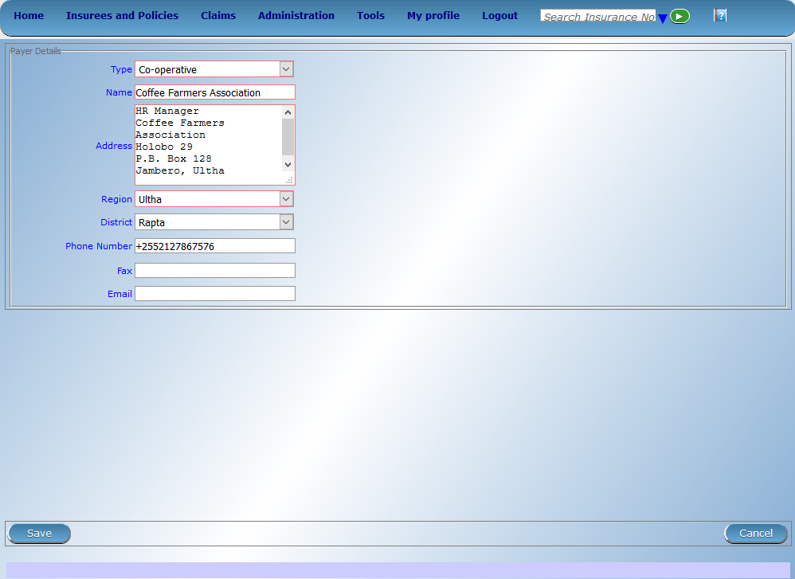
Payers

Slide 12
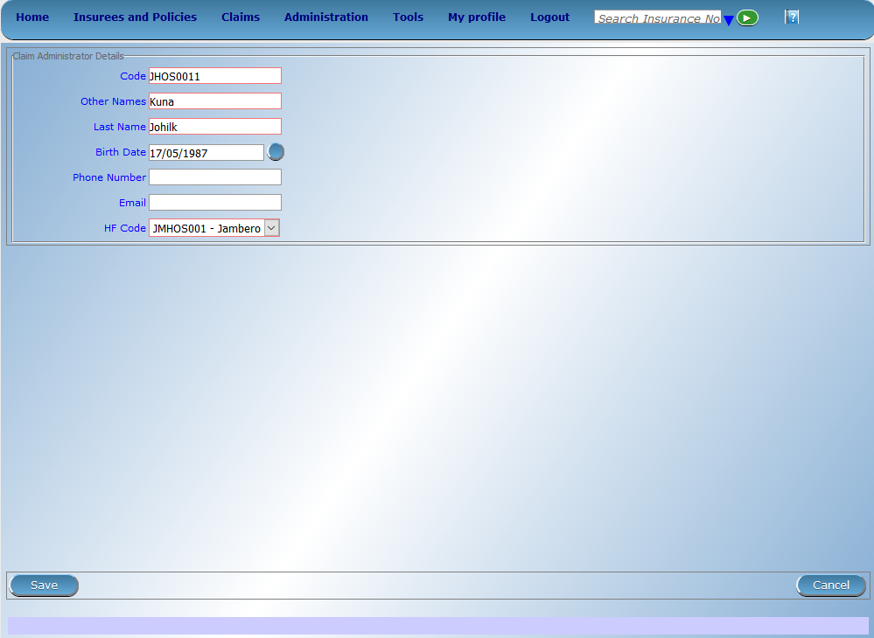
Claim administrators

Slide 13
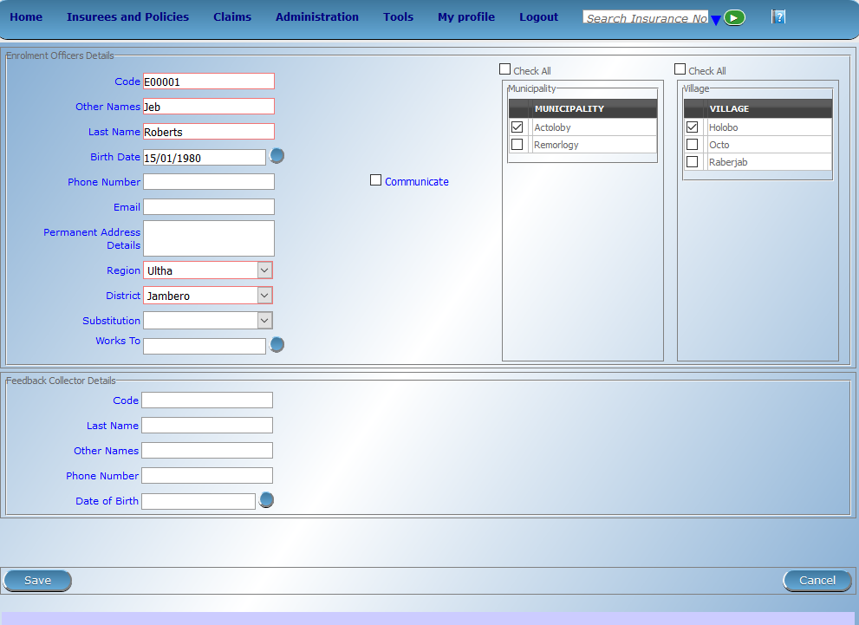
Enrolment Officers

Slide 14
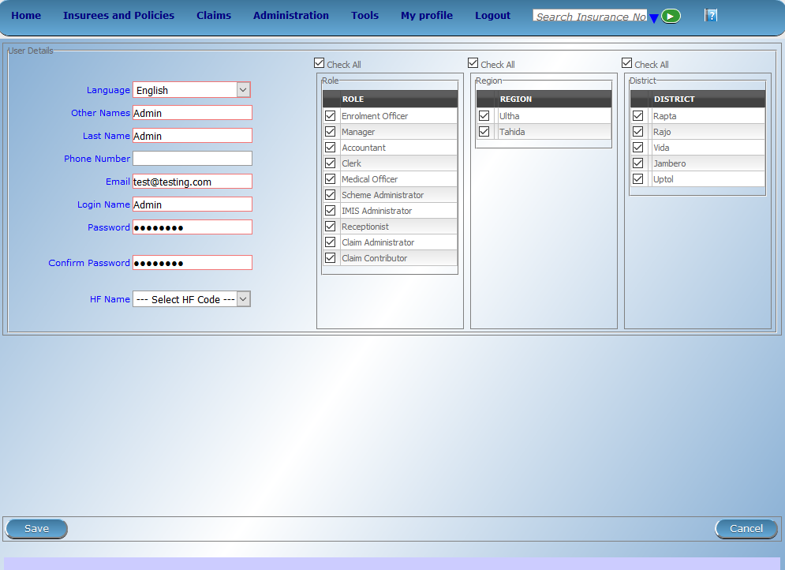
Users

Slide 15

Medical Items

Slide 16

Medical Services

Slide 17
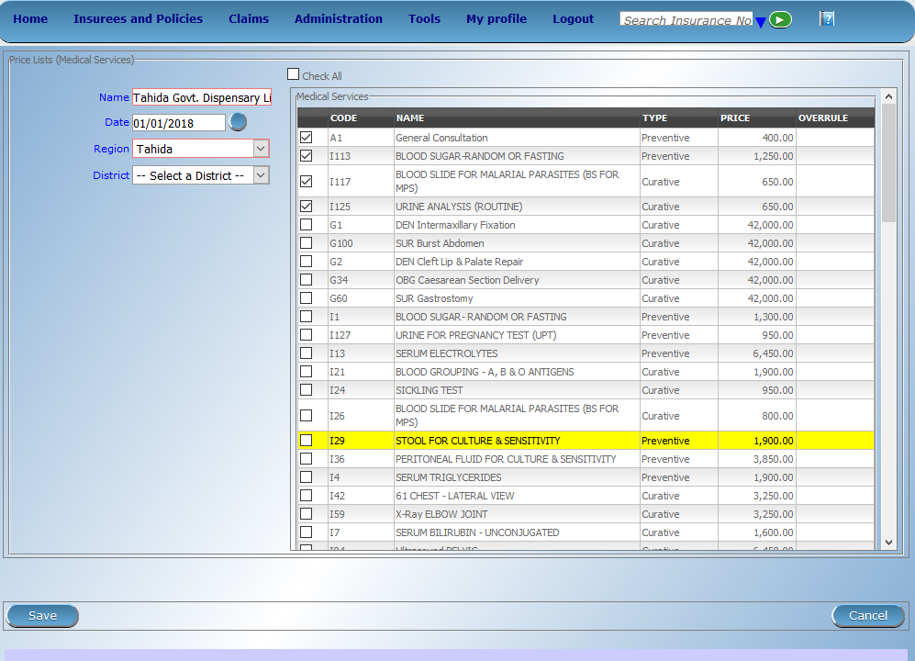
Price List -> Medical Services

Slide 18

Price List -> Medical Items

Slide 19
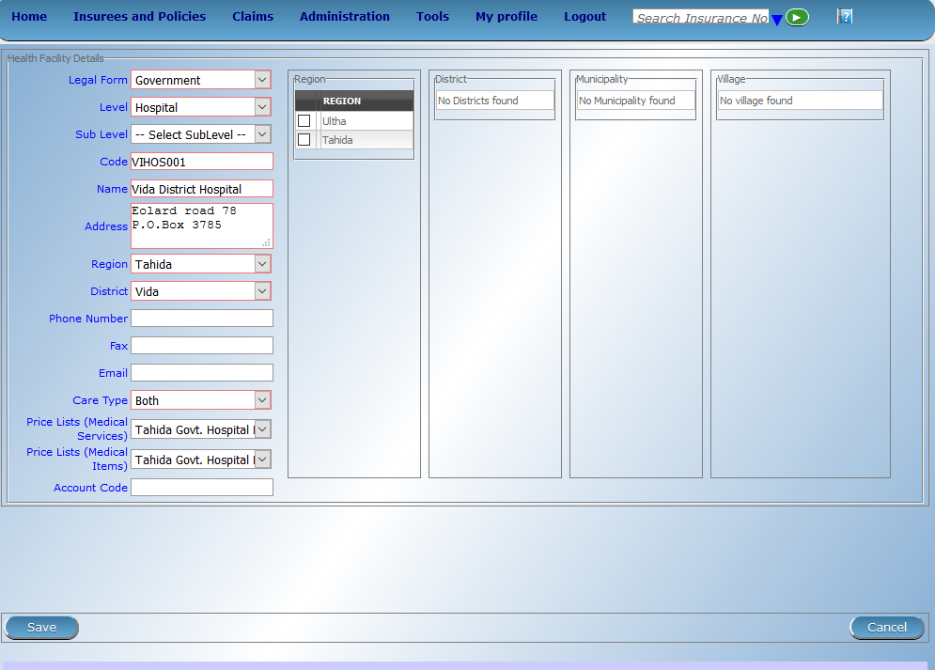
Health Facilities

Slide 20
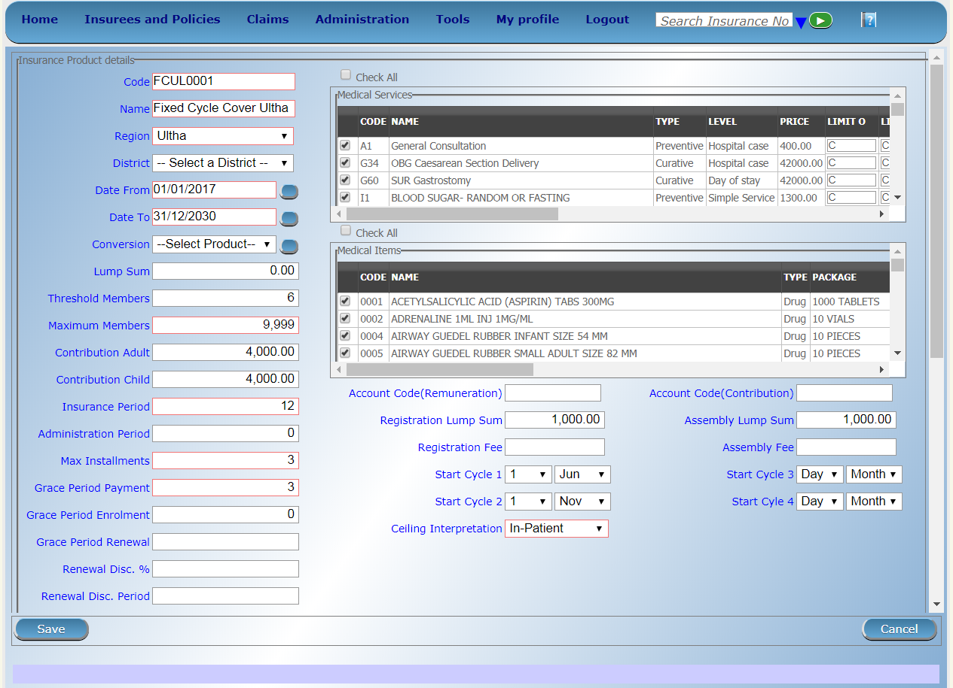
Products – I

Slide 21
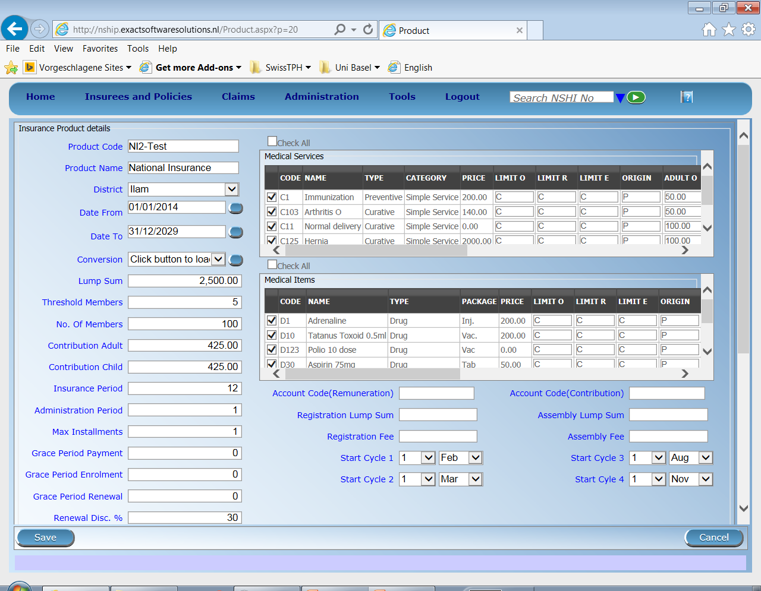
Products – II

Slide 22
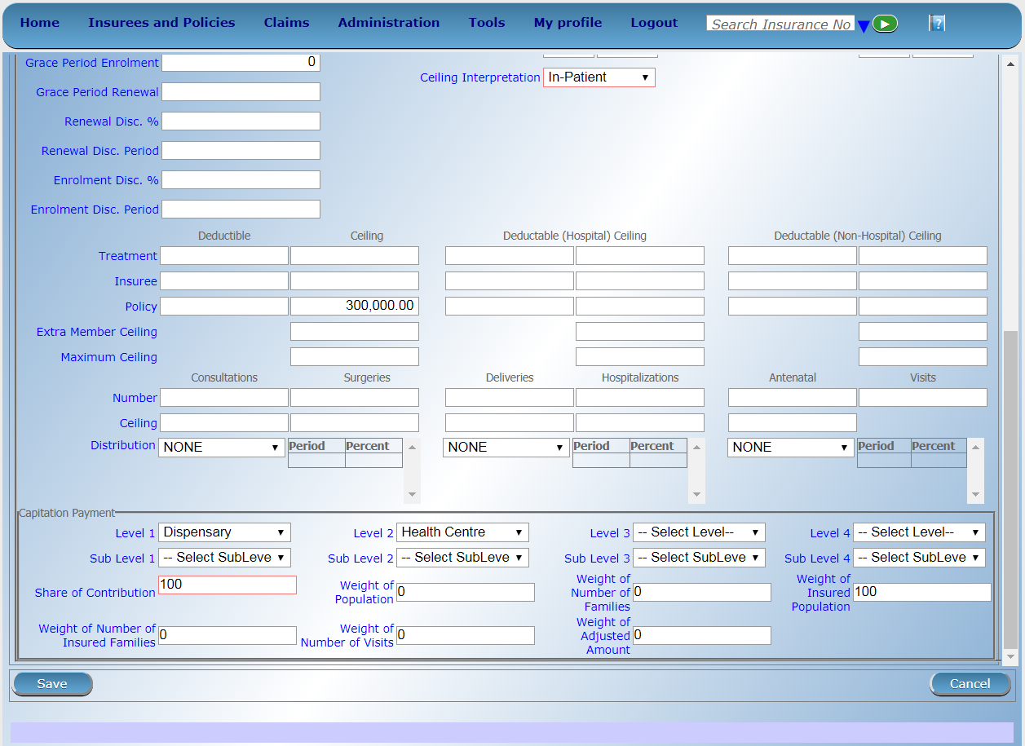
Products – III

Slide 23
Product Presentation Overview
Overview of data flow
Construction of a scheme
Processes
  Enrolment process
  Health Service Utilization
  Claims process
  Renewal Process
  Reporting
Notes:
Configuration
Split by process
Reporting

Slide 24
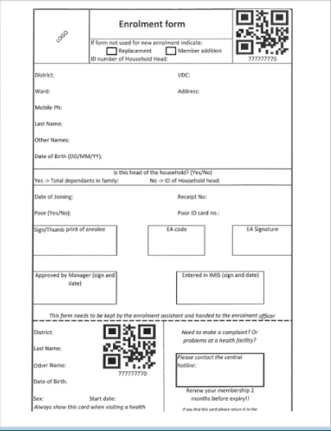
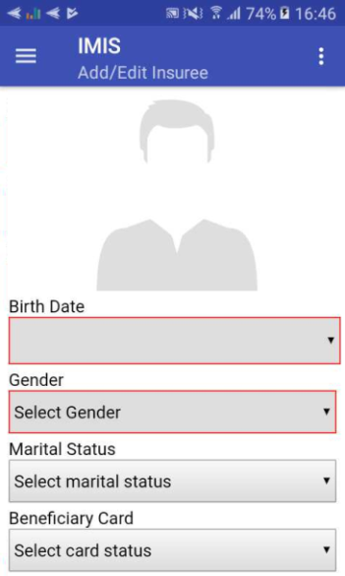
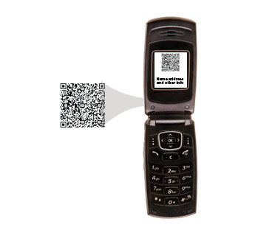


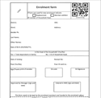


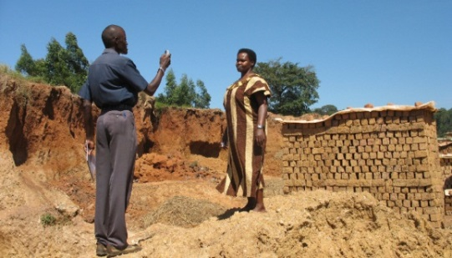
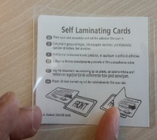
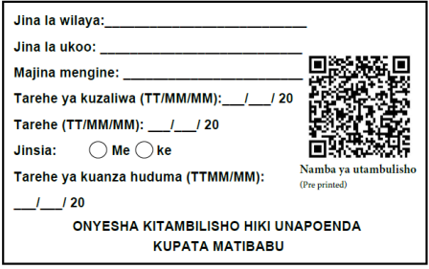
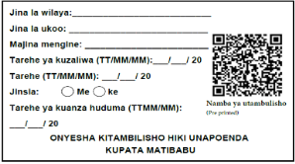
Enrolment – I (Sample Process)
Collect contribution

Slide 25
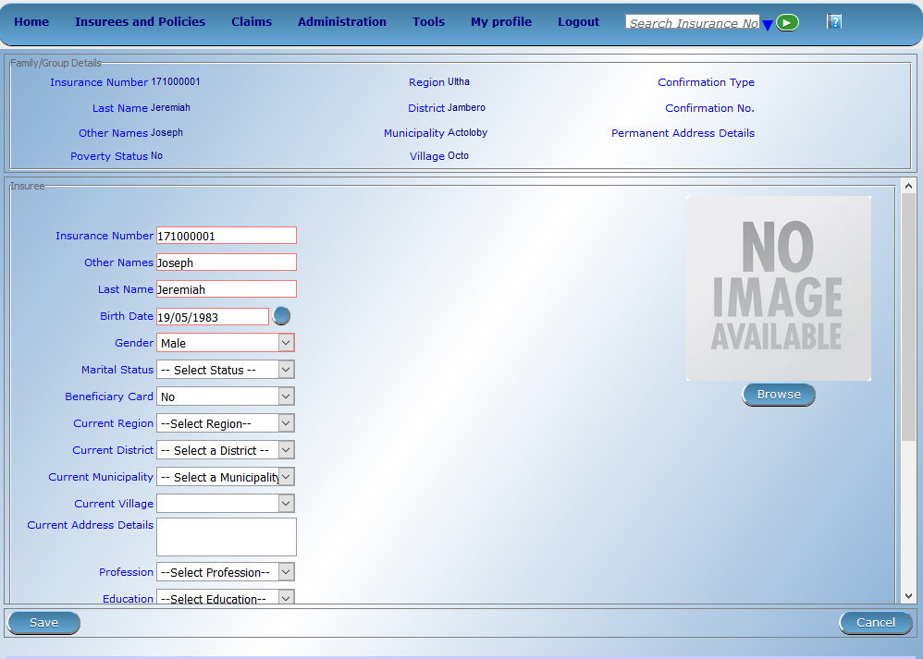

Enrolment of head of household unit

Slide 26
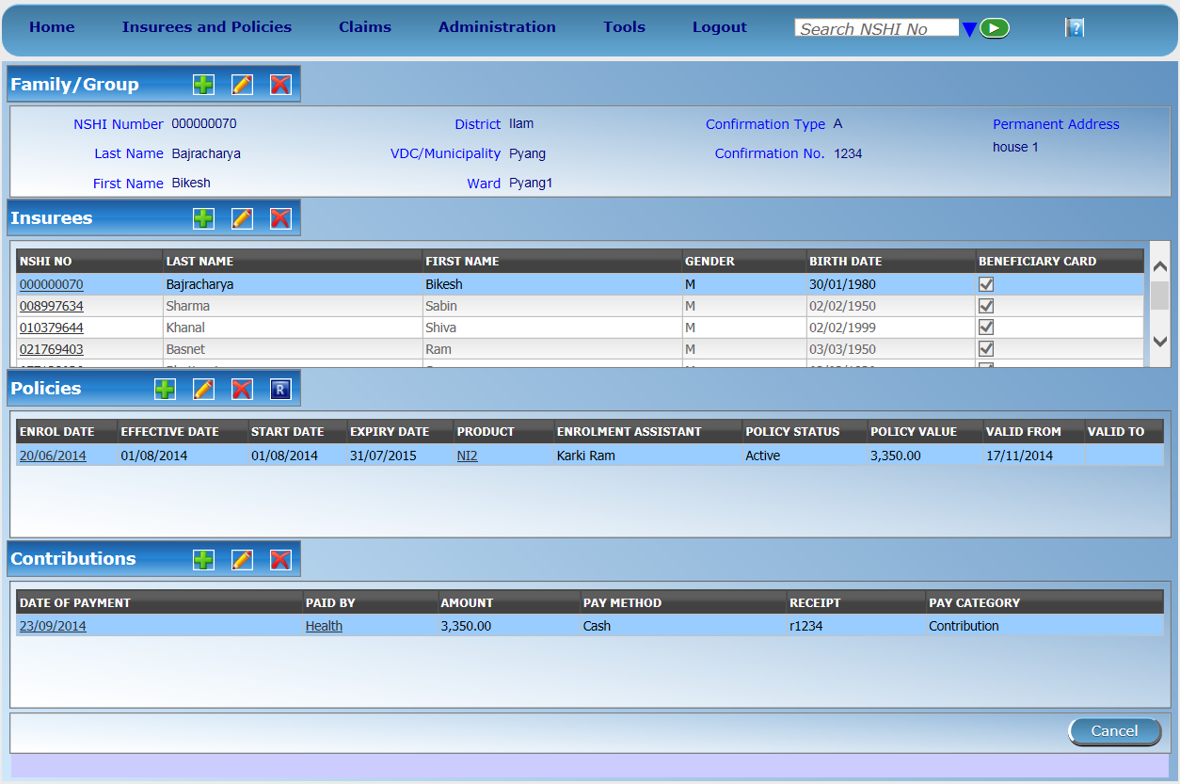
Enrolment of other members in the household

Slide 27
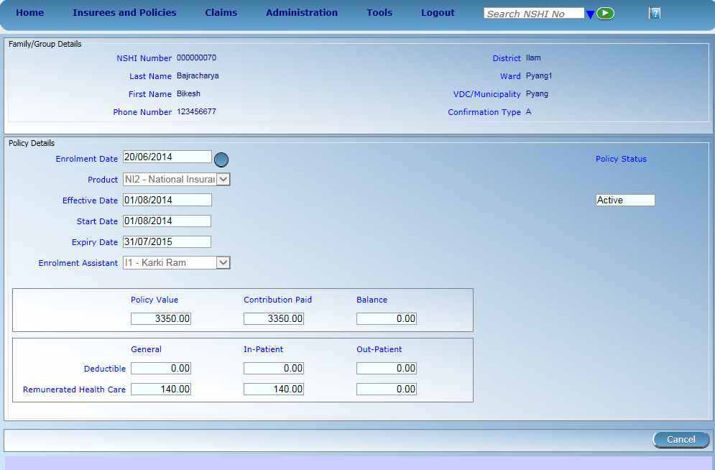
Product Selection

Slide 28
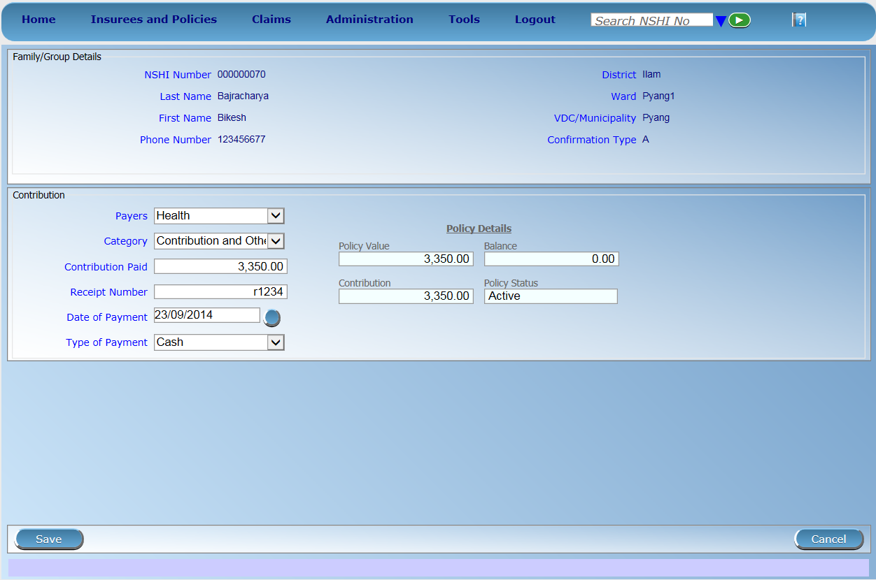
Payment Information

Slide 29
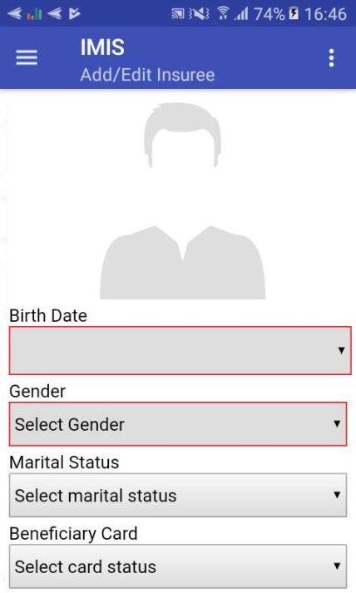

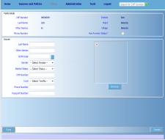
Mobile phone applications- Enrolment
1.acquiring of a photo of an insuree
by a mobile phone
3.assigning it to
the record of the insuree
(automatically)
2.sending it on
the central server
29

Slide 30
Product Presentation Overview
Overview of data flow
Construction of a scheme
Processes
  Enrolment process
  Health Service Utilization
  Claims process
  Renewal Process
  Reporting
Notes:
Configuration
Split by process
Reporting

Slide 31
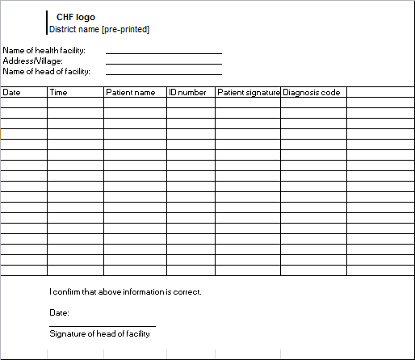

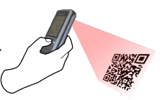

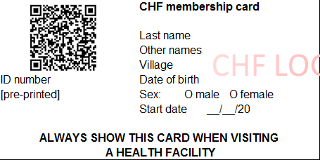
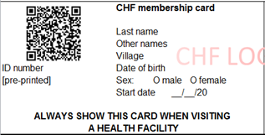
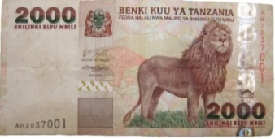
Health Service Utilization (Sample Process)
Reception1st registers patient in OPD/IPD register
Receptionist scans card with phone (offline & online) connectivity OK
EXPIRED
Send patient for treatment

Slide 32
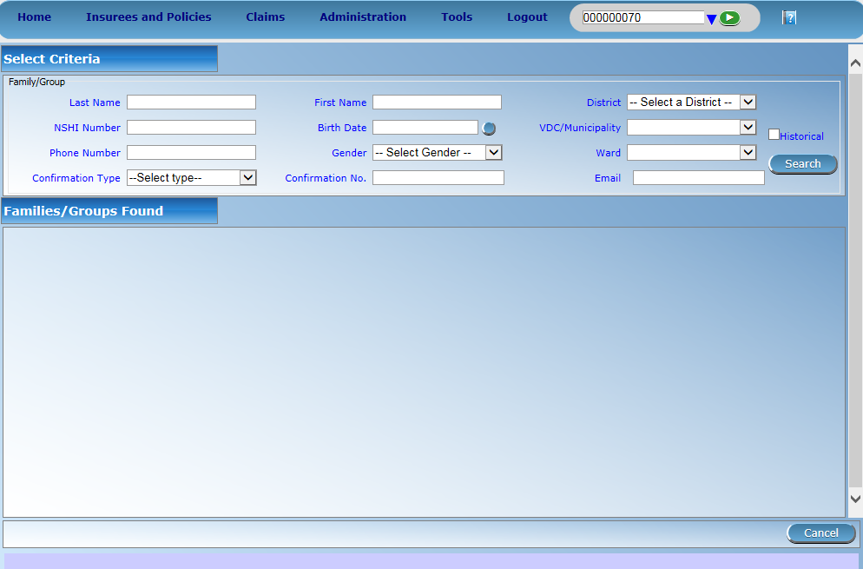
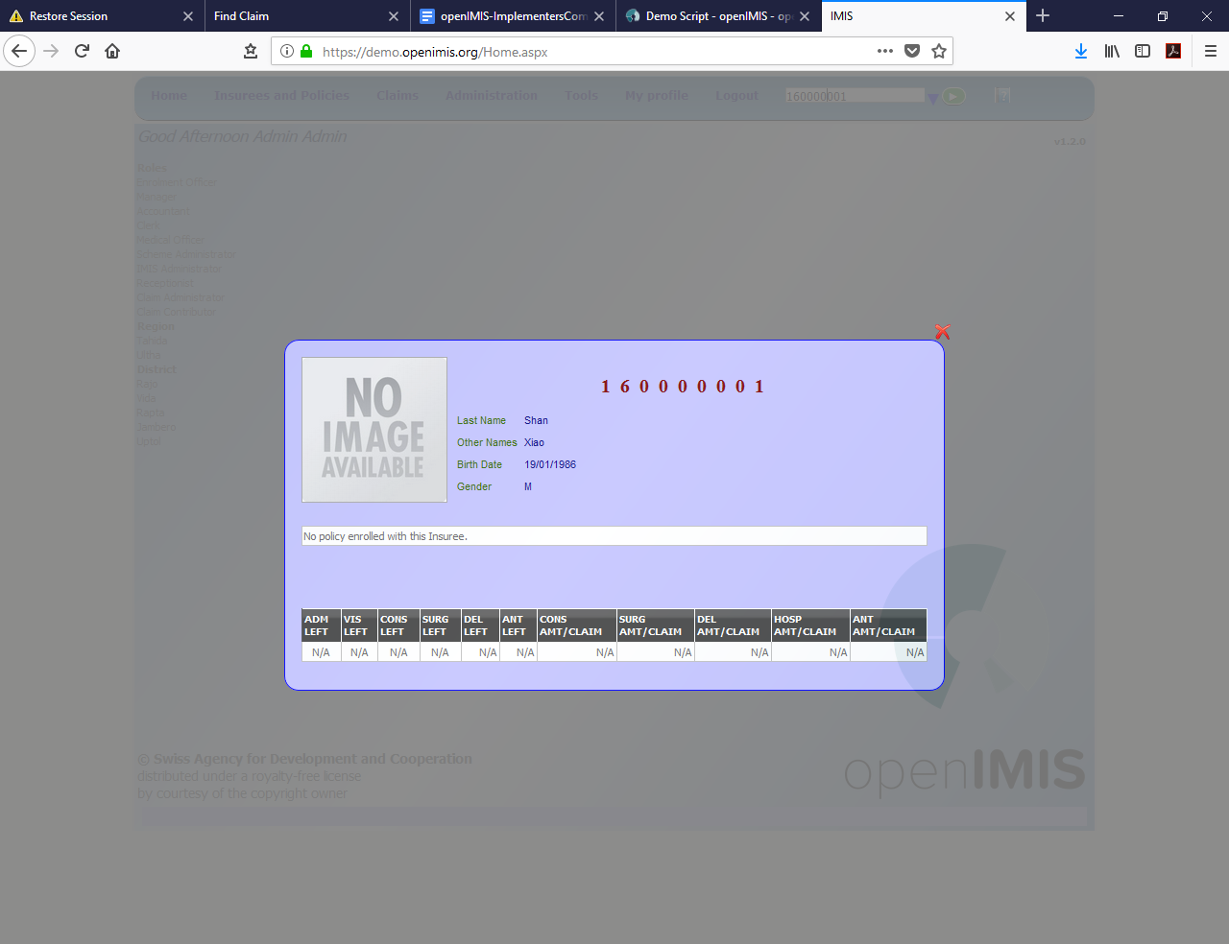

Online/Offline querying of clients

Slide 33
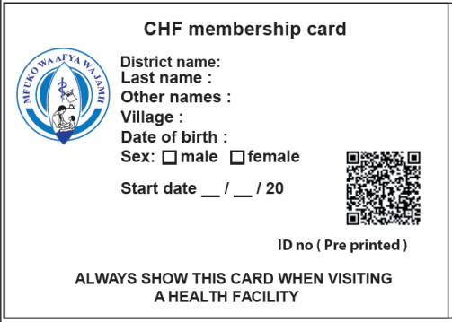
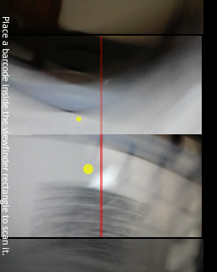

Use of mobile application
1. insuree’s ID number read by phone through QR code
3.retrieving photo and information
on coverage
2.send it to
the central server

Slide 34
Product Presentation Overview
Overview of data flow
Construction of a scheme
Processes
  Enrolment process
  Health Service Utilization
  Claims process
  Renewal Process
  Reporting
Notes:
Configuration
Split by process
Reporting

Slide 35
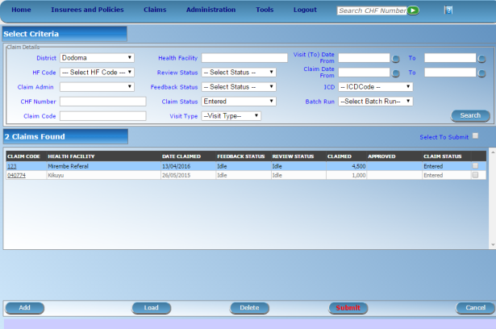




Claims Process – I (Sample Process)
server
mobile
network
health facility
Internet
network
mobile client
on-line client
Internal claims processing in IMIS
CHF office
off-line client
Automated Checking (client status, price lists, etc.)
Review by a Medical Advisor
Automated final claim calculations (remaining limits, etc.)
Generating consolidated claims report
paper forms
on-line client

Slide 36
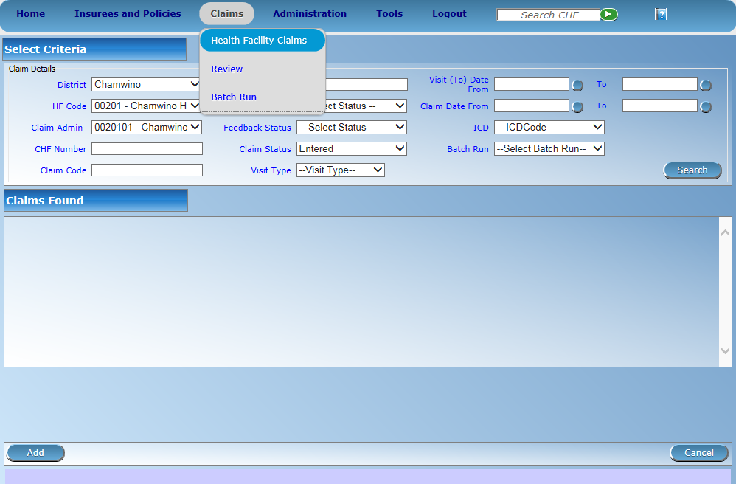
Online/offline entry of claims

Slide 37
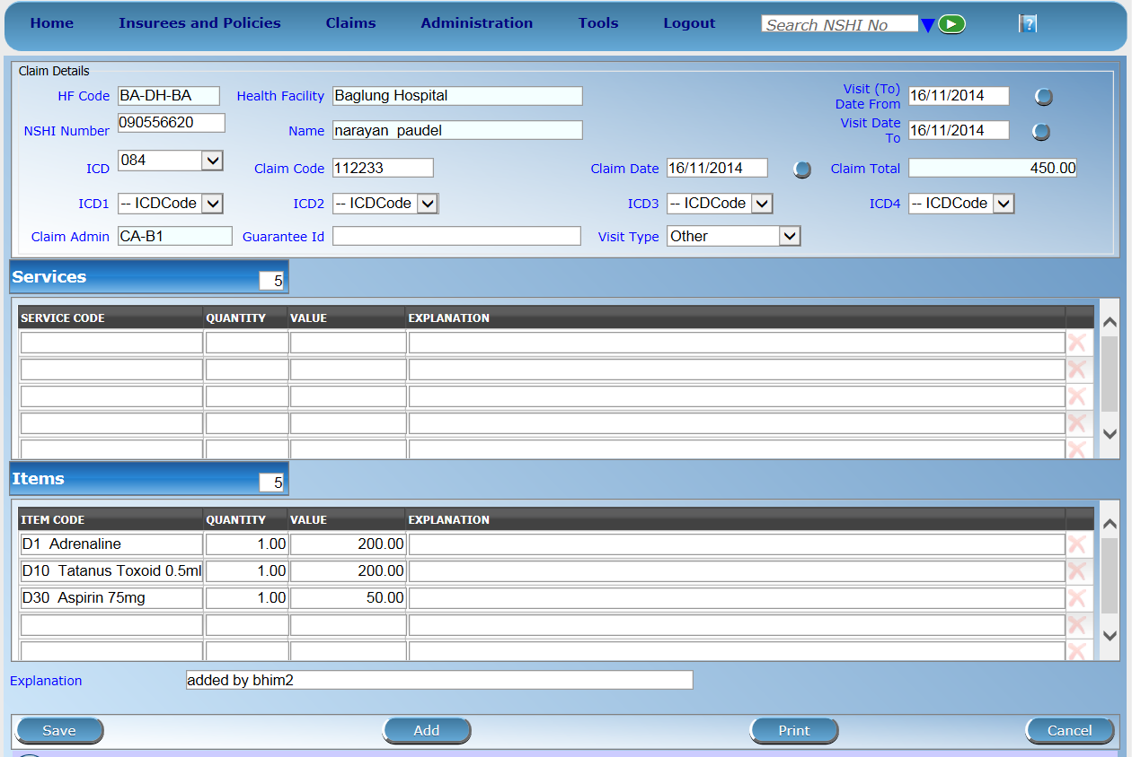
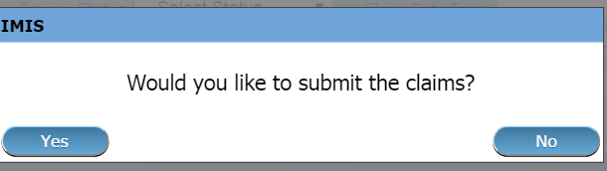
Claim entry page

Slide 38
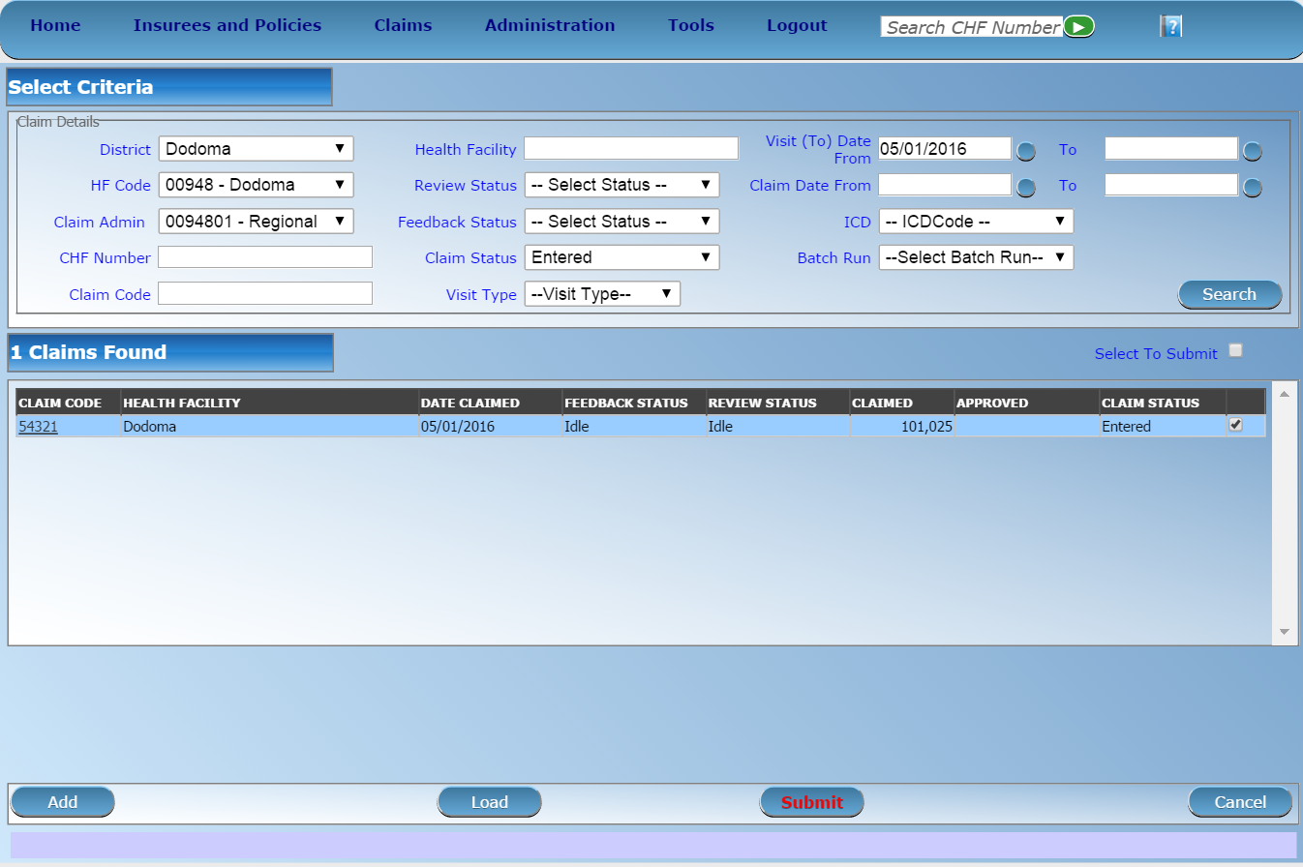

Submission of claims - administrative checks

Slide 39

Selection for medical review and feedback - I

Slide 40



Selection for medical review and feedback - II

Slide 41
Selection for medical review and feedback - III

Slide 42

Reviewing of claims

Slide 43



Processing of reviewed claims
Notes:
After reviewing is accomplished and feedback gathered, claims can be sent to valuation-processed

Slide 44

Batch run - calculate final payment to facilities for given period

Slide 45



Creation of batches/link to accounting

Slide 46

Creation of batches - generating report for making final payment

Slide 47

Creation of batches - report for payment

Slide 48
Use of mobile application – claim submission
1. insuree’s ID number read by phone through QR code
2. claim details entered
3. send it to the
central server

Slide 49
Product Presentation Overview
Overview of data flow
Construction of a scheme
Processes
  Enrolment process
  Health Service Utilization
  Claims process
  Renewal Process
  Reporting
Notes:
Configuration
Split by process
Reporting

Slide 50








Renewal process flow
server
mobile
Network - sms
mobile
Network – data transfer
Renewal trigger
Print out of
generated
Renewal list OR
offline file to be
uploaded to
mobile phone
CHF office

Slide 51

Generating list of renewals (Tools -> Policy Renewals)

Slide 52

Print out of list of renewals

Slide 53

Completing renewals using web application

Slide 54


Using mobile application

Slide 55
Product Presentation Overview
Overview of data flow
Construction of a scheme
Processes
  Enrolment process
  Health Service Utilization
  Claims process
  Renewal Process
  Reporting
Notes:
Configuration
Split by process
Reporting

Slide 56

Generating pre configured reports

Slide 57

Saving and printing reports

Slide 58
Types of reports
Reports on management of families, insurees, policies, premiums:
Primary Operational Indicators-policies & claims
Derived Operational Indicators
Contribution Collection
Product Sales
Contribution Distribution
User Activity Report
Enrolment Performance Indicators
Status of registers
Insurees without photos
Matching Funds
Families and Insurees Overview
Pending Insurees
Renewals
Capitation Payment
Rejected Photos

Slide 59



Customizable reporting – AR IMIS
mobile
network
Front-end (Excel)
server
Operational database of IMIS
IMIS Data Warehouse
ETL
mobile phone clients
AR-IMIS
External data sources (eg. DHIS)
on-line
(thin) clients
off-line
(thick) clients
59

Slide 60



Excel front end

Slide 61
Additional resources
www.openimis.org - Home of the openIMIS Initiative
Strategic direction given by a Steering Group
Technical directions guided by a Technical Advisory Group
openIMIS wiki - Read more about openIMIS
www.github.com/openimis - Download software and source code
openIMIS Demo: demo.openimis.org - use the demo now !
openIMIS Service Desk- report issues, bugs, or feature requests !
Notes:
Configuration
Split by process
Reporting

