Slide 1






A global good for Universal Health Coverage (UHC)

Slide 2

CONTENT
openIMIS
Overview: Health Financing 01
WHO Classification of Digital Health Atlas 02
Brief overview of openIMIS 03
Country Cases 04
Implementation steps 05
Implementation challenges 06
Interoperability 07

Slide 3
Overview
Global Good for UHC

Slide 4
Universal Health Coverage – a SDG 3 target
and systemic approach to health
100 million people pushed into extreme poverty due to out-of-pocket payments
400 million people without access to complete set of essential health services lead to:
Individual poverty and societal welfare losses
WHO defines health financing as the “function of a health system concerned with the mobilization, accumulation and allocation of money to cover the health needs of the people, individually and collectively, in the health system”.
Access to Health Services
Range of Health Services
Social Health Protection
against financial risks
UHC
Quality of Health Services

Slide 5

The basics of financing health care
HOUSEHOLDS PAYMENT
HEALTH BUDGET
HEALTH SERVICES
General tax/
payroll
Capitation
Insurance contributions
DRG
FFS
User Fees/
Co-payments
Historical
Budget

Slide 6
Primary business domains and use cases
openIMIS covers the main hehalth financing processes
Social health protection / health financing schemes
National health insurance
Community-based health fund
Voucher scheme
Strategic purchasing arrangements, P4P or RBF
Modules for complex business processes
Beneficiary enrolment
Claims management (processing and review)
Membership renewal and feedback,
Provider reimbursement
Operational core of scheme management
Health purchaser needs data to manage resource collection, service provision and provider reimbursement

Slide 7
WHO Digital Health Classification Atlas

Slide 8

Health System Challenges
WHO Digital Health Classification Atlas
Core Challenge
7 | Cost
7.4 | Lack of coordinated payer mechanism
Secondary Impacts
1 | Information
1.* | All sub-categories
4 | Acceptability
4.1 | Lack of alignment with local norms
6 | Efficiency
6.1 | Inadequate workflow management
6.2 | Lack of or inappropriate referrals
6.3 | Poor planning and coordination
7 | Cost
7.* | All sub-categories
8 | Accountability
8.5 | Poor accountability between the levels of the health sector
8.6 | Inadequate understanding of beneficiary populations
Health System Challenges
Digital Health Interventions
IT System Categories
Source: World Health Organisation. (2018, 05 01). WHO | Classification of digital health interventions v1.0. Retrieved 06 25, 2018, from WHO | World Health Organization: http://apps.who.int/iris/bitstream/10665/260480/1/WHO-RHR-18.06-eng.pdf

Slide 9
Health System Challenges
WHO Digital Health Classification Atlas
Core Intervention
3 | Health System Managers
3.5 | Health financing
3.5.1 | Register and verify client insurance membership
3.5.2 | Track insurance billing and claims submissions
3.5.3 | Track and manage insurance reimbursement
Secondary Interventions
1 | Clients
1.5.* | Reporting of health system feedback by clients
1.7.* | Client financial transactions
2 | Healthcare Providers
2.1.* | Client identification and registration
3 | Health System Managers
3.1 | Human resource management
3.1.2 | Monitor performance of healthcare providers
3.1.3 | Manage certification/registration of healthcare providers
3.3 | Public health event notification
3.3.1 | Notification of public health events from point of diagnosis
3.5.* | Health financing
3.7.* | Facility management
4.* | Data Services
Health System Challenges
Digital Health Interventions
IT System Categories

Slide 10
Health System Challenges
WHO Digital Health Classification Atlas
Health System Challenges
Core Role
M | Health finance and insurance information system
Secondary Roles
E | Clinical terminology and classifications
G | Data interchange interoperability and accessibility
P | Identification registries and directories
V | Public health and disease surveillance system
D | Client communication system
Digital Health Interventions
ICT System Categories

Slide 11
Brief overview of openIMIS

Slide 12
A global perspective - Why openIMIS?
Increasing and improving coverage effectiveness through more efficient and transparent digital administration processes
Need to focus on operational core of scheme management
Complex business processes linking beneficiary, provider and payer data (e.g. patient registry, claims processing and provider reimbursement)
UHC Agenda: Social (health) protection and financing schemes

Slide 13
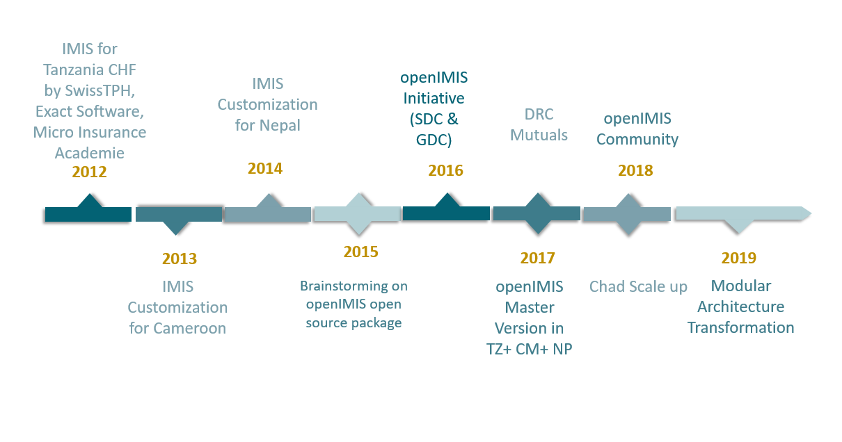
From IMIS to openIMIS

Slide 14
openIMIS – a Global Good advancing the Agenda 2030 and SDGs
Management Information System for social health protection schemes
Open Source
Free download, changes to the code, feed new developments back to the Community
Sustainable community
Continuously improved solution driven by open source Software Community
Capacity development and technical assistance
Interoperability
Compatible formats and interfaces for data exchange (international standard protocols and codes)
Customizable architecture
Customizable to different scheme types, organizations and countries

Slide 15
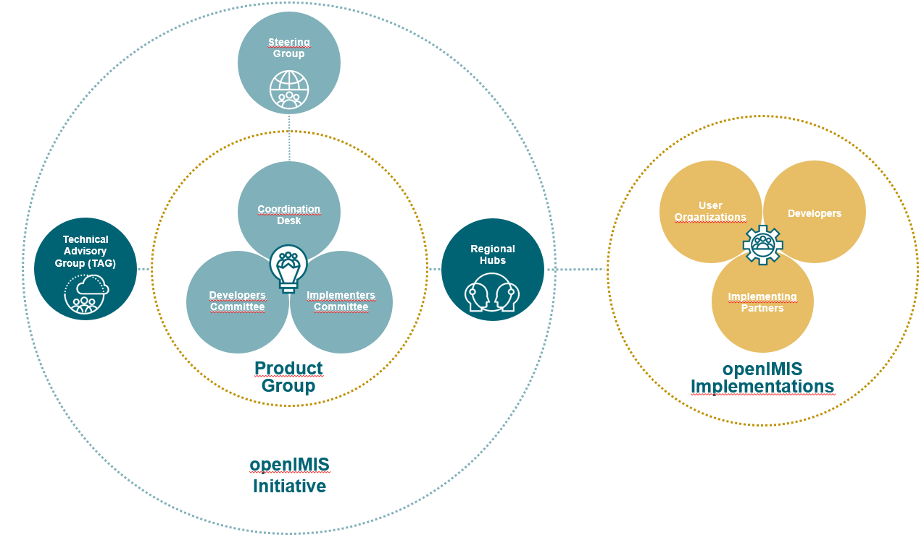
Our Governance structure
Notes:
Discourse – DIAL free account

Slide 16
Country Cases:
Nepal, Tanzania, Cameroon

Slide 17
Nepal
Nepal’s Social Health Insurance Scheme
Governed by National Health Insurance Policy (2014) & Health Insurance Act (2017)
Managed fully by Government of Nepal’s Health Insurance Board
National level pooling and a single payer
Contribution based scheme with subsidies for the poor
Services available through empaneled facilities (public and private)
Cash-less system

Slide 18
Nepal
Operational numbers – first application adjustments in 2013, operations since 2016
870,000 actively insured members
607,286 claims processed
USD 5,182,000 paid out to facilities
6553 total claims received on a single day (e.g. June 11, 2018)
3256 Enrolment Assistants using openIMIS through Android phones
228 Health Facilities submitting claims through web interface
5 IT personnel as backstoppers

Slide 19
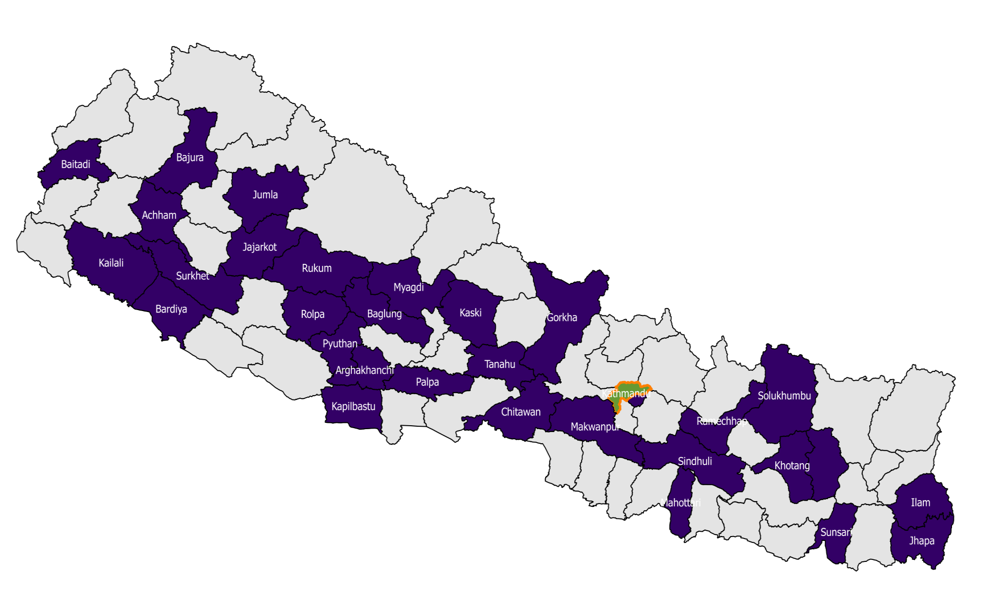

Nepal
National roll-out: 42 districts out of 77
Central Server
(Kathmandu)
Districts where SHI is active
Remaining districts
HIB Office - Kathmandu

Slide 20
Nepal
Implementation: Technical Setup
Single server setup in Kathmandu
Hosted in Government of Nepal’s Datacenter
Microsoft Windows Server
Database backup both on-site and off-site
Immediate upgrade plans: Mirrored server at Disaster Recovery Site
Outside of Kathmandu
Managed by Government of Nepal
Data Security
ALL insurance related information stored on server in Nepal
No external hosting

Slide 21
TANZANIA
Government run district based health insurance scheme (Community Health Funds)
Operated by a dedicated CHF team under the governments regional (and district) structure
Pooling at district level initially and since 2018 shifting to regional
Voluntary contribution based scheme with matching amount contributed by government
Primary and higher level care offered at all empaneled government (and charitable) facilities
Cashless system
Primary level facilities paid based on relative pricing concept (based on available resources and utilization rate)
Secondary level paid fee for service
System implemented in 1 region (Dodoma) in 2011-12, 3 regions (Dodoma, Morogoro and Shinyanga)
in 2016 and being rolled out nationally in 2018

Slide 22
openIMIS in TANZANIA
Operational numbers – first application adjustments in 2011-12
800,000 actively insured members at any point in time
1.8 million registered in the database
4167 Enrolment Assistants through Android phones
867 Health Facilities submitting claims through web interface and phones

Slide 23
TANZANIA
Operational numbers – first application adjustments in 2011-12
Single server setup in Dodoma
  Hosted at the Presidents Office of Regional Administration and Local Governance
  Microsoft Windows Server
Database backup both on-site and off-site
Data Security
  ALL insurance related information stored on server in Tanzania
  No external hosting

Slide 24
CAMEROON
Church run community based health insurance scheme
Operated by a dedicated teams established by the Church (5 schemes coordinated by a regional office)
Pooling at scheme level (plans to shift to regional level)
Voluntary contribution based scheme
Primary and higher level care offered at all empaneled catholic (and some government) and other charitable facilities
25% co payment by users – primary and higher level care covered with some limitations by type of services utilized (e.g. outpatient, hospitalization, surgery)
System implemented since 2013

Slide 25
CAMEROON
Operational numbers – first application adjustments in 2013
25,000 actively insured members at any point in time
44,542 registered in the database
82 Agents (no use of phones)
149 Health Facilities (no use of phones)

Slide 26
openIMIS in CAMEROON
Implementation: Technical Setup
Single server setup in the cloud
  Hosted on a cloud server (outside of the country)
  Microsoft Windows Server
Database backup both off-site – also stored on the cloud

Slide 27
Implementation Steps

Slide 28
Scheme design
Assessment & Planning
Scheme operationalization
Software customization
Adaptation
Software set up
& Training
Piloting
On going maintenance
Scale up
Scale-up

Slide 29

Scheme design
Definition of
Insurance modality
  Benefit Package
  Contribution amounts/modalities
Policies, regulations etc.
Organizational structure
operating procedures
provider payment mechanism
provider empanelment criteria and process
Notes:
There are key requirements for an insurance scheme to be established.
Explain all activities in list
The above points are some key pre requisites from the perspective of implementing the software
In some contexts (like Nepal) as a pre requisite, appropriate law had to be passed to establish the body that would implement the insurance program and hence there can be other additional aspects as pre requisites
Knowing how the scheme functions (procedures), who are the key actors (structure), what benefits are offered and how providers will be managed give a blue print of what the software needs to do
The process involved in this stage needs to be consultative in nature and involve relevant actors from the insurance body, relevant ministries (Health, Finance) and other key stakeholders involved and directly related to the insurance implementation.
Assessment and planning for the introduction of the software ideally should be done towards the end of this step (once design aspects are clarified) otherwise the assessment remains incomplete and prone to gaps

Slide 30

Scheme operationalization
Recruitment of
Procurement of
Organizational staff (at all levels)
Data transfer service from telecommunication provider (sim cards with internet)
SMS gateway services (SMS package)
Production of forms and laminations
IT hardware (phones, computers)
Appropriate hosting environment as per openIMIS community recommendations
Identification and contacting of
Health care providers
Telecommunication provider
SMS gateway
Mobile payment service provider/payment gateway
Notes:
These are some external dependencies in practical implementation of the system (hence also pre requisites for rolling out s/w)
Explain all steps
Recruitment of staff – technical team needs to be in place to support the system – key decision whether to do in house s/w development and/or maintenance or outsource it?
Contracting of providers – establish modalities of engagement, scale of deployment and ensure supporting infrastructure is in place.
Contracting of telecommunication provider – required especially for connectivity with mobile phone apps. Paper based implementations without mobile apps can be supported (eg. Cameroon currently) but not ideal & arrangements should be found with telecos. Closed loop data connectivity packages ideal to allow separate tracking of openIMIS usage and payment modalities.
SMS gateway integration – SMS bundles, management of SMS sending and tracking (SMS gateway) is done by external gateways that can be locally chosen, interaction of openIMIS with external gateways is defined but link to chosen SMS gateway needs to be undertaken based on choice. Costs are not negligible and hence this module is optional for insurer – reminding users to renew, confirmation of enrolment, etc.
Contracting of mobile payment service/payment provider – this is also optional for the insurer, here as well interaction of openIMIS with payment channel is defined and needs to be customized based on chosen provider in country.
Once contracted procurement of all required materials is needed – a lot of time delays happen in these activities – once received management of these resources – registries for computers, phones, memory cards, sim cards with internet connections, forms & laminations, etc.
Procurement of hosting environment – there are different configurations but ideal is to set up separate environments for development, testing, training, live and backing up.

Slide 31

Software customazation
Compare openIMIS functionalities to scheme’s operating procedures
Define amendment requirements to SOPs or openIMIS functionalities as needed
Modify software as per amendment requirements (if applicable)
Language customization (resource files and supporting documentation)
Set up of test server (installation and loading with test dataset)
Integration with SMS gateway
Integration with mobile payment service/payment gateway
Test developments
Finalize of system developments based on test results
openIMIS customized for your scheme is ready!

Slide 32

System set up
Configuration
Software set up
Scheme
  Services offered
  Contributions
  Eligibility rules etc.
SMS & Payment gateways
User accounts and privileges
Live server
  Security
  Backup
Dedicated training server (installation with dummy dataset)
openIMIS mobile apps
Prepare
Enrolment Forms
Insurance ID Cards
Claim forms

Slide 33

Training
Training
Server administrator(s)
System administrator(s)
Scheme staff
Enrolment agents
Health facility staff

Slide 34

Piloting
Design pilot
Capture user feedback (bugs or new requests)
Translate user feedback into software/process requirements
Adapt software/processes to incorporate feedback
Test new developments/adaptations
Deploy new developments/ enhancements

Slide 35

Ongoing maintenance & upgrades
Day to day
Link to global community
Updates to configurations –
new users, facilities etc
Ensuring system backup
Backstopping support to users at various levels
Preparing data extracts for offline use
Capacity development of (new) users
Ongoing capture of user requirements,
gaps and bugs
Feedback to openIMIS global community
  Implementation experiences
  Software developments
Downloading new openIMIS release
Test new openIMIS release
Testing of scheme specific customization in
new release
Upgrading live environment

Slide 36






Scale up
Ensure
Infrastructure (personnel and equipment) in place
All staff are trained
Server configuration is appropriate (as per expected load)
Go Live!

Slide 37
Key cost components
Supplies, Equipment, and Capacity Development
On Time
Recurring
Office IT Equipment (excluding phones) * no. of insurance schemes
Office running costs * no. of insurance schemes
Enrolment forms (with QR code plus card) * no. of individuals registered in system
Claim forms * no. of claims
Cold Laminations (pouches) * no. of individuals registered in system
Mobile phones * (no. of enrolment officers + no. of health facilities)
Server related costs (depending on set up - license, hosting charges, security related costs, antivirus)
External SMS gateway charges (SMS package charges)
Mobile money payment transaction cost (if applicable)
IT Maintenance/software development charges (where applicable)
Office running costs * no. of insurance schemes
Printing of forms: enrolment forms, ID cards (incl. lamination)
1 per each individuals registered in system, claim forms (for claims at health facilities)
Server related costs (hosting costs, recurring software license costs, if applicable)
External SMS gateway charges (charges per SMS sent from system)
Mobile money payment transaction cost (if applicable)
IT Maintenance/software development charges (where applicable)
Refresher trainings for users at various levels

Slide 38
Implementation
Challenges

Slide 39
Implementation Challenges
Tanzania I
Challenge
Solution
Lack of interoperability standards or broader architecture overview at the time of developing the software
Standards being encouraged now later but lack of in country initiative with many systems – different ownership, motivations and priorities
Establish single agency (department or entity) responsible for driving integration/interoperability discussion
Linkage to other initiatives around establishing standards (not just design but implementation of the standards)
Secure commitment from different stakeholders through allocation of their resources to contribute to development of standards/integration with other systems
Develop practical forums where programmers of different systems can interact and develop and build system linkages

Slide 40
Implementation Challenges
Tanzania II
Challenge
Solution
Improving usage of the system – Delays in data entry or incomplete data entry still happens. A number of new features have been developed and added to monitor and cut down inefficiencies in processing but delay/incompleteness still exists. At times claims settled outside of the system or payment collected mismatches what is in the system due to delays in entry
Matching the speed of software development with field requirements
Management of offline and mobile phone applications (versioning and synchronization of data) when scaling up
Create (non financial) incentives to improve data entry, for eg.
Use provider payment arrangements to encourage better claims submission rates (i.e. payment dependent on claims submission within time frame)
Involve more stakeholders to use insurance data – eg. Health ministry stakeholders demanding regular statistics of claims paid to their facilities pressuring schemes to ensure timely claim pay outs
More emphasis on indicators like claims turn around time, enrolment processing time, etc.
Create more channels to report performance to insured clients

Slide 41
Implementation Challenges
Nepal I
Challenge
Solution
Adaptation of the Nepali Calendar
Nepal uses a lunar calendar as the official calendar, whereas openIMIS features the Gregorian calendar. This makes data entry during enrolment very difficult (e.g. entering in insurees DOB)
Unstable internet connections in remote areas (during enrolment)
In areas where internet connectivity is not very strong, the transfer of images from the android devices to the openIMIS server is not always possible.
Data entry errors
Data entry errors particularly during enrolment cause issues with policies not being activated
Nepal specific customizations have included user interface changes in openIMIS, particularly in data entry screens, to include drop-down menus with the Nepali calendar
Use of offline photo transfer (android phone -> laptop/USB drive -> physical transport to insurance office -> upload to server) is being practiced. Even though not as convenient as direct transfer from phone, it is achieving the same result. Also, locations requiring offline transfers are reduced as wireless internet connectivity becomes better throughout the country
Creating awareness of data entry errors. Capacity building exercises: refresher trainings, training videos etc.

Slide 42
Implementation Challenges
Nepal II
Challenge
Solution
Rise in fraudulent claims
There has been an increase in claims that are not inline with standard treatment guidelines or other standard procedures
System capacities are stretched with rapid scale up
Rapid scale-up of the insurance scheme to new districts within Nepal has strained the IT system – number of transactions with openIMIS have increased rapidly
Intensified claim review efforts. This has a negative effect of increased HR requirements and delays in processing and validating claims. IT based solutions being discussed with the global openIMIS community
Improved planning exercises involving IT and SHI teams. As a result of these planning exercises, the time required for procurement of new hardware, deployment, and capacity building is also factored in while planning the expansion of the insurance scheme

Slide 43
Interoperability

Slide 44

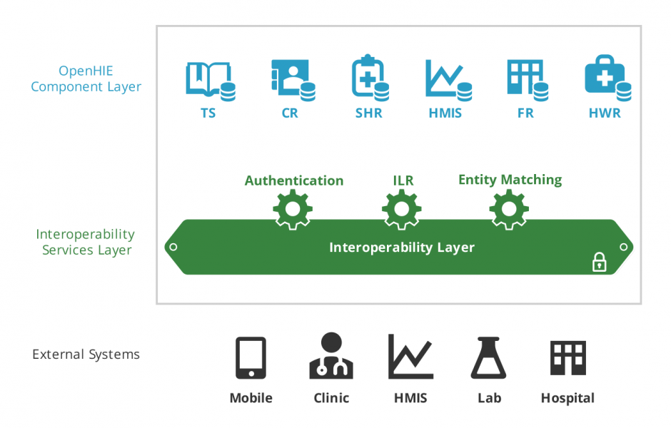

Vision: Integration into OpenHIE Landscape
Interoperability
OpenHIE Business Domain
Layer
Institutional
Financing
Mobile
Payment
Insurance
Management
Civil
Registration
OpenHIE Metadata
Component Layer
Place of Service
Store

Slide 45

Vision: Integrated Workflows (Example: Eligibility)
Interoperability
Insurance Mgmt
Client Registry:
Medic CR
Insurance Adjudication
openIMIS
4
3
2
FHIR Data Store:
Hearth
Interop Layer:
OpenHIM
1
EMR:
OpenMRS
5

Slide 46
Vision: Integrated Workflows (Example: Claiming)
Interoperability
Insurance Mgmt
Client Registry:
Medic CR
Insurance Adjudication
openIMIS
3
5
2
FHIR Data Store:
Hearth
Interop Layer:
OpenHIM
1
EMR:
OpenMRS

Slide 47
Ressources
https://openimis.org/ - home of the openIMIS Initiative
https://openimis.atlassian.net/wiki/spaces/OP/overview - community knowledge sharing
https://github.com/openimis - source code for download
https://demo.openimis.org/ - try the demo and test out features
https://openimis.atlassian.net/servicedesk/customer/portal/1 - report issues, bugs, or feature requests
contact@openimis.org - questions and queries

Slide 48




