Slide 1
Insights from the openIMIS Developers Committee
Uwe Wahser, Dragos Dobre
openIMIS Implementers Workshop
Dar es Salaam, Tanzania, 15/02/2019

Slide 2
From MS IMIS to openIMIS
IMIS for Tanzania CHF
by SwissTPH, Exact Software,
MicroInsurance Academie
IMIS Customization for Nepal
openIMIS Master Version
(TZ+CM+NP)
Modular Architecture Transformation
2012
2014
2017
2019
2013
2016
2018
IMIS Customization for Cameroon
openIMIS Initiative
(SDC & GDC)
openIMIS Community

Slide 3
Digital Principles
Principles for Digital Development https://digitalprinciples.org/
Principles for Digital Investment http://digitalinvestmentprinciples.org/
complement other commitments such as SDGs, UHC2030, the Busan Partnership for Effective Development Cooperation, and the Paris Declaration and Accra Agenda on Aid Effectiveness.
openIMIS Strategic Principles (March 2018)

Slide 4
openIMIS Strategy: Open Source
Open Source
Sustainable Community
OpenIMIS
Interoperability
Customisable Architecture

Slide 5
openIMIS in an OS eHealth Landscape (Examples)
Analytics
Master Patient Index
Logistics
Medical Records
Data Integration
Health Insurance
Workforce
Administration

Slide 6
openIMIS Strategy: Customisable Architecture
Open Source
Sustainable Community
OpenIMIS
Interoperability
Customisable Architecture

Slide 7
Local Development
 | Developer | Implementer | User
Organization
Vertical Programs
Sector
Type of Application
Universal
IMIS CM
IMIS NP
IMIS TZ
VB
SQL

Slide 8
Global Development Local Customization
 | Developer | Implementer | User
Organization
Vertical Programs
Sector
Type of Application
Universal
Country IMIS
openIMIS
JAVA
VB
SQL

Slide 9
Modular Transformation
monolithic
modular
openIMIS
openIMIS
Web User Interface
Web User Interface
WUI
Business Logic
Enroll
Claim
Mx
My
Mz
Data Access Layer
DA
DA
DA
DA
Data Base
Data Base
DB
DB

Slide 10
Slow Transition (Example)
Claiming
openIMIS
MS IMIS
Enrollment
Module X
Module Y
Module Y
Year 1
Year 2
Year 3

Slide 11
openIMIS Strategy: Interoperability
Open Source
Sustainable Community
OpenIMIS
Interoperability
Customisable Architecture

Slide 12
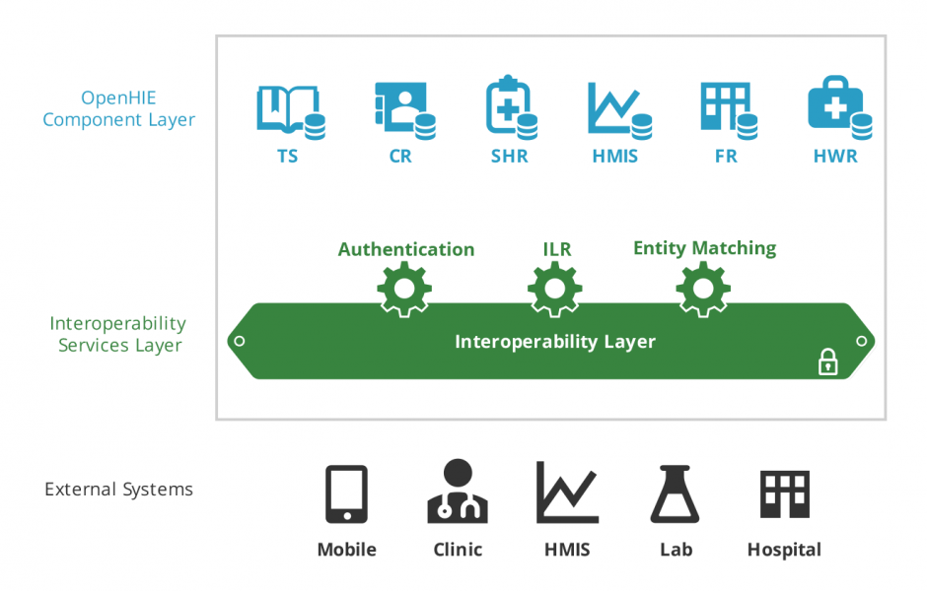
Interoperability - OpenHIE

Slide 13
Vision: Integrated Workflows (Example: Eligibility)
Insurance Mgmt
Client Registry:
Medic CR
Insurance Adjudication
openIMIS
4
3
2
FHIR Data Store: Hearth
Interop Layer:
OpenHIM
1
EMR:
OpenMRS
5

Slide 14
Vision: Integrated Workflows (Example: Claiming)
Insurance Mgmt
Client Registry:
Medic CR
Insurance Adjudication
openIMIS
3
5
2
FHIR Data Store: Hearth
Interop Layer:
OpenHIM
1
EMR:
OpenMRS
Notes:
Missing:
- Payment notification

Slide 15
openIMIS Strategy: Sustainable Community
Open Source
Sustainable Community
OpenIMIS
Interoperability
Customisable Architecture

Slide 16
Governance Structure
BMZ Steering Group* SDC
Product Group
Technical Advisory Group (TAG)
Coordination Desk (GIZ)
External Developers
Developers Committee
Implementers Committee
Implementation Consultants
Regional Hubs
User Community
Local Support / Dev. Team
Local Support / Dev. Team
Local Support / Dev. Team
Ministries of Health
Payer
Payer
Payer

Slide 17
openIMIS Outsourcing 2019
Tender
Partnerships
Continuity
Software Maintenance & Technical User Support
Hub South-East Asia
Expansion
Community Building & Promotion
Hub Sub-Saharan Africa
Architecture
Modular Transformation
Digital Square Notice C

Slide 18
Teams in Developers Group
Continuity
Re-Architecture
Interoperability
Maintenance & Support
Modular Transformation
Digital Square Notice C1
HISP India
SwissTPH
SwissTPH
BlueSquare
SolDevelo
SolDevelo
Possible Health

Slide 19
Current Activities
continue routine support and release building
getting the teams on board
concise weekly co-ordination calls
need oriented special topic calls
Developers Workshop (Bonn, February 2019)
decide on technology options
learn new technologies
harmonise work plans

