Slide 1
Release cycle and change management
Dragos Dobre
openIMIS Maintenance and Support Project

Slide 2
Inter-projects collaboration
Outcome 2
Capacity Building Project
●
Technical support
●
Demo server update
User needs
●
Top-down approach
Issues
●
Outcome 1
Maintenance and Support Project
Functional
specifications
●
Architectural
changes
●
●
Packaging
mechanism
●
Bottom-up approach
Legacy system support
New functionalities updates
●
Outcome 3
Modular Transformation Project

Slide 3
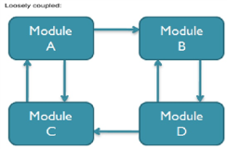
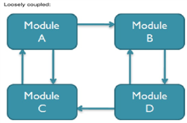
Development Life Cycle
Implementers
committee
Analysis and Requirements
Architecture, R&D, Prototyping
Design and Development
Testing and Quality Assurance
Release management
Training and Product Support
Maintenance
Modular
Transformation project
HL7/openHIE
Interoperability
projects
HL7/openHIE
Interoperability
projects
openIMIS
Maintenance and Support
Project
Implementers
committee
Modular
Transformation project
Notes:
Key tasks of the Maintanance and User Support Project and interrelatedness with the modular transformation and capacity building project
Digital square call (on behalf of giz/path): modularisation and interoperability with HL7 in openHIE, ..
HL7/ openHIE-interoperability project (digital square call)

Slide 4
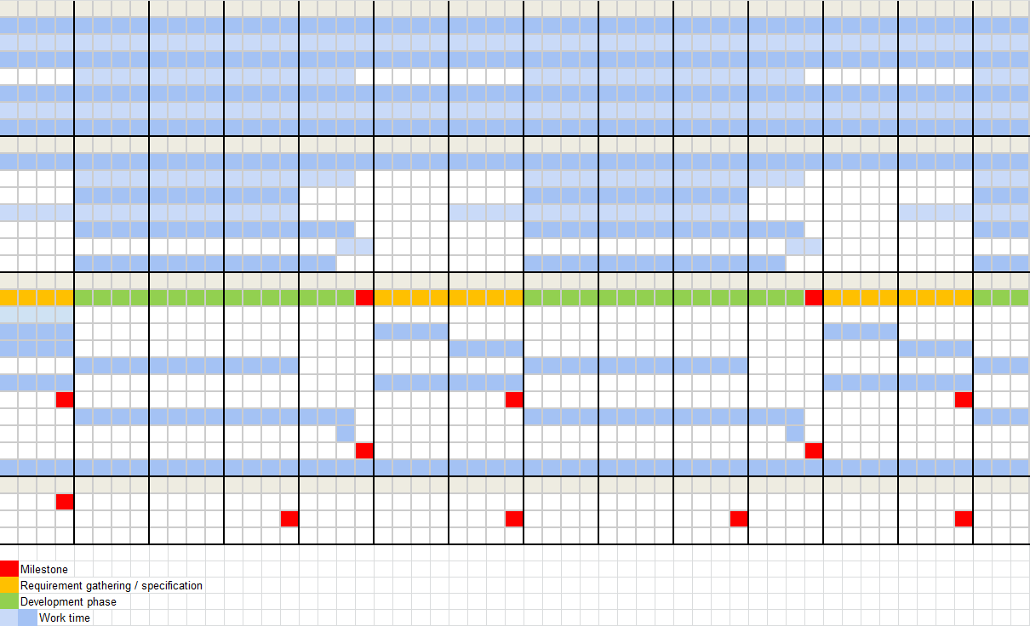
Maintenance and support project planning

Slide 5
Release dates
Next releases (end of):
April 2019
October 2019
April 2020

Slide 6
RFC Pipeline
RfC | Title | Complexity | Urgency
78 | Time correlations | High | Medium
91 | Generation of user records for enrolment officers | Low | High
92 | User profiles | Low | High
94 | Formal adjustments of user interface | Low | Low
95 | Enhancements of Claim Overview report | Low | Low
97 | Enhancements of contribution model | Medium | Medium
98 | Additional parameters of conversion | Low | Low
99 | Adding selection capabilities | Low | Low
100 | Description of rejection codes | Low | Low
101 | Easy access to claimhistory | Low | Low
102 | Report Claim History | Low | Low
103 | Report Overview of Commisions | Low | High
104 | Acquiring control numbers by IMIS policies | Medium | High
67 | Provision of data for DHIS2 | Medium | Medium
N/A | Formal sector adjustments | High | Medium

Slide 7
Security related issues
Title | Complexity | Urgency
Increase of the password's strength | Low | Medium
Integration of current Web Services into the new secured API | Medium | High
Remove FTP credentials service and photo transfer | Medium | High
Integration of HTTPS communication into mobile applications | Medium | Critical
Replace DB ids from URLs with UUIDs | High | Medium
Offline data files encryption | Medium | Medium
Vulnerabilities detected by SonarQube | Medium | Medium

Slide 8
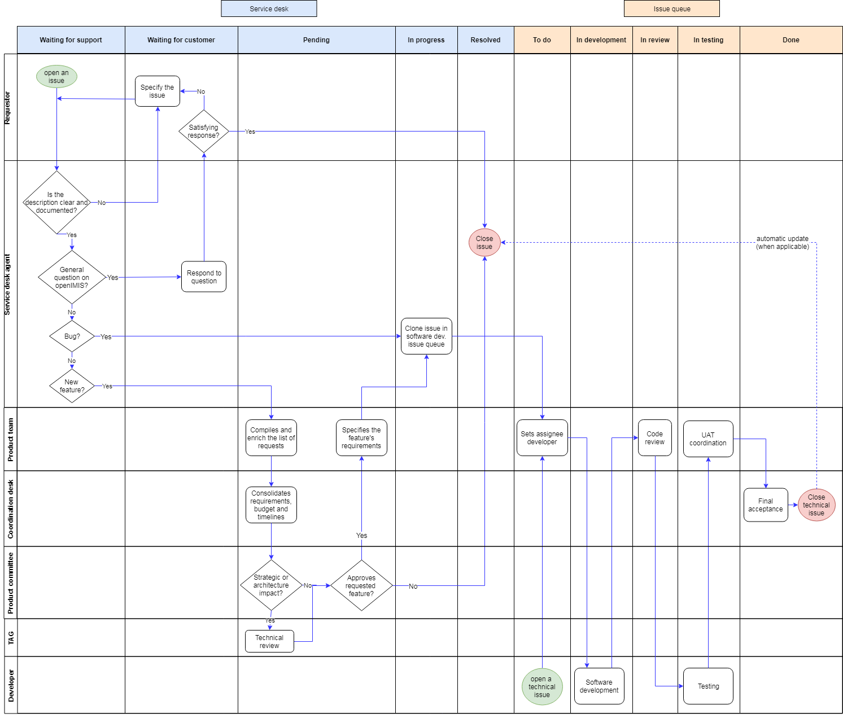
JIRA Issue Queue Management

Slide 9
Version management
Semantic version
All components’ versions (API, mobile app, web app) will consist of 3 digits: MAJOR.MINOR.PATCH, where:
MAJOR version when incompatible changes are made
MINOR version when functionality in a backwards-compatible manner are made
PATCH version when backwards-compatible bug fixes are made
Maintenance / Compatibility of latest 3 API versions (similar to DHIS2)?

Slide 10
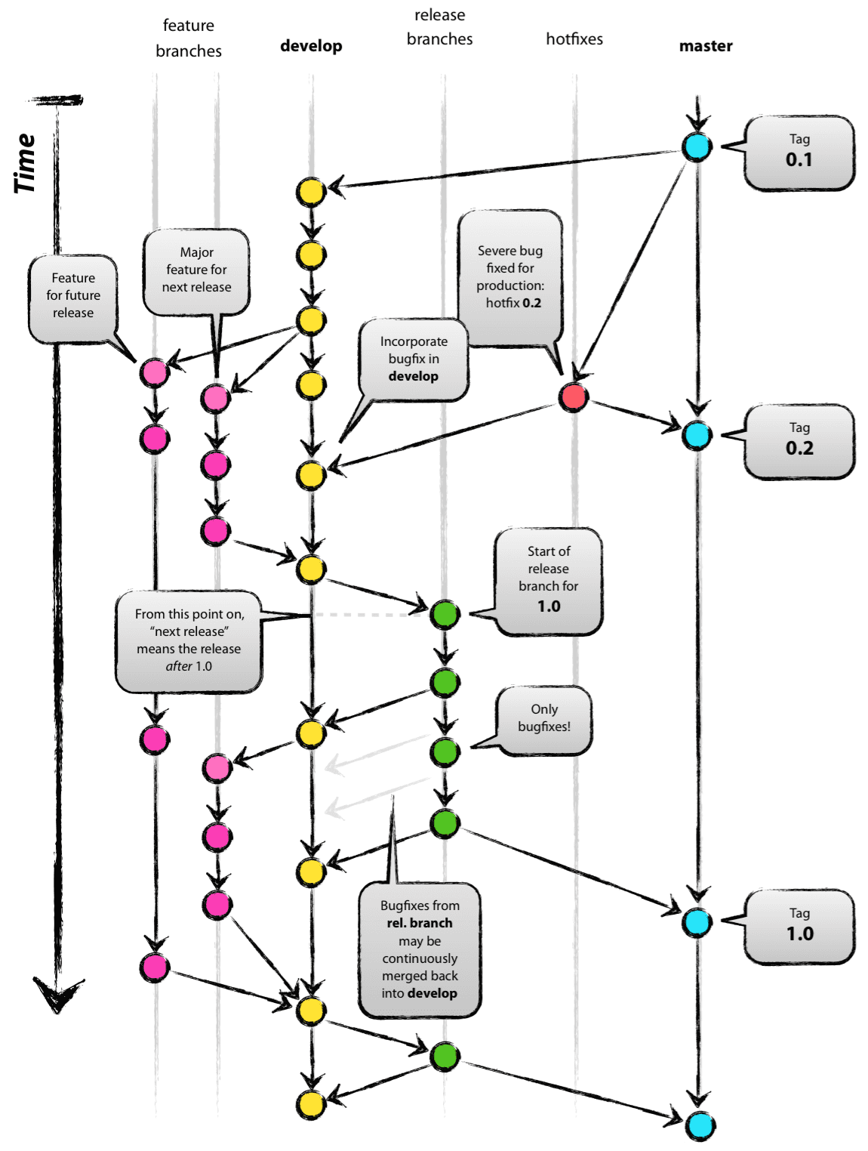
Gitflow workflow
country
release
integration
country
feature
country
develop
country
master

