Slide 1
Current openIMIS Architecture
Dragos Dobre
Swiss TPH, Switzerland

Slide 2
openIMIS legacy system architecture
openIMIS Web Application
(online or offline)
XML
openIMIS Feedback Prompt Service
openIMIS Claim Mobile
openIMIS Web Services (limited functionalities)
openIMIS Database
openIMIS Backup Service
openIMIS Enrolment Mobile
openIMIS Policy Renewal Service
XML
openIMIS RESTful API (modular business logic and integrated security)
SMS
(send control numbers, payment confirmation and policy validation)
GePG ePayment
(policy payment confirmation)
eGA USSD
(request control numbers for policy payment)

Slide 3
openIMIS Microsoft SQL Database
BL – Stored Procedures
DB - Relational tables
Relational database ~60 tables
Composite design pattern for location, but limited to 4 levels because it uses views
~100 stored procedures
DB integrate a part of business logic
Allow reuse for Web Application and Web Services
Some stored procedures read XML files generated by the Web Services or Web Application
Internalization: special tables for translation of select inputs

Slide 4
openIMIS Web Application
openIMIS Web Application
IMIS
IMIS-BI
IMIS-BL
5 layered architecture
IMIS – presentation
IMIS-BI – business interface (facade design pattern)
IMIS-BL – business logic
IMIS-DAL – data access layer
IMIS-EN – entity framework entities
Security
Session based authentication
Role based authorisation => hardcodded limited roles and authorities
user defined roles based on authorities under development
Internalization: support only 2 languages because of DB translation tables
Can work online or offline
IMIS-DAL
IMIS-EN
openIMIS Database

Slide 5
Web Services and Mobile Applications
Web Services
36 actions => limited to Mobile Apps requirements
No integrated authentication or authorisation
Act as a proxy between the Mobile Apps and the DB (through Stored Procedures)
Mobile Apps
Offline first, «authentication» last (at synchronisation)
Simulates security by validating credentials
Claims APK requires manual upload of the items/services list (automatic upload under dev)
Mobile Apps Versions
Current: openIMIS APK, Claim APK, Enquire APK, Feedback APK
Future:
openIMIS Policies: enrolment, modify, renewal, enquire, feedback
openIMIS Claims: claim submission, enquire

Slide 6
openIMIS Windows Services
Policy renewal: marks for renewal all expiring policies in 14 days
Assign photos: assign the uploaded photos to the insurees
Backup: creates a DB backup file
Feedback prompt: send marked claims for feedback through SMS
All openIMIS Windows Services access the DB directly => better to install them on the same server as the DB
Configures DB access, first start and future interval schedule + app specific config

Slide 7
openIMIS REST API and current integration
JWT authentication and role authorisation
Modular architecture:
module entity logic  entity model entity repository  database
Insurance policy electronic payment in Tanzania (under testing):
GePG e-Payment integration
eGA USSD portal for gathering payment control numbers
SMS gateway to send control numbers
Limitations
There are no interoperability standards used
SMS
(control numbers and payment confirmation)
GePG ePayment
(policy payment confirmation)
eGA USSD
(request control numbers for policy payment)
openIMIS Web Application
(monitoring and report)
openIMIS RESTful API (modular and integrated security)
openIMIS Database

Slide 8
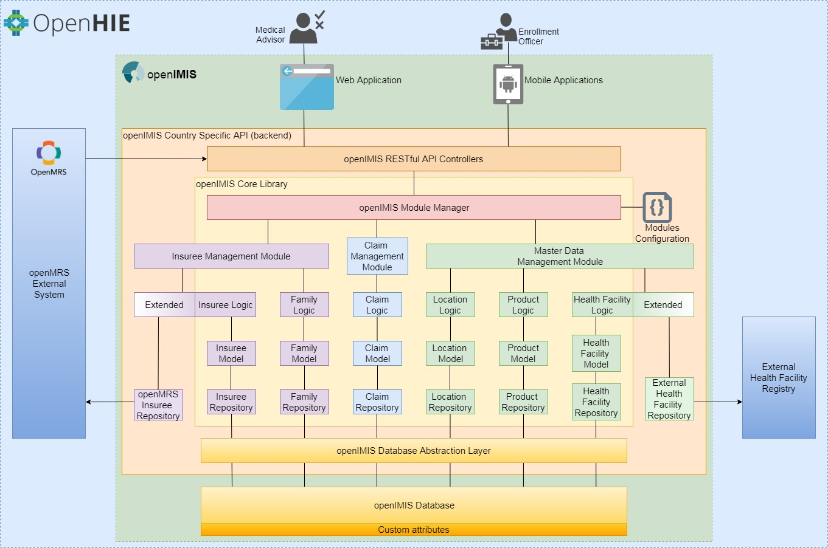
openIMIS REST API

