Slide 1


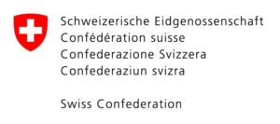


Data privacy choices – a greenfield opportunity with

Slide 2
Agenda
Timing | Workshop Section
12:00 | Optional lunch
13:00 | Welcome
13:10 | Introductions
13:25 | Malini and her context
13:45 | openIMIS an introduction
13:55 | Data Privacy Concerns in LMIC setting
14:05 | Persona Group work
15:10 | Discussion
15:50 | Wrap up and reflections
2

Slide 3
Social media and reporting on the day
Please let us know if you don’t want your picture and name used
@openIMIS
@SwissTPH
#dayonebasel
@baselarea.swiss

Slide 4
Why are we here?
Notes:
openIMIS Initiative – open source, modular, interoperable health insurance/financing solution. The roots of this IT solution/Initiative stems from strong Swiss involvement (Swiss Agency for Development Corporation and Swiss TPH) starting with a development project in Tanzania. Since then its turned into a collaborative global initiative, where we are establishing a vibrant community of contributors (developers, technical experts, implementers) in Asia and Africa as well as in Europe and beyond (more in subsequent presentation). We feel challenges we deal with in the openIMIS Initiative are also relevant in the health care ecosystem here. With the vast expertise and experience in the community here, with Day One we are attempting to create a bridge. We hope such events can help foster collaboration and we all gain from this. We intend to use todays discussion inputs to feed into similar discussions we try to facilitate in Tanzania next month around a data privacy policy for openIMIS that the government now wants to use nationally.
DayOne is an initiative managed by BaselArea.Swiss in close collaboration with Basel-Stadt
Create a world leading
hub for healthcare innovation,
built on the strength of the Basel region respected for its impact and collaboration
across disciplines and industries
with a focus on precision medicine
– the convergence of diagnostics, treatment and digital health
DayOne – Why openIMIS is important (DH) – why Data Privacy (Tbr)
All – very excited that so many of you chose to spend the time here – believe this is an important topic and hope we can capture your expertise and provide you with a good experience with each other

Slide 5

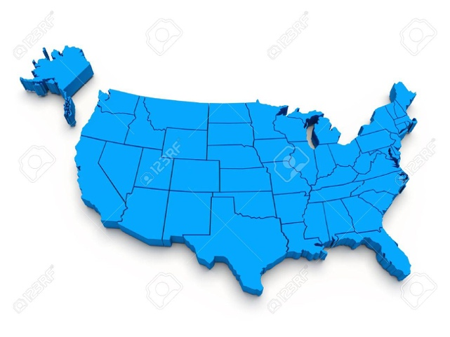
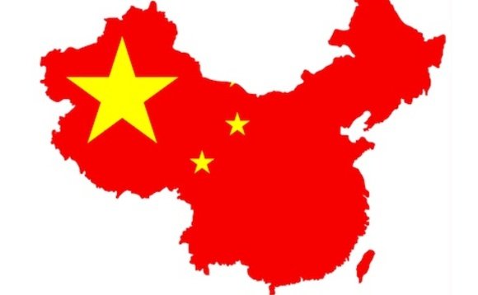


Industry transformation
How will the data game be played?
market
low regulation
data is an asset
citizen
high regulation
data is private
government
total control
data is state owned

Slide 6
Industry transformation
How will the data game be played?
data is a (public)
resource
versus
privacy is a human right
creating an ecosystem which allows the data to flow
1
serving the citizen’s/patient’s needs
2
enabling and accelerating healthcare innovation
3

Slide 7
Greenfield Opportunity
What opportunities exist when we don‘t have legacy systems?
Source: http://www.icosystem.com/simplifying-the-complexity-of-healthcare/

Slide 8
Agenda
Timing | Workshop Section
12:00 | Optional lunch
13:00 | Welcome
13:10 | Introductions
13:25 | Malini and her context
13:45 | openIMIS an introduction
13:55 | Data Privacy Concerns in LMIC setting
14:05 | Persona Group work
15:10 | Discussion
15:50 | Wrap up and reflections
8

Slide 9
Participants and introductions
Name | Affiliation
Andrew Bushell | Oonida
Carsten Danzer | Roche
Covino Giancarlo | Helsana
Daniel Burgwinkel | Information Governance
Dirk Ziegler, Michael Rebhan, Peter Speyer, Abhi Vermu | Novartis
Isabel Knodel | Gentinetta Scholten
Leila Alexander | SPHN
Luis Magalhaes | Clinerion
Matthias Cullmann | Baloise
Stefan Germann | Fondation Botnar
Effy Vayena | ETH
Siddharth, Martin Raab, Alex, Goncalo, Torsten Schmitz, Nicole | Swiss TPH
Alexandre Schulz | SDC
Uwe Wahse, Viktoria Rabovskaja | GIZ
Thomas Brenzikofer, Rahel Schneider, Doug Haggstrom | DayOne (BaselArea)
9

Slide 10
Agenda
Timing | Workshop Section
12:00 | Optional lunch
13:00 | Welcome
13:10 | Introductions
13:25 | Malini and her context
13:45 | openIMIS an introduction
13:55 | Data Privacy Concerns in LMIC setting
14:05 | Persona Group work
15:10 | Discussion
15:50 | Wrap up and reflections
10

Slide 11
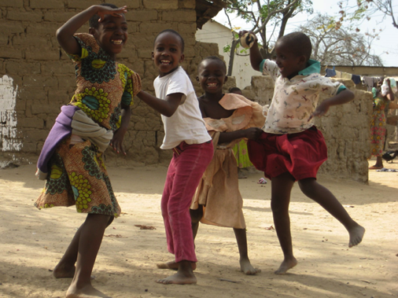
Malini – openIMIS story
Notes:
She lives in Tanzania in Milimani village (300 Kms from Dar es Salaam).
Her nearest health facility is Dumila dispensary manned by a health worker and is situated 20 Kms away from her village.
The health worker from Dumila dispensary visits her village twice a month to provide basic level of services – simple diagnosis, carries a few medicines and otherwise refers.
The nearest hospital is in Dar es Salaam where they can make more detailed diagnosis and have a broad range of medicines.
In the hospital there are 50 doctors as well as nurses and support staff to provide administration and lab testing
Her parents in the past have had to sell their livestock to cover hospitalization costs as well travel costs to go to Dar es Salaam to the government regional hospital.
This prompted them to join the government health insurance scheme and register into IMIS in 2011 when Malini was due to be born. While registering all members of the family had their photo taken along with name, age, gender, relationship, phone number and a government ID number that was directly recorded in a mobile phone and sent to the insurance database.
Her parents want to be able to ensure she gets a good level of care today and that she can continue to receive this throughout her life.

Slide 12
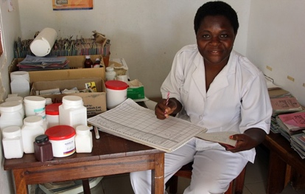
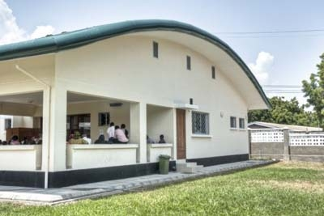
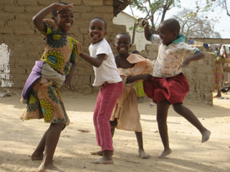
Nearest health service - Dispensary in Dumila. 20kms away
Nearest Hospital in Dar es Salaam. 300kms away
Malini lives in the village of Milimani
Notes:
She lives in Tanzania in Milimani village (300 Kms from Dar es Salaam).
Her nearest health facility is Dumila dispensary manned by a health worker and is situated 20 Kms away from her village.
The health worker from Dumila dispensary visits her village twice a month to provide basic level of services – simple diagnosis, carries a few medicines and otherwise refers.
The nearest hospital is in Dar es Salaam where they can make more detailed diagnosis and have a broad range of medicines.
In the hospital there are 50 doctors as well as nurses and support staff to provide administration and lab testing
Her parents in the past have had to sell their livestock to cover hospitalization costs as well travel costs to go to Dar es Salaam to the government regional hospital.
This prompted them to join the government health insurance scheme and register into IMIS in 2011 when Malini was due to be born. While registering all members of the family had their photo taken along with name, age, gender, relationship, phone number and a government ID number that was directly recorded in a mobile phone and sent to the insurance database.
Her parents want to be able to ensure she gets a good level of care today and that she can continue to receive this throughout her life.

Slide 13
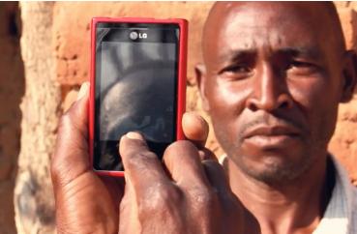
Nearest health service - Dispensary in Dumila. 20kms away
Nearest Hospital in Dar es Salaam. 300kms away
Malini lives in the village of Milimani
OpenIMIS – Insurance scheme Agent
Notes:
She lives in Tanzania in Milimani village (300 Kms from Dar es Salaam).
Her nearest health facility is Dumila dispensary manned by a health worker and is situated 20 Kms away from her village.
The health worker from Dumila dispensary visits her village twice a month to provide basic level of services – simple diagnosis, carries a few medicines and otherwise refers.
The nearest hospital is in Dar es Salaam where they can make more detailed diagnosis and have a broad range of medicines.
In the hospital there are 50 doctors as well as nurses and support staff to provide administration and lab testing
Her parents in the past have had to sell their livestock to cover hospitalization costs as well travel costs to go to Dar es Salaam to the government regional hospital.
This prompted them to join the government health insurance scheme and register into IMIS in 2011 when Malini was due to be born. While registering all members of the family had their photo taken along with name, age, gender, relationship, phone number and a government ID number that was directly recorded in a mobile phone and sent to the insurance database.
Her parents want to be able to ensure she gets a good level of care today and that she can continue to receive this throughout her life.
We will return to Malini later in the workshop. Now we will explain some more about the context that Malini lives in

Slide 14
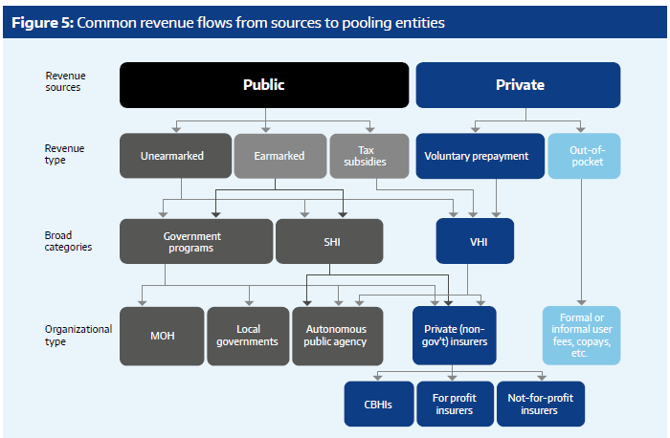
What is Malini’s health system context?
Single National Health Insurer
Multiple: companies – local/regional
National Health Insurance Fund
Church based, Charitable health facilities, etc.
Community Health Funds (CHF)
NGO based, savings groups, etc.
Source: http://apps.who.int/iris/bitstream/10665/254757/1/9789241512107-eng.pdf?ua=1
Notes:
Financing of health care is an essential building block of any health care system
As with many struggling low resource settings/countries the financing of care has been/still is fragmented, quality of care is low, shortage of staff and drugs, facilities are far away, fragmented digitalization efforts, amongst others problems.
In terms of health insurance there have been different forms and the future direction is like in other such countries – Single National Health Insurer (centralized pooling, govt role, pre payment mechanism)!
But currently we talk about a low cost health insurance that Malini’s family is part of – The Community Health Funds/CHF

Slide 15
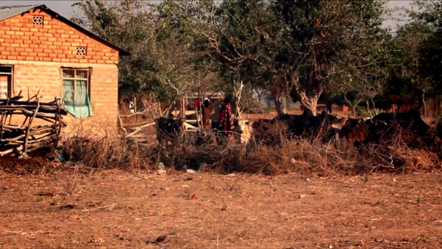
What is the context of Malini’s experience in CHF?
https://www.youtube.com/watch?v=nSB3UCHXnd4

Slide 16
Agenda
Timing | Workshop Section
12:00 | Optional lunch
13:00 | Welcome
13:10 | Introductions
13:25 | Malini and her context
13:45 | openIMIS an introduction
13:55 | Data Privacy Concerns in LMIC setting
14:05 | Persona Group work
15:10 | Discussion
15:50 | Wrap up and reflections
16

Slide 17
The issue at hand
Individual poverty and societal welfare losses
100 million people pushed into extreme poverty due to out-of-pocket payments
400 million people without access to complete set of essential health services
Ill-health
SDG3, target 3.8
Agenda 2030!
SDG1, target 1.3

Slide 18
Universal Health Coverage – a SDG 3 target and systemic approach to health
Systems
thinking!
UHC
Quality of health services
Social protection against health risks
Range of health services
Access to health services
Equity!

Slide 19
Why openIMIS?
Social (health) protection and financing schemes
Focus on operational core of scheme management
Complex business processes linking beneficiary, provider and payer data (e.g. beneficiary enrolment, claims processing and provider reimbursement)
Expanding schemes to
hitherto excluded populations
Notes:
Emphasize on complex environment with different IT systems covering different interactions at different points (patient record systems, hospital management systems, billing and accounting systems, etc.)

Slide 20
openIMIS – a global good advancing the Agenda 2030 and SDGs
Management Information System for social (health) protection schemes
Open source solution
Free download, changes to the code, feed new developments back to the Community
Sustainable approach
Continuously improved solution driven by Open source Software Community
Capacity development and technical assistance
Interoperable system
Compatible formats and interfaces for data exchange (international standard protocols and codes)
Adaptable and modular design
Customizable to different scheme types, organizational and country needs
Notes:
Emphasize – motivation behind making it Global Public Good for Digital Health, what difference do we make and why is this a game changer!!

Slide 21
openIMIS Community Resources
5 countries currently implementing the system
Dedicated development teams
Implementation support teams
across Asia, Africa and Europe!
www.openimis.org - Home of the openIMIS Initiative
Strategic direction given by a Steering Group
Technical directions guided by a Technical Advisory Group
openIMIS wiki - Read more about openIMIS
www.github.com/openimis - Download software and source code
openIMIS Demo: demo.openimis.org - use the demo now !
openIMIS Service Desk- report issues, bugs, or feature requests !

Slide 22
Agenda
Timing | Workshop Section
12:00 | Optional lunch
13:00 | Welcome
13:10 | Introductions
13:25 | Malini and her context
13:45 | openIMIS an introduction
13:55 | Data Privacy Concerns in LMIC setting
14:05 | Persona Group work
15:10 | Discussion
15:50 | Wrap up and reflections
22

Slide 23
Data Confidentiality
@ re:publica Accra, 2018
Uwe Wahser - DayOneLab, 18.01.2019

Slide 24


Slide 25
re:publica Accra 2019
December 14-15th, 2018 in Accra, Ghana
spin-off from re:publica Berlin "Europe’s largest internet and digital society conference"
Co-operation of re:publica Gmbh, Berlin and ImpactHub, Accra
Support from German Federal Ministry for Economic Cooperation and Development (BMZ)
ca. 2000 participants
274 speakers from 30 countries
110 hours of content

Slide 26
Motivation for Participation
Where is the red line?
benefits of disruptive technologies
vs.
disadvantages because of weak systems
Example: mPESA Kenya

Slide 27
Panel on Data Confidentiality
"Data Confidentiality vs. Shared Data: Enabler or Show Stopper for Development?"
Edmund Benjamin-Addy, Cooperative Susu Collectors Association, Ghana
Faith Tonkei, National Hospital Insurance Fund, Kenya
Peter Ngallya, President’s Office Regional Administration and Local Government (PO-RALG), Tanzania
Moderator: Elizabeth Mwashuma, Good Partners, Kenya

Slide 28
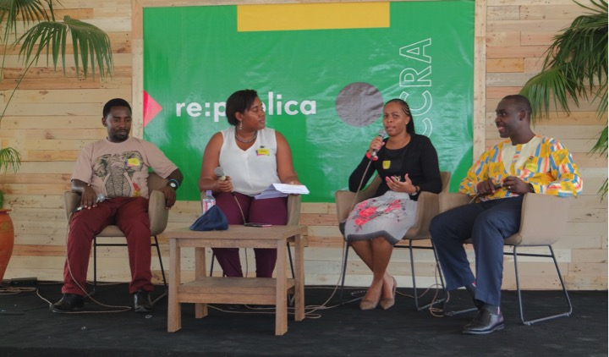

Slide 29
Discussion Points
Interview Format
Definition of Confidential Data
Benefits of Data Confidentiality
Data Sharing: Benefits & Challenges
Protection mechanisms
Data Confidentiality as showstopper
Q & A with audience

Slide 30
Highlights
Awareness of importance amongst audience & panellists - "Don't worry - we care"
"Data confidentiality results in client confidentiality"
All countries have legal frameworks in place and organisations act according to it
Donor support is needed to strengthen systems
Donors requesting data to plan support
Footage will be available on YouTube

Slide 31
Impression
Unique Session: one of two sessions on Data Confidentiality
Involvement of stakeholders from classic organisations rare
Discussion between society and actors important

Slide 32
Further Thoughts
Cultural parameters for the red line are defined locally
Also consider Data Validity & Data Ownership
GIZ Guidelines on Responsible Data Use
Looking at openIMIS:
A robust openIMS can improve Data Protection
System must be ready for maximum standards
Support needed for hardening of systems

Slide 33
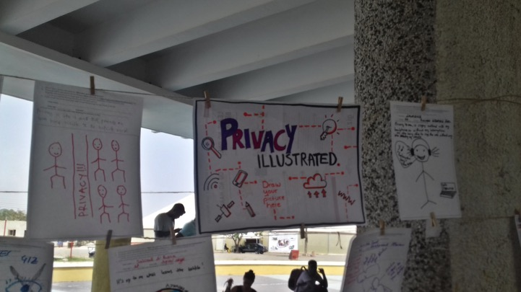

Slide 34
Agenda
Timing | Workshop Section
12:00 | Optional lunch
13:00 | Welcome
13:10 | Introductions
13:25 | Malini and her context
13:45 | openIMIS an introduction
13:55 | Data Privacy Concerns in LMIC setting
14:05 | Persona Group work
15:10 | Discussion
15:50 | Wrap up and reflections
34

Slide 35
Malini – openIMIS story
Notes:
We are back with our persona Malini
We are going to work with her to define some aspects of Data Privacy principles and guidelines

Slide 36
Persona Group Work – input into what data should flow and how to get the balance between openness and privacy
Malini’s story
Discussion
Plenum
5-10 minutes
Introduction of the story
What data should flow today? How?
What data could flow? Why?
What can go wrong?
Plenum
~40 minutes
Sharing of experiences and discussion
Group work
~10-15 minutes
What data is missing to provide care?
What data should be kept Private (kept within the organization that collects it)?
Group work
~20-25 minutes
What extra data could flow? To whom?
What value could be created? For whom?
Group work
~20-25 minutes
What could go wrong?
What principles and guidelines are needed to prevent this doomsday scenario?

Slide 37

Round 1 - Malini – An openIMIS story
Notes:
We are back with our persona Malini

Slide 38
Visit 1
Paracetamol
Visit 2
Malaria?
Claims
Dispensary
Visit 1
Diagnosis
HIV
Claims
Repeat visits
Hospital
Milimani
Registration data
Registration and payment data
OpenIMIS –Agent
Notes:
We are back with our persona Malini.
Remember Malini lives in Milimani 300lms outside Dar es Salaam
Her nearest Health care service is a dispensary 20kms away in Dumila
She is enrolled in the openIMIS program
Malini’s parents decided to approach the health worker as they felt Malini was getting tired easily and seemed weak unlike her friends in the village.
Health worker on her regular visits had seen Malini twice. On the first visit she gave her paracetamol and an antibiotic.
On the second visit she got a different antibiotic and chloroquine for Malaria. Both times she was given medicines that did not seem to help. (As Malini was insured no costs were incurred. The health worker recorded the drugs she administered on paper forms as there is intermittent internet connectivity in this village. When the health worker returned to the dispensary the data was entered on her mobile phone and sent to the insurer for claiming the payment)
Her dissatisfied parents decided to take her to the regional hospital in Dar es Salaam where the support staff using their phone scanned her insurance card and identified her. The family did not have to pay anything for the visit.
The doctor who saw Malini did not have any of her medical history and hence asked for the history of her illness and family history of chronic illnesses. The doctor undertook a standard Physical examination to check for heart and lung functions and wrote down on a form a list of tests (blood tests and X ray) to be done to check for Anemia, Immunodeficiency disorders and Tuberculosis that were commonly diagnosed problems there.
Luckily for Malini the regional hospital had all required departments to undertake these tests. Malini went from one department to another with this form within the same day she was able to get all these done. Each department captured her details in respective registers, undertook the tests and the billing section did not charge her due to her insurance status. She was sent back to the doctor who took her form and asked her family to come back after two weeks as the results of the tests would come from an external specialized lab. The form was sent to the administration department to submit them for claiming from the insurer.
Two weeks later Malini travelled back to Dar es Salaam and met the doctor who diagnosed her as HIV + (in an early stage). He gave the family a prescription to buy ARV (anti-retroviral) drugs and a booklet to keep track of her diagnosis and treatment regime. She was asked to come back every 3 weeks. Her family was again not charged for the visit due to her insurance status and her patient form
Due to the stigma her family preferred to buy the drugs at a pharmacy in Dar es Salaam to cover the time frame till the next visit. The family had to pay for these drugs.
The family continued this routine for years and were able to manage and improve Malini’s situation.

Slide 40
Persona Group Work – input into what data should flow and how to get the balance between openness and privacy
Malini’s story
Plenum
5-10 minutes
Introduction of the story
What data should flow today? How?
Group work
~10-15 minutes
What data is missing to provide care?
What data should be kept Private (kept within the organization that collects it)?

Slide 41
Groups
 | Group 1 | Group 2 | Group 3
 | Andrew Bushell | Isabel Knodel | Covino Giancarlo
 | Daniel Burgwinkel | Carsten Danzer | Peter Speyer
 | Dirk Siegler | Abhi Vermu | Luis Magalhaes
 | Stefan Germann | Leila Alexander | Matthias Cullmann
 | Michael Rebhan | Effy Vayena
 | Plus TPH/SDC | Plus TPH/SDC | Plus TPH/SDC
Room | Main room | Main room | Main room
 | Doug | Siddharth | Thomas

Slide 42
Group 1
Round 1
Missing data/actions –
  Family data
  Village data
  Data consent
Metaquestions/overarching principles
  Minimum data for any action
  What is the data used for?
  Is the data correct? Is it validated? Can it be deleted when wrong?
Private – see chart
Round 2
Should IMIS be used for hospital billing?
Outcomes data - help to improve process with health dept.
Specialty care teams to share data
Health information exchange (HIE)
IMIS + EMR + HIE – selected use case
Round 3A
What can go wrong if IMIS + EMR?
Wrong data to wrong person
Syncronisation
More data --> more attractive target
Identity fraud
Ownership of data/data access → trust?
What if the data is misused by the data owner? – selected problem
  Country sells data, changes model, runs out of money?
Round 3B – How to prevent it happening?
Delete your data – is this even possible – probably not in most systems
Meaningful individual control – how to achieve this?
Role of inter country entities? UN – someone else? Who has the right to be police?
How to certify hosting authorities?
  Global certificate?
  UN rules?

Slide 43
Group 2
Round 1 – What data is private?
question is rather generic
data transfer depends always on safeguards available
privacy is about risk management, not about locking data away
as seen from Malini eg., privacy does matter a lot - what can save your life can also threaten it
who owns the data – patient should define own data
data transfer, important to define: to whom, for what purpose, under which condition
a significant risk is that you do not know who will manage the data in the future (even NHS tried to sell patient data), in a LMIC setting that is a question of even higher relevance
education of patients is important - digital health literacy - so that they can take informed decisions (e.g. opt-in/opt-out), do they know what data is captured about them?
Identifiers (like unique ID no.) are important to avoid using private data while referring to a person across systems.
Round 2 – What additional data could be captured?
opt-in/opt-out - capture consent for every data element captured
Round 3A – What could go wrong
what can go wrong - depends on behavioural economics
risk that too many opt-outs will threaten provision of services/insurance provision
it has to be clear what happens when you opt-in/opt-out otherwise data captured is inconsistent
is individual or house-hold consent more appropriate? Based on context this could vary
opting-out from sharing data should not hinder getting access to services
Round 3B – How to prevent it happening?
important to empower/educate data owners - Carefully design communication and ensure no negative consequence for not giving consent (treatment should not be affected – no punishment)
develop a good system to capture consent
cultural sensitivity in data privacy management
Perhaps have a minimum set of mandatory consent (essential data to run operations) and ask for consent to additional data elements
Have an independent agency monitor whether this consent system is functioning properly
regulatory frame is crucial - will define which policy can be enforced – define smart protocols that adjust as per regulation changes

Slide 44
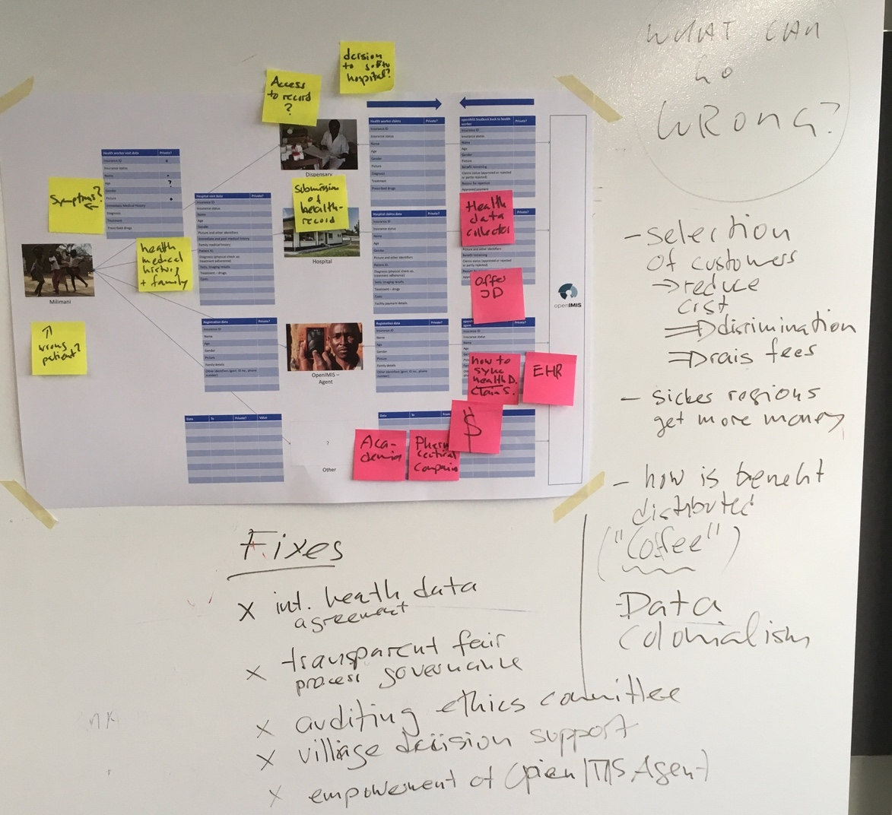
Group 3
Round 1
Generally persons related data is private.
Health data is mostly private
This means for the system:
Transmission of data has to be secure – encryption
Broader Use of health data is only possible through anonymization
Specific Use of health data needs consent of patient
What is missing:
Symptoms
Access to health history record of health worker (consent patient)
Transmission of case record/ history to hospital (consent patient)
Additional Story – Use Case
1) Open IMIS offers personal Identification
2) Open IMIS also collects healt data, integrate health record and claoms systems.
Group chose to follow 2) → Data could be provided to third parties (Pharmaceutical industry)
Round 3A – What could go wrong
Discrimination of patients: if some one is cronically ill it is better for health insurer to not cure him than to pay for long term consequences
Data colonialism: how to fairly distribute the value created by the Data provided to Industry – will it be used for developing therapeutics that improve healthcare in LMCs? – do patients/community get their share? (- example coffee: farmer get’s 2 percent of value of the espresso sold in CH – most likely this scenario will repeat itself)
Round 3B – How to prevent it happening?
Top Down: Need for a global agreement on governance of health data – will take more than a decade.
Audit by ethic commitees
Bring the decision of data usage back to community/village level – empower Open IMIS agent to engage this process

Slide 45
Agenda
Timing | Workshop Section
12:00 | Optional lunch
13:00 | Welcome
13:10 | Introductions
13:25 | Malini and her context
13:45 | openIMIS an introduction
13:55 | Data Privacy Concerns in LMIC setting
14:05 | Persona Group work
15:10 | Discussion
15:50 | Wrap up and reflections
45

Slide 46
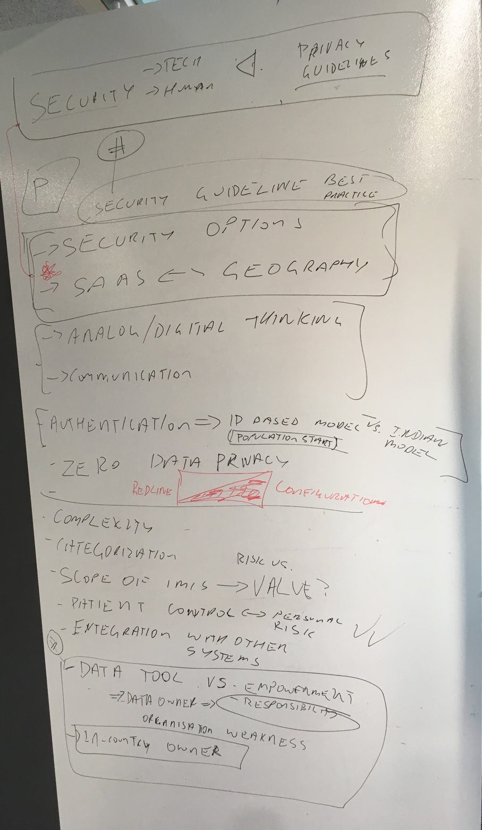
Parking lot and final discussion
Key themes
Data Privacy needs are contextual including security options
Option to enable Consent is likely to be needed

Slide 47
Agenda
Timing | Workshop Section
12:00 | Optional lunch
13:00 | Welcome
13:10 | Introductions
13:25 | Malini and her context
13:45 | openIMIS an introduction
13:55 | Data Privacy Concerns in LMIC setting
14:05 | Persona Group work
15:10 | Discussion
15:50 | Wrap up and reflections
47

Slide 48
Thank you!

