Slide 1
A global good for Universal Health Coverage (UHC)

Slide 2
Introducing openIMIS

Slide 3
Why openIMIS?
Increasing and improving coverage effectiveness through more efficient and transparent digital administration processes
Need to focus on operational core of scheme management
Complex business processes linking beneficiary, provider and payer data (e.g. beneficiary enrolment, claims processing and provider reimbursement)
UHC Agenda: Social (health) protection and financing schemes

Slide 4
openIMIS – a Global Good for UHC

Slide 5
Primary business domains and use cases
openIMIS covers the main health financing processes
Social health protection / health financing schemes
National health insurance/ Community-based health fund
Voucher scheme
Strategic purchasing arrangements, P4P or RBF
Modules for complex business processes
Beneficiary enrolment and management
Claims management (filing, submission and review)
Members feedback
Reporting

Slide 6
Country Cases:
Nepal and Tanzania

Slide 7
Nepal Nepal’s Social Health Insurance Scheme
Governed by National Health Insurance Policy (2014) & Health Insurance Act (2017)
Managed fully by Government of Nepal’s Health Insurance Board
National level pooling and a single payer
Contribution based scheme with subsidies for the poor
Services available through empaneled facilities (public and private)
Cash-less system

Slide 8
Nepal Operational numbers – first application adjustments in 2013, operations since 2016
870,000 actively insured members
607,286 claims processed
USD 5,182,000 paid out to facilities
6553 total claims received on a single day (e.g. June 11, 2018)
3256 Enrolment Assistants using openIMIS through Android phones
228 Health Facilities submitting claims through web interface
5 IT personnel as backstoppers

Slide 9
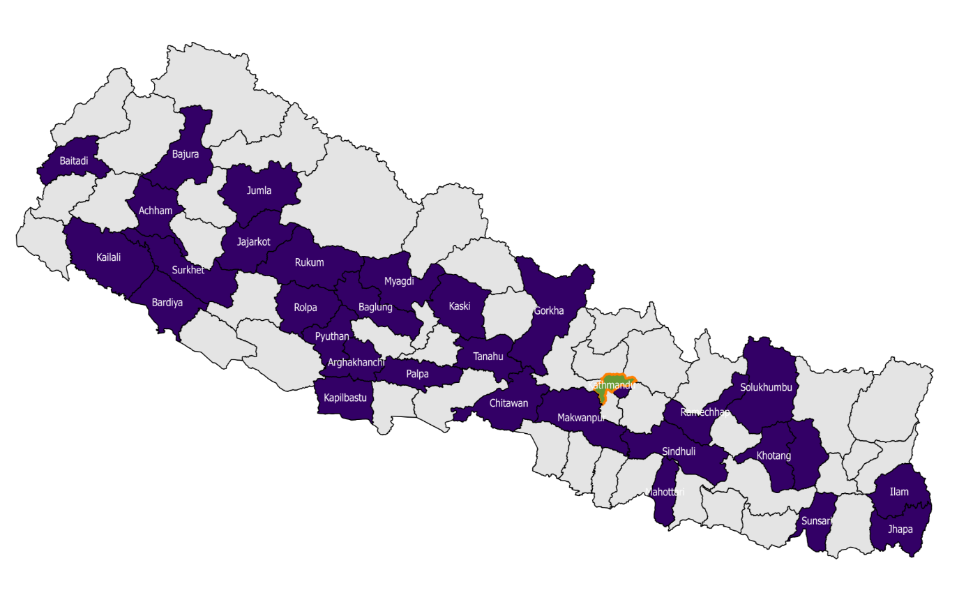
Nepal National roll-out: 42 districts out of 77
Central Server (Kathmandu)
Districts where SHI is active
Remaining districts
HIB Office - Kathmandu

Slide 10
Nepal Implementation: Technical Setup
Single server setup in Kathmandu
Hosted in Government of Nepal’s Datacenter
Microsoft Windows Server
Database backup both on-site and off-site
Immediate upgrade plans: Mirrored server at Disaster Recovery Site
Outside of Kathmandu
Managed by Government of Nepal
Data Security
ALL insurance related information stored on server in Nepal
No external hosting

Slide 11
TANZANIA Government run district based health insurance scheme (Community Health Funds)
Operated by a dedicated CHF team under the governments regional (and district) structure
Pooling at district level initially and since 2018 shifting to regional
Voluntary contribution based scheme with matching amount contributed by government
Primary and higher level care offered at all empaneled government (and charitable) facilities
Cashless system
Primary level facilities paid based on relative pricing concept (based on available resources and utilization rate)
Secondary level paid fee for service
System implemented in 1 region (Dodoma) in 2011-12, 3 regions (Dodoma, Morogoro and Shinyanga) in 2016 and being rolled out nationally in 2018

Slide 12
openIMIS in TANZANIA Operational numbers – first application adjustments in 2011-12
800,000 actively insured members at any point in time
1.8 million registered in the database
4167 Enrolment Assistants through Android phones
867 Health Facilities submitting claims through web interface and phones

Slide 13
TANZANIA Operational numbers – first application adjustments in 2011-12
Single server setup in Dodoma
Hosted at the Presidents Office of Regional Administration and Local Governance
Microsoft Windows Server
Database backup both on-site and off-site
Data Security
ALL insurance related information stored on server in Tanzania
No external hosting

Slide 14
openIMIS implementation steps

Slide 15
1. System & business process analysis
I Assessment & Planning
2. IT analysis
3. Software prototyping & set up
II Adaptation
4. Prototype testing & adjustment
5. Training
6. Roll out
III Scale up
7. Ongoing maintenance & exchange with global community
Notes:
4. Training

Slide 16
I ASSESSMENT & PLANNING
1. System & business process analysis
This step assesses the current operations of the scheme and collects the needed “ingredients” to feed into the digital system set up.
Relevant policies and regulations (e.g. national digital policy/ e-health/ health insurance legal framework/ provider reimbursement regulation
Key organizational structures, incl. staffing, roles and responsibilities
Process flows (incl. SOPs) for
Identification of beneficiary at facility level (interaction with beneficiary database, beneficiary card and unique number)
Voucher and invoice filing (incl. claim forms)
Submission, review, approval and payment process
Service package (list of services) and tariffs (price lists)*
Product package (list of medicines, devices, etc.) and prices*
List of facilities (type, location, service package provided)
* Variation by geographical area, type of provider etc. are possible but should be spelled out

Slide 17
I ASSESSMENT & PLANNING
2. IT analysis
This step compares the identified scheme processes and requirements with openIMIS functionalities and maps gaps/ adjustment needs in either the business or the IT processes.
Scope of interaction with beneficiary database: assessment of possible digital interaction/interface with the 3MS database
Benefit package specifics (Utilization ceiling, individual ceiling?)
Claims verification levels and steps
Fraud detection measures in place/expected from openIMIS
Reporting needs
Software capacity vs. volume of processes
Connectivity and hardware availability
Present IT-HR capacities and availability/ work load

Slide 18
II Adaptation
Configuration
3. Software prototyping & testing set up
During this step the openIMIS is adjusted to fit the identified requirements and scheme specific characteristics.
Definition of software modification need
Software adjustment by openIMIS developer team (if applicable)
Configuration of registers (services, items, pricelists, health facilities, product definition)
Entry of dummy data set
Configuration of user accounts and privileges
Test run of processes (developer level)

Slide 19
II Adaptation
Configuration
4. Training
The training is conducted in country and covers the core operations.
Primary training is conducted at central level
*See staff profile specifications on slide 28
Position (central level) | Number of staff | Training duration | Remarks
Server administrator* | 1x full time, 1x part time | 3 days | If staff is already in place and could participate in the set up, this could be covered as training on the job.
System administrator* | 2x full time, 1x part time | 3 days | If staff is already in place and could participate in the set up, this could be covered as training on the job.
System user (training of trainers) | tbd, e.g. 15-25pax | 3-5 days | Establish a pool of trainers to build up local training capacity with multiplier function for roll out

Slide 20
II Adaptation
Configuration
5. Testing (User level)
Testing takes place via the installed demo-server and the identified facilities.
Design test features – size, location, duration, users involved
Server set up at HQ
Offline installation at selected test facilities
Capture user feedback (bugs, requests, etc.)
Translate user feedback into software/ process requirements
Adapt software/ processes to incorporate feedback
Test new developments/ adaptations
Deploy new developments/ enhancements

Slide 21
III Scale up
Configuration
6. Roll out
After the successful testing in selected sites, further roll out is planned.
Design roll out and plan sequence, location, duration
Ensure infrastructure (personnel and equipment) is in place
Conduct trainings for facility staff and reviewers
Ensure appropriate server configuration (as per expected load)
Go Live!

Slide 22
III Scale up
Configuration
7. Ongoing maintenance and upgrade
As with any software solution, the implementation parameter change with time. Continuous system support and maintenance are hence needed. The global community of practice offers a platform for exchange but local maintenance is needed.
Updates to configurations – new users, facilities etc.
Ensuring system backup
Backstopping support to users at various levels
Preparing data extracts for offline use (if applicable)
Capacity development of (new) users
Monitoring and reporting
Ongoing capture of user requirements, gaps and bugs
Feedback to openIMIS global community
Implementation experiences
Software developments
Downloading & testing new openIMIS release

Slide 23
Time Line
(example)
No | Activity | Month 1 | 2 | 3 | 4 | 5 | 6 | 7
I | Assessment & Planning
1 | System & business process analysis
2 | IT analysis
II | Adaptation
3 | Software prototyping & set up
4 | Prototype testing & adjustment
5 | Training
III | Scale up
6 | Roll out
7 | Ongoing maintenance & exchange with global community

Slide 24
Key cost components
One Time Cost
 | Cost category
1 | IT analysis
2 | Software prototyping & testing
3 | Trainings (tech and users) - Local logistics/ facility/ equipment - Training delivery/ material
4 | Server related costs (license, hosting charges, security related costs, antivirus)
5 | IT hardware
6 | Updated patient files printing (ideally with a carbon copy)
7 | Roll out user trainings – see next slide for details

Slide 25
Key cost components
One Time Cost
For roll out training of staff (facility/verifiers/HQ), consider the following cost elements:
Training groups of max. 25pax
Training duration: 3-5 days (depending on capacities in place and tasks)
Training delivered by 2 trainers
Equipment: Training facility/ computers/ server running/ connectivity
Accommodation/ travel & logistics for participants
For estimated currently about 1,400 users this would translate into
56 training sessions with 25 participants each
224 training days (assuming 4 days trainings on average)
448 trainer days
448 days/20 trainers = 22.4 training days to deliver by each trainer
-> If a trainer delivers 2 trainings per month, about 3 months would be needed for the roll out trainings.

Slide 26
Key cost components
Recurring Cost
Cost category
HR and office running for openIMIS maintenance at HQ
Server related costs (hosting costs, recurring software license costs
Refresher trainings for users at various levels
Support structure
IT Maintenance/ software development charges (if applicable)

Slide 27
IT staff profiles
 | openIMIS system administrator | openIMIS server administrator
Responsibilities | Maintain the list of registries Health Facilities Services Prices Support system users with technical issues Track issue resolution Change management (e.g. introducing new features) | Maintain the Windows Server (OS upgrade, internet access, security aspects) Manage the openIMIS web application (Microsoft IIS) Perfom web application upgrades Perform database upgrades Perform web services / API updates
Key qualifications and requirements | Data manipulation with Microsoft office suite (or equivalent) skills Know how in insurance processes | Bachelor degree Experience in deploying web applications and experience with MS SQL Server

Slide 28
Ressources
Home of the openIMIS Initiative
https://openimis.org/
Community knowledge sharing
https://openimis.atlassian.net/wiki/spaces/OP/overview
Source code for download
https://github.com/openimis
Try the demo and test out features
https://demo.openimis.org/
Report issues, bugs, or feature requests
https://openimis.atlassian.net/servicedesk/customer/portal/1
Questions and Queries
contact@openimis.org

