Slide 1
A Generic Open Source Tool to Manage the Health Financing Bit of UHC & USP
Uwe Wahser, Alicia Spengler, Saurav Bhattarai
HELINA Conference, Nairobi, Kenya
December 2018

Slide 2
Agenda 2030: UHC & USP
100 million people pushed into extreme poverty due to out-of-pocket payments
400 million people without access to complete set of essential health services
SDG1, 1.3
SDG3, 3.8
Individual poverty & societal welfare losses
Ill-health
Universal Social Protection
Universal Health Coverage

Slide 3
Systemic Approach of UHC
UHC
Quality of health services
Social protection against health risks
Range of health services
Access to health services
Systems
thinking!
Equity!

Slide 4
Principal Actors in openIMIS
People
Provider
Payer

Slide 5
From MS IMIS to openIMIS
IMIS for Tanzania CHF
by SwissTPH, Exact Software,
MicroInsurance Academie
IMIS Customization for Nepal
openIMIS Master Version
(TZ+CM+NP)
Modular Architecture Transformation
2012
2014
2017
2019
2013
2016
2018
IMIS Customization for Cameroon
openIMIS Initiative
(SDC & GDC)
openIMIS Community

Slide 6
openIMIS Strategy: Open Source
Open Source
Sustainable Community
OpenIMIS
Interoperability
Customisable Architecture

Slide 7
openIMIS in an OS eHealth Landscape (Examples)
Analytics
Master Patient Index
Logistics
Medical Records
Data Integration
Health Insurance
Workforce
Administration

Slide 8
openIMIS Strategy: Interoperability
Open Source
Sustainable Community
OpenIMIS
Interoperability
Customisable Architecture

Slide 9
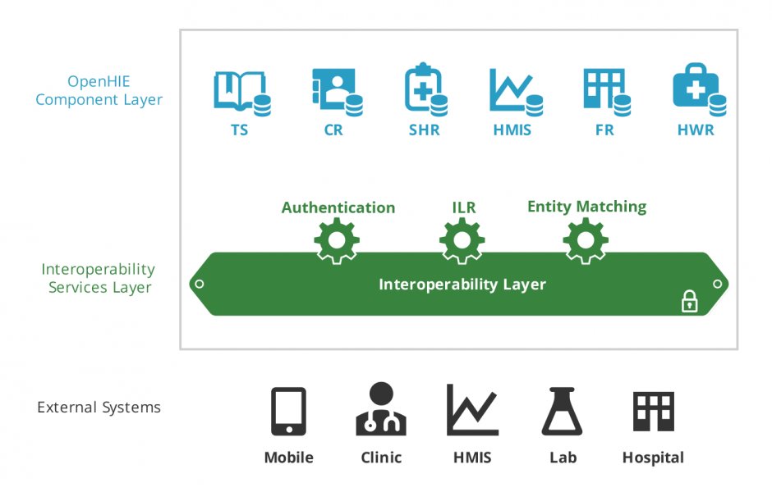
Interoperability - OpenHIE

Slide 10
openIMIS Strategy: Customisable Architecture
Open Source
Sustainable Community
OpenIMIS
Interoperability
Customisable Architecture

Slide 11
Local Development
 | Developer | Implementer | User
Organization
Vertical Programs
Sector
Type of Application
Universal
Country IMIS
VB
SQL

Slide 12
Global Development Local Customization
 | Developer | Implementer | User
Organization
Vertical Programs
Sector
Type of Application
Universal
Country IMIS
OpenIMIS
JAVA
VB
SQL

Slide 13
Modular Transformation
monolithic
modular
openIMIS
openIMIS
Web User Interface
Web User Interface
WUI
Business Logic
Enroll
Claim
Mx
My
Mz
Data Access Layer
DA
DA
DA
DA
Data Base
Data Base
DB
DB

Slide 14
Slow Transition (Example)
Claiming
openIMIS
MS IMIS
Enrollment
Module X
Module Y
Module Y
Year 1
Year 2
Year 3

Slide 15
openIMIS Strategy: Sustainable Community
Open Source
Sustainable Community
OpenIMIS
Interoperability
Customisable Architecture

Slide 16
Community Platforms
Homepage: openimis.org
Demo server: demo.openimis.org
Documentation: openimis.readthedocs.io
Issue queue: openimis.atlassian.net/secure/Dashboard.jspa
Wiki: openimis.atlassian.net/wiki/spaces/OP/overview
Code repository: github.com/openimis

Slide 17
openIMIS Outsourcing 2019
Tender
Partnerships
Continuity
Software Maintenance & Technical User Support
Hub South-East Asia
Expansion
Community Building & Promotion
Hub Sub-Saharan Africa
Architecture
Modular Transformation
Digital Square Notice C

Slide 18
Lessons Learnt (so far)
Political processes take time
Community processes take time
Development takes time
Address chicken or the egg causality dilemma:
Implementations vs. Functionality
Adhere to the Digital Development Principles right from the start (https://digitalprinciples.org/)

