Slide 1
CORE-MIS to openIMIS Migration
Developer Workshop 2024
2024-01-22

Slide 2
Agenda
Current Roadmap
Solution Building
Overview, Scoping & Monitoring
Rest of the workshop:

Slide 3
Current Roadmap

Slide 4
Current Roadmap
today
2023
2024
Project Phase 2020 -2023
Project Phase 2023 -2025
Dev. Contracts
Maintenance
Maintenance
REST-API, Reports
CORE-MIS Migration
CORE-MIS Migration
Sprints
Releases
23-04
23-10
24-04
24-10

Slide 5
Community Integration

Mandatory: Weekly CORE-MIS deep dive (Tuesday)
Mandatory: Weekly developers call (Thursday)
Mandatory: Monthly Gumzo (First Monday of the week)
Mandatory: Focused Developers Workshop (week of Jan. 22nd 2024)
Optional: General weekly deep-dive (Thursday)
Optional: Weekly implementers call (Wednesday)
Proposed: Daily energizer (15 minutes)
Proposed: regular work calls






Slide 6
Enable Solution Building

Slide 7
Additional QA Layer
2023
2024
Project Phase 2020 -2023
Project Phase 2023 -2025
Dev. Contracts
REST-API, Reports
Developing
CORE-MIS Migration
CORE-MIS Migration
Sprints
Technical
QA
Maintenance
Maintenance
Bug-Fixing
Releases
23-04
23-10
24-04
24-10
Application
QA
Solution Building
Sandboxing

Slide 8
Release of Solution Bundles
2024
2025
openIMIS Releases
24-04
24-10
25-04
25-10
Solution releases of
Solution Bundles
“powered by openIMIS”
whenever they are ready / needed
CORE-MIS (Cash Transfer)
Health Insurance
Social Beneficiary Register
Next Big Thing

Slide 9
openIMIS Solution Bundles
Beneficiary Management
Contract Management
Product Management
Premium Management
Provider Management
Claim Management
Accounting
Social Beneficiary Register “powered by openIMIS”
insuree/family
contract
product
contributions
medical pricelist
claim
invoice
insuree batch
policy
medical
payer
health facility
claim batch
payment
policy holder
contribution plan
policy notification
claim AI
Technical Administration
authentication
user & roles
GEO location
Interoperability
FHIR 3
FHIR 4
ETL (DHIS2)
+ mobile apps
Customization
language packs
calculations
Core
reports
AI services
tools, home, …
Beneficiary Management
Contract Management
Product Management
Premium Management
Provider Management
Claim Management
Accounting
CORE-MIS UCT “powered by openIMIS”
insuree/family
contract
product
contributions
medical pricelist
claim
invoice
insuree batch
policy
medical
payer
health facility
claim batch
payment
policy holder
contribution plan
policy notification
claim AI
Technical Administration
authentication
user & roles
GEO location
Interoperability
FHIR 3
FHIR 4
ETL (DHIS2)
+ mobile apps
Customization
language packs
calculations
Core
reports
AI services
tools, home, …

Slide 10
Release Cycle with Solution Cycle
Solution configuration (technical 2do’s by SolDevelo)
with every openIMIS Release:
Create
Update
Package
Solution releases with independent release cycles?

Slide 11
Architecture Vision
Mandatory deliverable
Additional deliverable
OpenHIE / FHIR View
DCI View
oI Health
oI UBR
OpenHIM
OpenHIM
oI CORE MIS
MIFOS
DHIS2
oI Farmer
MojaLoop
OpenMRS
OpenCRVS
oI Education
OpenSPP

Slide 12
Scoping & Monitoring

Slide 13
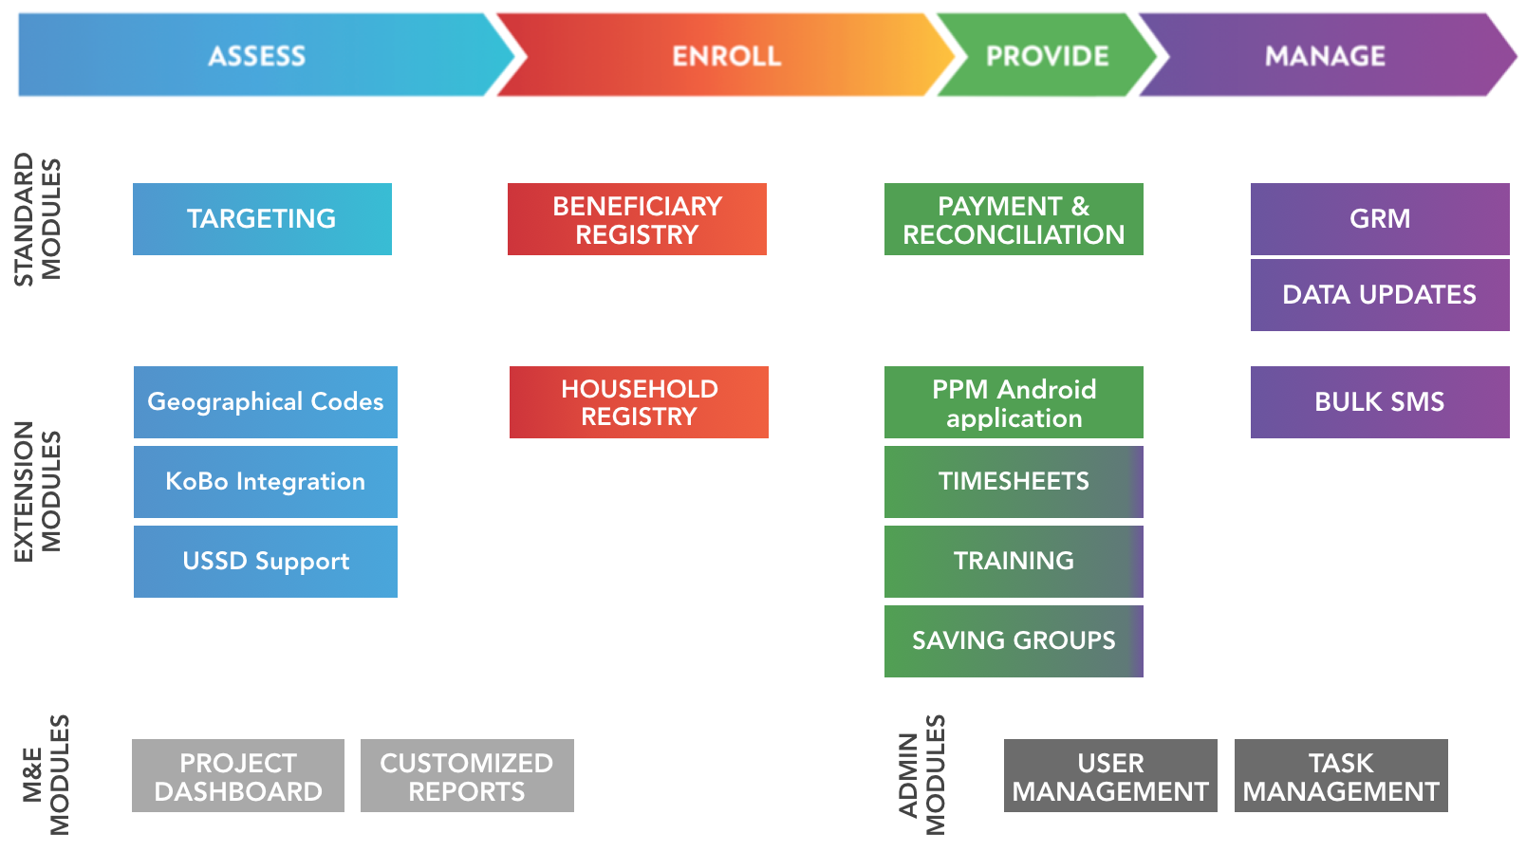
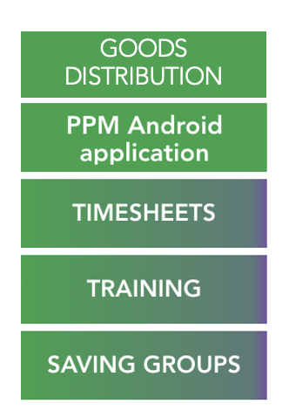
Identify WIP and completed Migrations
Delivered
Doing
Define Scope
Targeted
Dropped
1
3
5
4
8
7
2
PROGRAMS
6
Individuals
PROGRAM STAFF
12
10
9
11

Slide 14
openIMIS Modules & Functions
Beneficiary Management
Contract Management
Product Management
Premium Management
Provider Management
Claim Management
Accounting
insuree/family
contract
product
contributions
medical pricelist
claim
invoice
insuree batch
policy
medical
payer
health facility
claim batch
payment
policy holder
contribution plan
policy notification
claim AI

Slide 15
openIMIS Modules & Functions
Technical Administration
authentication
user & roles
GEO location
Interoperability
FHIR 3
FHIR 4
ETL (DHIS2)
+ mobile apps
Customization
language packs
calculations
Core
reports
AI services
tools, home, …

Slide 16
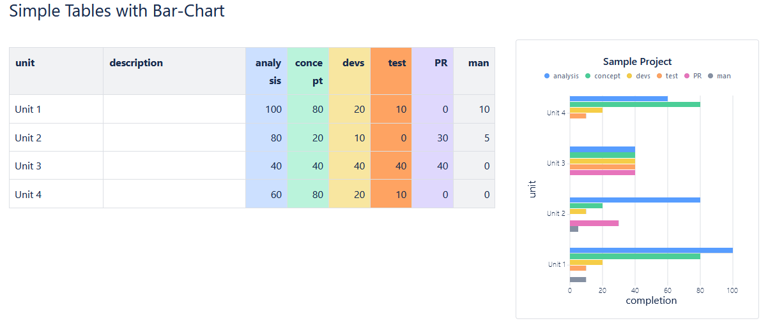
Scope Monitoring
Functional Checklist (Excel Sheet Malike)
Migrate to Google Docs in project directory

High Level Overview of Sprint Completion (table in new project page)


Slide 17
Technical Monitoring
Overview of new / modified repositories
High-level object model (Patricks model – link?)
Overview of new / modified data base tables
Distinction: core data model vs. custom data stores
Overview of new / modified technology choices
Lightning
Elastic search
…

Slide 18
Colour scheme
0
0
0
255
255
255
79
75
76
169
167
168
Dark 1
Light 1
Dark 2
Light 2
0
99
116
128
176
185
244
174
43
200
15
15
248
233
70
164
160
208
Accent 1
Accent 2
Accent 3
Accent 4
Accent 5
Accent 6

