Slide 1
Kadchma openIMIS Implementation
By
Yolande M. Goswell (2M Corp)

Slide 2
Content
About Kadchma
The Kadchma Scheme
openIMIS Customizations for Kadchma

Slide 3
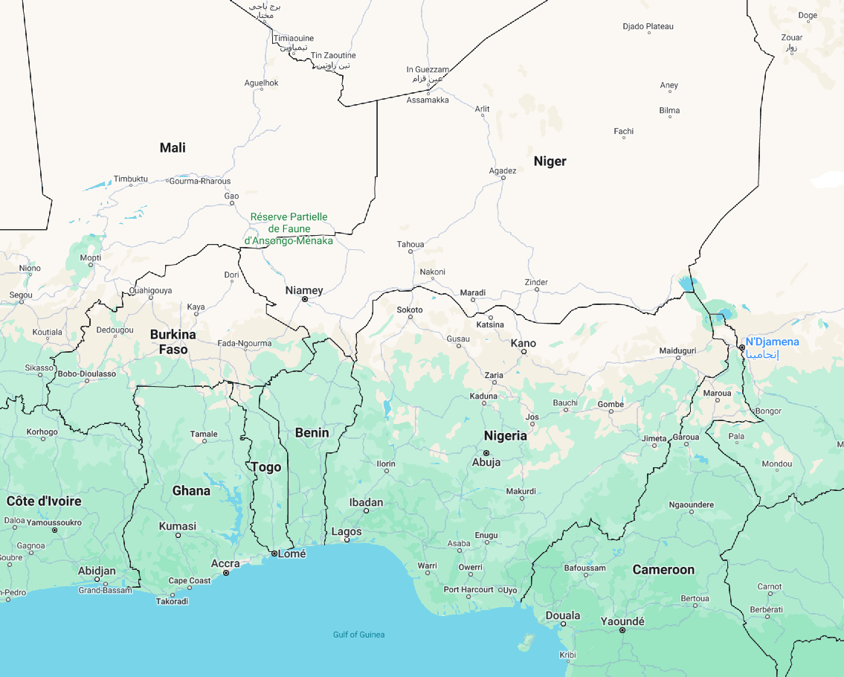
About Kadchma
Kaduna State Contributory Health Management Authority (Kadchma) is a state wide health insurance management scheme for the state of Kaduna, Nigeria.
Current total enrollees: over 400,000
Existing System: Yes, custom
Kaduna Population: over 1million
Stakeholders: Primary HF, Secondary HF, TPA, Kadchma,

Slide 4
The Kadchma Scheme
The Kadchma scheme is a general package for everyone. It provides coverage for both formal and informal sector.
The scheme consists of Primary Health Facilities where enrollees receive primary health care services. In the event that further treatment is required which is not available at the Primary Health facilities, then they are referred to the secondary and tertiary HF.
The primary HF are paid by Kadchma through a capitation scheme while the secondary/tertiary are paid via a fee-for-service scheme.
The benefit package provided by Kadchma provides a set of items and services at a fixed price.

Slide 5
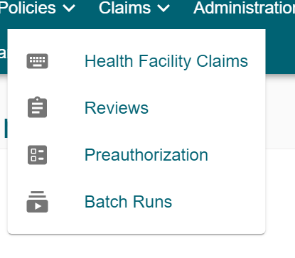
openIMIS Customizations for Kadchma
1
Preauthorization: A pre request issuance for the issuance of authorization to access care in secondary/tertiary Health Facilities
2
Auto generation of Insuree Number and claim ID
3
A custom percentage income for formal sector
4
Custom Reports
5
Cleaning, transforming and migration Data from the existing system to openIMIS
6
Grievance Module
7
Employer Portal*

Slide 6
THE END

