Slide 1
openIMIS Quality Gateway

Slide 2
Agenda
Backend pipeline
Frontend checks
Best practises
Community Involvement
‹#›
06.07.23
openIMIS-coreMIS integration

Slide 3
Backend pipeline
‹#›
06.07.23
openIMIS-coreMIS integration

Slide 4
‹#›
06.07.23
openIMIS-coreMIS integration

Slide 5
Jobs:
build_backend: Prepares the backend for testing.
ci_module_mssql_tests: Runs all tests on Microsoft SQL Server.
ci_module_psql_test: Runs all tests on PostgreSQL.
flake-8-linter - This job is responsible for running code style checks using Flake8 on Python code.
sonar_scan - This job is responsible for running static code analysis using SonarCloud to identify code vulnerabilities, code smells, and to analyze the coverage report.
‹#›
06.07.23
openIMIS-coreMIS integration

Slide 6
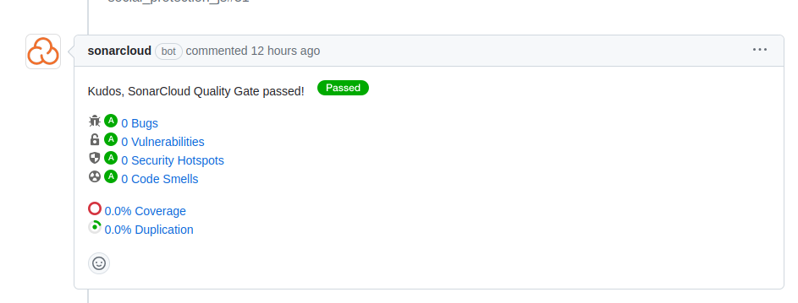
Static code analysis
‹#›
06.07.23
openIMIS-coreMIS integration

Slide 7
Sonar Quality Gateway
Currently all modules are using default Quality Gateway provided by Sonar. It expects code to:
Have 80% coverage
< 3% duplicates
< 5% Technical Debt
No Bugs
No Security Issues
‹#›
06.07.23
openIMIS-coreMIS integration

Slide 8
Frontend checks
‹#›
06.07.23
openIMIS-coreMIS integration

Slide 9
FE checks
Static code analysis -> SonarCloud
Linter check -> Eslint
‹#›
06.07.23
openIMIS-coreMIS integration

Slide 10
Best practises
‹#›
06.07.23
openIMIS-coreMIS integration

Slide 11
Code Quality Metrics:
All PRs should pass the default quality gates set in SonarQube.
Linter errors (from both flake8 and ESLint) must be addressed.
Backend unit tests should always pass.
We encourage the community to provide feedback on additional metrics and standards. Open a discussion thread or issue for suggestions.
Sonar documentation: https://docs.sonarsource.com/sonarqube/latest/user-guide/metric-definitions/
‹#›
06.07.23
openIMIS-coreMIS integration

Slide 12
Code Review Process:
Every PR undergoes a review by at least one core developer.
Address all failing checks in the CI/CD pipeline before requesting a review.
Reviewers should prioritize the logic, efficiency, and alignment with the project's goals.
SonarQube's feedback should be considered advisory. Address critical and high-severity issues. For minor issues, reviewers' discretion is advised.
‹#›
06.07.23
openIMIS-coreMIS integration

Slide 13
Refactoring
As the project evolves, refactoring becomes necessary to maintain code quality:
Regular Refactoring Sprints: Every three months, a sprint dedicated to refactoring and addressing tech debt can be beneficial.
Community Involvement: While community contributions primarily focus on features and fixes, we should encourage community members to participate in refactoring. Picking up smaller refactoring tasks can be a great way to familiarize oneself with the codebase.
‹#›
06.07.23
openIMIS-coreMIS integration

Slide 14
Community involvement
‹#›
06.07.23
openIMIS-coreMIS integration

Slide 15
Community Involvement:
Given the open-source nature of the project, community feedback on code quality metrics and practices is invaluable. Please contribute to the discussion threads or open new ones with suggestions.
Link to the sonar documentation:
https://docs.sonarsource.com/sonarqube/latest/user-guide/metric-definitions/
Link to the confluence page:
https://openimis.atlassian.net/wiki/spaces/OP/pages/3613917185/Code+Quality+and+Static+Code+Analysis
‹#›
06.07.23
openIMIS-coreMIS integration

