Slide 1
openIMIS-coreMIS integration
Documentation summary

Slide 2
Agenda
List of new modules related to coreMIS integration
Changes in database structure
List of current openIMIS modules where there are changes related to coreMIS integration
Workflows (openFN)
OpenSearch
Test server and CD process
‹#›
06.07.23
openIMIS-coreMIS integration

Slide 3
List of new modules related to coreMIS integration
‹#›
06.07.23
openIMIS-coreMIS integration

Slide 4
Backend
Frontend
openimis-be-individual_py
openimis-be-social_protection_py
openimis-be-tasks_management_py
openimis-be-opensearch_reports_py
openimis-be-workflow_py
openimis-fe-individual_js
openimis-fe-social_protection_js
openimis-fe-tasks_management_js
openimis-fe-opensearch_reports_js
openimis-fe-coremis_language_pack_js
‹#›
06.07.23
openIMIS-coreMIS integration

Slide 5
Individual
responsible for managing Individuals, Groups and relations between them
stores data on how Individuals have been added
Fe: https://github.com/openimis/openimis-fe-individual_js
Be: https://github.com/openimis/openimis-be-individual_py
‹#›
06.07.23
openIMIS-coreMIS integration

Slide 6
Social Protection
is in charge of Benefit Plans/Programmes
connects Beneficiaries with Benefit Plans
Fe: https://github.com/openimis/openimis-fe-social_protection_js
Be: https://github.com/openimis/openimis-be-social_protection_py
‹#›
06.07.23
openIMIS-coreMIS integration

Slide 7
Tasks Management
handles maker-checker logic for different modules
stores tasks
Concept: https://openimis.atlassian.net/wiki/spaces/OP/pages/3564503053/Task+based+update+-+technical+details
Fe: https://github.com/openimis/openimis-fe-tasks_management_js
Be: https://github.com/openimis/openimis-be-tasks_management_py
‹#›
06.07.23
openIMIS-coreMIS integration

Slide 8
coreMIS language pack (just FE)
adjusts naming convention to one required by coreMIS
Fe: https://github.com/openimis/openimis-fe-coremis_language_pack_js
‹#›
06.07.23
openIMIS-coreMIS integration

Slide 9
Workflow (just BE)
allows to choose what kind of workflow will be performed (graphQL query used to fetch type of workflows to execute - see “Wokflows (openFN)” part)
We can also setup here https://github.com/openimis/openimis-be-workflow_py/blob/35e46c774644c704c89b7d61fee6ad963b413db4/workflow/apps.py#L3 what kind of workflow could be performed (python one, lightning one, etc), API key for lighting connection.
Be: https://github.com/openimis/openimis-be-workflow_py/tree/develop
‹#›
06.07.23
openIMIS-coreMIS integration

Slide 10
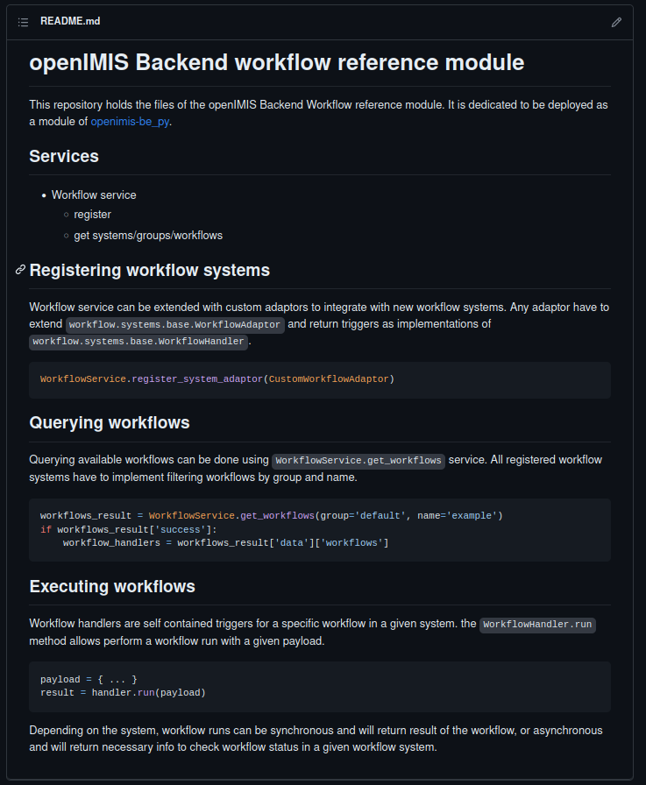
‹#›
06.07.23
openIMIS-coreMIS integration

Slide 11
Opensearch Reports
Still work in progress on review (docker part)
Handle showing <iFrame> with embedded openSearch webpage
Embedding is based on proxy and basic authorization
Authorization to openIMIS is required in order to display on openIMIS level. (defined on nginx level)
Fe: https://github.com/openimis/openimis-fe-opensearch_reports_js
‹#›
06.07.23
openIMIS-coreMIS integration

Slide 12
Changes in database structure
‹#›
06.07.23
openIMIS-coreMIS integration

Slide 13
Individual models
Individual(HistoryModel)
IndividualDataSourceUpload(HistoryModel)
IndividualDataSource(HistoryModel)
Group(HistoryModel)
GroupIndividual(HistoryModel)
‹#›
06.07.23
openIMIS-coreMIS integration

Slide 14
Social Protection models
BenefitPlan(HistoryBusinessModel)
Beneficiary(HistoryBusinessModel)
GroupBeneficiary(HistoryBusinessModel)
‹#›
06.07.23
openIMIS-coreMIS integration

Slide 15
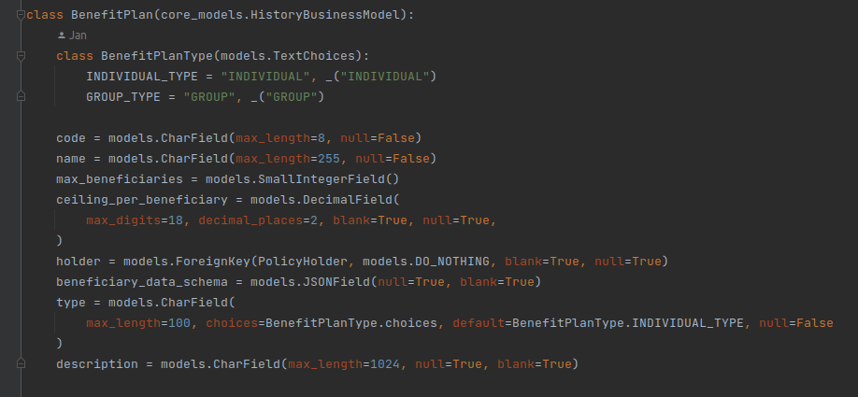
Social Protection models
‹#›
06.07.23
openIMIS-coreMIS integration

Slide 16
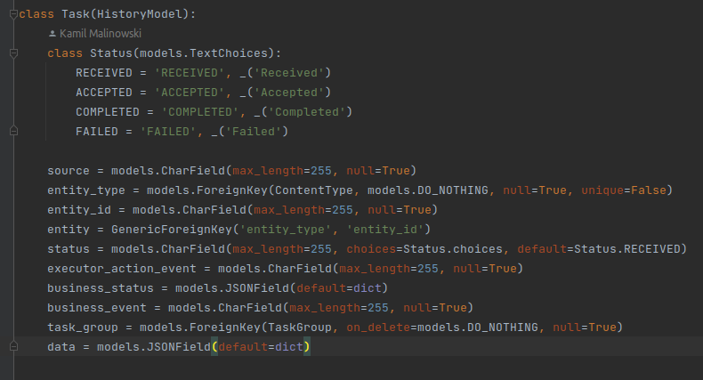
Tasks Management models
TaskGroup(HistoryModel)
TaskExecutor(HistoryModel)
Task(HistoryModel)
‹#›
06.07.23
openIMIS-coreMIS integration

Slide 17
List of current openIMIS modules where there are changes related to coreMIS integration
‹#›
06.07.23
openIMIS-coreMIS integration

Slide 18
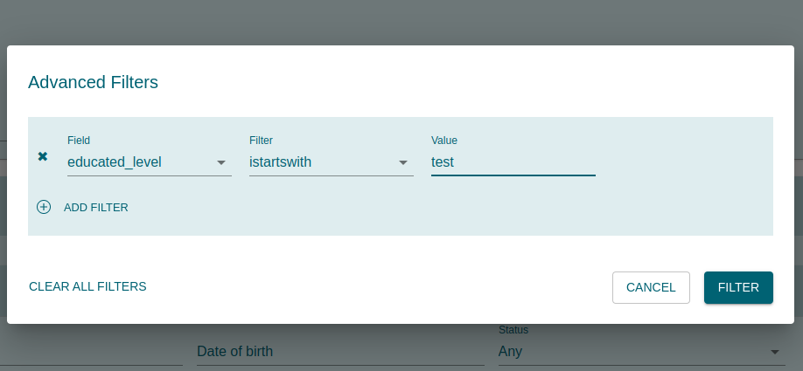
Core module on FE and BE
Advanced Filters:
allow to add custom filters to searcher in order to retrieve information about unstructured data saved on json_ext level
filters need to be defined in schema on BenefitPlan page
Documentation: https://github.com/openimis/openimis-be-core_py#customfilters
schema = {"$id": "https://example.com/beneficiares.schema.json", "type": "object", "title": "Record of beneficiares", "$schema": "http://json-schema.org/draft-04/schema#", "properties": "educated_level": {"type": "string", "description": "The level of person when it comes to the school/education/studies"}
}
‹#›
06.07.23
openIMIS-coreMIS integration

Slide 19
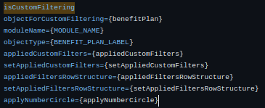
Core module on FE and BE
Advanced Filters - fe:
Searcher component updated by adding additional optional (to not break current searcher pages) arguments:
Another params are also optional - are related to the progress of particular custom filter states
‹#›
06.07.23
openIMIS-coreMIS integration

Slide 20
Workflows (openFN)
‹#›
06.07.23
openIMIS-coreMIS integration

Slide 21
Workflows (openFN)
Functionality which allows to upload data from particular source (mostly csv) into desired object in system
In openIMIS-coreMIS integration it refers to data upload for Beneficiary on Benefit Plan level
Part of optional deployment in openIMIS dockerized package (see section below openimis-dist_dkr repository)
‹#›
06.07.23
openIMIS-coreMIS integration

Slide 22
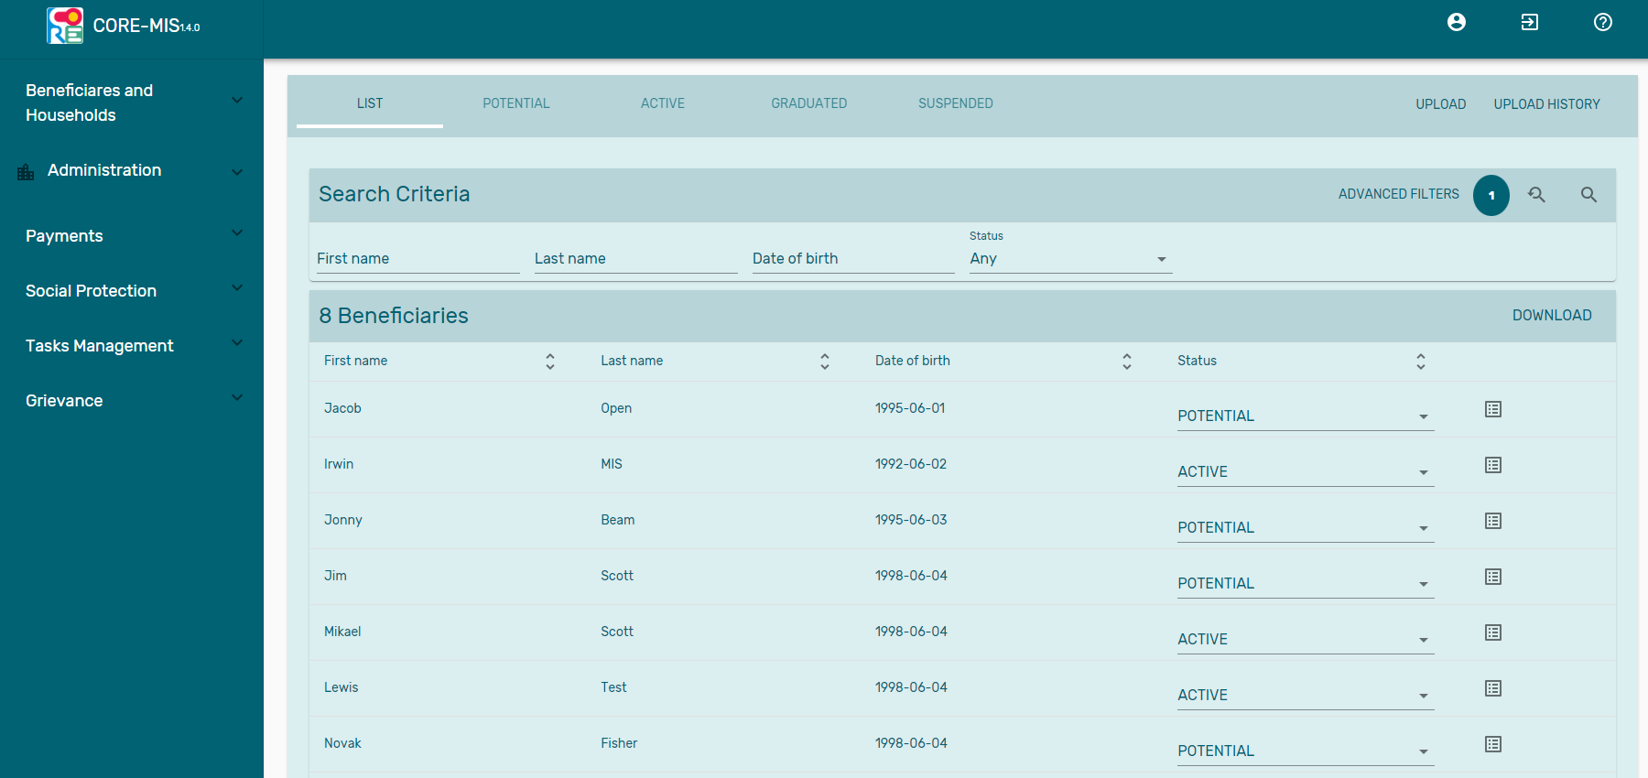
Workflows (openFN) - UI on openIMIS level
‹#›
06.07.23
openIMIS-coreMIS integration

Slide 23
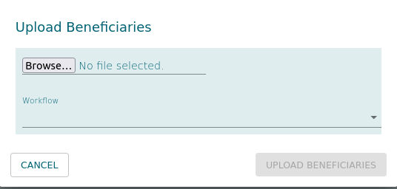
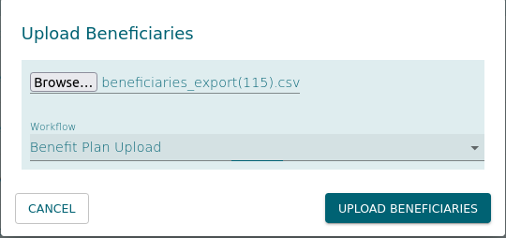
Workflows (openFN) - UI on openIMIS level
‹#›
06.07.23
openIMIS-coreMIS integration

Slide 24
Workflows (openFN) - UI on openIMIS level
upload history
‹#›
06.07.23
openIMIS-coreMIS integration

Slide 25
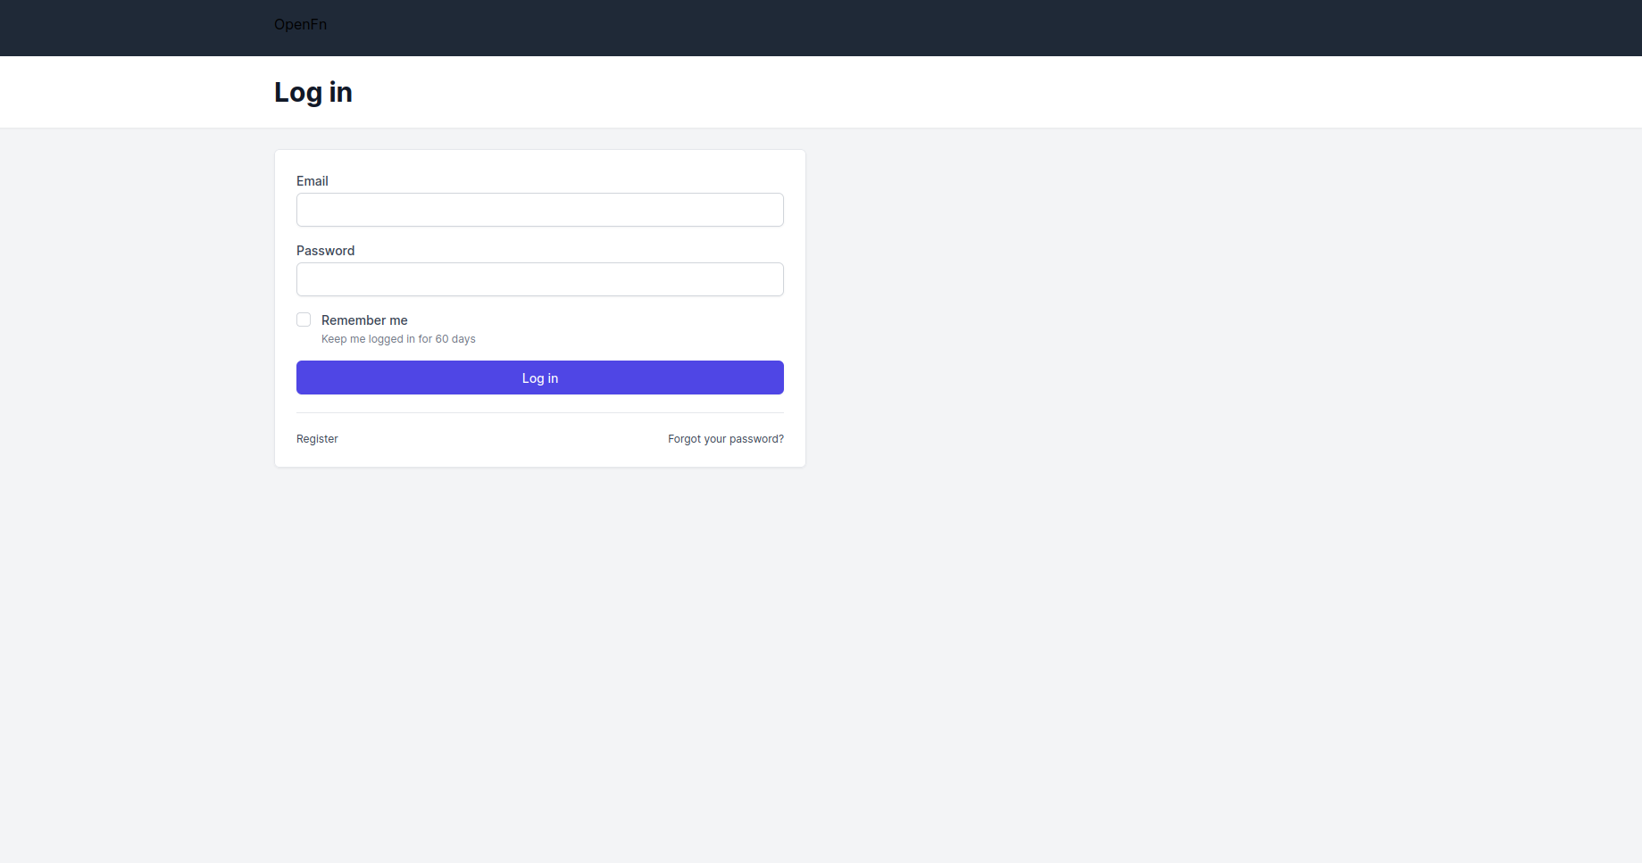
Workflows (openFN)
https://coremis-etl.s1.openimis.org/users/log_in - openFN lightning on coreMIS test server
https://github.com/OpenFn/Lightning - github repo
Exposed on port 4000
‹#›
06.07.23
openIMIS-coreMIS integration

Slide 26
Workflows (openFN) - server
‹#›
06.07.23
openIMIS-coreMIS integration

Slide 27
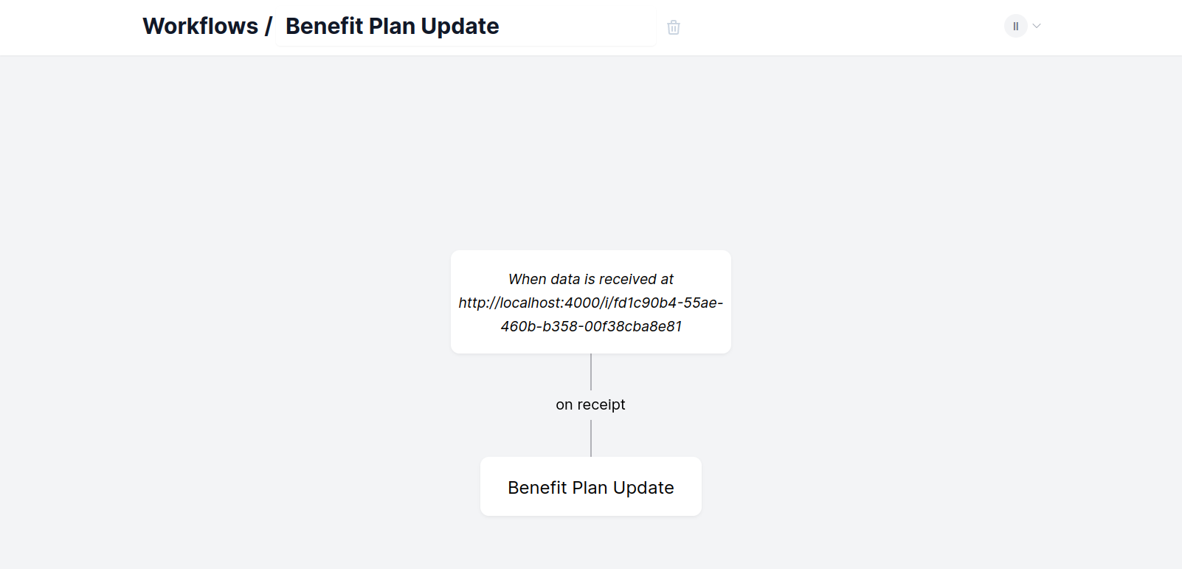
Workflows (openFN) - server
‹#›
06.07.23
openIMIS-coreMIS integration

Slide 28
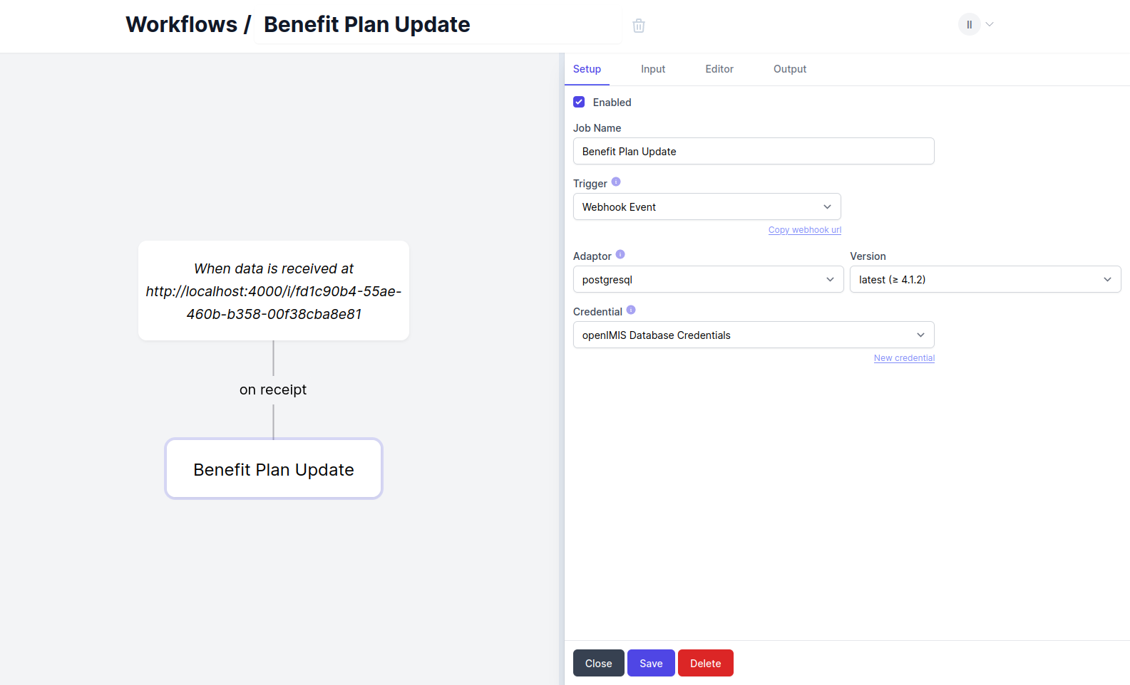
Workflows (openFN)
‹#›
06.07.23
openIMIS-coreMIS integration

Slide 29
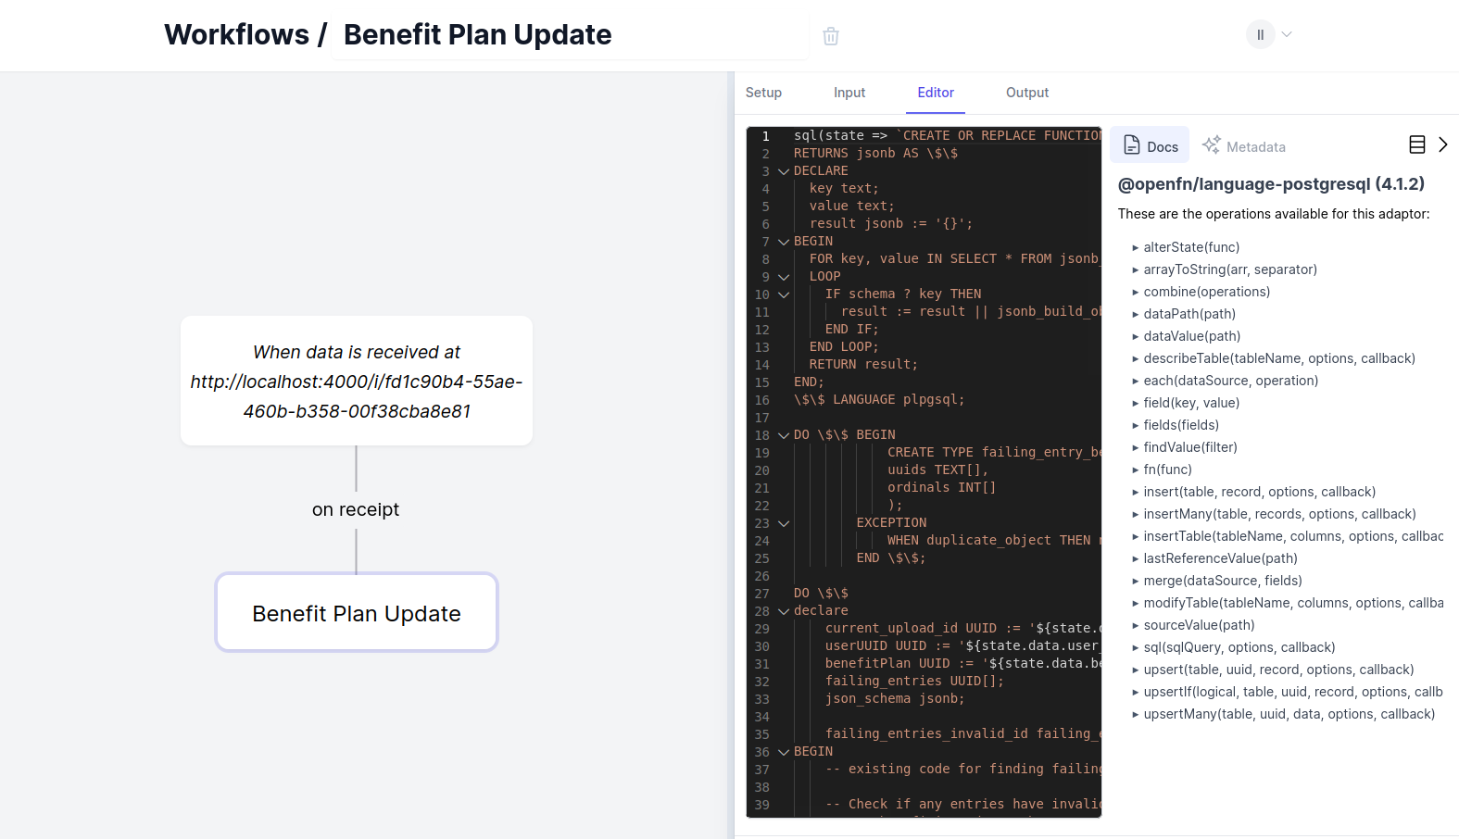
Workflows (openFN)
‹#›
06.07.23
openIMIS-coreMIS integration

Slide 30
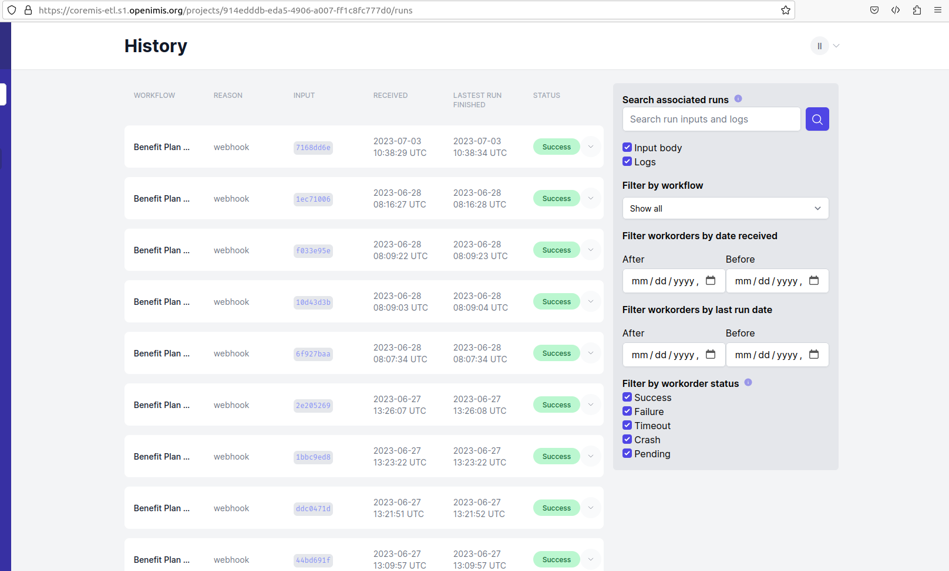
Workflows (openFN)
‹#›
06.07.23
openIMIS-coreMIS integration

Slide 31
Workflows (openFN)
Repositories
https://github.com/openimis/openimis-lightning_dkr
‹#›
06.07.23
openIMIS-coreMIS integration

Slide 32
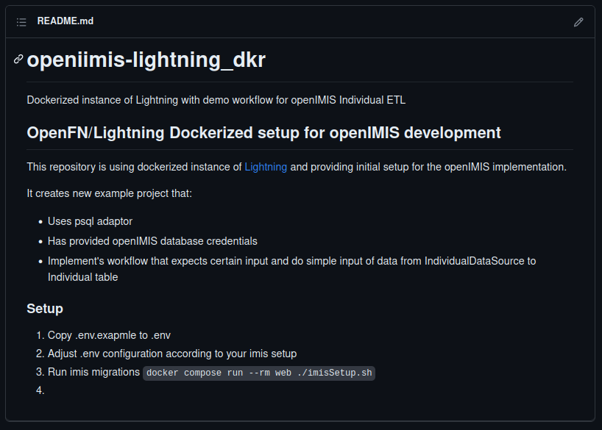
Workflows (openFN)
‹#›
05.07.23
openIMIS-coreMIS integration

Slide 33
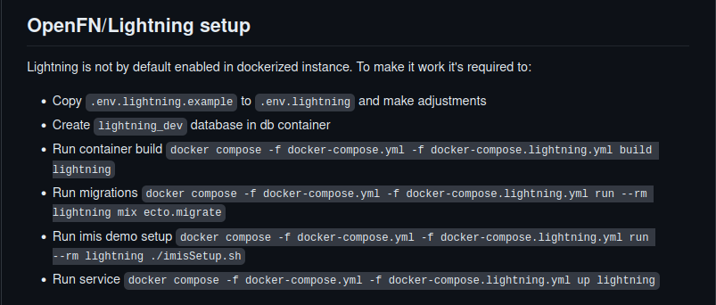
Workflows (openFN)
https://github.com/openimis/openimis-dist_dkr
‹#›
06.07.23
openIMIS-coreMIS integration

Slide 34
OpenSearch
‹#›
06.07.23
openIMIS-coreMIS integration

Slide 35
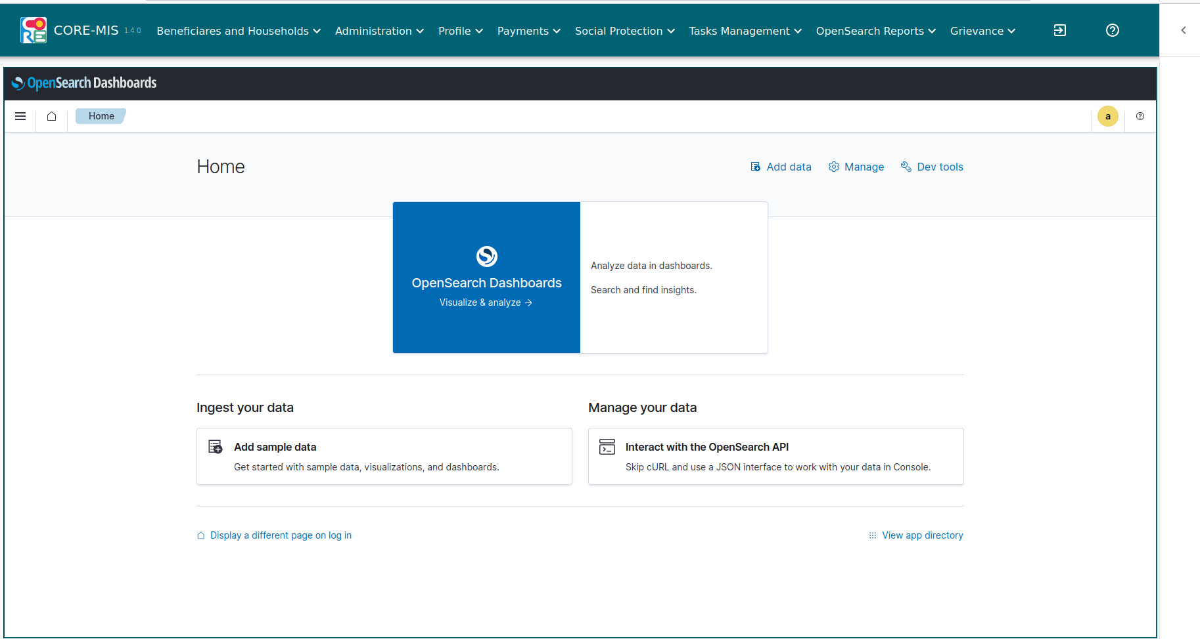
OpenSearch
Tools which allows to create different types of visualisations based on provided data sources.
https://opensearch.org/
https://github.com/opensearch-project
Used recent version of openSearch and openSearch dashboards
‹#›
06.07.23
openIMIS-coreMIS integration

Slide 36
OpenSearch
OpenSearch is in dockerized package optional like openFN
Package will consists of three services:
OpenSearch - exposed on 9200 port - serves as backend for this application
OpenSearch Dashboards - exposed on port 5601, serves as frontend for this application
Nginx on additional ipv4 network - proxy to handle OpenSearch Dashboards embedding and authorization on embedded mode. Proxy will be based on basic authorization.
‹#›
06.07.23
openIMIS-coreMIS integration

Slide 37
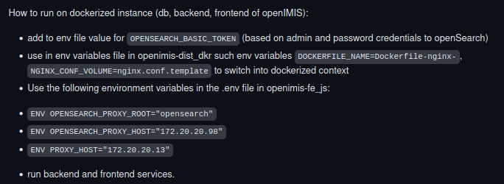
OpenSearch
https://github.com/openimis/openimis-dist_dkr/tree/feature/CM-153#opensearchopensearch-dashboards-setup - readme how to deploy locally and on dockerized openIMIS
‹#›
06.07.23
openIMIS-coreMIS integration

Slide 38
Test server and CD process
‹#›
06.07.23
openIMIS-coreMIS integration

Slide 39
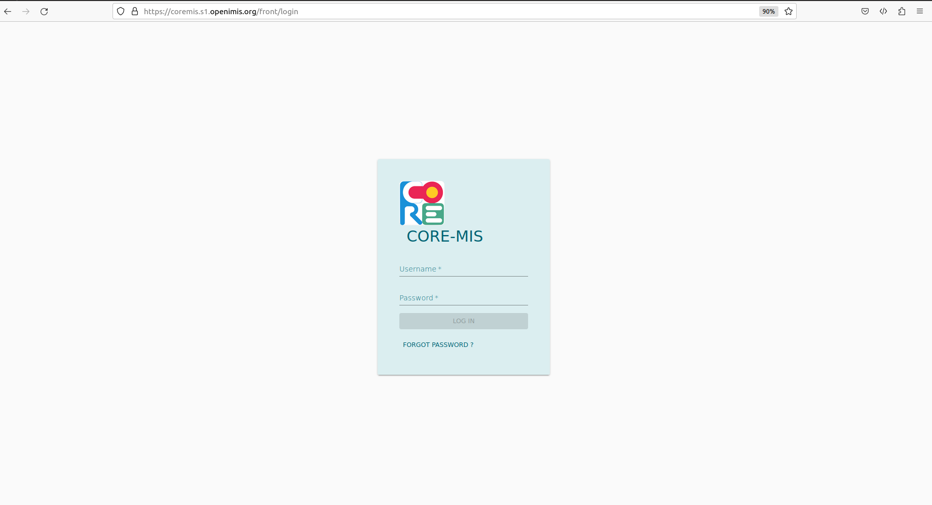
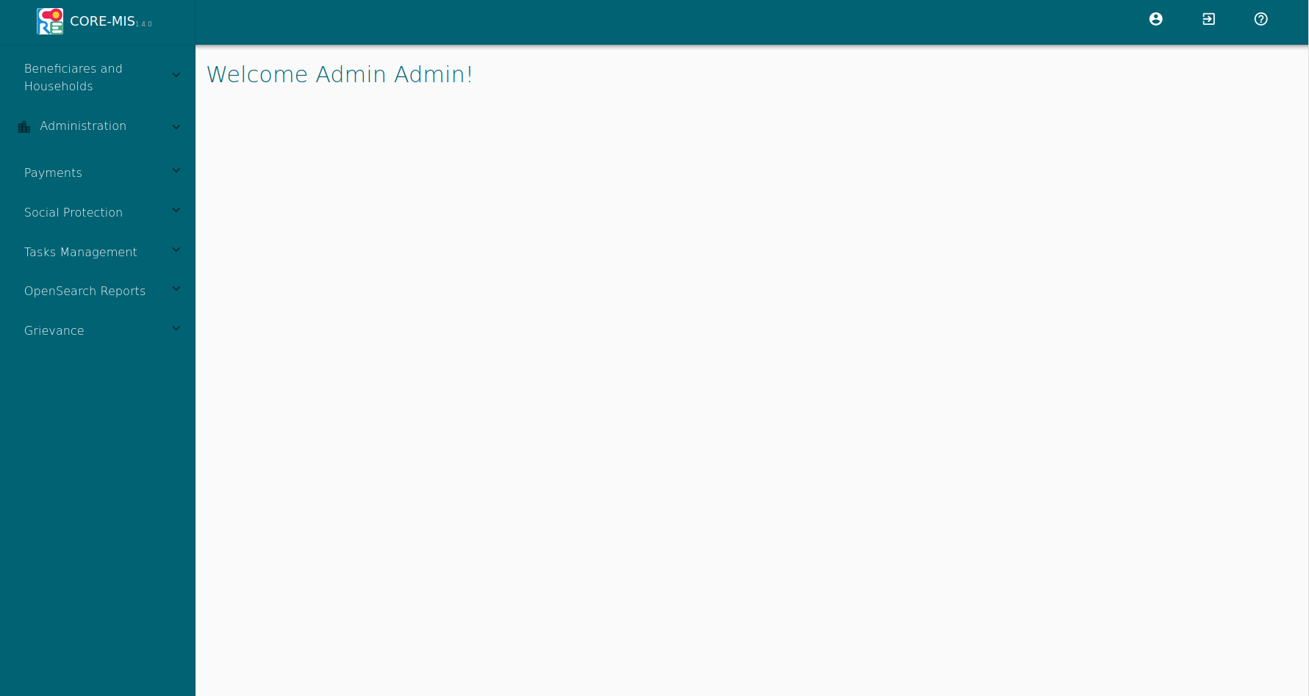
Test server
Login page
Main page
‹#›
06.07.23
openIMIS-coreMIS integration

Slide 40
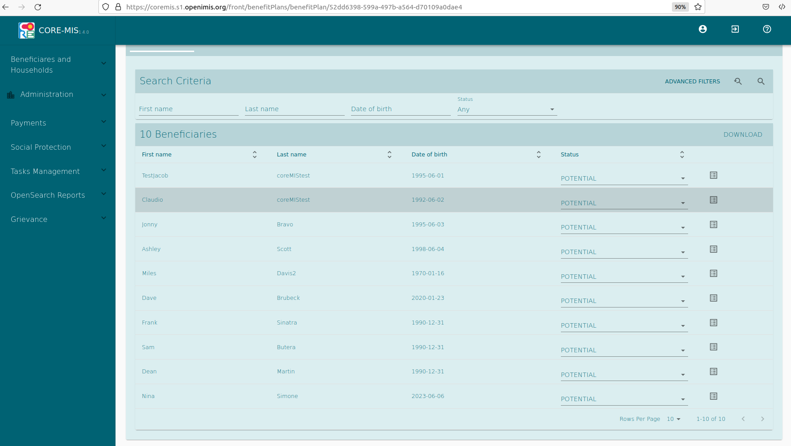
Test server CD
Server is built based on the context from:
https://github.com/openimis/openimis-be_py/tree/coreMIS
https://github.com/openimis/openimis-fe_js/tree/coreMIS
Changes are automatically deployed after merging changes from particular feature branch into develop, for example (based on github workflow):
https://github.com/openimis/openimis-be-individual_py/blob/develop/.github/workflows/core-mis-test-server-deploy.yml
https://github.com/openimis/openimis-fe-individual_js/blob/develop/.github/workflows/core-mis-test-server-deploy.yml
s
‹#›
06.07.23
openIMIS-coreMIS integration

Slide 41
CI/CD
Additionally we have for every coreMIS frontend module github workflow to check estlint
https://github.com/openimis/openimis-fe-social_protection_js/blob/develop/.github/workflows/eslint_check.yml
‹#›
06.07.23
openIMIS-coreMIS integration

Slide 42
Thank you
‹#›
06.07.23
openIMIS-coreMIS integration
Notes:
‹#›

