Slide 1
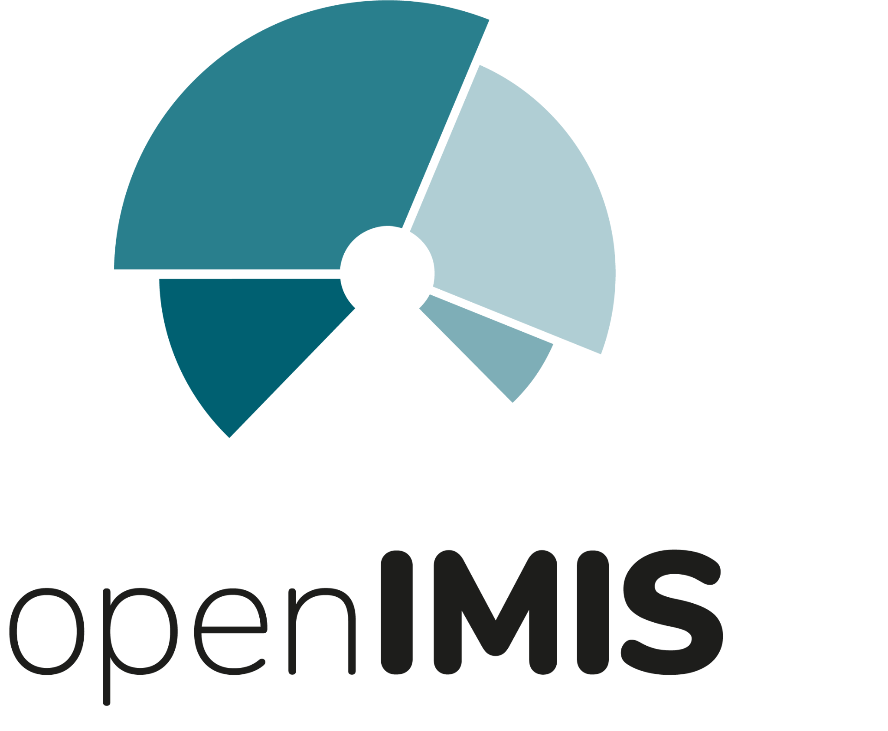
Regional Community of Practice

Slide 2
What is a community of practice?
A community of practice (CoP) is a group of people who share a common concern, a set of problems, or an interest in a topic and who come together to fulfill both individual and group goals.
Communities of practice often focus on sharing best practices and creating new knowledge to advance a domain of professional practice. Interaction on an ongoing basis is an important part of this.
Many communities of practice rely on face-to-face meetings as well as web-based collaborative environments to communicate, connect and conduct community activities.

Slide 3
Role of Regional Hubs:
The Regional Hubs are the second level support structure of the openIMIS Initiative building the link between the local and global community. The Regional Hubs should become regional knowledge and network platforms engaging countries and guiding them in their initial steps of getting to know the products and the community. Among their tasks are:
Promote openIMIS at regional and national events
Represent openIMIS to regional and country stakeholders
Build networks and feed them with information on openIMIS
Undertake country assessments regarding feasibility of implementing openIMIS
Onboard new implementing partners and technical teams

Slide 4
Conduct capacity development and master training to local user organizations and implementing partners
Collect requirements and channel them to the openIMIS Product Group
Assess country implementations during introduction of openIMIS to feed experience and material back to global level
Provide technical support regarding demo server set up, pilot system implementations, and scale up
Insert health financing information system as component into national eHealth strategies as well as ongoing discussions in the region
Contribute to the global level of the Initiative on country needs and feeding back regional discussions

Slide 5
Asian Community of Practice

Slide 6
Establishing an openIMIS Community of Practice
AeHIN hosts the openIMIS Community of Practice (CoP) in Asia
Brings together its members to understand the importance of digital health global public goods (DHGPGs) in general and openIMIS in particular
The members discuss and share knowledge on how DHGPGs and openIMIS can be leveraged to address their own local needs
Members contribute their learnings back to the CoP

Slide 7
None of us is as good as all of us

