Slide 1
KeHIA - openIMIS WORKSHOP
Thursday, 27 April 2023
Savannah Informatics
One Padmore Place
Dr. Stephen Mburu, PhD
Health Informatics, University of Nairobi

Slide 2
PROJECT 1
Integration of openIMIS and Nepal Insurance System (SOSYS) via openHIM
Python Mediators

Slide 3
Introduction
The new openIMIS platform is implemented using a modular architecture that supports seamless integration through Fast Health Interoperability Resources (FHIR) Standard.
FHIR is a Health Level 7 standard that defines how information can be exchanged between disparate systems.
In the first project, the goal was to integrate openIMIS with Nepal’s National Insurance System called SOSYS via openHIM (http://sosys.ssf.gov.np). Key developers were Dr. Stephen Mburu, Ms. Doreen Wamiti and Davis Mutuku under Healthix Solutions.
The aim of integrating openIMIS with Nepal’s SOSYS an equivalent of Kenya’s NHIF was to accelerate the achievement of UHC, USP and SDG 3.

Slide 4
Redeveloped openIMIS
The redeveloped OpenIMIS Backend is implemented in Django. Django is a high-level Python Web framework that encourages rapid development and clean, pragmatic design through:
  ORM Mapping, and help manage the MSSQL database schema via migrations
  Management of user and group Authentication and authorization features.
  To expose the API endpoints, a REST interface is built on top of the Django models via Django REST Framework.
We worked with Healthix, PATH, Nepal, Swiss TPH Institute and Bluesquare development teams to extend the scope of openIMIS by upgrading FHIR STU3 modules to R4 and creating new FHIR R4 API endpoints.

Slide 5
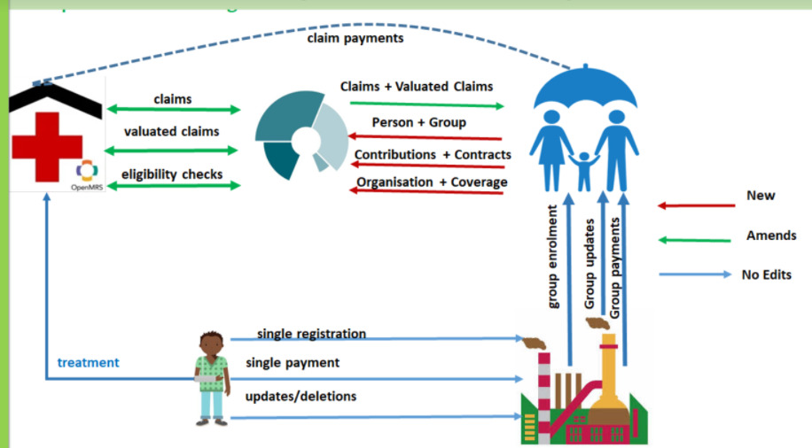
Introduction

Slide 6
OpenHIM Interoperability Layer
Open Health Information Mediator (OpenHIM) is an interoperability platform that supports integration of disparate systems by providing a central point where the exchange of data is managed.
OpenHIM receives transactions from different information systems and coordinates the interactions between them.
The interoperability layer provides a layer of abstraction between systems that allows for the transformation of incoming messages to a form supported by the target system.
OpenHIM is a current reference technology for the interoperability layer of the open Health Information Exchange (openHIE).

Slide 7
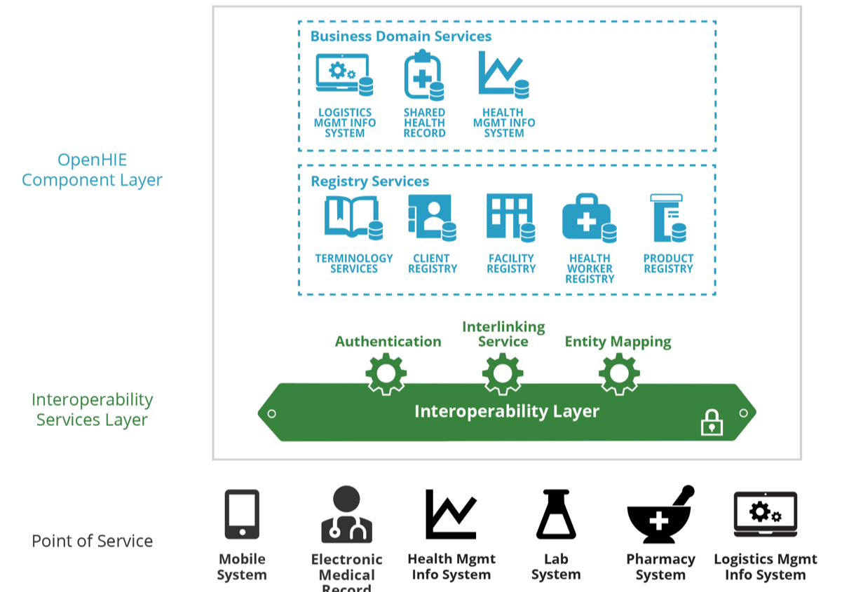
OpenHIE Architecture

Slide 8
Python Mediators
The main function performed by openHIM Core is to process transactions from client systems. Its functionality is enhanced by mediators
Mediators are loosely coupled services that add business logic to the transaction flow in openHIM
Integration between OpenIMIS and external systems involved developing openHIM mediators in Python that are mapped to OpenHIM core using Utils forked from https://github.com/de-laz/openhim-mediator-utils-py.
The mediators are first registered with openHIM core before they start the process of extracting data from the source, transforming (orchestration) and loading into the target system(s).

Slide 9
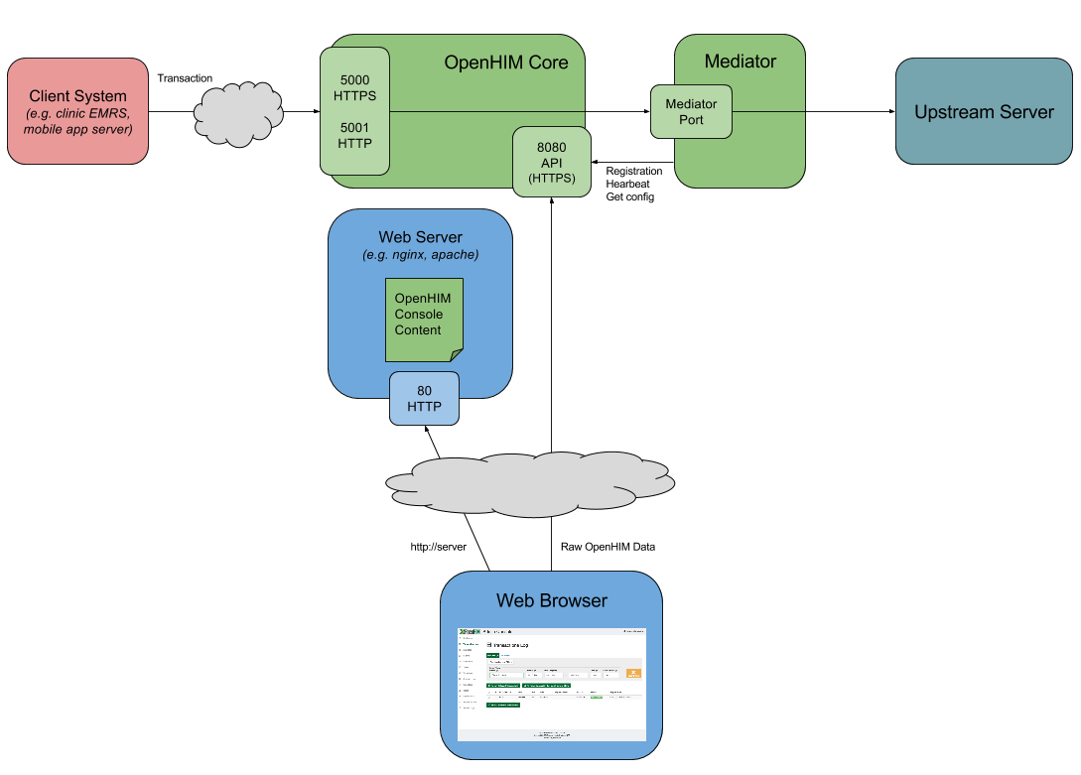
OpenHIM Workflow

Slide 10
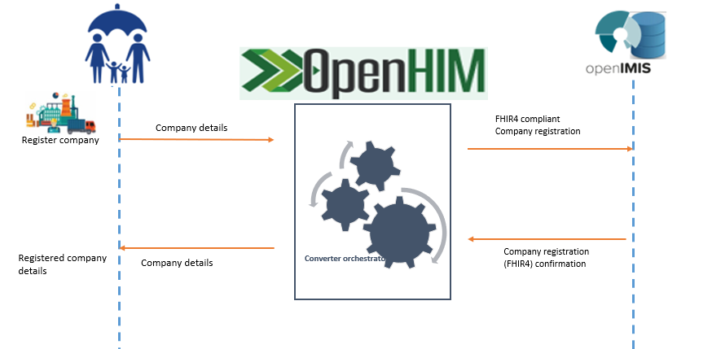
Python mediators

Slide 11
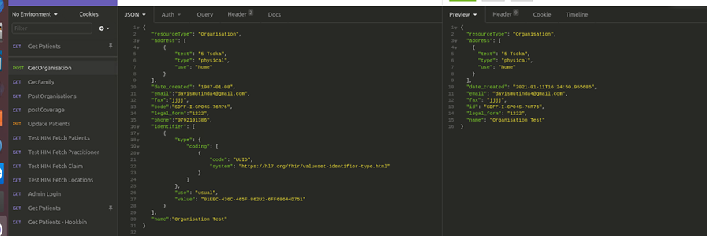
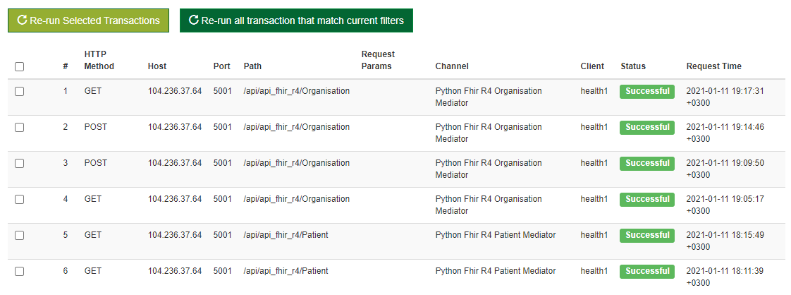
Testing Mediators

Slide 12
Project 2
Integrating openIMIS with MIFOS X via openHIM
Python Mediators

Slide 13
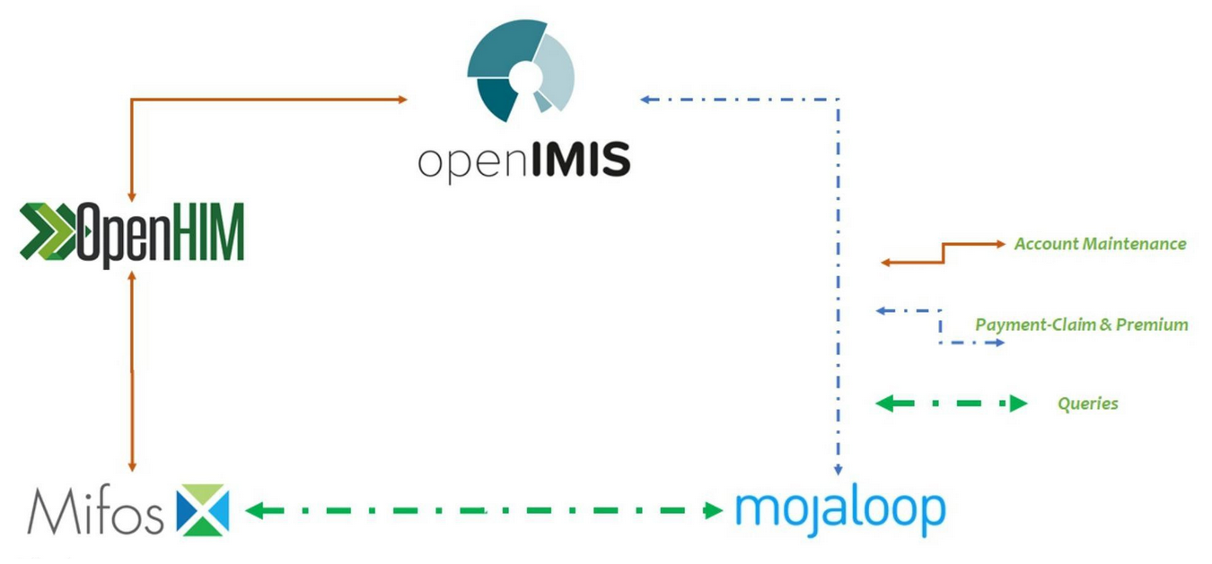
OpenIMIS to MiFos X
Modern Technology Computer Centre Ltd (MTCCL) worked on interoperability between openIMIS and Mifos X. Mifos is open source Payment platforms The key developers were Dr. Stephen Mburu and Ms. Doreen Wamiti.

Slide 14
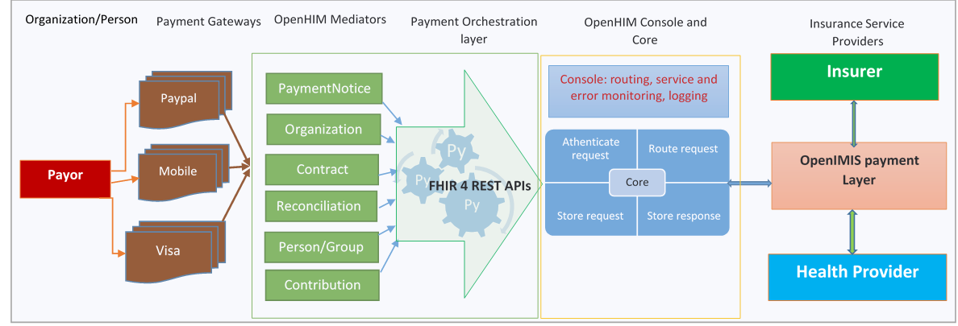
OpenIMIS Payment Layer
OpenHIM Payment Mediators Workflow

Slide 15
OpenIMIS to MiFos X
The openIMIS Payment Layer Integration solution implements client/server architecture. The openIMIS upstream server exchanges data through FHIR R4 APIs such as patient, claim, billing, invoice, organization with Mifos through Python mediators.

Slide 16
Integration with Payment Systems
Payment information from Mifos or MojaLoop is sent or received from openIMIS through orchestration mediators developed in Python.
The mediators receive payloads from the source system and transforms the received schema using define business rules.
The payment layer mediators are deployed using openHIM mediators we developed in Python and packaged them using Docker.
The mediators performed canonical transformation of openIMIS FHIR4 Resource into MIFOS Client JSON objects.

Slide 17
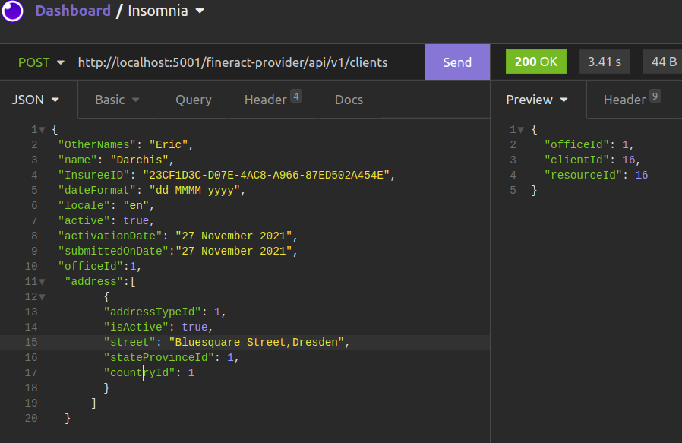
Python Mediators

Slide 18
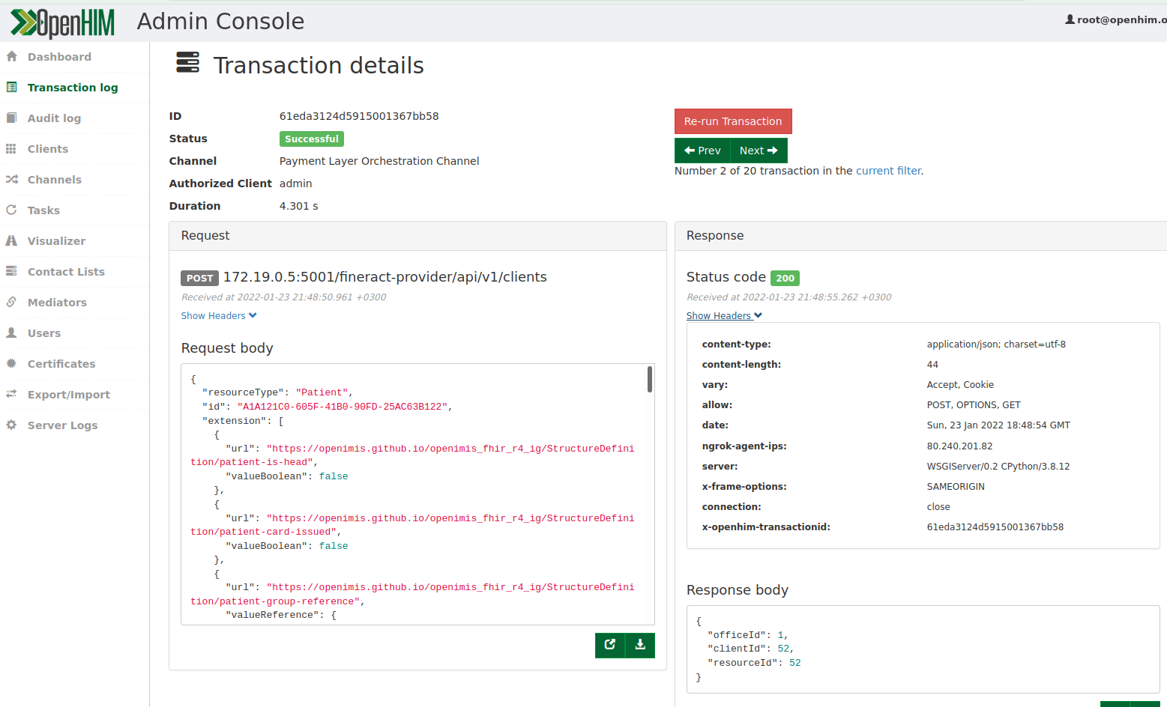
Python Mediators

Slide 19
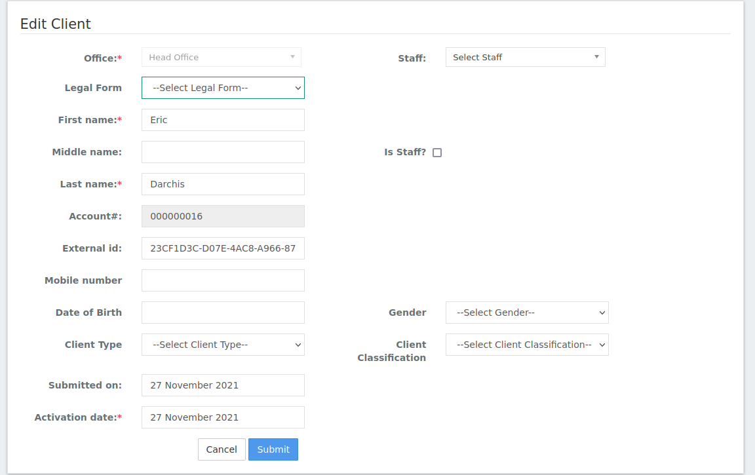
Mifos Integration

