Slide 1
A tool for managing business processes in
Health and Social Protection
27/04/2023

Slide 2
Health Information Systems and UHC
A well-functioning health information system is important in achieving UHC:
The building blocks under the WHO Health Systems Framework rely on timely and reliable information such as:
What is the covered population?
Are people getting the services they require?
How high are OOP expenditures?

Slide 3
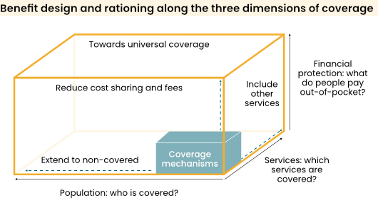
Universal Health Coverage – UHC Cube

Slide 4
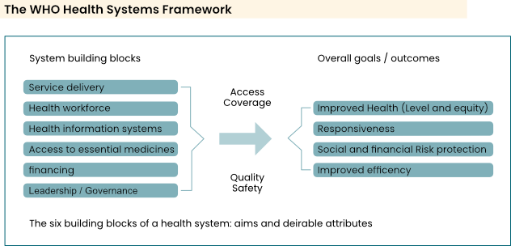
Health System Building Blocks

Slide 5
Health Insurance & Its Role Towards UHC
Advantages:
Additional funding for health
Better value for money (increasing efficiency/controlling cost)
Improving quality and targeting of healthcare (increased effectiveness)
Challenges:
Scarcity of money (revenue source)
Weak management capacity and infrastructures
Informal sector difficult to capture
Regional disparities
Weak regulation

Slide 6
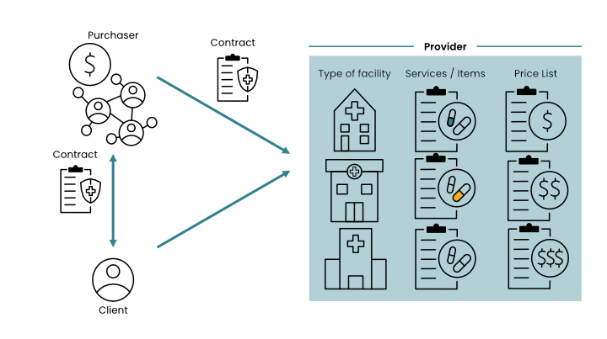
Health Insurance Systems

Slide 7
The success of health financing/social protection schemes depends on the highly efficient implementation of multiple, complex business processes.
Scheme operators in low- and middle-income countries struggle to achieve efficiencies in these schemes when they lack access to appropriate digital technologies.
  Build own IT system
  Buy commercial
  Use open source?

Slide 8
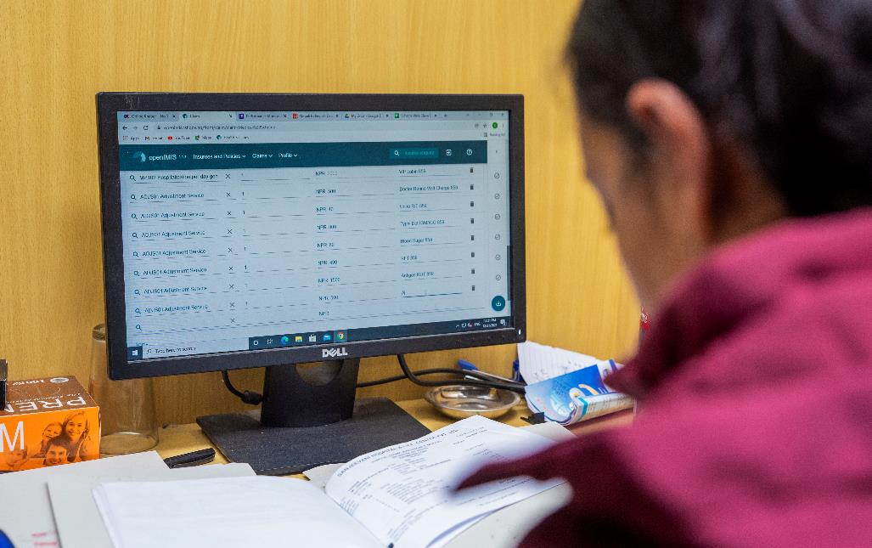
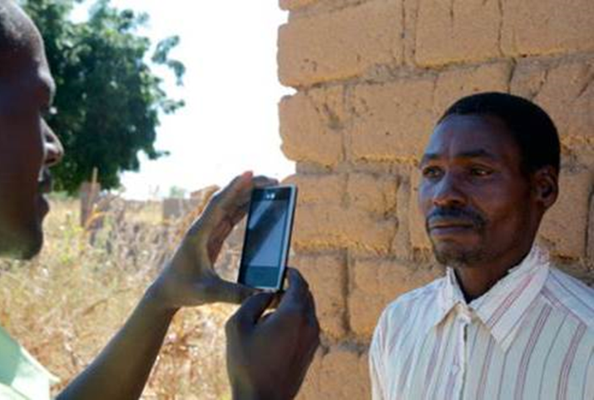
What is openIMIS?
openIMIS is an
open source software for managing social protection processes. It helps digitize the link between beneficiaries, providers, and payers of benefits.
It is supported by a
community of developers, users, and implementers
With the joint mission to
Increase and improve universal health coverage (UHC) and universal social protection (USP)

Slide 9
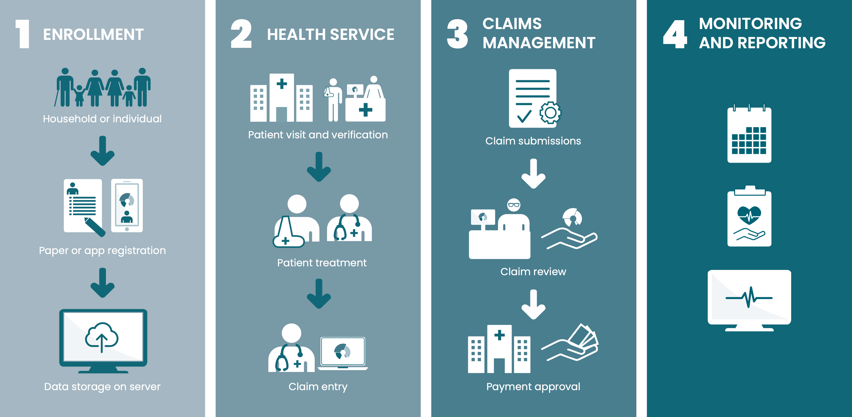
openIMIS Workflows
REIMBURSMENT
Submit service details
Review service details
Record service details
Calculate capitation, payment amount

Slide 10
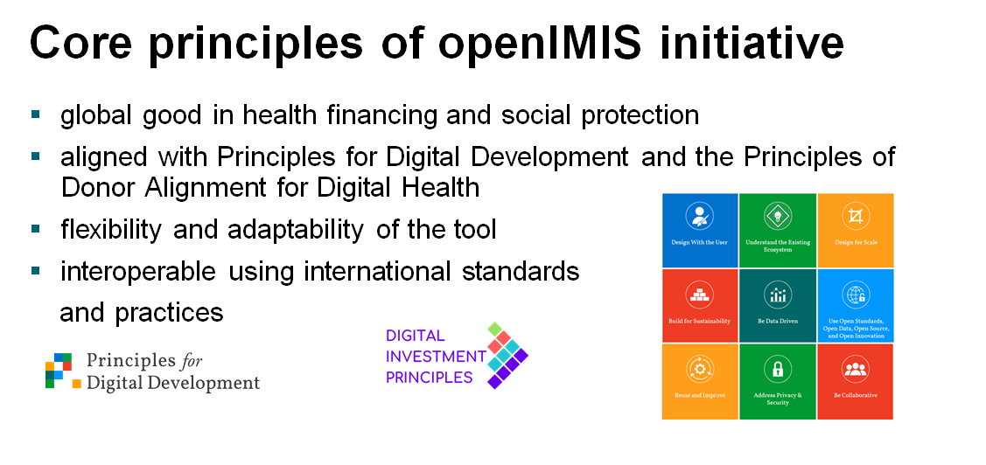
Notes:
Uwe will discuss the principles of di

Slide 11
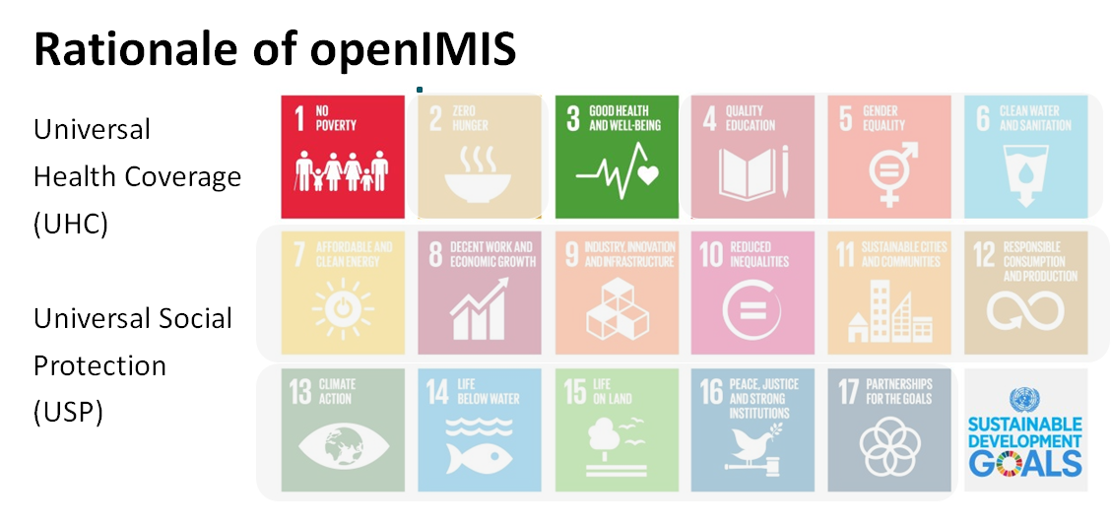

Slide 12
Licenses
Software: GNU Affero General Public License, Version 3.
Non-Software: Creative Commons
copy-left:
when publishing modified products …
… it must be under the same license

Slide 13
History & Timeline
Toumai (French-speaking) community;
Formal Sector support;
AI for claims;
Registered Digital Public Good
2021
openIMIS Master
Version
2017
Social Protection:
CORE-MIS Merger
with Worldbank
2023
Modular architecture transformation
Community building
2019
openIMIS Initiative
established by
Swiss & German
Development Cooperation
(SDC + BMZ)
2016
openIMIS Community established
2018
Cash Transfer &
Accident Insurance ;
Catalytic Implementation Fund
2020
100% OS stack
Payment layer
Stakeholder Committee established
2022
Evolution of product & initiative
Country implementations
2012
IMIS for
Tanzania Community Health Fund
2014
IMIS for Social Health Insurance in Nepal
2017
openIMIS in Tanzania, Cameroon, Nepal
2018
Pilots in DRC, Chad
2020
CashTransfer in The Gambia
2021
Mauritania, Niger, Zanzibar (Enable);
Employment Injury Insurance in Nepal
2022
CIF supported
scale-up in Cameroon; Employment Injury Insurance in Bangladesh
2023
Pilots in Burkina Faso, Nigeria (ILO)
2013
IMIS for Cameroon
Notes:
Cameroon user fee reimbursement for all HIV Testing and Treatment user fees
Cameroon Managing insurance schemes in various church dioces
DRC Community based insurance schemes
Gambia – Cash transfer program to protect poor households against the economic effects of covid related lockdown
Niger Health insurance scheme
Nepal Employee injury insurance, an accident and disability insurance scheme for workers in the formal sector
Mauritania – Voluntary health insurance scheme called the national health solidarity fund

Slide 14



Where is openIMIS Used?
9 countries
11 health + 2 social protection schemes
10+ Mio beneficiaries
Chad
Mauritania
Niger
Senegal
Sudan
The Gambia
Burkina Faso
Djibouti
Nigeria
Pakistan
Sierra Leone
Ethiopia
Nepal
Uganda
Cameroon
Kenya
Bangladesh
Rwanda
Myanmar
Tanzania
Laos
DR Congo
Malawi
Ongoing Implementations
Interest expressed

Slide 15
Examples of Use Cases
Country | Type of scheme | People covered
Tanzania Zanzibar | iCHF community based health insurance Scheme for UHC | 3,09 Mio 600,000
Cameroon | BEPHA community based micro health insurance | 66,878
 | HIV fee elimination scheme | 148,000
Nepal | HIB Voluntary Social Health Insurance scheme | 5,9 Mio
 | SSF Mandatory health & accident injury insurance scheme for formal sector employees | 200,000
DR Congo | Réseau des mutuelles de Santé Communautaires (REMUSACO) | 21,000
Chad | Community based health insurance scheme | 9,616
The Gambia | Nafa quick cash transfer scheme as a quick response to COVID-19 crisis | 500,000

Slide 16
Supported Social Protection Schemes
Insurance
  National Health Insurance (Formal/Informal)
  Community-Based Health Insurance
  Accident Insurance
Social Assistance
  Cash Transfers
  Voucher Schemes

Slide 17
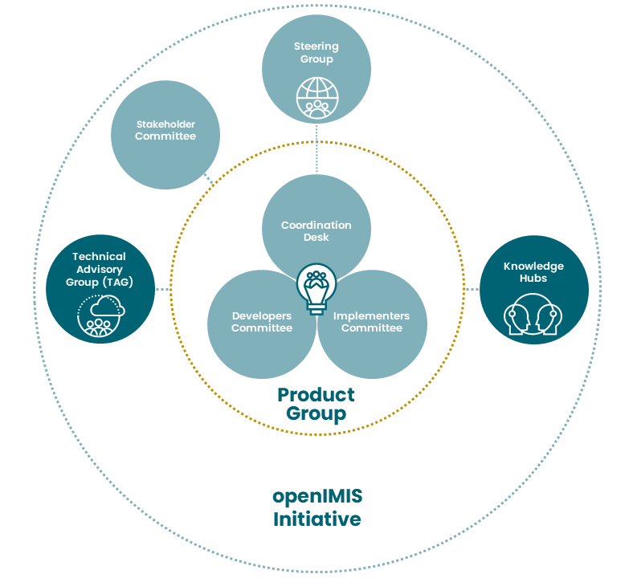
Governance Structure

Slide 18
Coordination Desk
Hosted at GIZ’s Global Initiative Social Protection Innovation and Learning
Coordinate the implementers’ and developers’ committees
Maintain wiki, and other collaboration tools
Manage new software development
Promote the use and further development of openIMIS
Implementation support
  Feasibility
  Requirements definition
  Support to implementation via Implementation Fund
Capacity development
  Through regional hubs in Asia and Africa
  Structured trainings + ad-hoc support

Slide 19
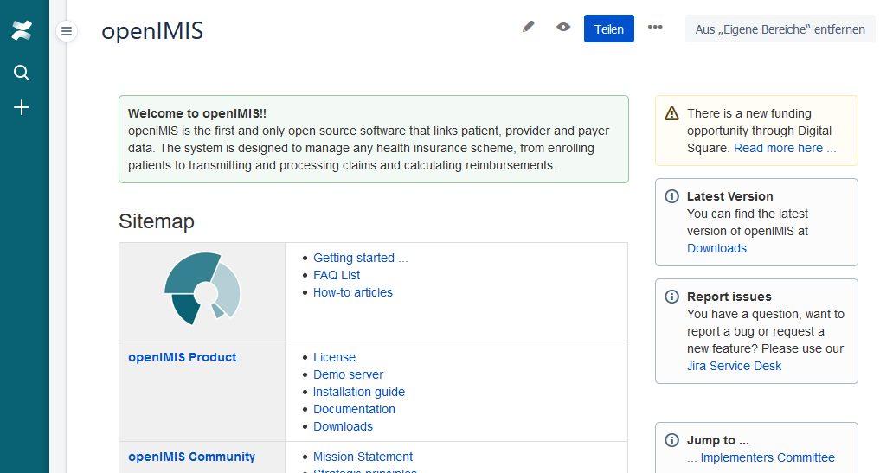
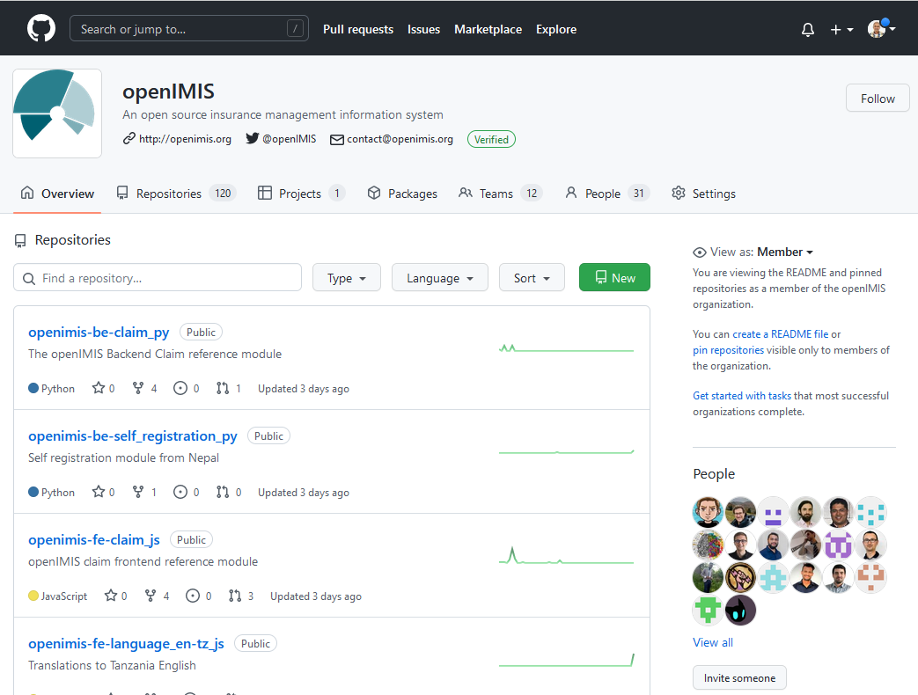
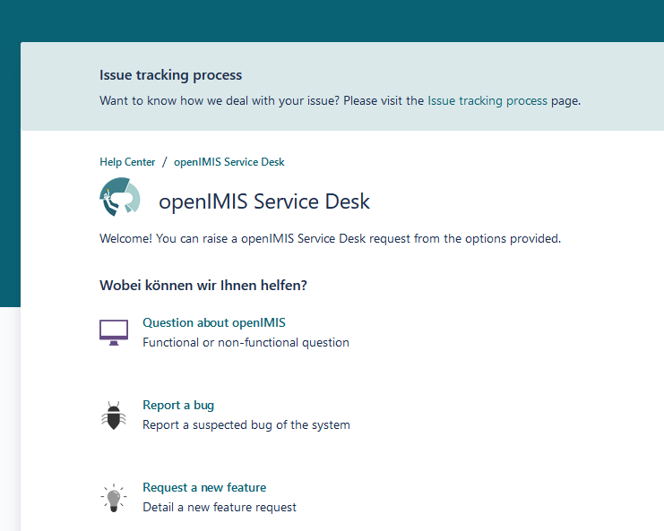
Community Tools
Homepage
Wiki
Forum
Document Share
Chatgroup
Service Desk
Issue Tracker
Code repository
Internationalization
Demo Server
Documentation

Slide 20

Thank you!

