Slide 1
openIMIS as a Global Good
a.k.a. Digital Public Good (DPG)

Slide 2
Content
Global Goods in Health
Business Cases for Global Goods

Slide 3
Digital Public Goods (DPG) in Health
aka Global Goods

Slide 4
Software in Global Health over Time
"We can co-create!"
"We can free the code!"
~ 2015
Ebola
"We can re-use software!"
~ 2005
"We can use computers!"
Global Goods
~ 1995
DPGs
Open Source
AIDS
Public Domain
~ 1985
Computer Graveyards
Pilotitis
APPendicitis

Slide 5
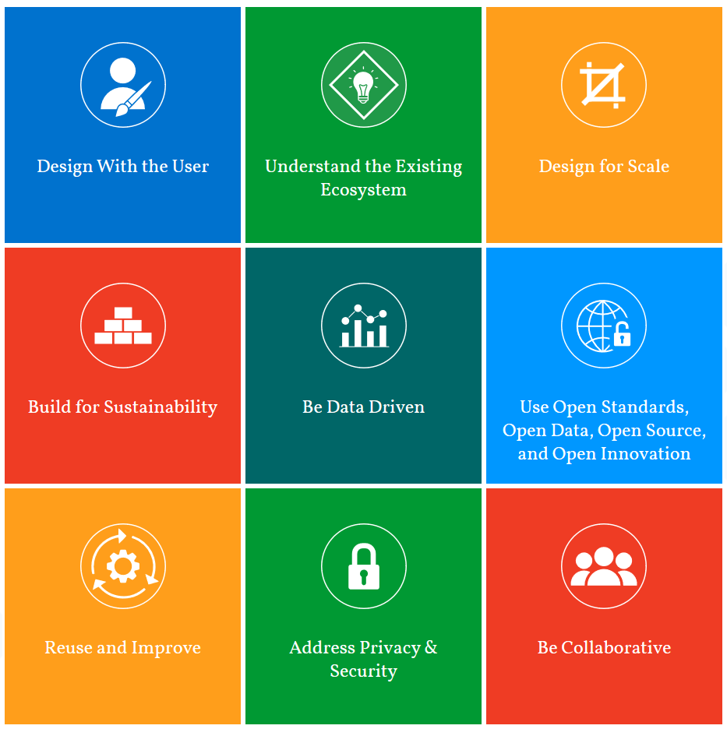
Digital Development Principles
Design with the user
Understand the existing eco-system
Design for scale
Build for sustainability
Be data driven
Use open standards, open data, open source and open innovation
Reuse and improve
Address privacy and security
Be collaborative
Evaluation: Maturity Matrix

Slide 6
Global Goods by WHO Classification of Digital Health Interventions
WHO Classification of Digital Health Interventions |  | Global Good
B | Civil Registration and Vital Statistics | OpenCRVS
E | Clinical Terminology and Classifications | Open Concept Lab
F | Community Based Information System | ComCare Community Health Toolkit
G | Data Interchange, Interoperability and Accessibility | OpenHIM
H | Electronic Medical Records | OpenMRS BAHMNI OpenSRP
M | Health Finance and Insurance Information System | openIMIS
N | Health Management Information System | DHIS2

Slide 7
Examples of Global Goods by WHO Classification (cont.)
WHO Classification of Digital Health Interventions |  | Global Good
O | Human Resource | iHRIS
Q | Knowledge Management | Digital Health Atlas
R | Laboratory Diagnostics | Child Growth Monitor OpenLabConnect
T | Logistics | OpenLMIS
V | Public Health and Disease Surveillance | Sormas Reveal
X | Shared Health Record and Health Information Repository | HEARTH
New version coming up!
New version coming up!
Find more in the Global Good Guidebook …

Slide 8
Maturity of Global Goods
Sustainability
Community Support
Developer, Contributor and Implementer Community Engagement Community Governance Software Roadmap User Documentation Multi-Lingual Support
Global Utility
Country Utilization Country Strategy Digital Health Interventions Source Code Accessibility Funding and Revenue
Software Maturity
Technical Documentation Software Productization Interoperability and Data Accessibility Security Scalability
Global Good Maturity

Slide 9
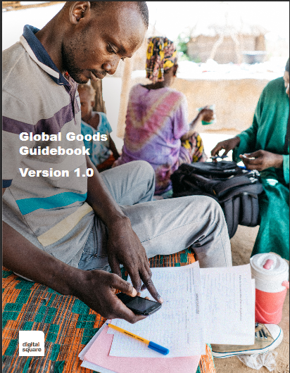
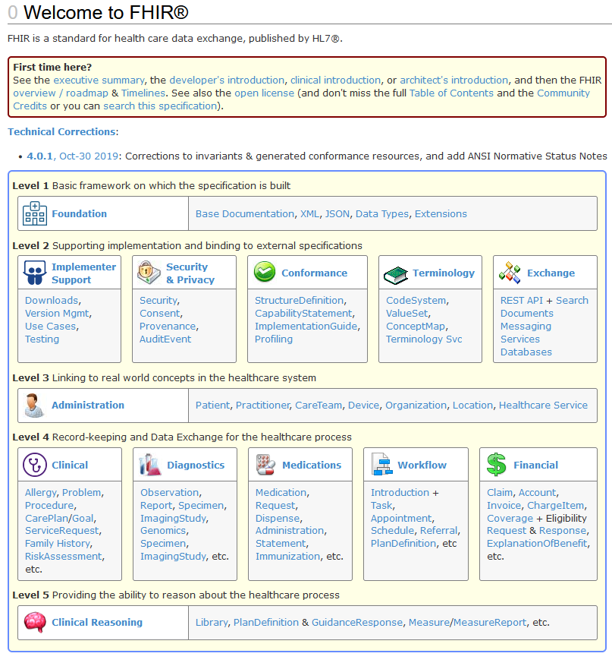
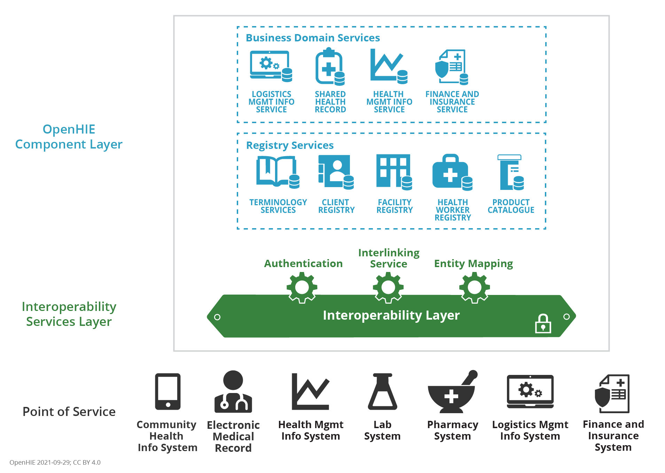
Some of our early Networks in Health
Digital Square
Joint Learning Network
OpenHIE
HL7-FHIR
Global Good Development
Requirements Specifications
Architecture
Data Standards
New version coming up!
New:
FIS Workflows
Approaching IHE
openIMIS FHIR Profile
Co-creative Funding Platform

Slide 10
Some of our early Networks in Health
Digital Square
Joint Learning Network
OpenHIE
HL7-FHIR
Global Good Development
Requirements Specifications
Architecture
Data Standards

Slide 11
Standardisation Initiatives
Health
OpenHIE (health information exchange in )
IHE International (proposal for health financing profile)
Cross-sectoral
GovStack Initiative:
architecture blueprint for digital government services
Sector specific
Social Protection: Convergence Initiative
Payments: OpenG2P
Agriculture …
Solution Registries
WHO:
Digital Health Atlas
Digital Square:
Global Goods Guidebook
Digital Impact Alliance (DIAL):
Catalogue of Digital Solutions
Digital Public Good Alliance:
DPG registry
UNDP:
Digital X Solution Catalogue
Inter-American Development Bank:
Toolbox
Disclaimer: the list is based on our (openIMIS) recent networking activities. It’s most likely not complete …

Slide 12
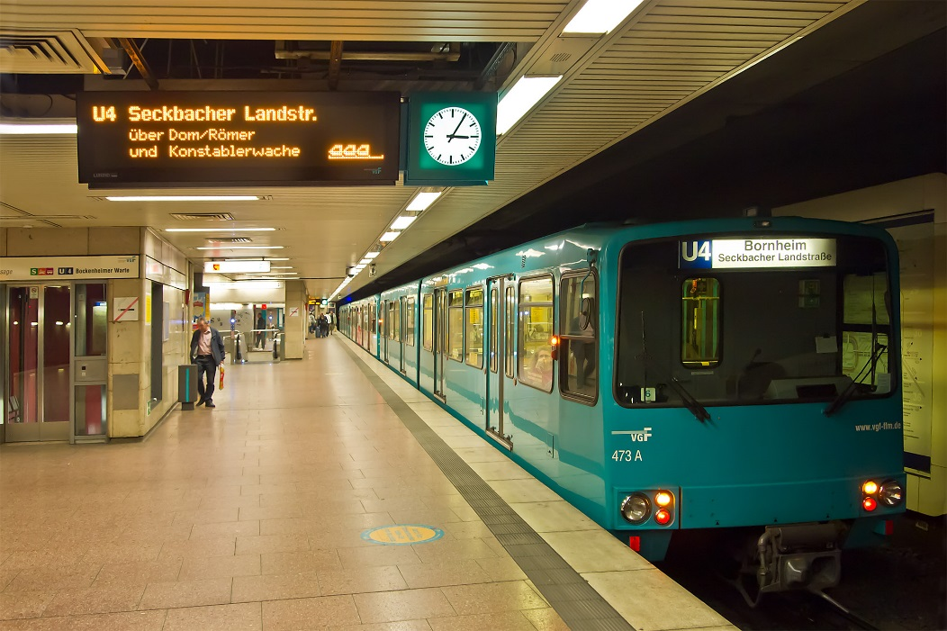
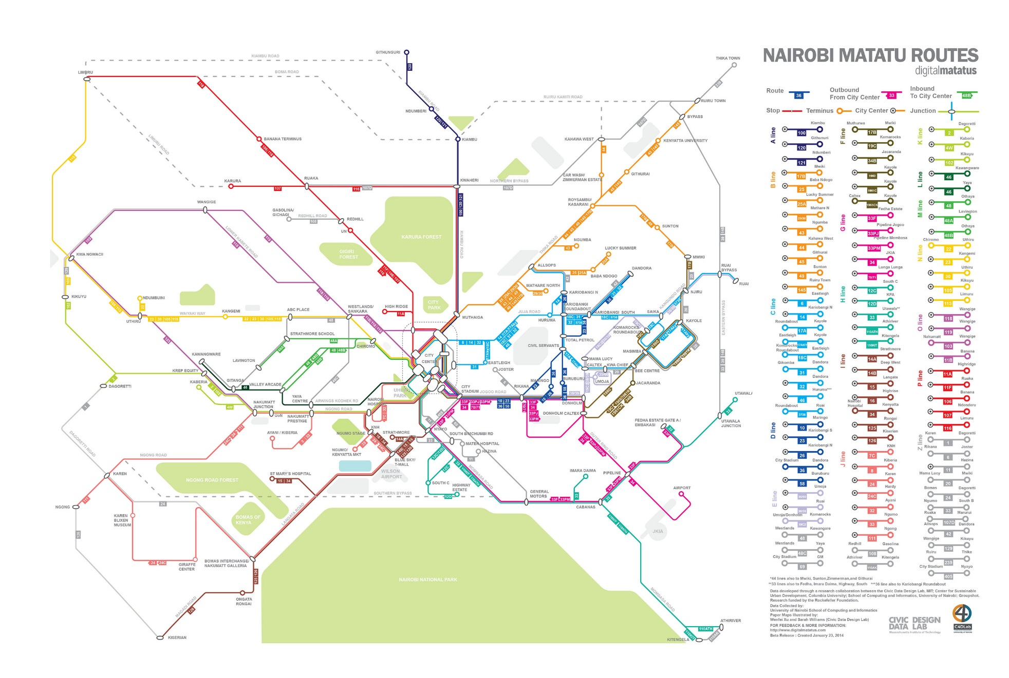
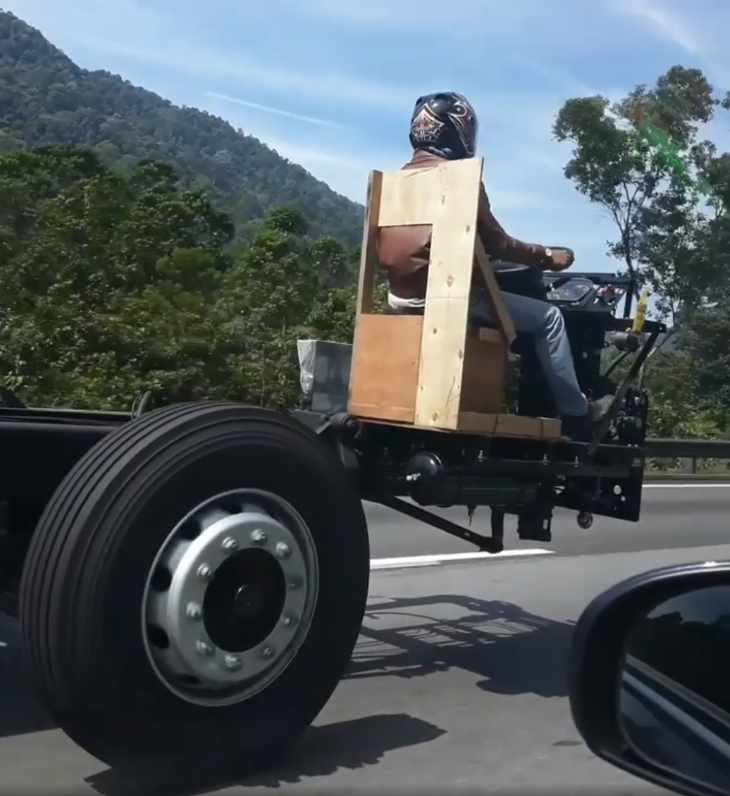
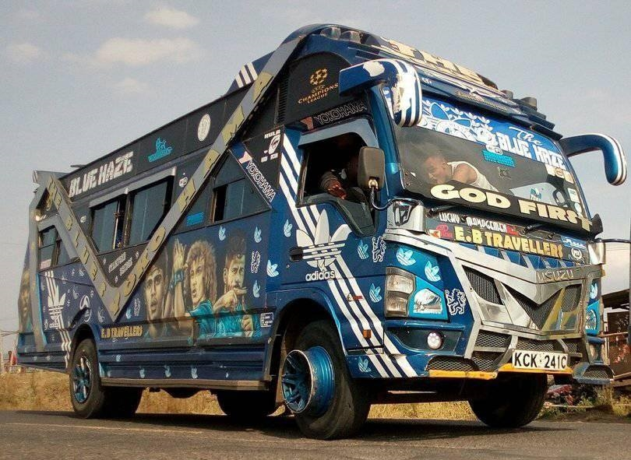
Modular Strategies vs. “If you had built a metro system 50 years ago …”
Images: Wikipedia; University of Nairobi, Facebook

Slide 13
Implementing openIMIS – a Business Case

Slide 14
Adapted Value Chain for Digital Global Goods
Community Management
Fundraising
Support Processes
Margin
Capacity Building & Service
Networking, Advocacy & Public Relations
Technical Platforms
Development
Implementation
Operation
Impact
Core Processes
So, where is the margin coming from, then?

Slide 15
Different Roles in the Community
 | Developer | Implementer | User
Organization
Business Domain
Sector
Type of Application
Universal
Country IMIS
OpenIMIS
DHIS2
Python
JS
SQL
Open up business opportunities in countries through DPGs
Identify sustainable business models for the global community

Slide 16
Example: Nepal
Funding Support
TA + Fin. Support
Community Support
SDC
BMZ
Gov. of Nepal
Operations, scaling
Training
Health Insurance Board Nepal
New Functionality
Capacity Development
Funds for
Nepal
GIZ Bilateral Programme NEPAL
Global Product
GIZ Global Program - openIMIS Initiative Coordination Desk
Community Support
Knowledge exchange
Funds for openIMIS

Slide 17
Example: Niger
Funding Support
TA + Fin. Support
Community Support
SDC
BMZ
Gov. of Belgium
State Health Insurance
Implementation partner
Customization, CapDev, deployment
ENABEL Bilateral Programme Niger
Global Product
GIZ Global Program
- openIMIS Initiative Coordination Desk
Community Support
Knowledge exchange
Funds for openIMIS

Slide 18
Example: The Gambia
Funding Support
TA + Fin. Support
Community Support
SDC
BMZ
World Bank
National Health Insurance Scheme
Implementation partner
Customization, CapDev, deployment
Loan/Grant
Ministry of Health The Gambia
Global Product
GIZ Global Program -
openIMIS Initiative Coordination Desk
Community Support
Knowledge exchange
Funds for openIMIS

Slide 19
Supporters to implementation
openIMIS Initiative Coordination Desk

Slide 20
Thank you!

Slide 21
Colour scheme
0
0
0
255
255
255
79
75
76
169
167
168
Dark 1
Light 1
Dark 2
Light 2
0
99
116
128
176
185
244
174
43
200
15
15
248
233
70
164
160
208
Accent 1
Accent 2
Accent 3
Accent 4
Accent 5
Accent 6

