Slide 1
The openIMIS Initiative
Recent Developments in the openIMIS Ecosystem

Slide 2
Maturity of Global Goods
Sustainability
Community Support
Developer, Contributor and Implementer Community Engagement Community Governance Software Roadmap User Documentation Multi-Lingual Support
Global Utility
Country Utilization Country Strategy Digital Health Interventions Source Code Accessibility Funding and Revenue
Software Maturity
Technical Documentation Software Productization Interoperability and Data Accessibility Security Scalability
Global Good Maturity

Slide 3
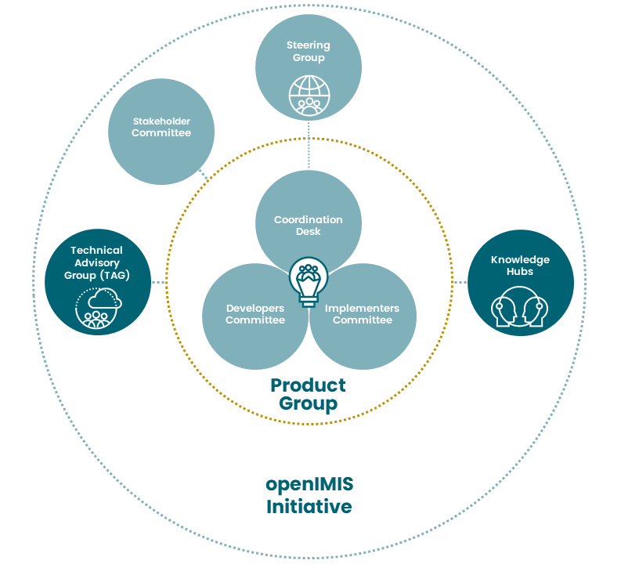

Governance Structure

Slide 4
Building Software Together

Slide 5
Roadmap
FOSS
Framework
openIMIS
MS IMIS
Claiming, Locations, Enrolment, Policy, Contributions
Users, Items, Services, Pricelists
Database
openHIE Integration (FHIR), Indicator Dashboard
Claims Adjudication - AI
Formal Sector, Accident Insurance
current
Payment Layer
Releases:
April 2019
Oct. 2019
April 2020
Oct. 2020
April 2021
Oct. 2021
April 2022
Oct. 2022
next: Social Protection

Slide 6
New: Full Open Source Stack
before
after
MS Server
Linux
RIP
MS ASP
React JS
RIP
MS VB .NET
Python (Django)
GraphQL
MS SQL Server
PostgreSQL
Docker Packages

Slide 7
openIMIS Modules & Functionalities
Beneficiary Management
Contract Management
Product Management
Premium Management
Provider Management
Claim Management
Accounting
insuree/family
contract
product
contributions
medical pricelist
claim
invoice
insuree batch
policy
medical
payer
health facility
claim batch
payment
policy holder
contribution plan
policy notification
claim AI
Technical Administration
authentication
user & roles
GEO location
Interoperability
FHIR 3
FHIR 4
ETL (DHIS2)
+ mobile apps
Customization
language packs
calculations
Core
reports
AI services
tools, home, …

Slide 8
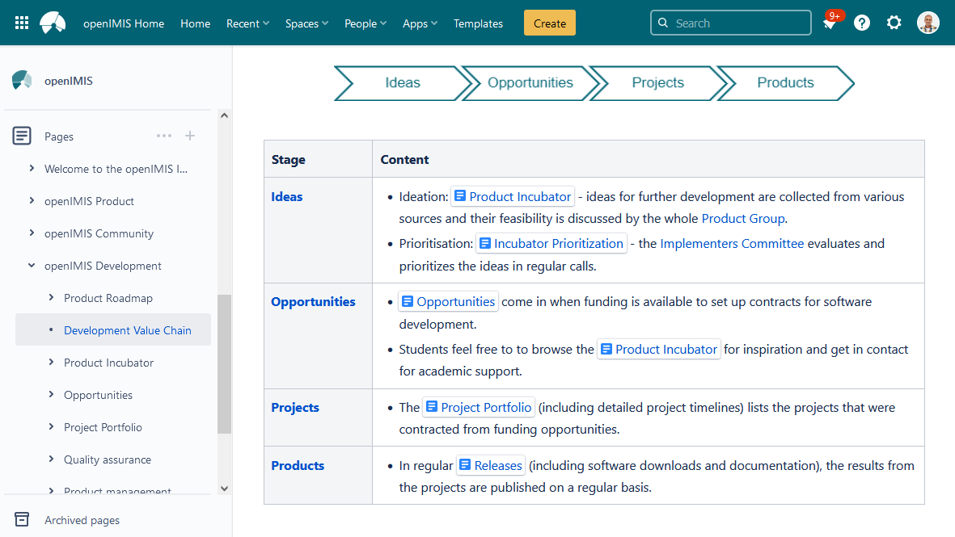
Value Chain
Open & Public
https://openimis.atlassian.net/wiki/spaces/OP/pages/3407904769/Development+Value+Chain

Slide 9
Developers Committee (2022)
SwissTPH
Exact
Possible H
PCS
GIZ S2HS (NP)
GIZ (DE)
funded
BlueSquare
unfunded
SolDevelo
HISP (IN)
Healthix
2M Corp
MTCC
SecurityOne
2012
2013
2014
2015
2016
2017
2018
2019
2020
2021
2022

Slide 10
Additional Developers & Implementers
From countries implementing or piloting openIMIS
  E.g. Nepal, Tanzania, Djibouti, Gambia, Zanzibar, Cameron, Ethiopia
Student projects
  Database migration to PostgreSQL
  Upgrade FHIR STU3 to FHIR R4
  Mars Software Lab
  AEHIN DRG Data-Thon
  Google Summer of Code (next year ;-) )
New Tenders
  Open tenders, Payment Layer Project

Slide 11
Co-Ordination: Calls and Events
Weekly calls (Thursdays)
  Daily business, troubleshooting
  Minutes
Gumzo ya mwezi = Monthly calls (1st Monday every month)
  Project progress
  Minutes
Ad-Hoc calls & Developer Deep Dives
Events
Open & Public

Slide 12
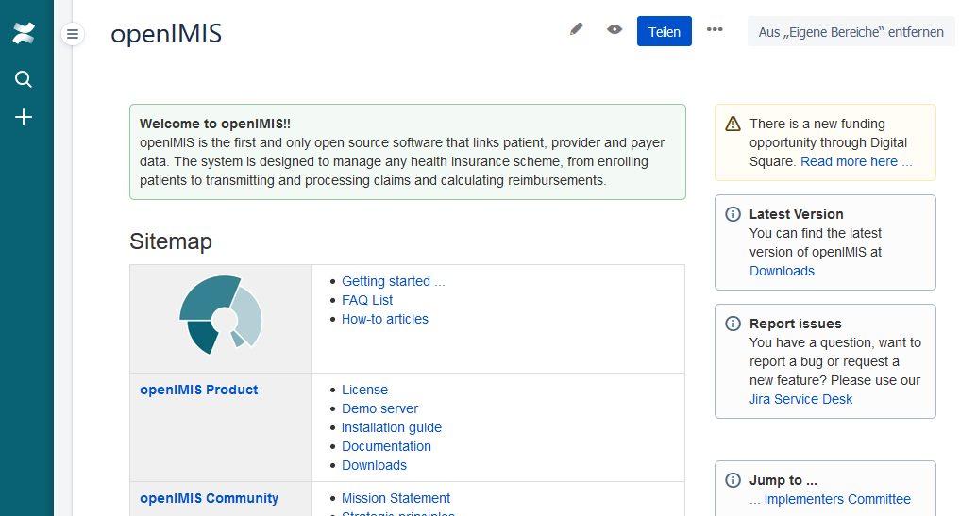
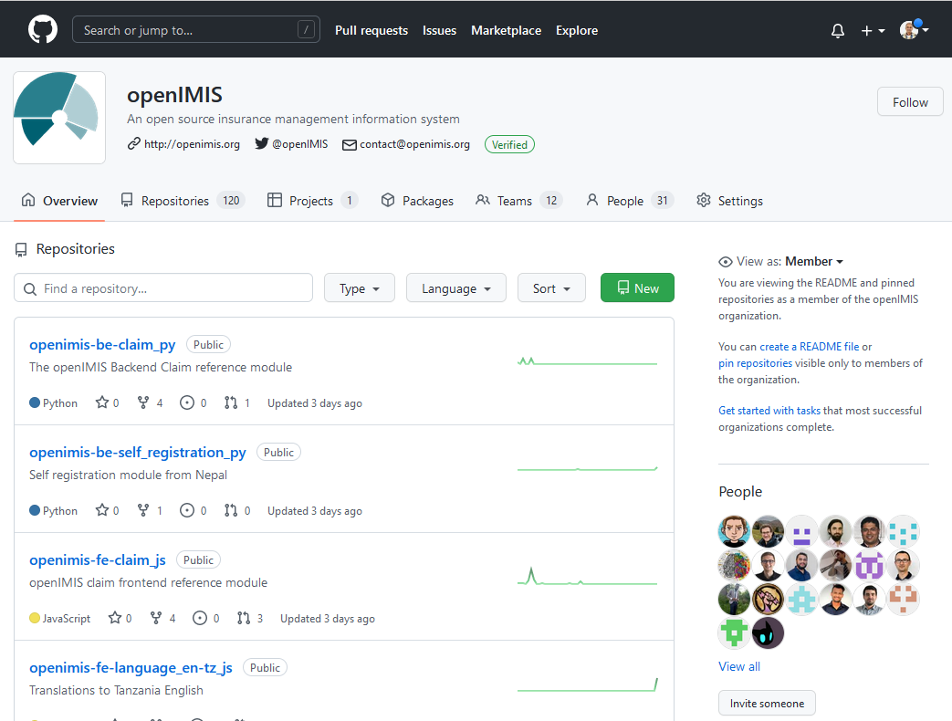
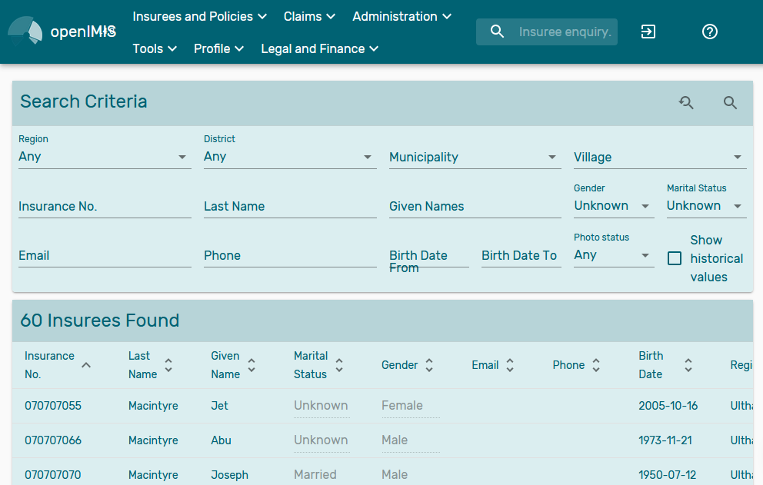
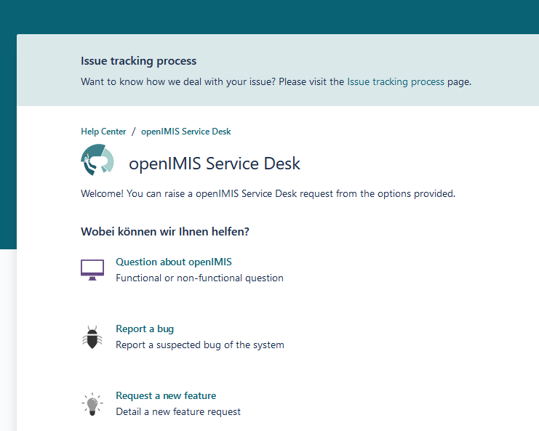
Community Tools
Open & Public
Homepage
Wiki
Forum
Document Share
Chatgroup
Service Desk
Issue Tracker
Code repository
Internationalization
Demo Server
Documentation

Slide 13
Interoperability
Connecting the Pieces

Slide 14






openIMIS Interoperability Standards
OpenHIE
(Health)
Convergence Initiative
(Social Protection)
openIMIS
OpenG2P
(Payment Layer)
GovStack
(Whole-of-Government)
existing standard
emerging standard

Slide 15
openIMIS Interoperability Options
Sormas
OpenHIE / FHIR
Convergence Initiative
DHIS2
openIMIS
BAHMNI
GovStack
OpenHIM
Odoo
openG2P
MIFOS
openCRVS
OpenELIS
Mosip
OpenMRS
OpenMRS
MojaLoop
native code
in production
existing standard
production ready
emerging standard
proof of concept
potential candidate

Slide 16







Payment Lab: Tooling Overview
Scheme
Provider
Mobile Network
Provider
Payment
Layer DPG
Banks
Accounting DPG
Government
openIMIS

Slide 17
What’s Next?

Slide 18




Building the Sectors’ Leading Software Coalition with the WB
DPG to manage social protection schemes
Insurance (non-/contributory)
Salary compensation
Voucher schemes
Cash transfer
Core MIS
Cash transfer
Targeting / PMT
‘Cash Plus’
  Public Works
  Training

Slide 19
Background
CORE-MIS: social protection management software from the WorldBank:
(https://core-mis.org/)
Joint feasibility workshop in September 2022
Agreement to join forces signed last year
Aim: migrate CORE-MIS functionality to openIMIS
Distribution: not yet specified

Slide 20
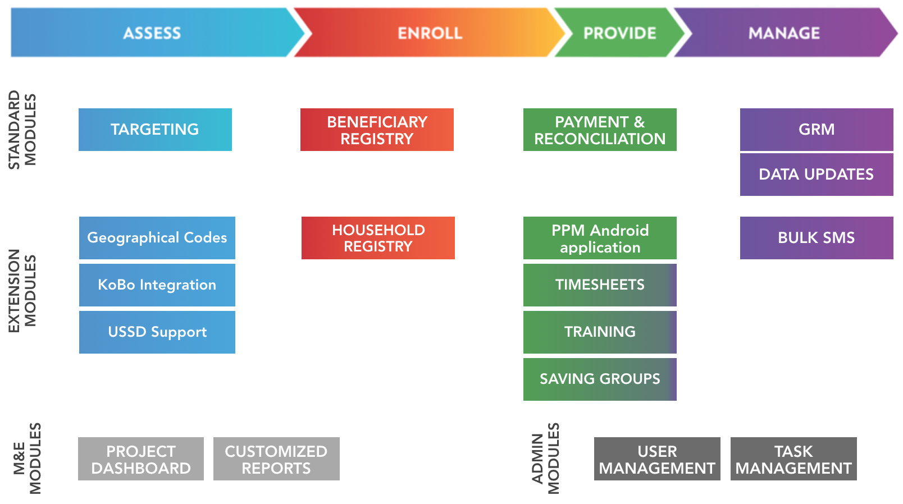
Several modules are already available and more are being developed

Slide 21
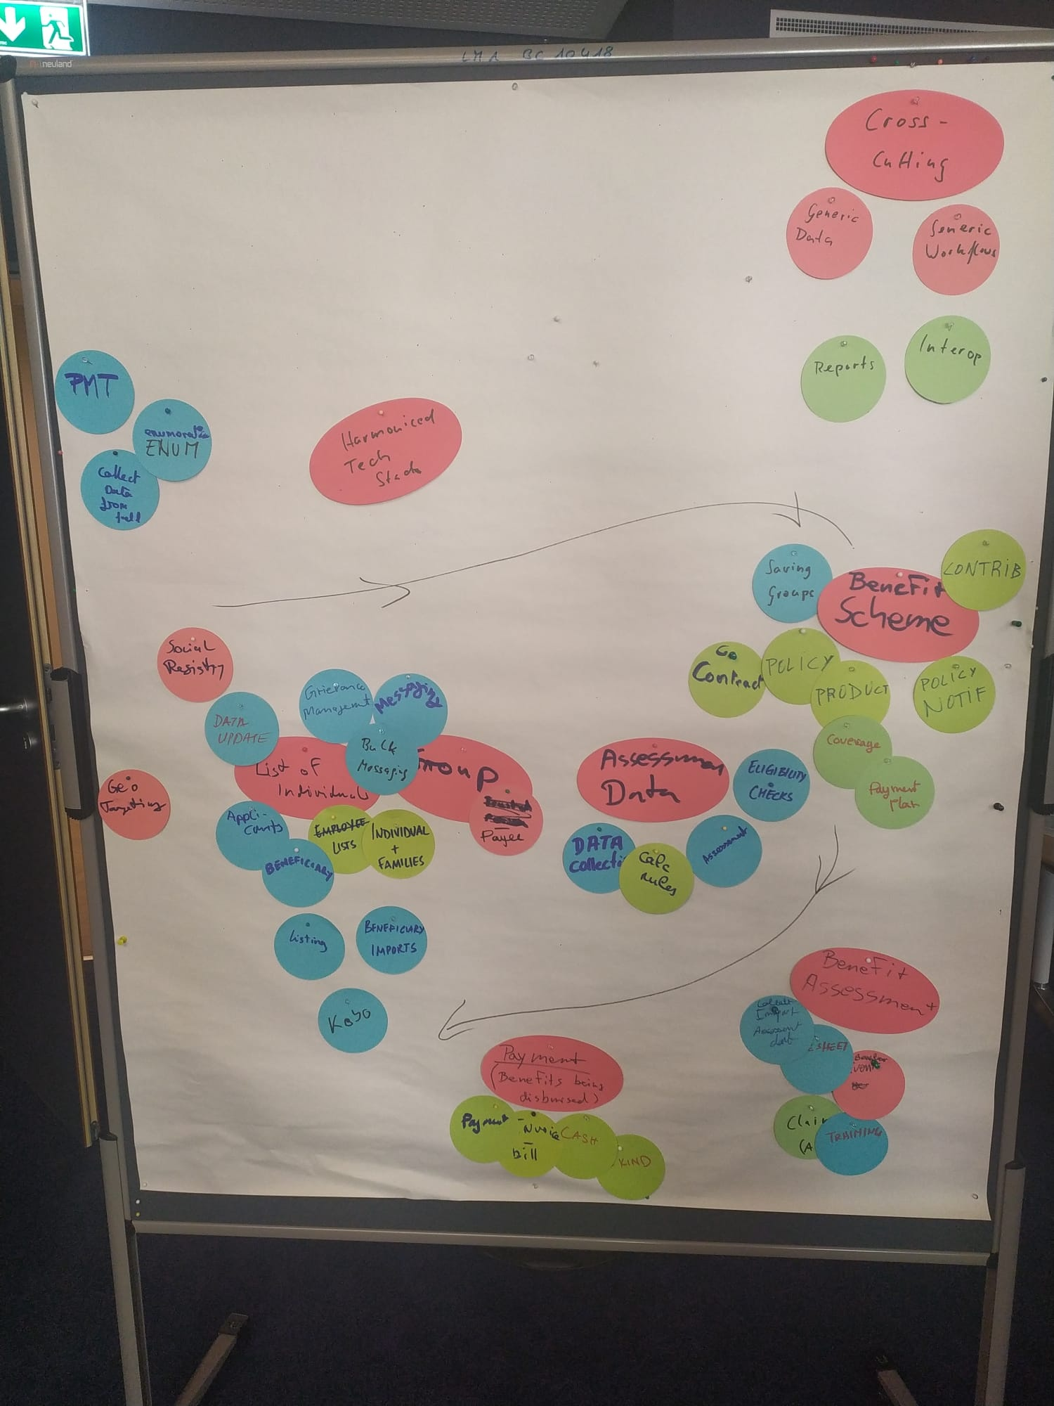
Objects to Migrate
(don’t nail me down on this)
Benefit Schemes
Individuals
Targeting
Groups
Assessment Data
Benefit Assessment
Payment / Benefit
Data
CORE-MIS features
openIMIS features

Slide 22






Migration of Features
future ?
now
intermediary

Slide 23

Thank you!

Slide 24
Colour scheme
0
0
0
255
255
255
79
75
76
169
167
168
Dark 1
Light 1
Dark 2
Light 2
0
99
116
128
176
185
244
174
43
200
15
15
248
233
70
164
160
208
Accent 1
Accent 2
Accent 3
Accent 4
Accent 5
Accent 6

