Slide 1
openIMIS & CORE-MIS
Developer Onboarding
2023-03-28

Slide 2
Background
CORE-MIS: social protection management software from the WorldBank: (https://core-mis.org/)
Joint feasibility workshop in September 2022
Agreement to join forces signed last year
Aim: migrate CORE-MIS functionality to openIMIS
Distribution: not yet specified

Slide 3
Roadmap to Joint Product & Initiative
*Status: Sep 2022
Year 1 (start: Jan 2023)
Year 2
Technical
core-MIS
Maintenance & Support
Added Features
openIMIS
new *MIS
new *MIS
Implementation
Migrate Country 1
Migrate Country 2
Migrate Country 3
New Country 1
New Country 2
New Country 3
Governance
Grant
License
Governance Structure
Communication
Announce
Branding (name, logo ..)
Demo
Community
Community Expansion

Slide 4
Timeline
GIZ New project phase
2023 (start: Jan 2023)
2024
General
Software maintenance
Software Maintenance
Contracts
Merger
specific
WB-GIZ EFO
WB-GIZ EFO Extension
Migration
carry over?
Development (new features …)
Releases
23-04
23-10
24-04
24-10
Milestones
23-04
23-06
23-10
WB Spring Mtg
oI Comm Mtg.
WB Fall Mtg
Release incl. CoreMIS features

Slide 5
Coordination & Community
Among the core (sub)teams
General (project management) – bi-weekly for the start, can be adjusted as needed
Regular “deep dive” Devs – weekly (start: 2023-04-04 09:00 UTC)
Communications
Regular standing weekly community calls (IC / DC etc.)
Introduce/explain CORE-MIS to openIMIS IC during monthly Bhela (22. Feb.), regular updates in the following
Developer calls (weekly, Gumzo monthly)
In person developers workshop: 2023-05-08 – 2023-05-12
Community meeting in Cameroon (June 2023)
Intro among WB team and funders

Slide 6
Development
WB: steering of the development:
e.g. migration strategy, definition of sprints, instructing developers, test cases, testing …
GIZ: moderation and integration into community structures
Next:
Alignment of objects
Agile workflow
Co-working platforms
Assembly line

Slide 7
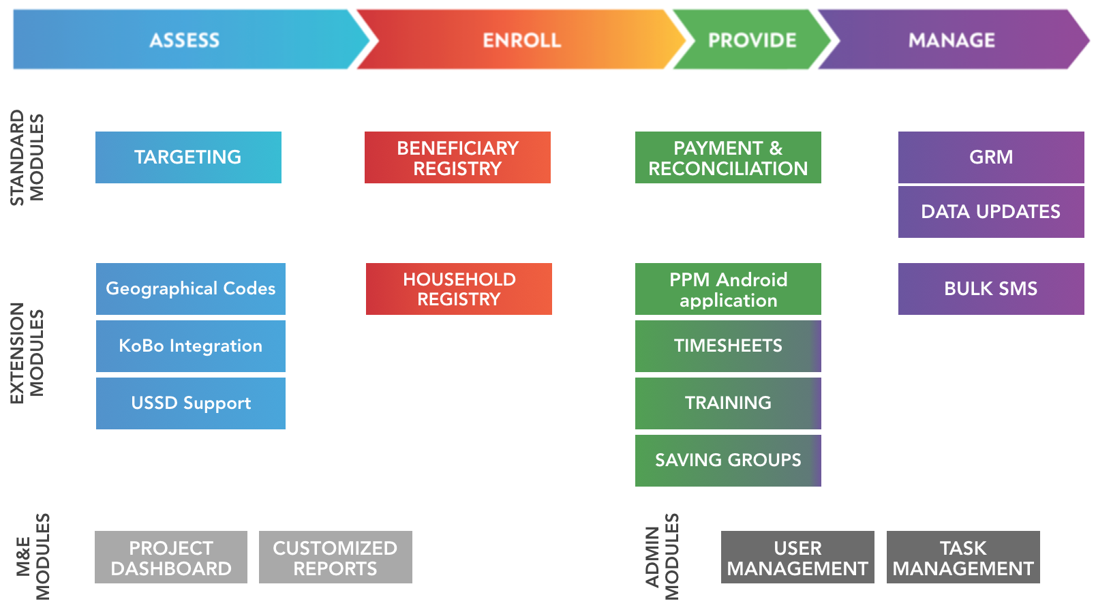
Several modules are already available and more are being developed

Slide 8
openIMIS Modules & Functionalities
Beneficiary Management
Contract Management
Product Management
Premium Management
Provider Management
Claim Management
Accounting
insuree/family
contract
product
contributions
medical pricelist
claim
invoice
insuree batch
policy
medical
payer
health facility
claim batch
payment
policy holder
contribution plan
policy notification
claim AI
Technical Administration
authentication
user & roles
GEO location
Interoperability
FHIR 3
FHIR 4
ETL (DHIS2)
+ mobile apps
Customization
language packs
calculations
Core
reports
AI services
tools, home, …

Slide 9
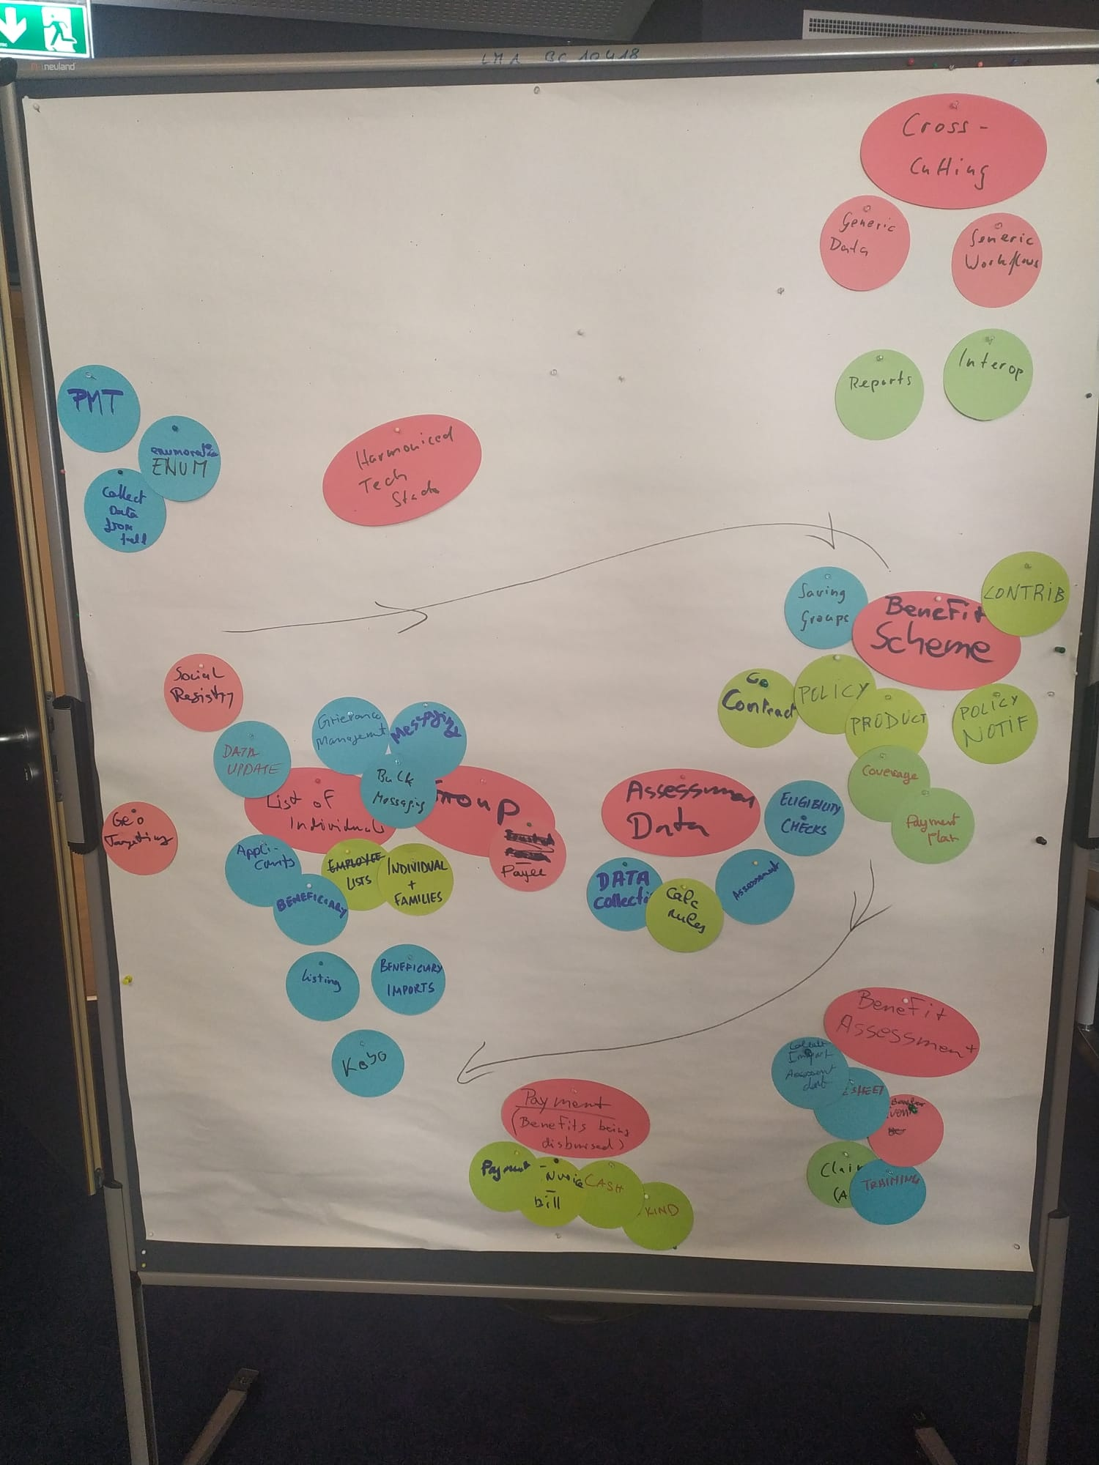
Objects to Migrate
(don’t nail me down on this)
Benefit Schemes
Individuals
Targeting
Groups
Assessment Data
Benefit Assessment
Payment / Benefit
Data
CORE-MIS features
openIMIS features

Slide 10
Migration of Features
future ?
Branding
now
intermediary
Packaging / Distribution
Functionalities
Technical Platform

Slide 11
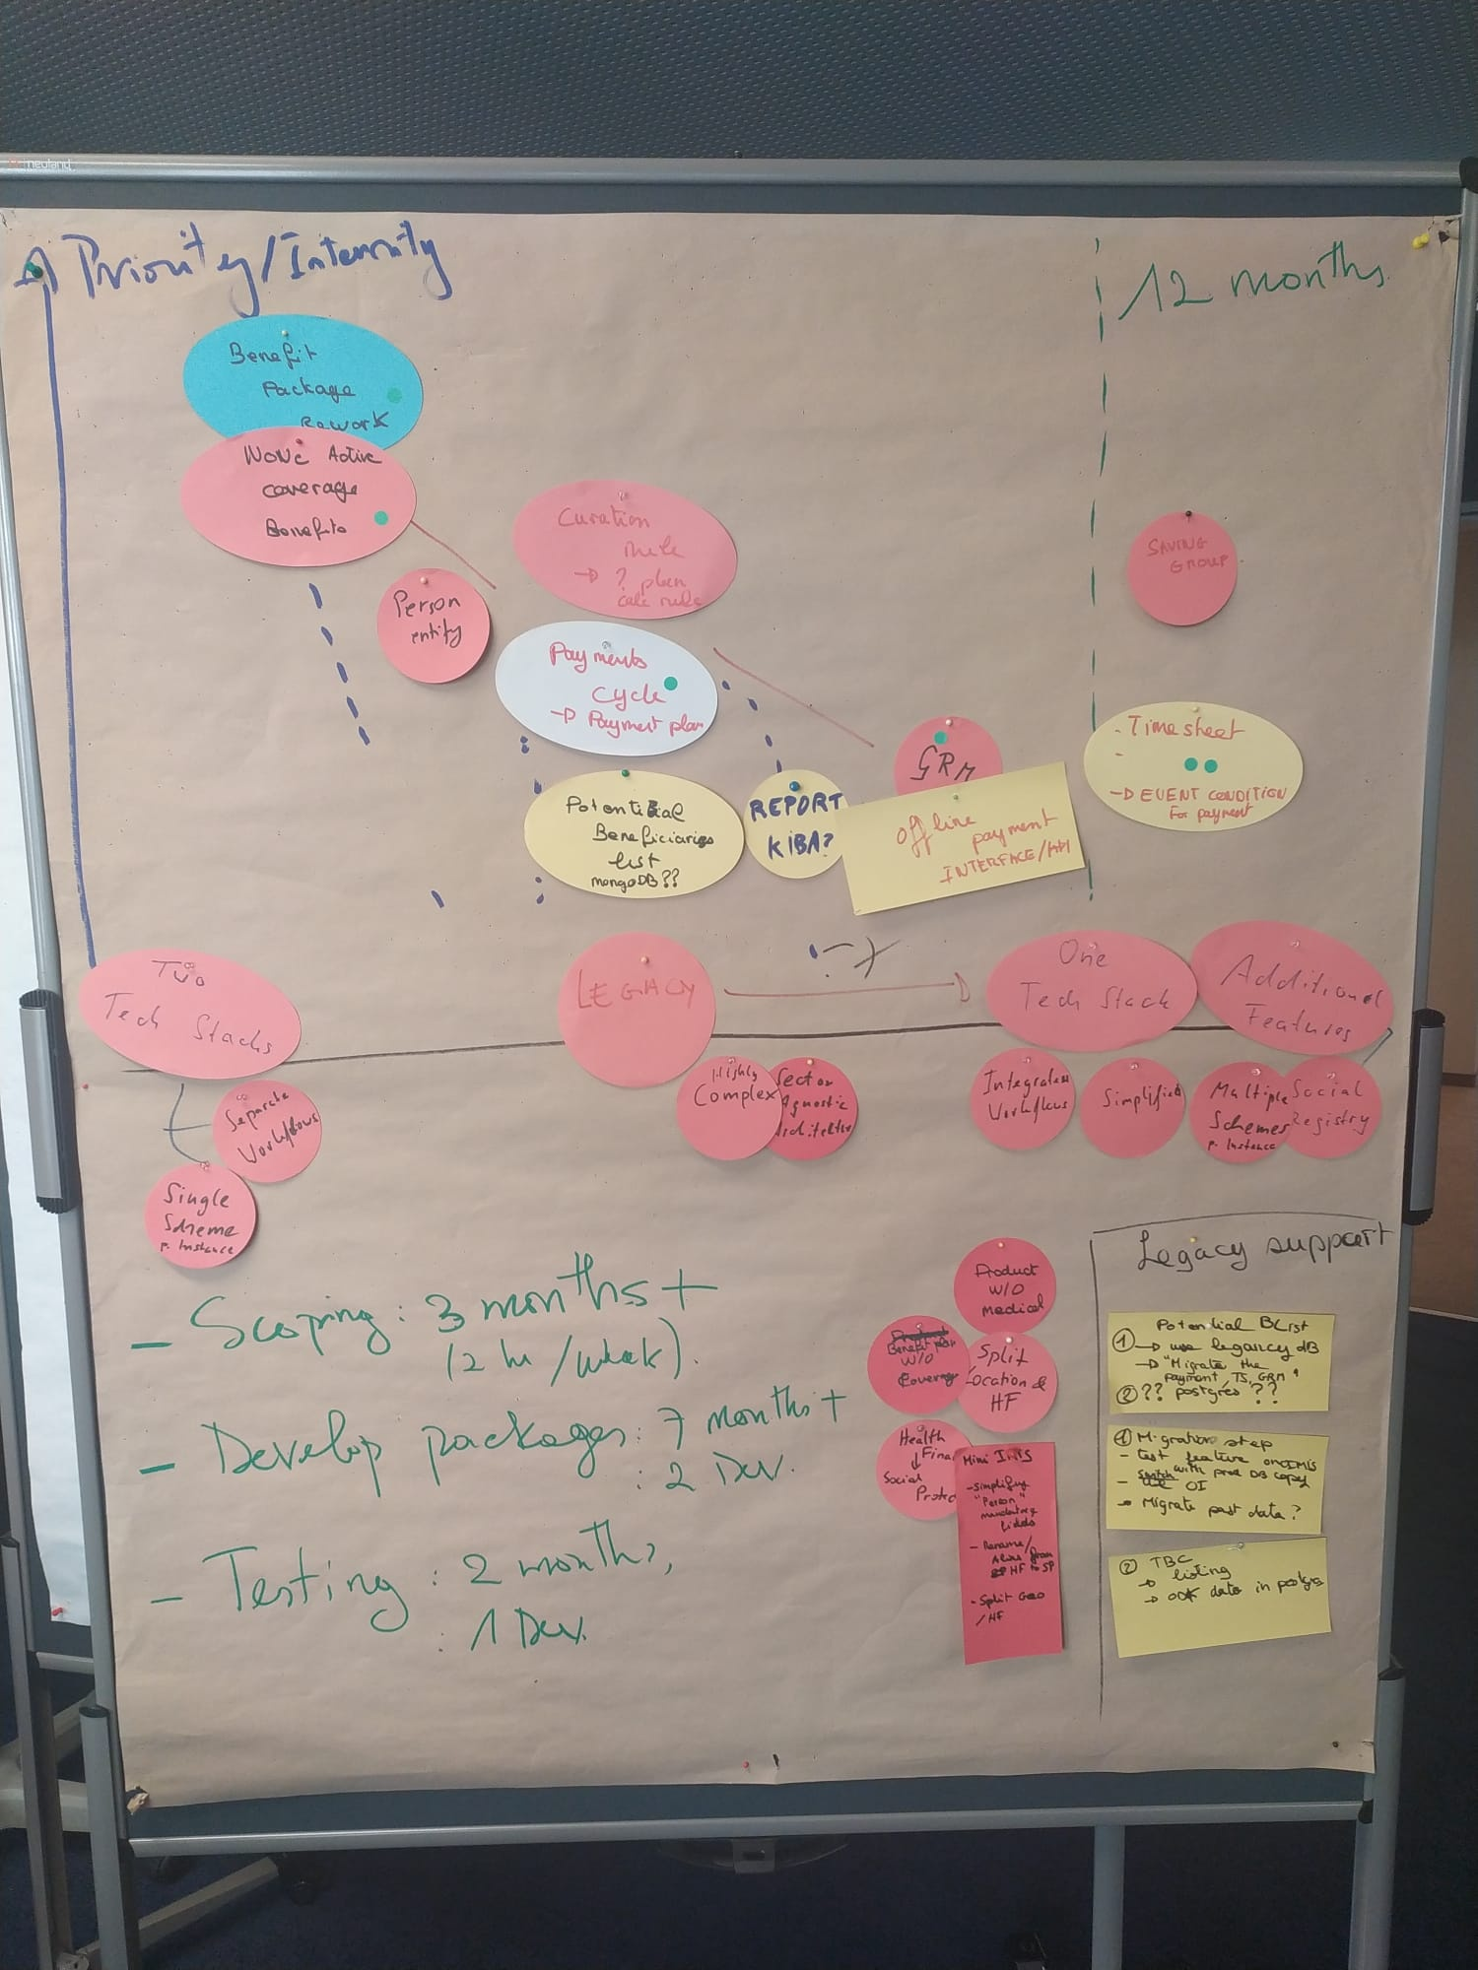
Proposal: Agile Workflow
2023 (start: Jan 2023)
2024
Project Phase 2020 -2023
Project Phase 2023 -2025
Dev. Contracts
Maintenance
Maintenance
REST-API, Reports
Migration
carry over?
Development
Sprints
Releases
23-04
23-10
24-04
24-10

Slide 12
Assembly Line: openIMIS Sandbox
on demand
Deployment
Application / Line | Feature [Develop] | Develop [Integration] | Release [Quality Assurance] | Demo [Demo] | Training [Training]
github branches | Feature | develop | release | main | main
used for | development / developer test | integration test | user acceptance test | current stable | customized demos / trainings
Status | only local | online | online | online | on demand
Packages |  | openIMIS (DHIS2) OpenHIM MIFOS CORE-MIS | openIMIS (DHIS2) (CORE-MIS) | openIMIS (DHIS2) (CORE-MIS) | on demand
https://openimis.atlassian.net/wiki/spaces/OP/pages/3219128428/Sandbox+Landscape

Slide 13
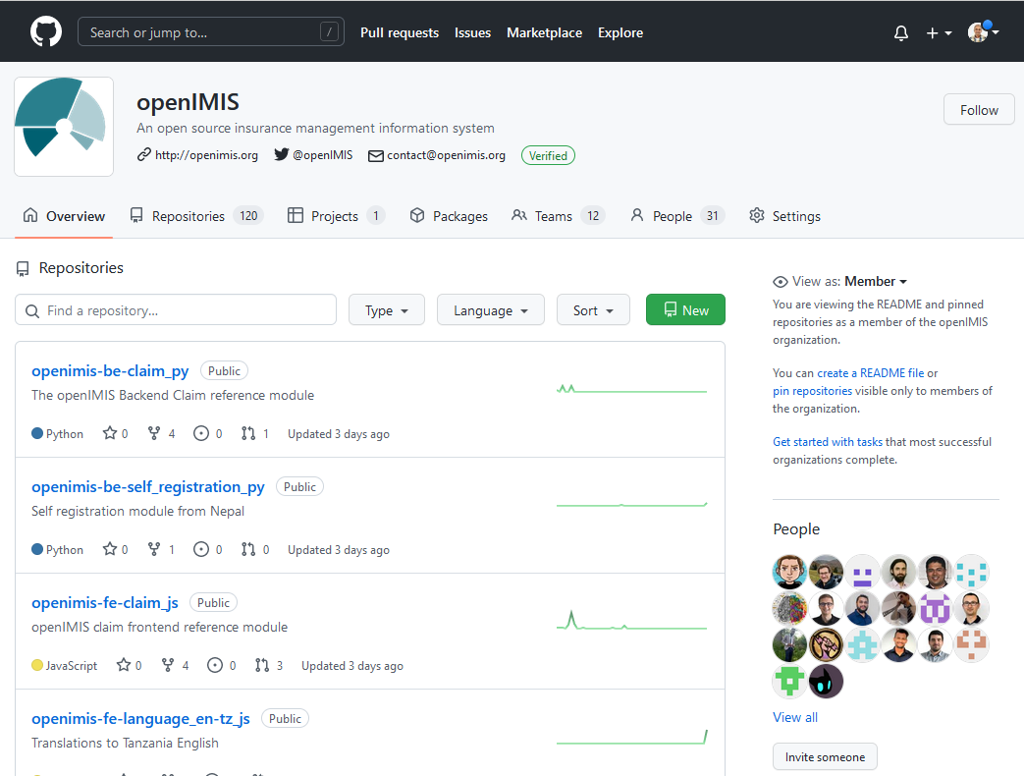
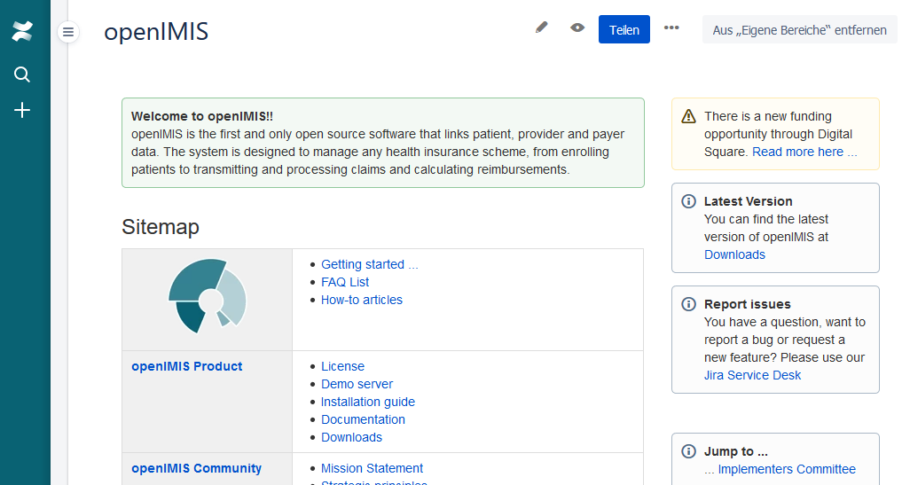
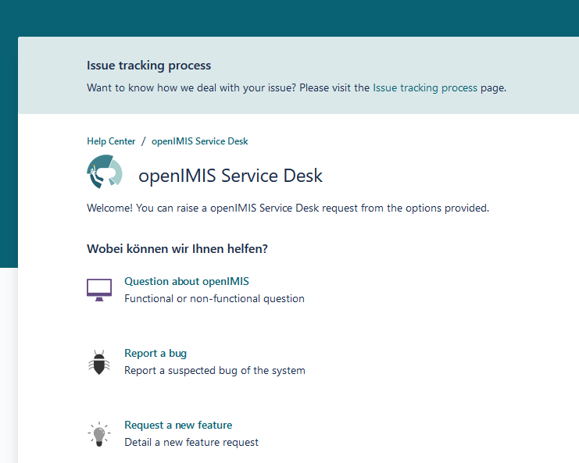
Platforms
Homepage
Wiki
Forum
Document Share
Chatgroup
Service Desk
Issue Tracker
Code repository
Internationalization
Demo Server
Documentation
Next call: Agreement on the base set of tools/platforms for coordination, joint work etc

Slide 14
Project Links in the Wiki
Project landing page
partner page CORE-MIS
partner page SolDevelo
Partner page WorldBank (2B done)
Developers Hall of Fame

