Slide 1
Maintenance and Support
April 3, 2023
Activity Report

Slide 2
March 2023 activities
Support:
OSD-262 - Data error : Server returned data error status – Waiting for customer
OSD-263 - data error on demo instance – Resolved
OSD-264 - openIMIS Chad modular - adding a policy – Waiting for customer
OSD-265 - Linking AMELIA to openIMIS using RESTful APIs – Waiting for customer
OSD-266 - Need help for openIMIS – Waiting for customer
OSD-270 - Modular instance Chad - Bug when processing claims – Resolved
OSD-271 - tblLanguage issues – Waiting for customer
Legend: Service request – Feature request - Bug

Slide 3
March 2023 activities
Support:
OSD-273 - Picture attachment – Resolved
OSD-274 - Renewal on Web Instance Chad – Waiting for customer
OSD-275 - Adding contributions on the mobile application – Waiting for customer
OSD-276 - Demo login in French is not working – Resolved
OSD-277 - User role problem – Waiting for customer
OSD-278 - Can not login – Resolved
OSD-279 - Installing openimis on vps – Waiting for customer
OSD-280 - Web interface – Waiting for customer
Legend: Service request – Feature request - Bug

Slide 4
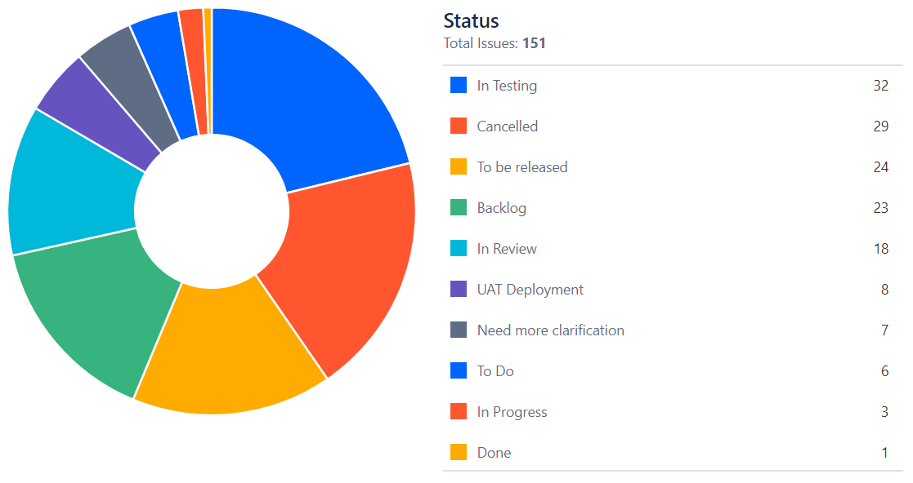
March 2023 activities
Maintenance/Development:
Bug fixes*
PR reviews
* Funded by Tanzania’s implementation

Slide 5
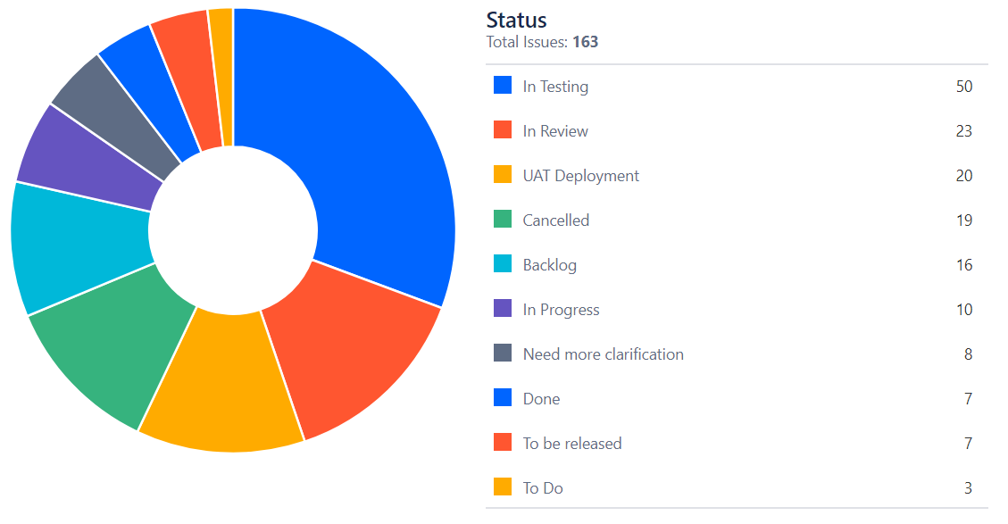
March 2023 activities
Maintenance/Development:
Bug fixes*
PR reviews
* Funded by Tanzania’s implementation

Slide 6
April 2023 Release

Slide 7
Access management
Access management dimensions:
Authorities (Configuration Items, roles and Authorities)
Location (Configuration Items, User District, User Village)
External affiliation
HF user (Configuration Items, Claim Administrator)
PolicyHolder User (Configuration Items, PolicyHolder user)
https://openimis.atlassian.net/wiki/spaces/OP/pages/3530162177/Access+management

Slide 8
Insuree without family
Some defects were put in stand by.

Slide 9
Time budget available
Total days | Remaining days | Remaining percentage
201 | 91 | 48%

Slide 10
Future activities
Maintenance and development:
Documentation and video tutorials
Generate large data set and train demo AI Model
Bug fixes & PR
Release management
April 2023 release

Slide 11
Maintenance and Support

