Slide 1
Maintenance and Support
March 6, 2022
Activity Report

Slide 2
February 2023 activities
Support:
OSD-256 - psycopg2.errors.UndefinedTable – Resolved
OSD-257 - Not able to complete the setup of the openIMIS backend. – Waiting for customer
OSD-258 - https://demo.openimis.org/front/policy/policy error – Waiting for customer
OSD-259 - https://demo.openimis.org/front/policy/policy error when select product option – Waiting for customer
OSD-260 - Starting Open MIS Back End - Python – Waiting for customer
OSD-261 - Front End Breaking – Waiting for customer
OSD-262 - Data error : Server returned data error status – Waiting for customer
Legend: Service request – Feature request - Bug

Slide 3
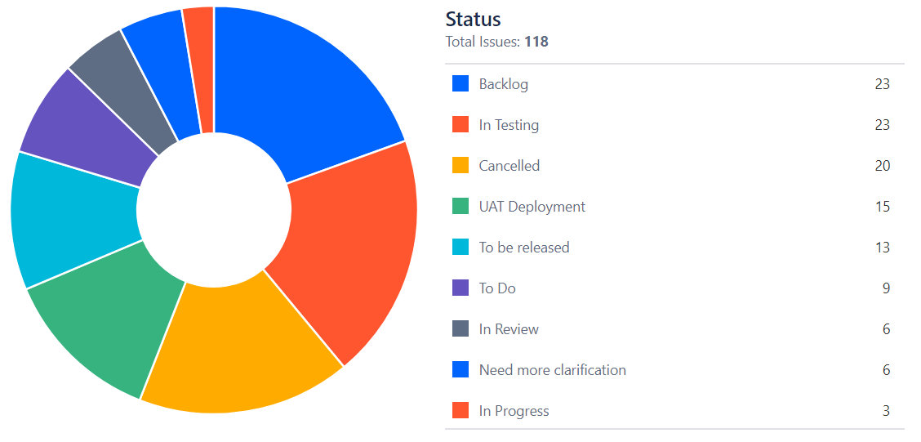
February 2023 activities
Maintenance/Development:
Bug fixes*
PR reviews
* Funded by Tanzania’s implementation

Slide 4
Time budget available
Total days | Remaining days | Remaining percentage
150 | 58 | 38%
No budget left for SolDevelo

Slide 5
Future activities
Maintenance and development:
Documentation and video tutorials
Generate large data set and train demo AI Model
Bug fixes & PR
Release management
April 2023 release

Slide 6
April 2023 Release

Slide 7
Maintenance and Support

