Slide 1
Maintenance and Support
February 6, 2022
Activity Report

Slide 2
January 2023 activities
Support:
OSD-250 - Paid Modules – Waiting for customer
OSD-251 - About Installing in m1 mac – Waiting for customer
OSD-252 - create shadow admin account for release/demo instances – In progress
OSD-253 - municipality and village visibility when enrolling and deletion of some user – Waiting for customer
OSD-254 - Medical items and services price lists - need for item search – Pending prioritization
OSD-255 - Submission of claims - view of accepted and rejected claims – Pending prioritization
OSD-256 - psycopg2.errors.UndefinedTable – In progress
Legend: Service request – Feature request - Bug

Slide 3
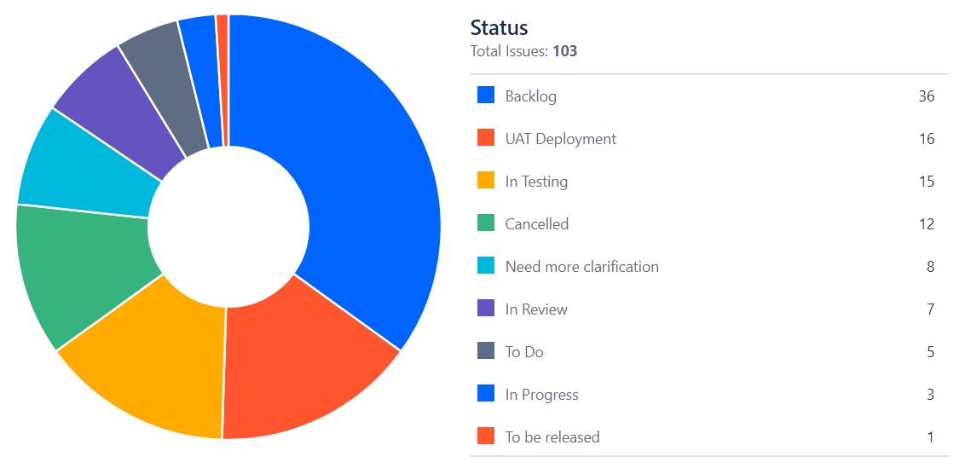
January 2023 activities
Maintenance/Development:
Bug fixes*
PR reviews
* Funded by Tanzania’s implementation

Slide 4
Time budget available
Total days | Remaining days | Remaining percentage
150 | 58 | 38%
No budget left for SolDevelo

Slide 5
Future activities
Maintenance and development:
Documentation and video tutorials
Generate large data set and train demo AI Model
Bug fixes & PR
Release management
April 2023 release

Slide 6
April 2023 Release

Slide 7
Maintenance and Support

