Slide 1
openIMIS Shelf Readiness
Digital Square Notice E0
June 21, 2022
Dr. Dragos Dobre
Swiss Tropical and Public Health Institute (Swiss TPH)

Slide 2
Project Description
Term: 08.04.2021 → 31.12.2021
Parties:
Digital Square / PATH
Swiss TPH & SolDevelo & Bluesquare
Work Packages:
openIMIS FHIR Module
Packaging and Installation
Community Engagement:
OpenHIE DevOps community
openIMIS communities

Slide 3
Project Outputs
openIMIS FHIR R4 module
openIMIS Docker package
Instant OpenHIE Script
openIMIS Developers Tools

Slide 4
1.openIMIS FHIR module
Why an interoperability layer for openIMIS?

Slide 5
Exemple d’intégration

Slide 6
Why an interoperability layer for openIMIS?
Improve productivity and quality of operations
Minimize data entry error risk
Multiple entry sources for the same data can lead to errors introduced by human operator
Reduce operational costs
Time limited to only one data entry
Ease claim submission
Automatize the transformation et sending of data
Reduce claim review and payment delays
Immediate reception of claims
Automatic payment request

Slide 7
Why an interoperability layer for openIMIS?
Optimize openIMIS for Social Protection data and process
One source of truth
Dedicated registries with updated data (i.e. Facility Registry)
Other business processes are managed externally
Specialized systems (i.e. Accounting, payment)

Slide 8
1.openIMIS FHIR module
What is FHIR®?

Slide 9
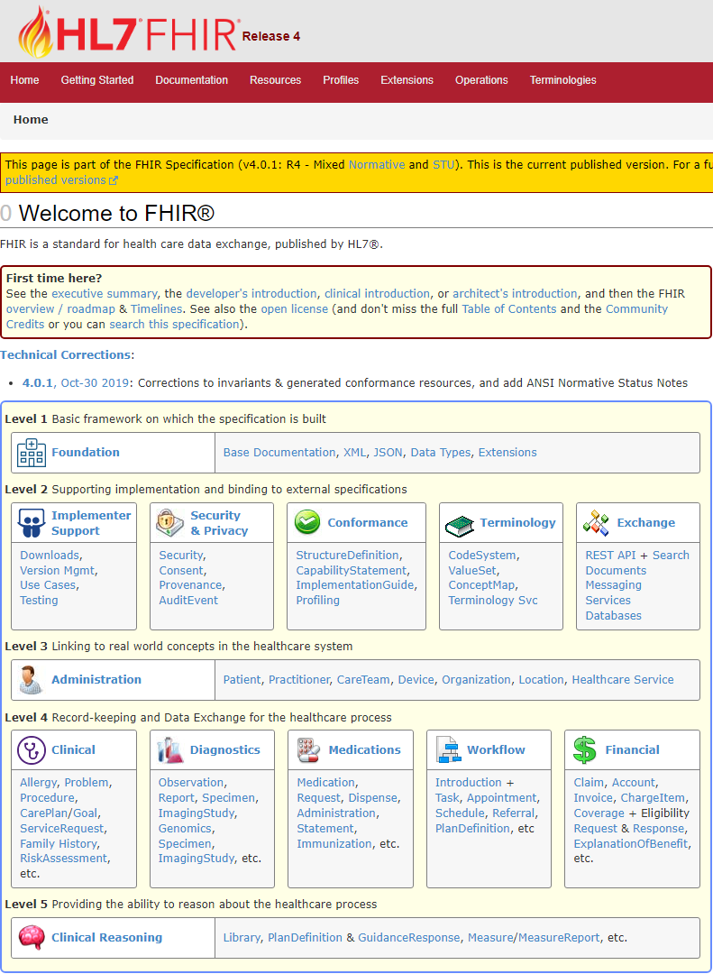
What is FHIR® ?
Standard for information representation and electronically exchange of information on health services based on modern web technologies
Specified by Health Level 7 (HL7®)
Versions:
First version in 2014
Version used during project: FHIR R4 (4.0.1 released on 30.10.2019)
Current version: FHIR R4B (4.3.0 released on 28.05.2022)
Next version: FHIR R5 (5.0.0-snapshot1 released on 19.12.2021)
Notes:
HL7 est un organisme de normalisation

Slide 10
What is FHIR® ?
Fast
To conceive and operate
Healthcare
The business domain
Interoperability
What interest us
Resources
Basic data sources
Notes:
HL7 est un organisme de normalisation

Slide 11
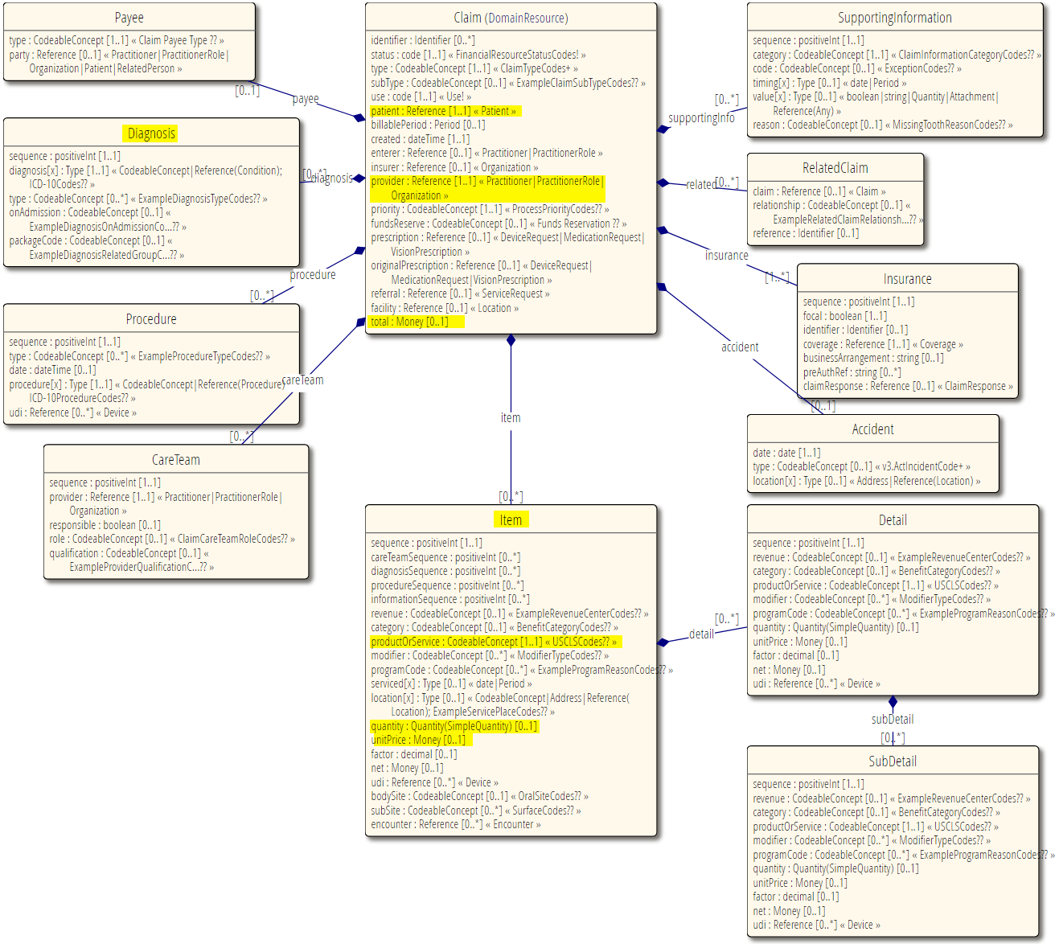
What is FHIR® ?
Resource and Profile
A Resource defines
Data structure
Data constraints
Data relations
Profile = Personalized Resource
Derived from other FHIR Resource
By extensions
By restrictions

Slide 12
What is FHIR® ?
Code System and Value Set
Code System
Defines the codes (symbols and/or expressions) which exists and how they are understood
Ex: SNOMED CT, LOINC, RxNorm, ICD family, etc.
Value Set
Select un group of codes from one or multiples Code Systems to list which codes can be used in a specific context

Slide 13
{
"resourceType": "Patient",
"id": "john-doe",
"meta": { "profile": [
"https://openimis.github.io/openimis_fhir_r4_ig/StructureDefinition/openimis-patient"
]},
"text": {
"status": "generated",
"div": "<div xmlns=\"http://www.w3.org/1999/xhtml\"><p><b>John Doe </b>
male, DoB: 1962-02-05 ( Unique code: 123456789)</p></div>"
},
"extension": [{
"url": "https://openimis.github.io/openimis_fhir_r4_ig/StructureDefinition/patient-is-head",
"valueBoolean": false
},{
"url": "https://openimis.github.io/openimis_fhir_r4_ig/StructureDefinition/patient-group-reference",
"valueReference": {
"reference": "Group/doe-family"
}}],
"identifier": [{
"type": {
"coding": [{
"system": "https://openimis.github.io/openimis_fhir_r4_ig/CodeSystem/openimis-identifiers",
"code": "Code"
}]},
"value": "123456789"
}],
"name": [{
"family": "Doe",
"given": [ "John" ]
}],
"gender": "male",
"birthDate": "1962-02-05"
}
Type
FHIR identifier and metadata
Human readable information
Extensions
Standard data:
Identifiers
Name
Gender
Birthdate
…

Slide 14
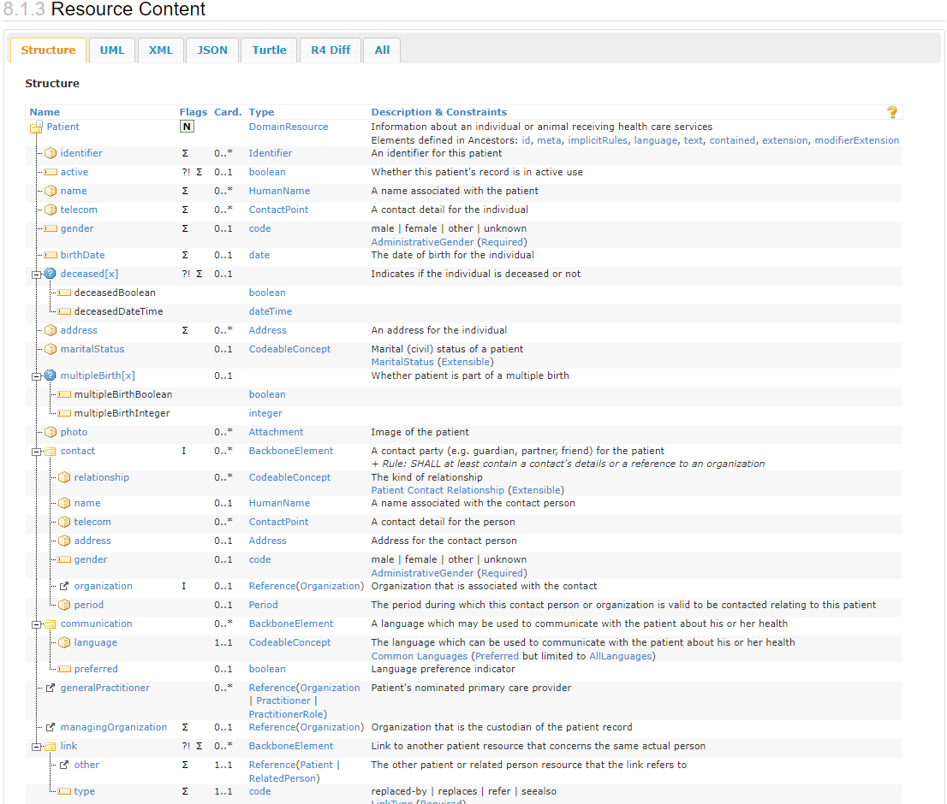
What is FHIR® ?
FHIR Implementation Guide
Profile documentation:
Personalized resources
Resource structure
List possible interoperability operations
read, search, create, update, delete
Other information:
Security : authentication, authorization
Integration workflows

Slide 15
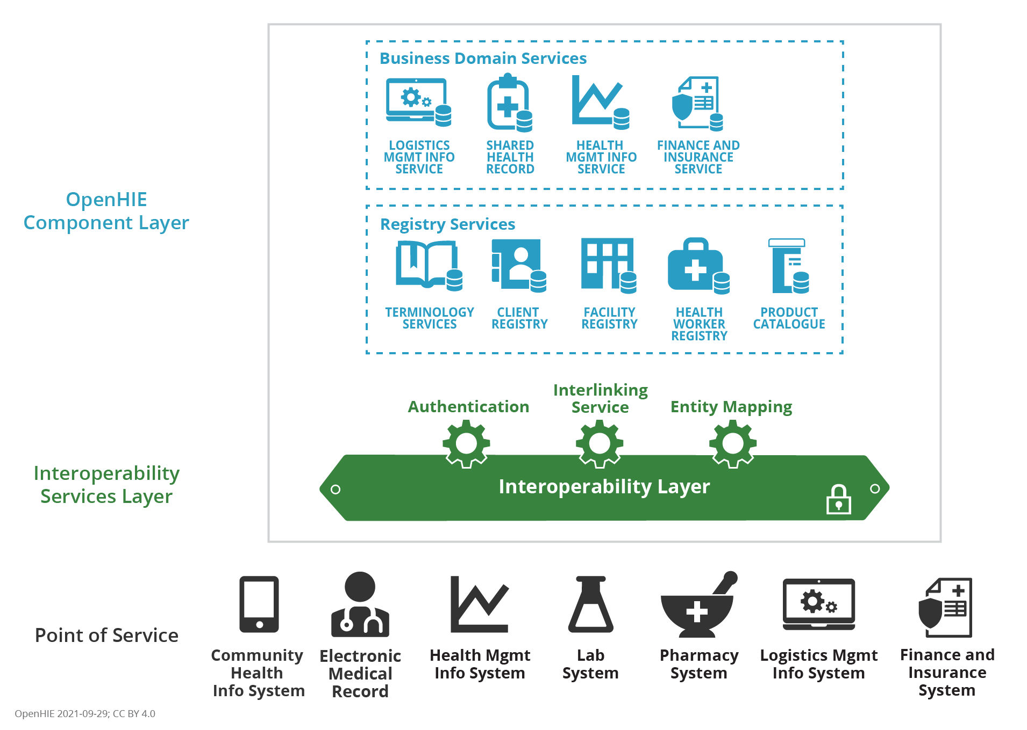
What is FHIR® ?
OpenHIE
Open Health Information Exchange
Community of practice
Specify data interoperability standards for health
Health Financing towards UHC Community
OpenHIE Architecture

Slide 16
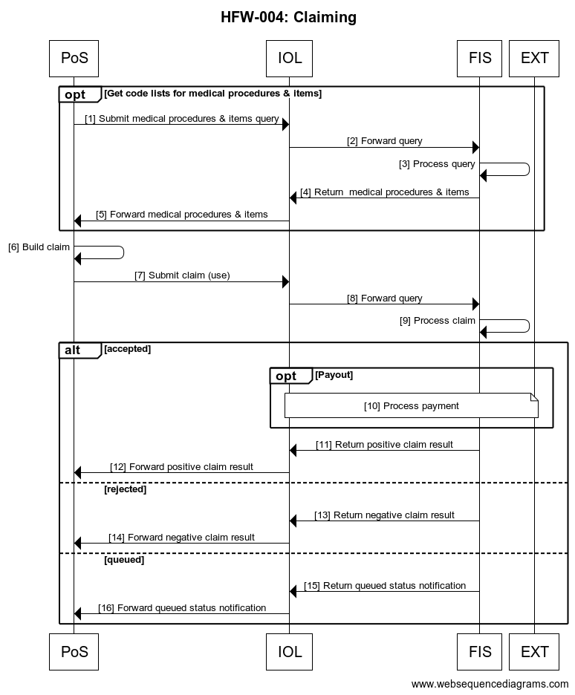
What is FHIR® ?
Claim submission workflow
Ref | Interaction | Endpoint | Data | Transaction Spec
1 | Submit medical procedures & items query | IOL | FHIR ActivityDefinition, FHIR Medication | http://hl7.org/fhir/R4/activitydefinition.html http://hl7.org/fhir/R4/medication.html
4 | Return medical procedures & items | IOL | FHIR ActivityDefinition, FHIR Medication | http://hl7.org/fhir/R4/activitydefinition.html http://hl7.org/fhir/R4/medication.html
7 | Submit claim (use) | IOL | FHIR Claim (use=[preauthorizsation, predetermination , claim]) | http://hl7.org/fhir/R4/claim.html
11 | Return positive claim result | IOL | FHIR ClaimResponse | http://hl7.org/fhir/R4/claimresponse.html
13 | Return negative claim result | IOL | FHIR ClaimResponse (use=[preauthorizsation, predetermination , claim]) | http://hl7.org/fhir/R4/claimresponse.html
15 | Return queued status notification | IOL | FHIR ClaimResponse (use=[preauthorizsation, predetermination , claim]) | http://hl7.org/fhir/R4/claimresponse.html

Slide 17
1.openIMIS FHIR module
Achievements

Slide 18
openIMIS FHIR module
Objectives
Allow openIMIS to integrate with external systems in a standardized way
Use an existing interoperability standard already used by other systems

Slide 19
openIMIS FHIR module
History
2019
2020
FHIR R4 Integration (Swiss TPH)
2021
openIMIS Shelf Readiness (Swiss TPH)
Bahmni Integration (Possible Health Nepal)
OpenMRS Integration (SolDevelo)
FHIR STU3 (SolDevelo)
Claim-AI (Swiss TPH)
2022
Payment Layer (Swiss TPH)
GovStack
DHIS2 Integration (HISP India)
Claim-AI v2 (Swiss TPH)
DHIS2 Integration v2 (Swiss TPH)

Slide 20
openIMIS FHIR module
openIMIS ⬄ FHIR mapping process – Before
FHIR STU3 resource | openIMIS database tables | Notes | Status
Claim | Claim table (tblClaim) tblClaimItems tblClaimServices | Request properties are mapped to Claim | mostly mapped
ClaimResponse | Claim table (tblClaim) tblClaimItems tblClaimServices | Response properties are mapped to Claim | mostly mapped
Coverage | tblPolicy |  | not mapped
Patient | tblInsuree |  | mostly mapped
Practitioner | tblClaimAdmin | used to represent base fields of Claim Administrator (without relation with health facility- FHIR Location) | mapped
Mapping done in openIMIS Wiki
Manual conformity validation
FHIR STU3 field | openIMIS field | Notes | Status
Identifier | tblClaim.ClaimID / tblClaim.ClaimUUID / tblClaim.ClaimCode | Claim can have multiple identifiers. The most important one is mapped from ClaimCode | ClaimID and ClaimCode mapped
patient | tblClaim.InsureeID |  | mapped
billablePeriod | tblClaim.DateFrom / tblClaim.DateTo | date from and date to are mapped to a period of time between them | mapped
diagnosis | tblClaim.ICDID / tblClaim.ICDID1 / tblClaim.ICDID2 / tblClaim.ICDID3 / tblClaim.ICDID4 | ICDID values are mapped to a list of diagnosis | mapped
provider | tblClaim.Adjuster |  | not mapped

Slide 21
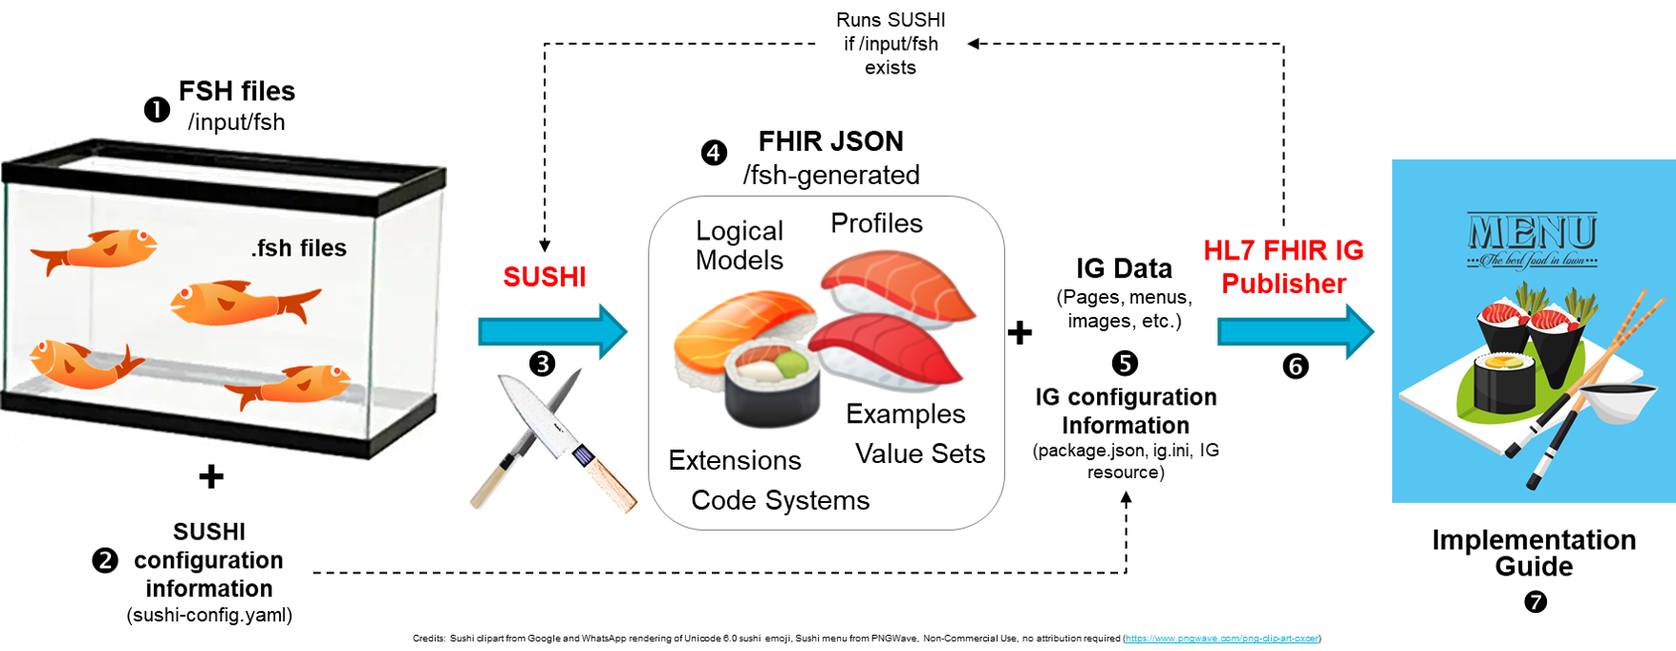
openIMIS FHIR module
openIMIS ⬄ FHIR mapping process – Now

Slide 22
openIMIS FHIR module
FHIR Resource | openIMIS Entity | Status
Claim | Claim | Updated
ClaimResponse | Claim | Updated
CommunicationRequest | Claim | Updated
Communication | Feedback | New
Practitioner | Claim Administrator | Updated
Practitioner | Enrolment Officer | New
PractitionerRole | Claim Administrator | Updated
PractitionerRole | Enrolment Officer | New
InsurancePlan | Product | New
Invoice | Invoice | New
Invoice | Bill | New
PaymentNotice | InvoicePayment | New
Subscription | - | New
Condition | Diagnosis | Deleted
HealthcareService | Health Facility | Deleted
Profiles
FHIR Resource | openIMIS Entity | Status
Patient | Insuree | Updated
Group | Family | Updated
Location | Location | Updated
Organization | Health Facility | New
Organization | Policy Holder | Updated
ActivityDefinition | Medical Service | Updated
Medication | Medical Item | Updated
Contract | Policy | New
CoverageEligibilityRequest | Policy | Updated
CoverageEligibilityResponse | Policy | Updated
Coverage | Policy | Updated

Slide 23
openIMIS FHIR module
{
"resourceType": "Patient",
"id": "john-doe",
"extension": [ {
"url": "StructureDefinition/patient-education-level",
"valueCodeableConcept": {
"coding": [ {
"system": "CodeSystem/patient-education-level",
"code": "4",
"display": "University“
}]}}, {
"url": "StructureDefinition/patient-profession",
"valueCodeableConcept": {
"coding": [ {
"system": "CodeSystem/patient-profession",
"code": "2",
"display": "Employee"
}]}}, {
"extension": [ {
"url": "number",
"valueString": "NationaID1"
}, {
"url": "type",
"valueCodeableConcept": {
"coding": [ {
"system": "CodeSystem/patient-identification-type",
"code": "N",
"display": "National ID"
}]}}],
"url": "StructureDefinition/patient-identification"
}, …
}
Code Systems
openIMIS FHIR Code Systems
Diagnosis
PatientEducationLevel
PatientProfession
PatientIdentificationType
PatientContactRelationship
GroupType
GroupConfirmationType
OrganizationHFLegalForm
OrganizationPHLegalForm
OrganizationPHActivity

Slide 24
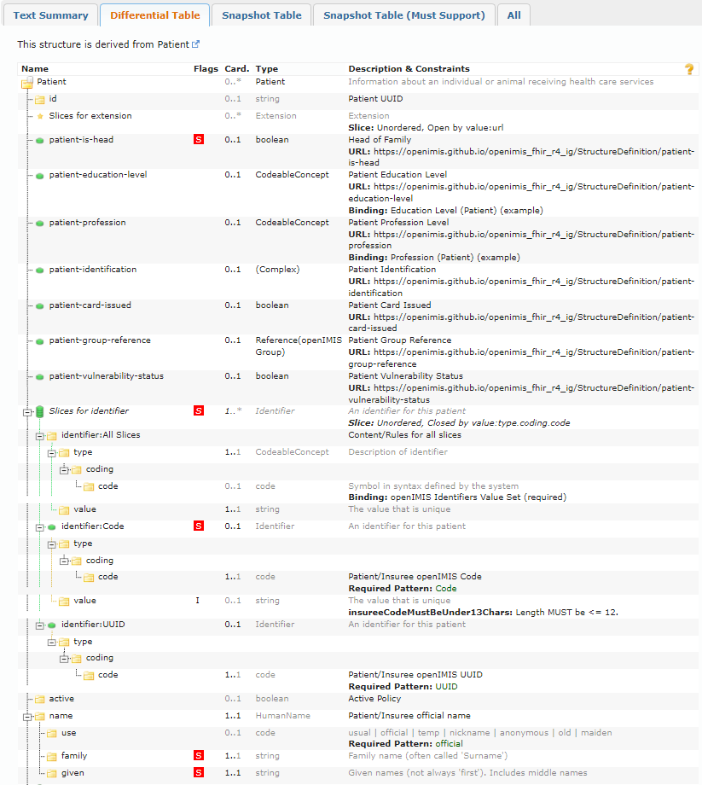
openIMIS FHIR module
Implementation Guide
openIMIS FHIR documentation
Available Resources
Resource structure
Resource examples
Security management
Integration workflows
fhir.openimis.org

Slide 25
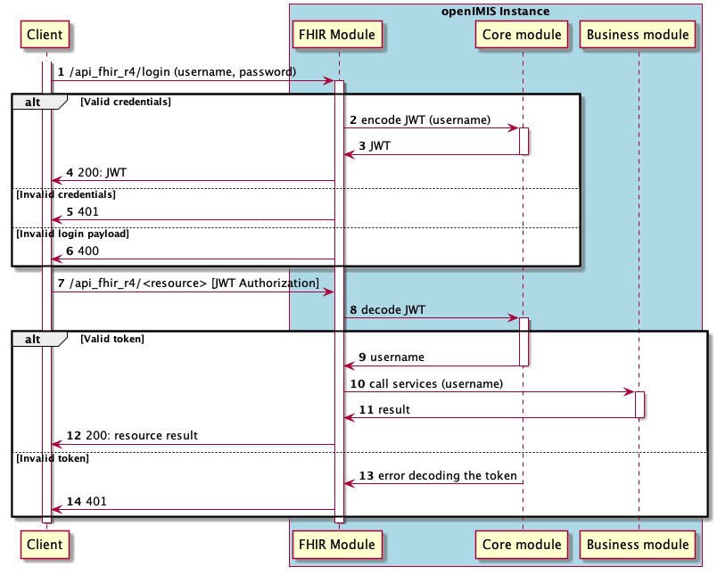
openIMIS FHIR module
FHIR Authentication and Authorisation
Same JWT authentication mechanism as the new modular openIMIS
<URL>/login endpoint to receive the token
All other FHIR endpoints require JWT bearer token in Authorization header
Added FHIR Authorisation based on User’s role and attached authorities
Because authorization is also based on User’s configured locations, the FHIR module takes the query set from business modules

Slide 26
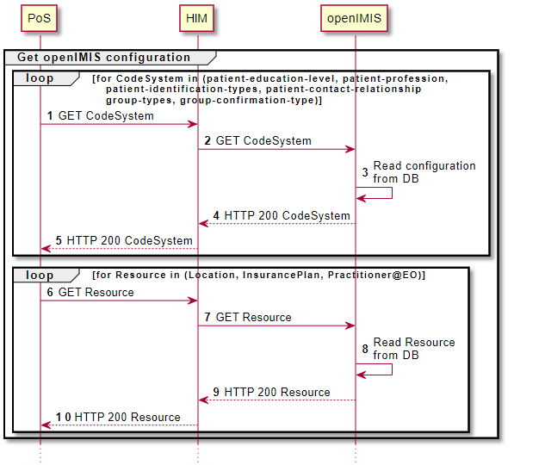
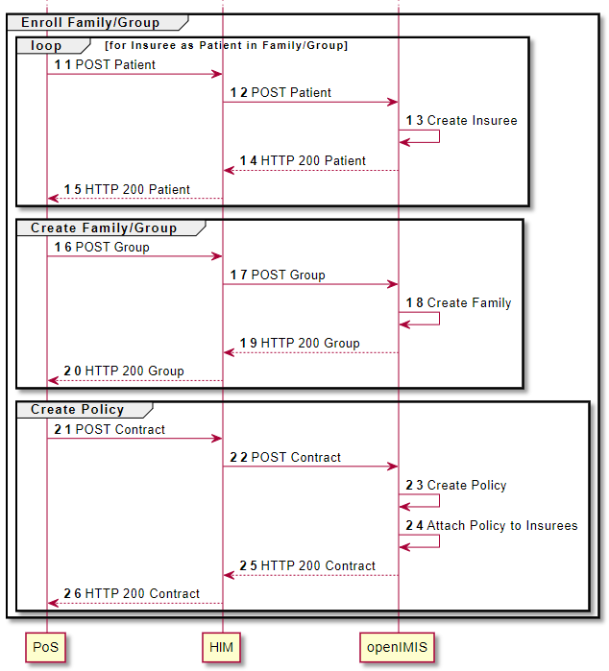
openIMIS FHIR module
Workflows: Enrolment
2 steps:
Master data synchronization
Enrolment data synchronization

Slide 27
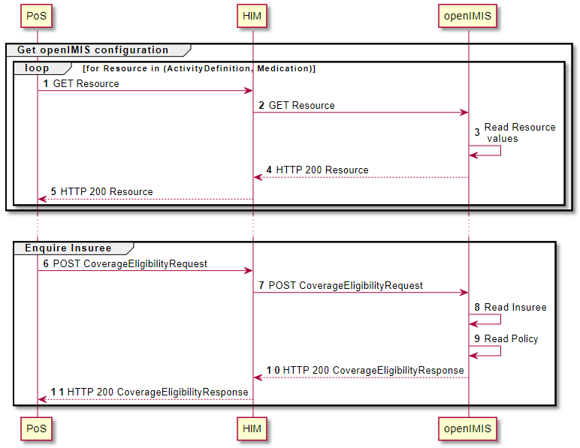
openIMIS FHIR module
Workflows: Enquiring
2 steps:
Master data synchronization
Information research (per Services and/or Item)

Slide 28
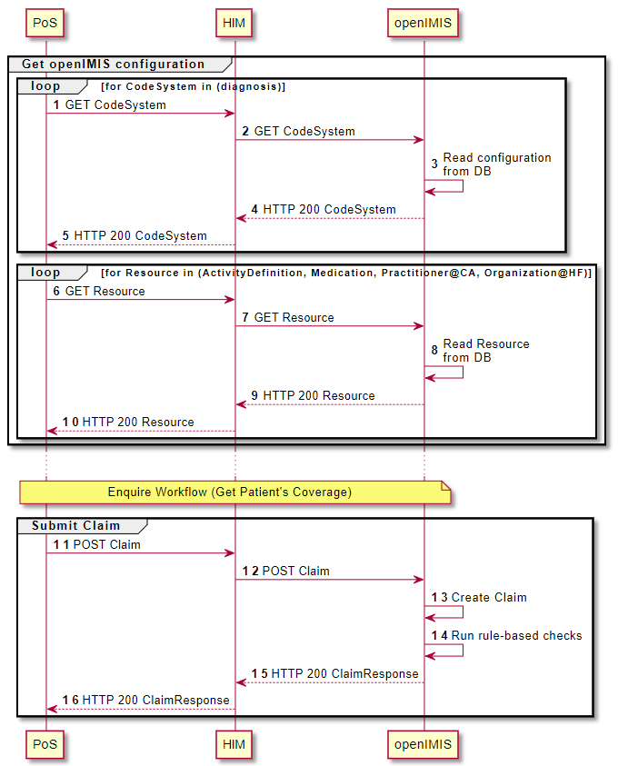
openIMIS FHIR module
Workflows: Claiming
3 steps:
Master data synchronization
Enquiring
Claim data synchronization

Slide 29
openIMIS FHIR module
Resources
openIMIS FHIR R4 Implementation Guide (last build):
https://openimis.github.io/openimis_fhir_r4_ig
GitHub openIMIS FHIR R4 IG (source):
https://github.com/openimis/openimis_fhir_r4_ig
GitHub openIMIS FHIR R4 module (source):
https://github.com/openimis/openimis-be-api_fhir_r4_py
Profiling and IG tools:
SUSHI
IG Publisher
Python FHIR library:
FHIR® Resources (R4, STU3, DSTU2)

Slide 30
1.openIMIS FHIR module
Interoperability examples

Slide 31
openIMIS interoperability options
Sormas
OpenHIE / FHIR
Convergence Initiative
DHIS2
openIMIS
OpenCRVS
BAHMNI
GovStack
OpenHIM
Odoo
OpenG2P
Mosip
OpenELIS
MIFOS
OpenMRS
OpenMRS
MojaLoop
Native code
In production
Existing standard
Ready for production
Emerging standard
Proof of concept
Candidate

Slide 32
AI-based Claim Adjudication
Claim-AI module integration
Input data model: FHIR R4 Claim
Output data model: FHIR R4 ClaimResponse
FHIR Contained Resources required for references
FHIR R4 Claim
AI Input model
AI Model execution
FHIR R4 ClaimResponse
Submission
Rule engine
AI engine
Manual
Quality Assurance
Payment
Response

Slide 33
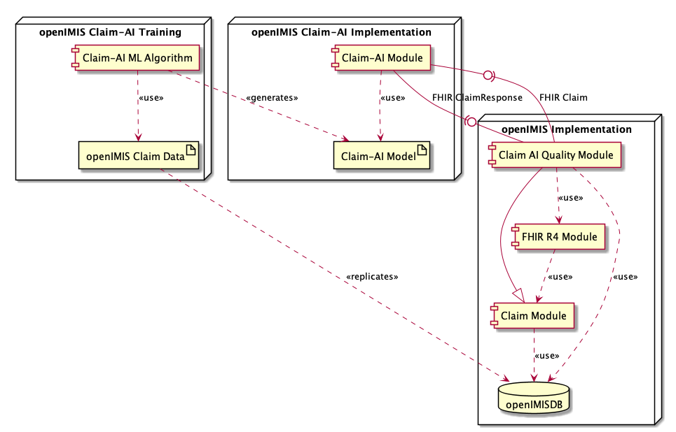
AI-based Claim Adjudication
Claim-AI module integration architecture

Slide 34
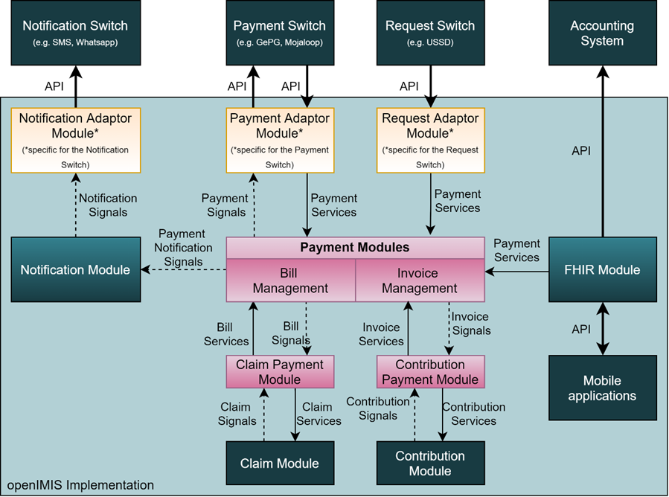
Payment Systems Integration
4 additional profiles
Invoice
Invoice
Bill
PaymentNotice
Subscription
Notes:
Invoice = appel de fonds / cotisation / primes
Bill = facture

Slide 35
2. openIMIS Docker package

Slide 36
Docker package improvement
openIMIS wiki page:
2.1 Docker package improvement
GitHub openIMIS Docker:
https://github.com/openimis/openimis-dist_dkr
GitHub openIMIS Instant OpenHIE:
https://github.com/openimis/openimis-dist_instant_openhie
Achievements:
openIMIS Docker package has been improved to allow User’s configuration from outside the repositories
Instant OpenHIE compliant Docker package has been developed reducing manual steps and allowing for easy configuration with other services
Communication started with Jembi to integrate the Instant OpenHIE compliant Docker package with the Instant OpenHIE GitHub repository

Slide 37
3.Developers Tools

Slide 38
Developer initialization script
Objectives
Easier setting up local backend and frontend with modules:
Wrap creating new backend modules in one command that can be called from manage.py, it’d create a new module next to assembly with all necessary features (README, etc.)
Pulling modules from source and using local instances also could be automatized
Backend module initialization:
Add .yml file to skeleton that’d allow to automatically execute CI
Automatically created simple service with unit test that’d allow to check if module is created properly
Skeletons adjusted to types of modules: business models / calculation rules / etc.
Frontend module initialization:
Yarn link automatically created when creating new modules, link should be done automatically from assembly module
Add react template for frontend builds
Add CI file to frontend, that’d check if frontend part is building with no issues

Slide 39
Developer initialization script
Achievements
BE Developer tools:
Create backend module skeleton in single command
Add GitHub files like workflows, gitignore
Fetch a module and install it from local directory
Fetch all modules and install them from local directories
Install modules from PyPI
Install all modules from PyPI
Create calculation backend module skeleton in single command
FE Developer tools:
Download from repository frontend module and build it locally in single command
Add GitHub workflows files to the particular module
Fetch all modules and install them from local directories

Slide 40
Thank you
Contact
dragos.dobre@swisstph.ch
+41 61 284 8643

