Slide 1
Maintenance and Support
5 December 2022
Activity Report

Slide 2
November 2022 activities
Support:
OSD-237 - Creating a product - price origin – Canceled
OSD-238 - Views in database – In progress
OSD-239 - Switch mobile apps to the current MS SQL server – Waiting for customer
OSD-240 - Policies and Records – Resolved
OSD-241 - not able to setup openIMIS dockerized instance – Waiting for customer
OSD-242 - Unable to log into frontend – In progress
OSD-243 - Missing Translation – In progress
OSD-244 - Medical officer cannot deliver review – Escalated
OSD-245 - Running RestAPI on IIS – Waiting for customer
Legend: Service request – Feature request - Bug

Slide 3
November 2022 activities
Maintenance/Development:
Nginx configuration file
Docker fixes
Bug fixes
PR reviews and integration
Documentation
User documentation updated
Installation guide wiki restructuring started

Slide 4
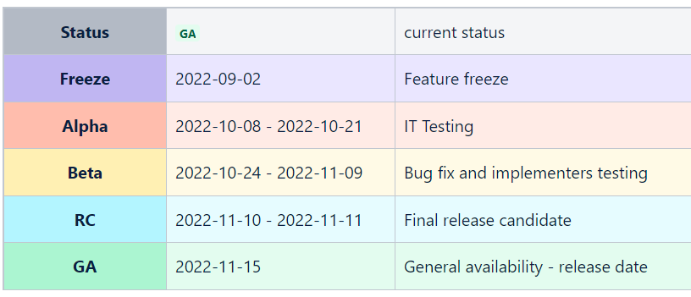
October 2022 Release
October 2022 Release Wiki Page
Main changes:
Django 3.2
Reporting support
PostgreSQL support
Insuree self registration portal (dedicated module)
openIMIS server:
demo.openimis.org – PostgreSQL (updated manually 2-3 times per year)
release.openimis.org – Microsoft SQL (updated manually 3-5 times per release)
develop.openimis.org – PostgreSQL (updated automatically every 4h)
Issue with the Front End that required released package

Slide 5
Time budget available
Total days | Remaining days | Remaining percentage
150 | 78 | 52%

Slide 6
Future activities
Maintenance and development:
Documentation and video tutorials
Generate large data set and train demo AI Model
Bug fixes & PR

Slide 7
Maintenance and Support

