Slide 1
Maintenance and Support
5 September 2022
Activity Report

Slide 2
August 2022 activities
Support:
OSD-205: During Installation i am not able to find open database – Waiting for customer
OSD-206: Importing locations doesn't attach them to the current user – Escalated
OSD-207: User Login – Waiting for customer
OSD-208: Login Issue – Waiting for customer
OSD-209: Reports – Escalated
OSD-210: Implementing the Reports – Waiting for customer
OSD-211: Creating a new medical item – Escalated

Slide 3
August 2022 activities
Support:
OSD-212: Impossible to create claim admin – Cancelled
OSD-213: No "select all" for price lists or producs – Escalated
OSD-214: Adding a medical service to a product – Escalated
OSD-215: Adding districts manually when creating a user account – Escalated
OSD-216: Upload Data – Waiting for customers
OSD-217: Upload Data – Waiting for customers

Slide 4
August 2022 activities
Maintenance/Development:
Bug fixes
PR reviews and integration
Documentation
Developers documentation from code

Slide 5
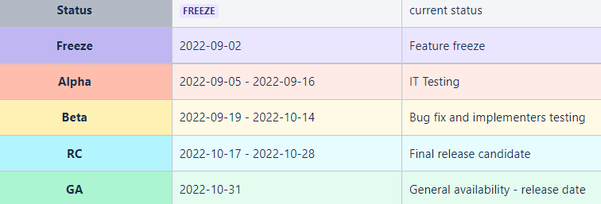
October 2022 Release
Checklist: https://openimis.atlassian.net/wiki/spaces/OP/pages/3312615490/Checklist+for+Release+2022-10
Freeze:
Assemblies freeze done
Modules freeze in progress
Will be finalized this week
Domains change:
release.openimis.org: now dedicated to release, will be updated manually
develop.openimis.org is the new dev server (updated every 4 h)
no change for demo.openimis.org and demo2.openimis.org
User Acceptance Testing:
Managed by Saurav and supported by Implementers
AeHIN, Nepal and Tanzania testers

Slide 6
Time budget available
Total days | Remaining days | Remaining percentage
240 | 0 | 0%
Total days | Remaining days | Remaining percentage
150 | 150 | 100%

Slide 7
Future activities
Maintenance and development:
Code customization with Docker implementation
Documentation and video tutorials
Generate large data set and train demo AI Model
Publish demo mobile apps on Google Play
Bug fixes & PR

Slide 8
Maintenance and Support

