Slide 1
OpenIMIS- Mojaloop Integration
By 2M-Corp

Slide 2
Table of Content
Introduction
Mojaloop
Initial idea
Possible usecases
Implementation approaches
Lessons learnt

Slide 3
Introduction
2M Corp (2MC) is a software solutions firm specializing in Data Analytics and Software Development. We at 2MC have more than 20 years of experience in the areas of data analysis of large-scale impact evaluations, surveys and developing software for a range of institutions in Africa.

Slide 4
What is Mojaloop
Mojaloop is open source software for creating digital payments platforms that connect all customers, merchants, banks, and other financial providers in a country's economy.
A set of central services provides a hub through which money can flow from one DFSP to another. This is similar to how money moves through a central bank or clearing house in developed countries. It provides the following services
Receiver lookup
Submitting a Quote
Transfer of funds

Slide 5
Proposed System OpenIMIS Mojaloop Adapter
Our proposed system is an adapter that connects the OpenIMIS System to Digital Financial Service providers (DFSPs) connected to a Mojaloop switch.
This is to enable insurees pay their contributions to their insurance scheme using their bank accounts or mobile money wallets. Also, this will enable insurance providers to pay hospital claims via bank transfers all within the OpenIMIS system.
The adapter will provide an account linking service to link user financial accounts to the openIMIS system and give authorization for payments to be made. The adapter will also receive invoices from the Mojaloop system and facilitate the payment process.
For this to work, both payer and payee accounts need to belong to DFSPs connected to the Mojaloop switch.
We have identified the Mojaloop sandbox environment that we will use to simulate DFSPs connect via a Mojaloop switch. https://sandbox.mojaloop.io/

Slide 6
Proposed System Architecture – Part A

Slide 7
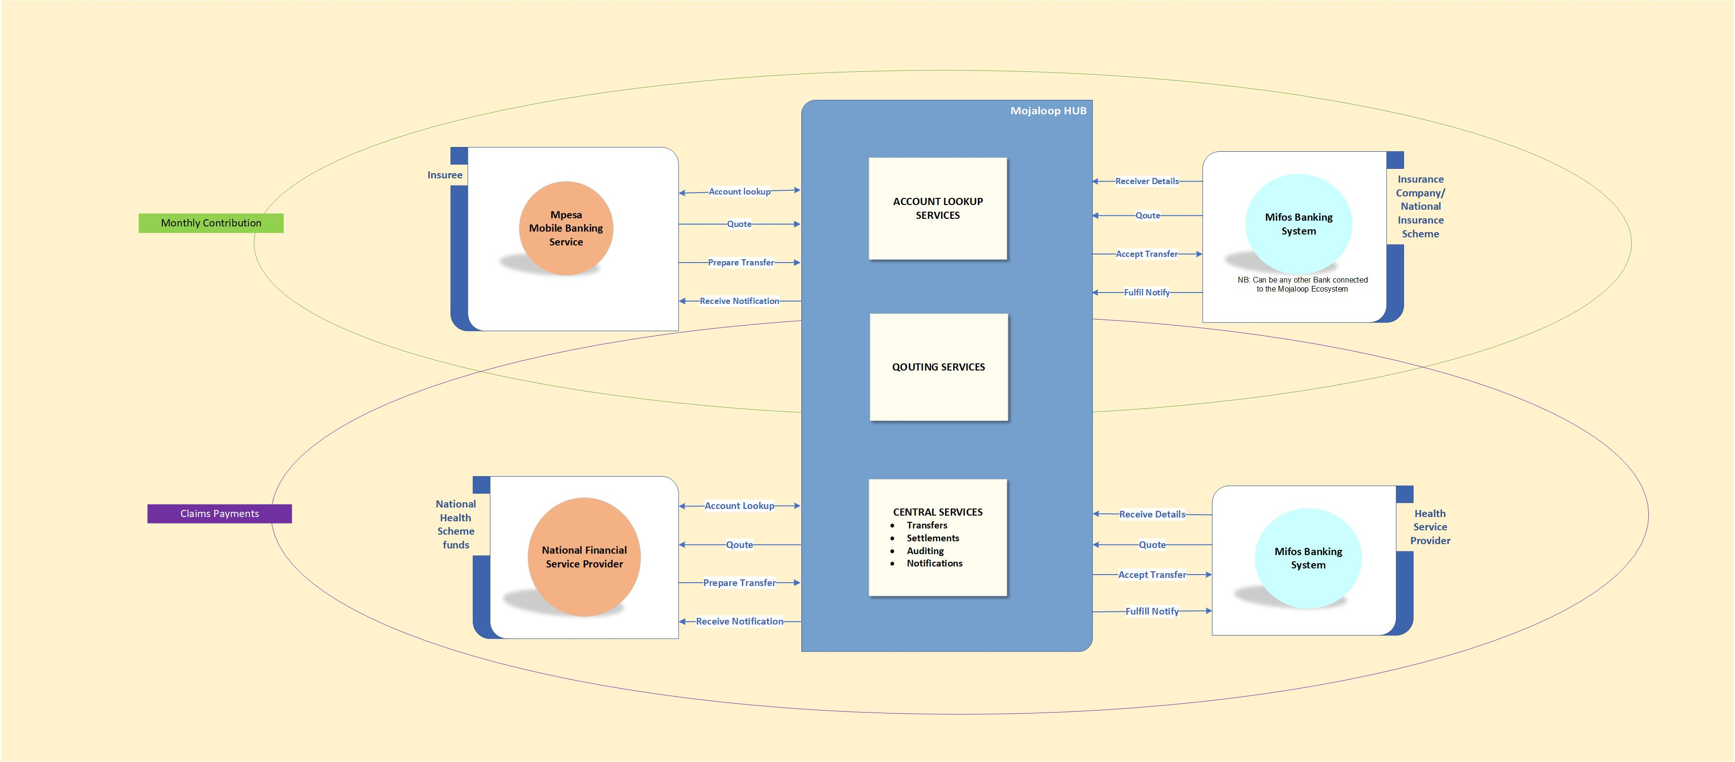
Proposed System Architecture – Part B

Slide 8
Possible Usecases
Payment of contributions by insurees
Payment of claims by insurance companies
Cash disbursement in the case of social protection scenarios

Slide 9
Implementation approaches
Build an adapter that mediates between openimis and mojaloop
Openimis internal module to mediate transactions between openimis and mojaloop

Slide 10
Lessons Learnt

Slide 11
Thank you!!!
Presented by:
Yolande M. Goswell
Systems and Project Manager 2M Corp

