Slide 1
Payment Layer
Demo
08 June 2022

Slide 2
Principles
Abstraction of the openIMIS business object with simpler and standard payment object : Invoice, bill and payments
Invoice, bill and payment objects were created in openIMIS
Convertion from openIMIS object to invoice and bills were created
From policy
From contract
From claim/ batch of claims
…
Generation of bill/invoice based on openIMIS Events
Unconditionnnal cash transfert

Slide 3
Configuration
Generation of invoice and bill is based
on payment or contribution plan : strategy for payment and princing attached to a product, or

Slide 4
Demo – unconditionnal transfert
Check up the configuration
Create a policy/contribution
Check that the bill was properly created

Slide 5
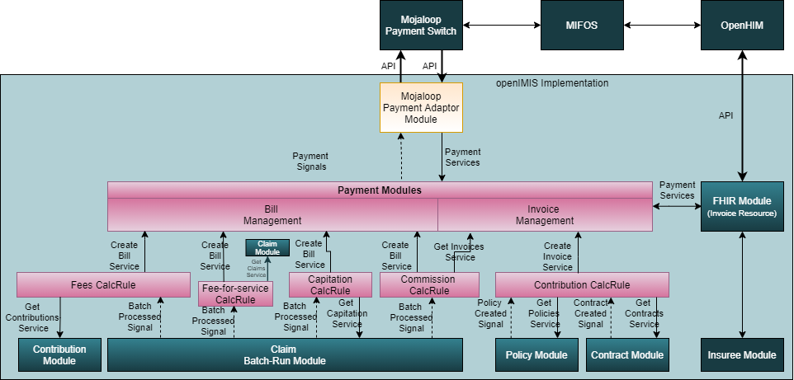
Architecture

