Slide 1
openIMIS
Gumzo ya Mwezi 07/03/2022

Slide 2
Agenda
Achieved
what we delivered this month
Roadmap
what we will deliver and what are our dependencies
openIMIS implementation
Updates about openIMIS implementation opportunities

Slide 3
Achieved this month

Slide 4
Achieved in February
The month of February has been dedicated to implementing the small missing bits:
Check missing parts of the application (we removed a few menu items)
Packaging
Testing the application and adding reports
Still some reports to add and frontend to finalize
Authentication

Slide 5
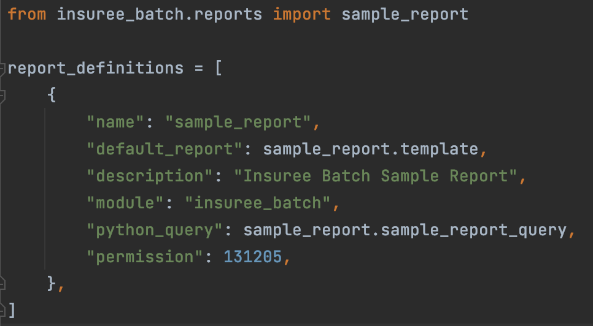
Reports: <module>/report.py

Slide 6
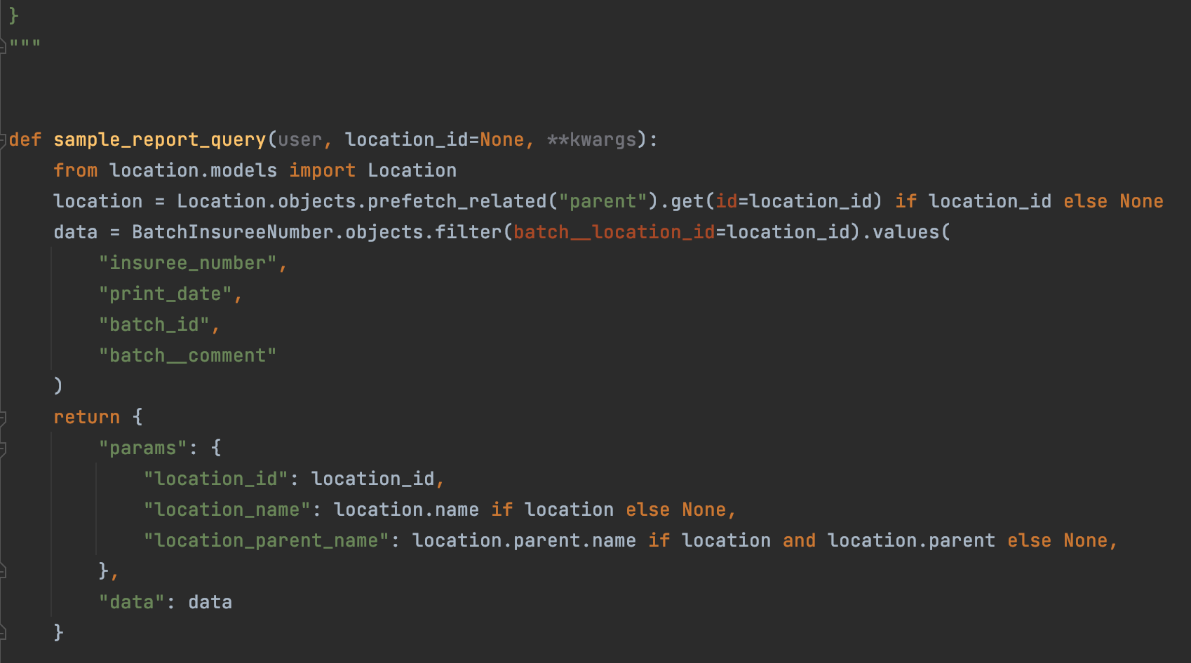
<module>/reports/sample_report.py

Slide 7
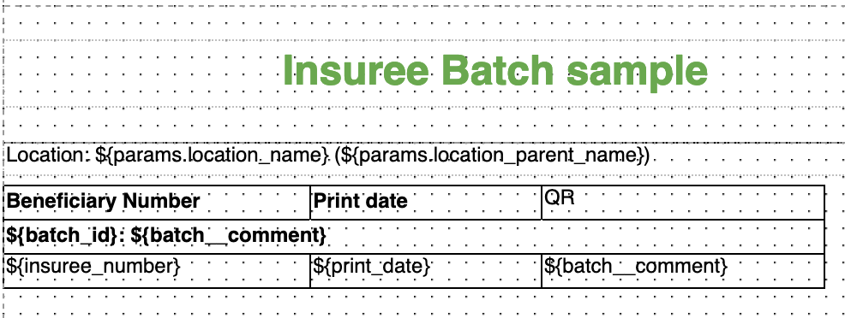
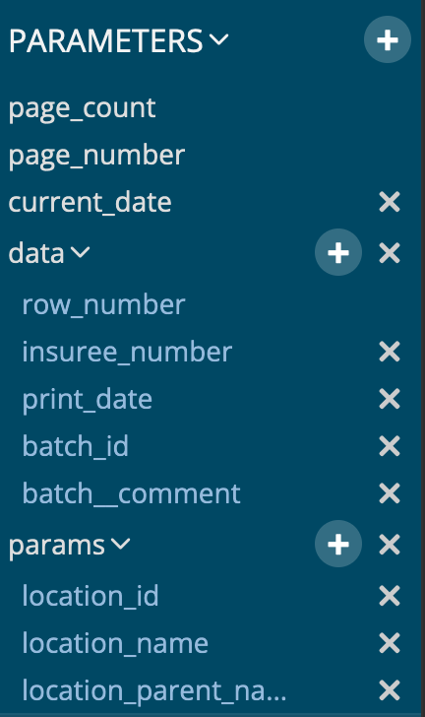
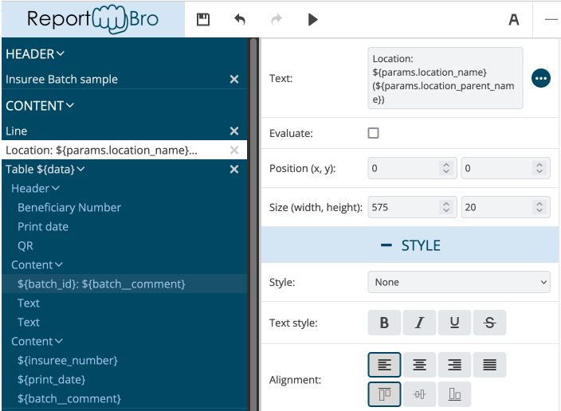
ReportBro

Slide 8
Running the report
https://<server>/api/report/insuree_batch/sample_report/pdf/?location_id=42
/api/report/ run a report
Insuree_batch module that contains the report to run
sample_report report name to run
pdf format (could be xlsx)
?location_id=42 parameter (report dependent)
We have support for …/pdf/alternate_template_name/ so that a single report can have multiple templates but not yet fully implemented.

Slide 9
Roadmap

Slide 10
Release… release… release
Focus on release testing, performance checks with Nepal and make sure that we have as good a release as possible.
From there, the focus will be on migrating the database to PostgreSQL. Target is May 2022

Slide 11
Bluesquare team
Eric Darchis Lead Senior Dev
Quentin Gérôme Senior Dev
Christine Verstraete Health Financing Lead PM
Laure Pontis PM
General discussion and exchanges => openimis-implementers-committee@googlegroups.com openimis-developers-committee@googlegroups.com
Feedback on mocks/testing => Wiki https://openimis.atlassian.net/wiki/home
All other => PM (Christine and Laure) cverstraete@bluesquarehub.com lpontis@bluesquarehub.com

Slide 12
Thank you!

