Slide 1
Maintenance and Support
07 March 2022
Activity Report

Slide 2
February 2022 activities
Support:
OSD-158: Region is not displayed – Waiting for customer
OSD-159: Creating a new claim is not working – Resolved
OSD-160: The review of the claim is not working – Resolved
OSD-161: Claim View – Resolved
OSD-163: Deployment of OpenIMIS on linux – In progress
OSD-164: OpenHIM password update – Closed
OSD-165: Validation of Insuree Number – Waiting for customer

Slide 3
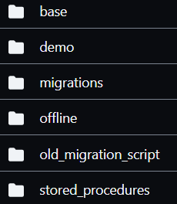
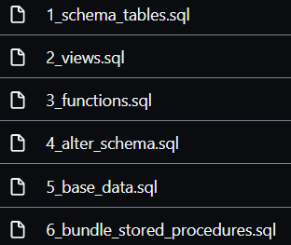
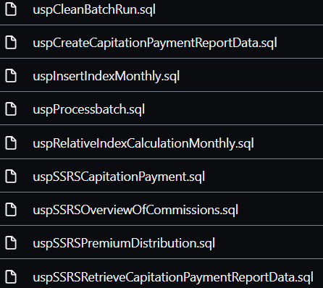
February 2022 activities
Maintenance/Development:
Security issues
CI fixes
New SQL structure
Bug fixes
PR reviews and integration
Server installation/maintenance:
Demo and release server issues

Slide 4
Time budget available
Total days | Remaining days | Remaining percentage
240 | 73 | 30.42%

Slide 5
Future activities
Maintenance and development:
Fix modular openIMIS version
Generate large data set and train demo AI Model
Publish demo mobile apps on Google Play
Bug fixes & PR
Release:
April 2022 Release
Full modular version release
New FHIR R4 module
New SQL structure
Testing of April 2022 Release

Slide 6
Maintenance and Support

