Slide 1
openIMIS
Implementers 23-Feb-2022

Slide 2
Agenda
New modules
Existing modules
Testing strategy

Slide 3
New modules

Slide 4
New modules
October release:
Users management
Products and Services
Price lists

Slide 5
New modules
Upcoming release:
Login
Product page heavy redesign
Extracts (reference data, mobile and offline)
Reports

Slide 6
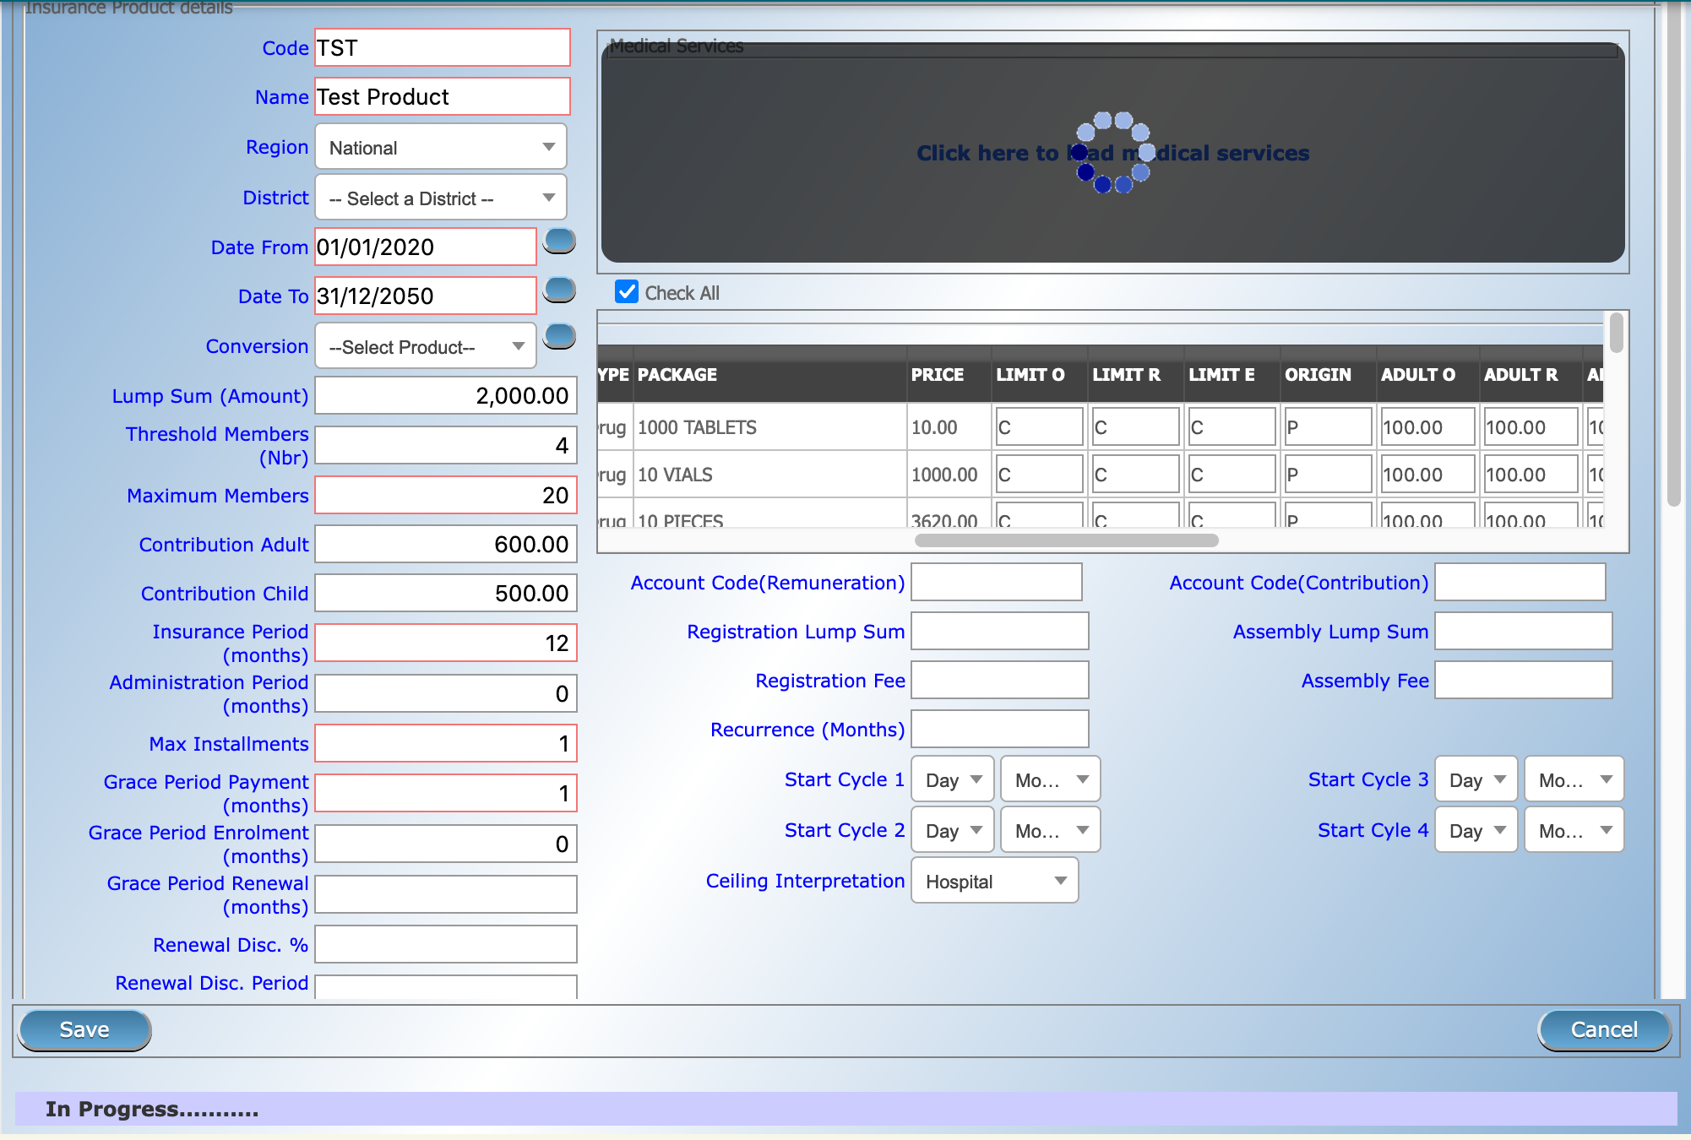
Product page

Slide 7
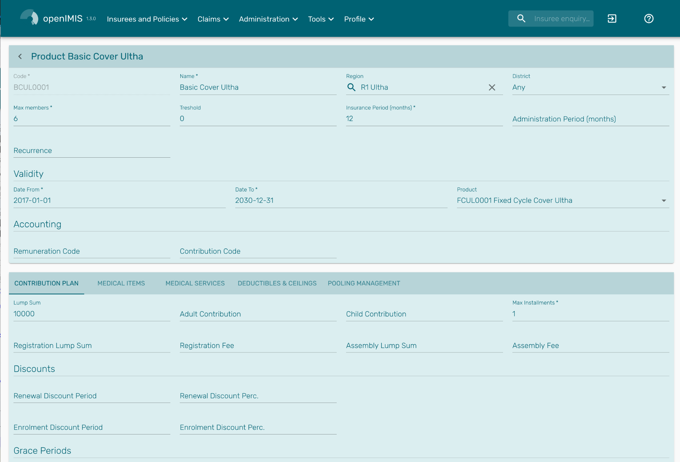

Slide 8
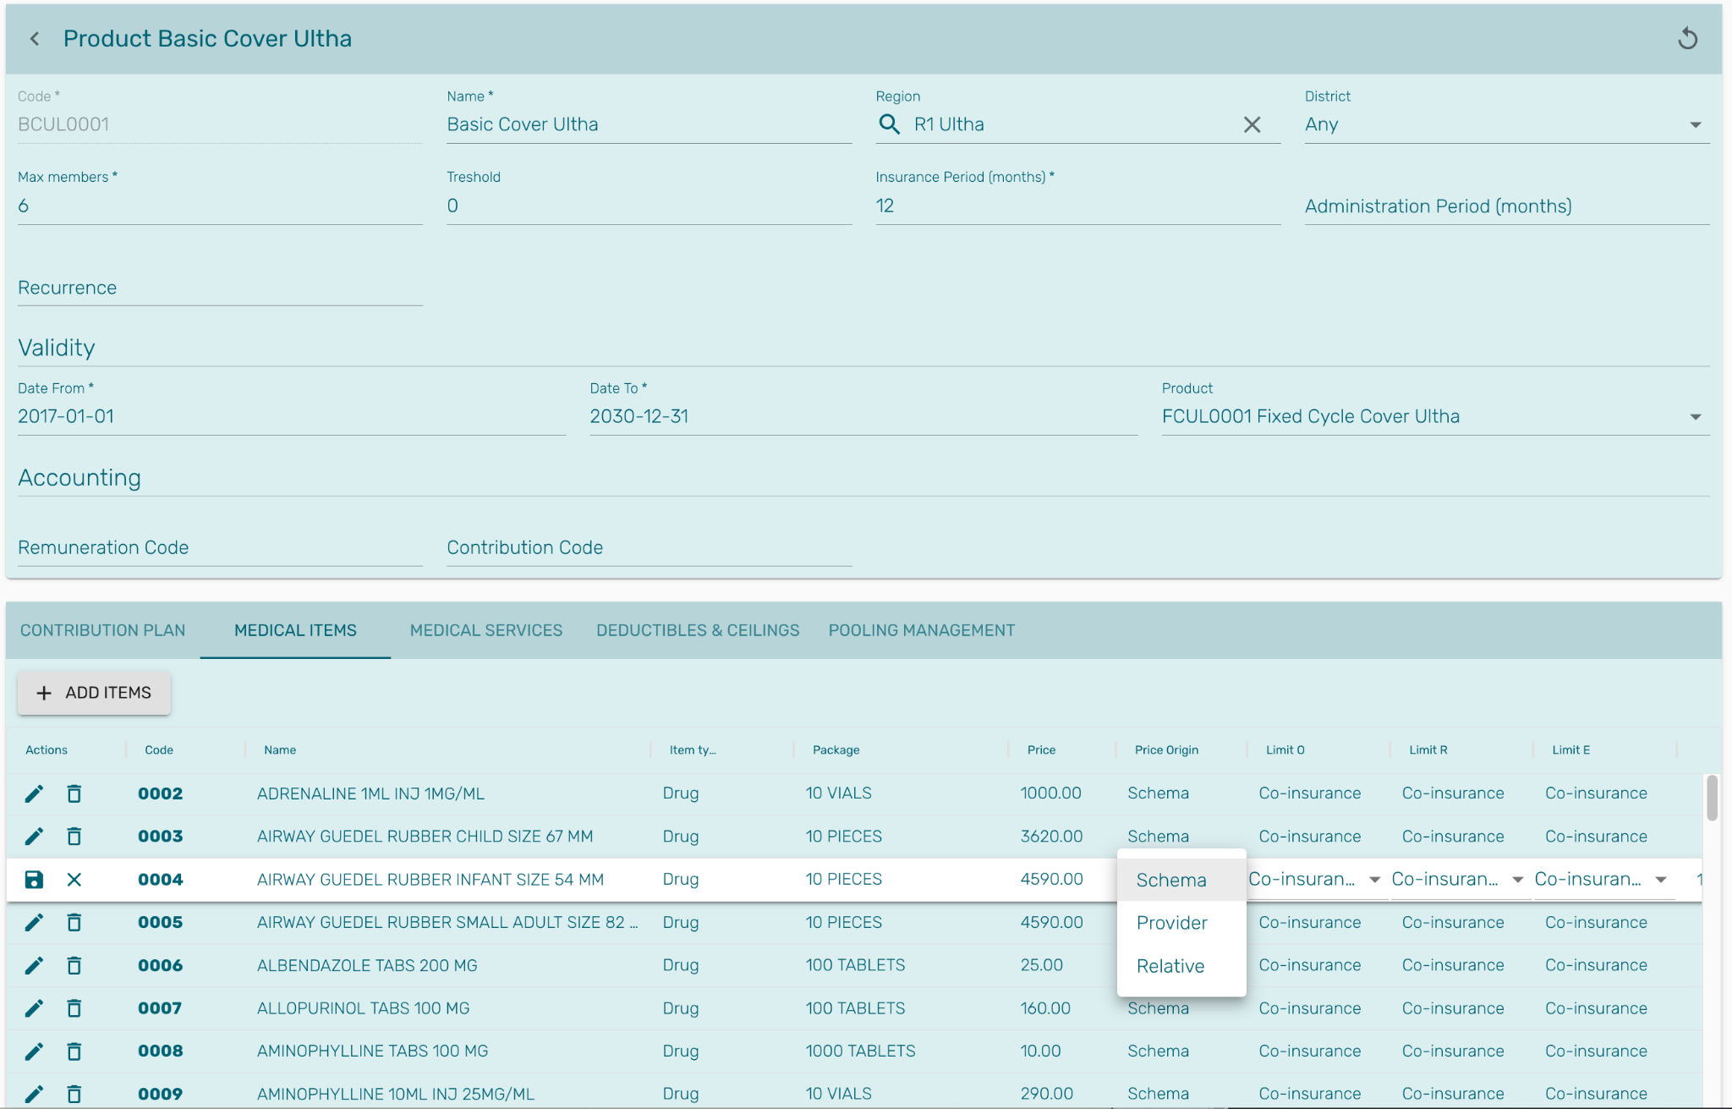

Slide 9
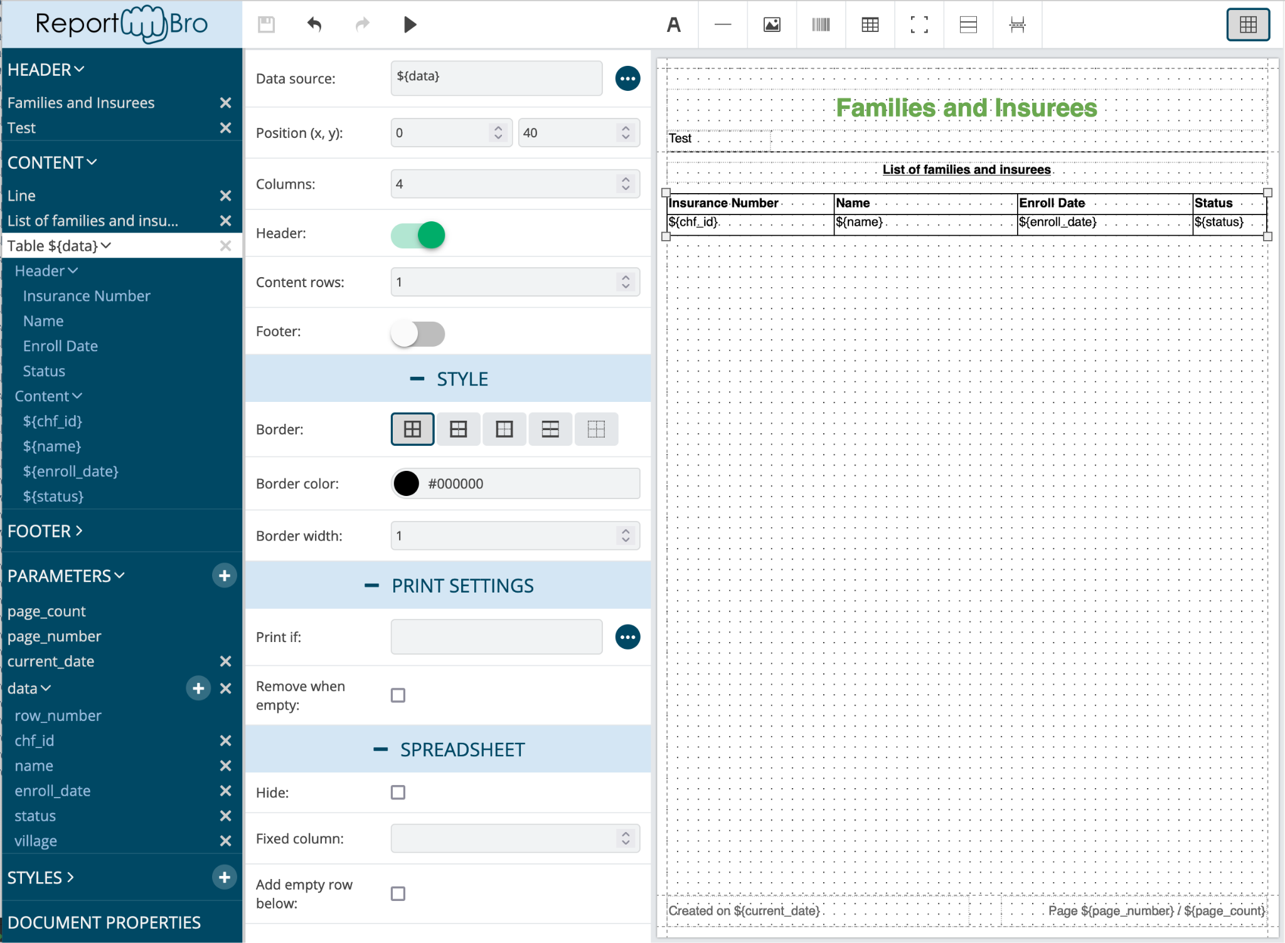

Slide 10
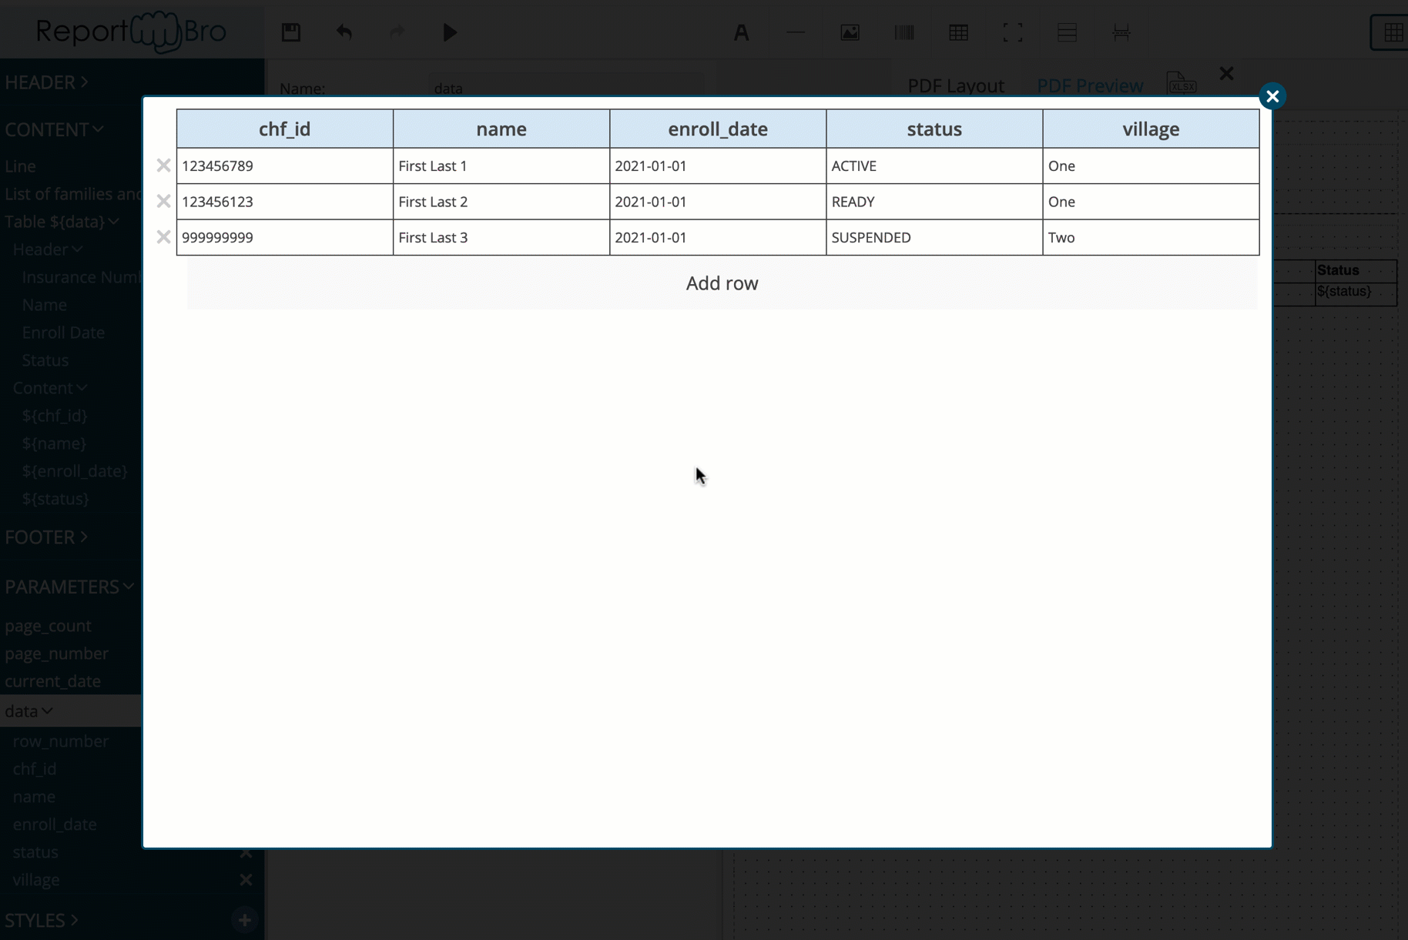

Slide 11
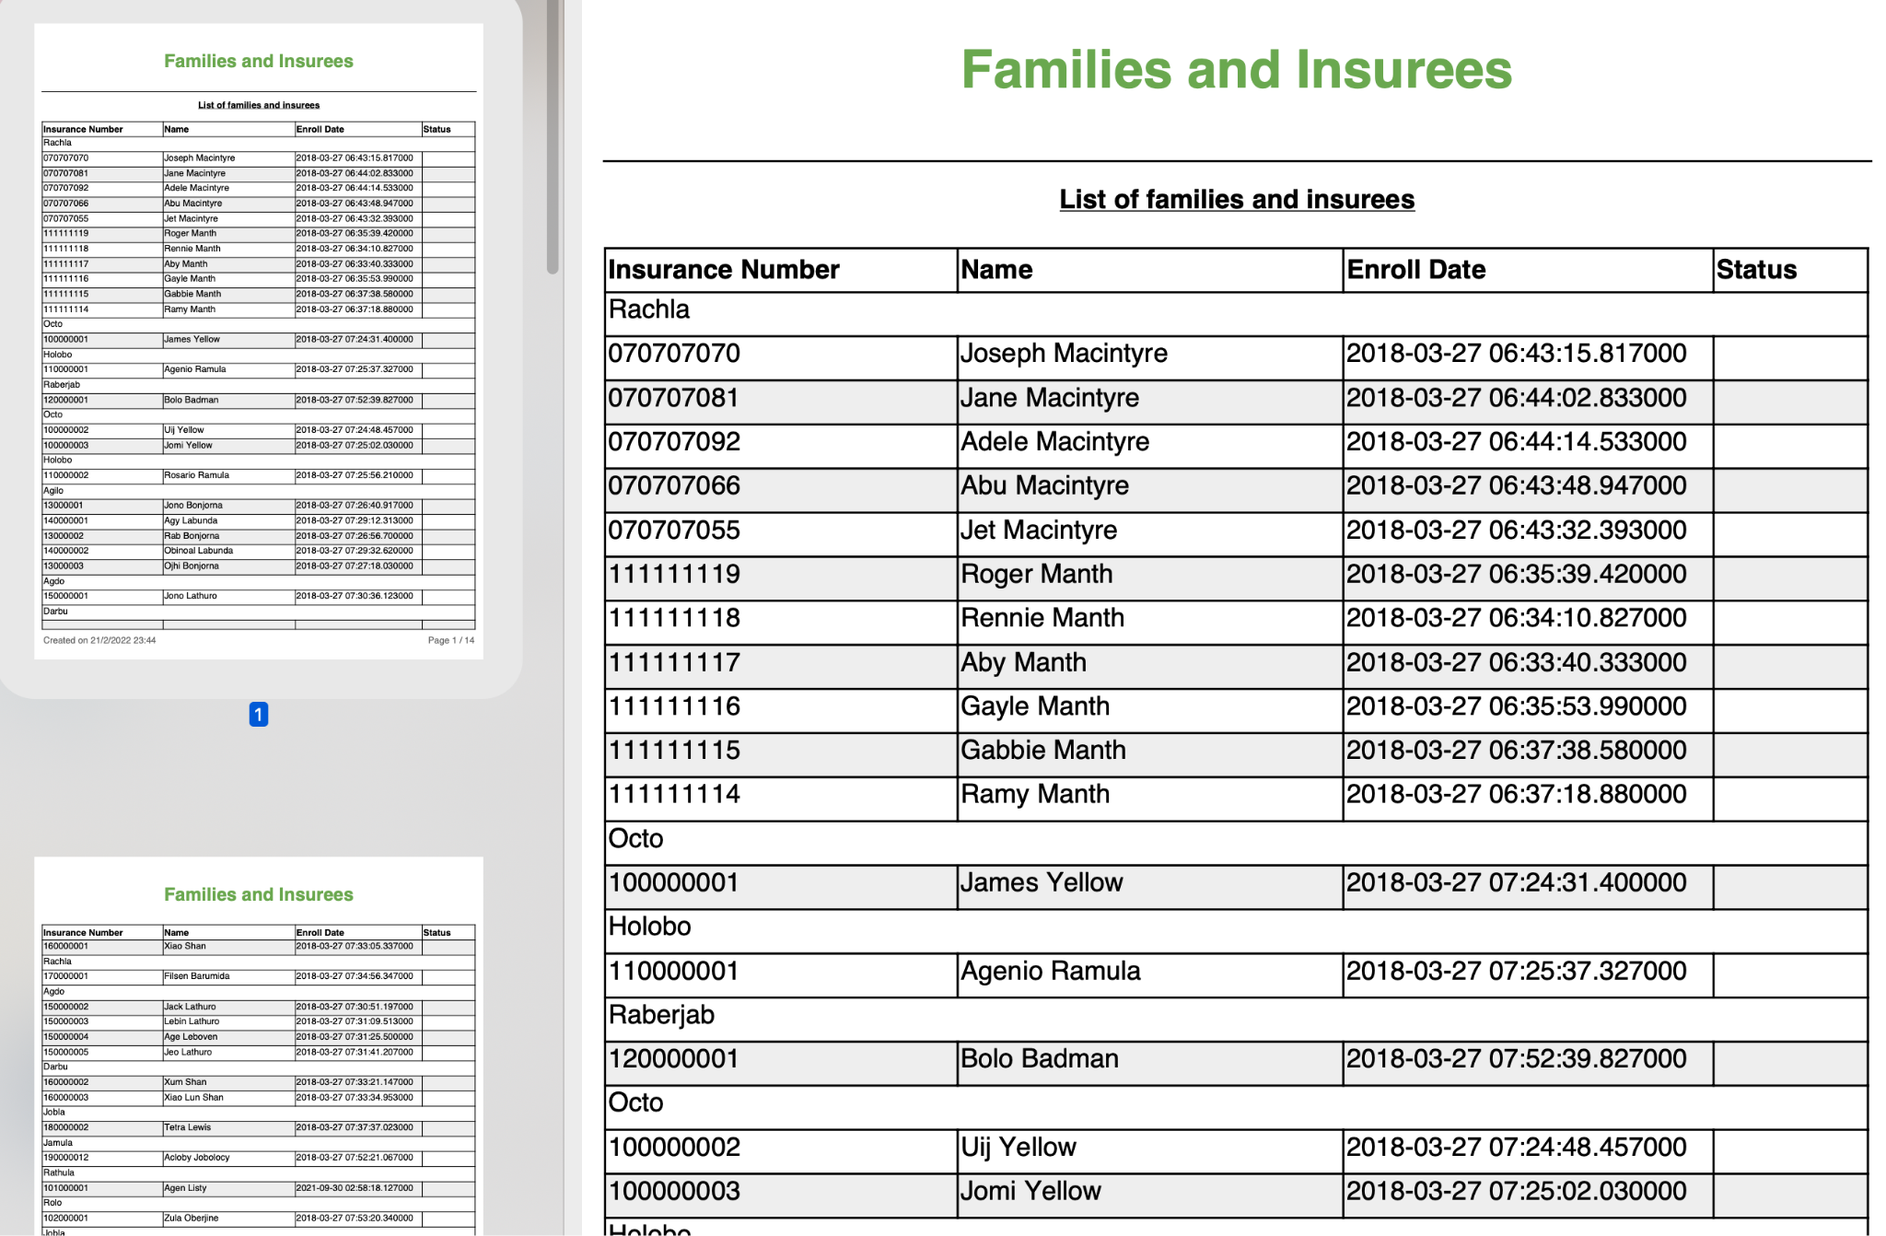

Slide 12
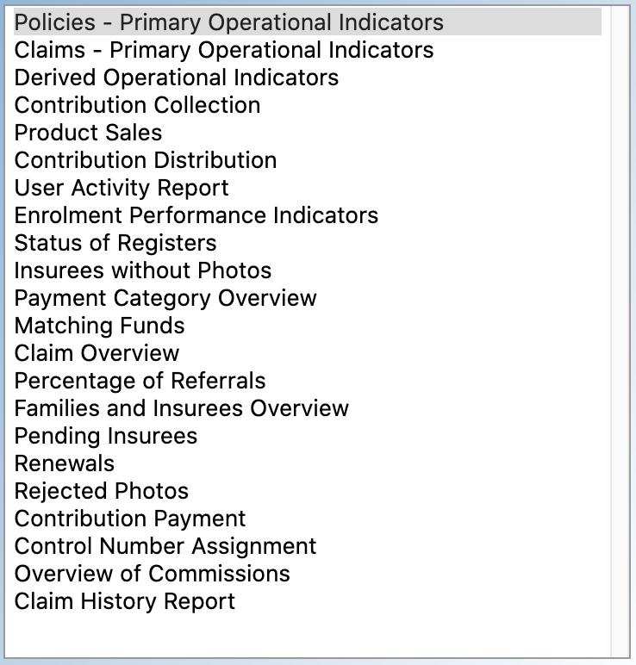
Report list
Some reports are not really reports but “batches”:
Capitation => SwissTPH rewrote it
Commissions => to rewrite with SwissTPH’s invoices

Slide 13
JWT authentication changes
In the previous cycle, the JWT authentication was implemented in the frontend by handling the token in JS, storing it in Local Storage and adding it to every request.
This however wasn’t compatible with the reports nor the claim attachments upload.
We reverted to a Cookie-based mechanism, handled by the frontend itself.
This implied a rewrite of the JWT authentication method in the backend, which should stay compatible.

Slide 14
Existing modules

Slide 15
Existing modules
The first and main modules that were already ported include:
Enrollment: beneficiaries, families, policies, contributions, payments
Claim: entering claims, automated validations, medical review, feedback, submission
Claim batch

Slide 16
Testing strategies

Slide 17
Testing strategies
The development team had to reverse engineer a number of features, rules, verifications, computations etc. We would really like to make sure that the results are what is actually expected for each insurance scheme.
We would also like to make sure that no part of the application or use case was lost in the rewrite.

Slide 18
Bluesquare team
Eric Darchis Lead Senior Dev
Quentin Gérôme Senior Dev
Christine Verstraete Health Financing Lead PM
Laure Pontis PM
General discussion and exchanges => openimis-implementers-committee@googlegroups.com openimis-developers-committee@googlegroups.com
Feedback on mocks/testing => Wiki https://openimis.atlassian.net/wiki/home
All other => PM (Christine and Laure) cverstraete@bluesquarehub.com lpontis@bluesquarehub.com

Slide 19
Thank you!

