Slide 1
openIMIS
Gumzo ya Mwezi 07/02/2022

Slide 2
Agenda
Achieved
what we delivered this month
Roadmap
what we will deliver and what are our dependencies
openIMIS implementation
Updates about openIMIS implementation opportunities

Slide 3
Achieved this month

Slide 4
Report module (deadline 1 Feb)
Work is under finalization on the report module.
As previously stated the report module is using the same reporting engine as the previous modules.
The generic report handling is performed in the report module but each module will be able to expose its reports.

Slide 5
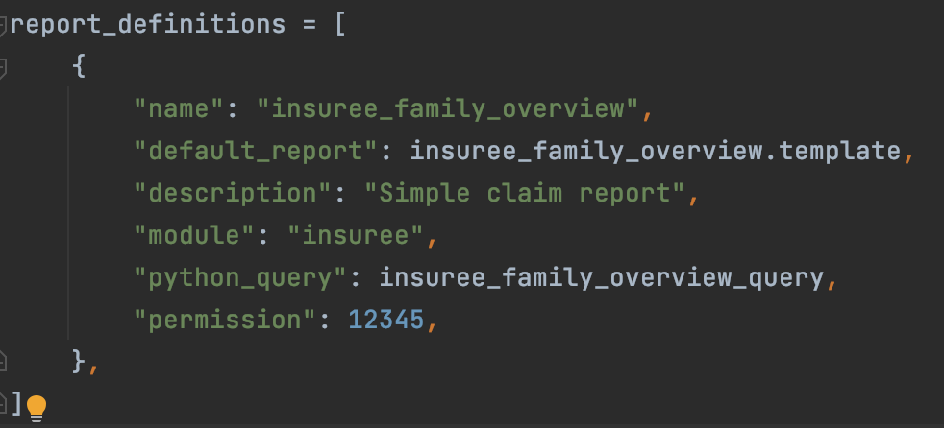
Each module can expose report.py
Default ReportBro template
Simple Python function that
generates the report
Permission required to generate this report, can be left to the report/admin default

Slide 6
ReportBro design
ReportBro was already bundled but only on the backend. The designer was left for implementers to handle.
The designer is now included into the application.
ReportBro also supports Excel output with specific features into the designer
The mechanism to override the report definitions was purely database driven. We are now exposing the list of available reports, the report definition overrides and GraphQL mutations to update them.
QR codes are supported in latest ReportBro version

Slide 7
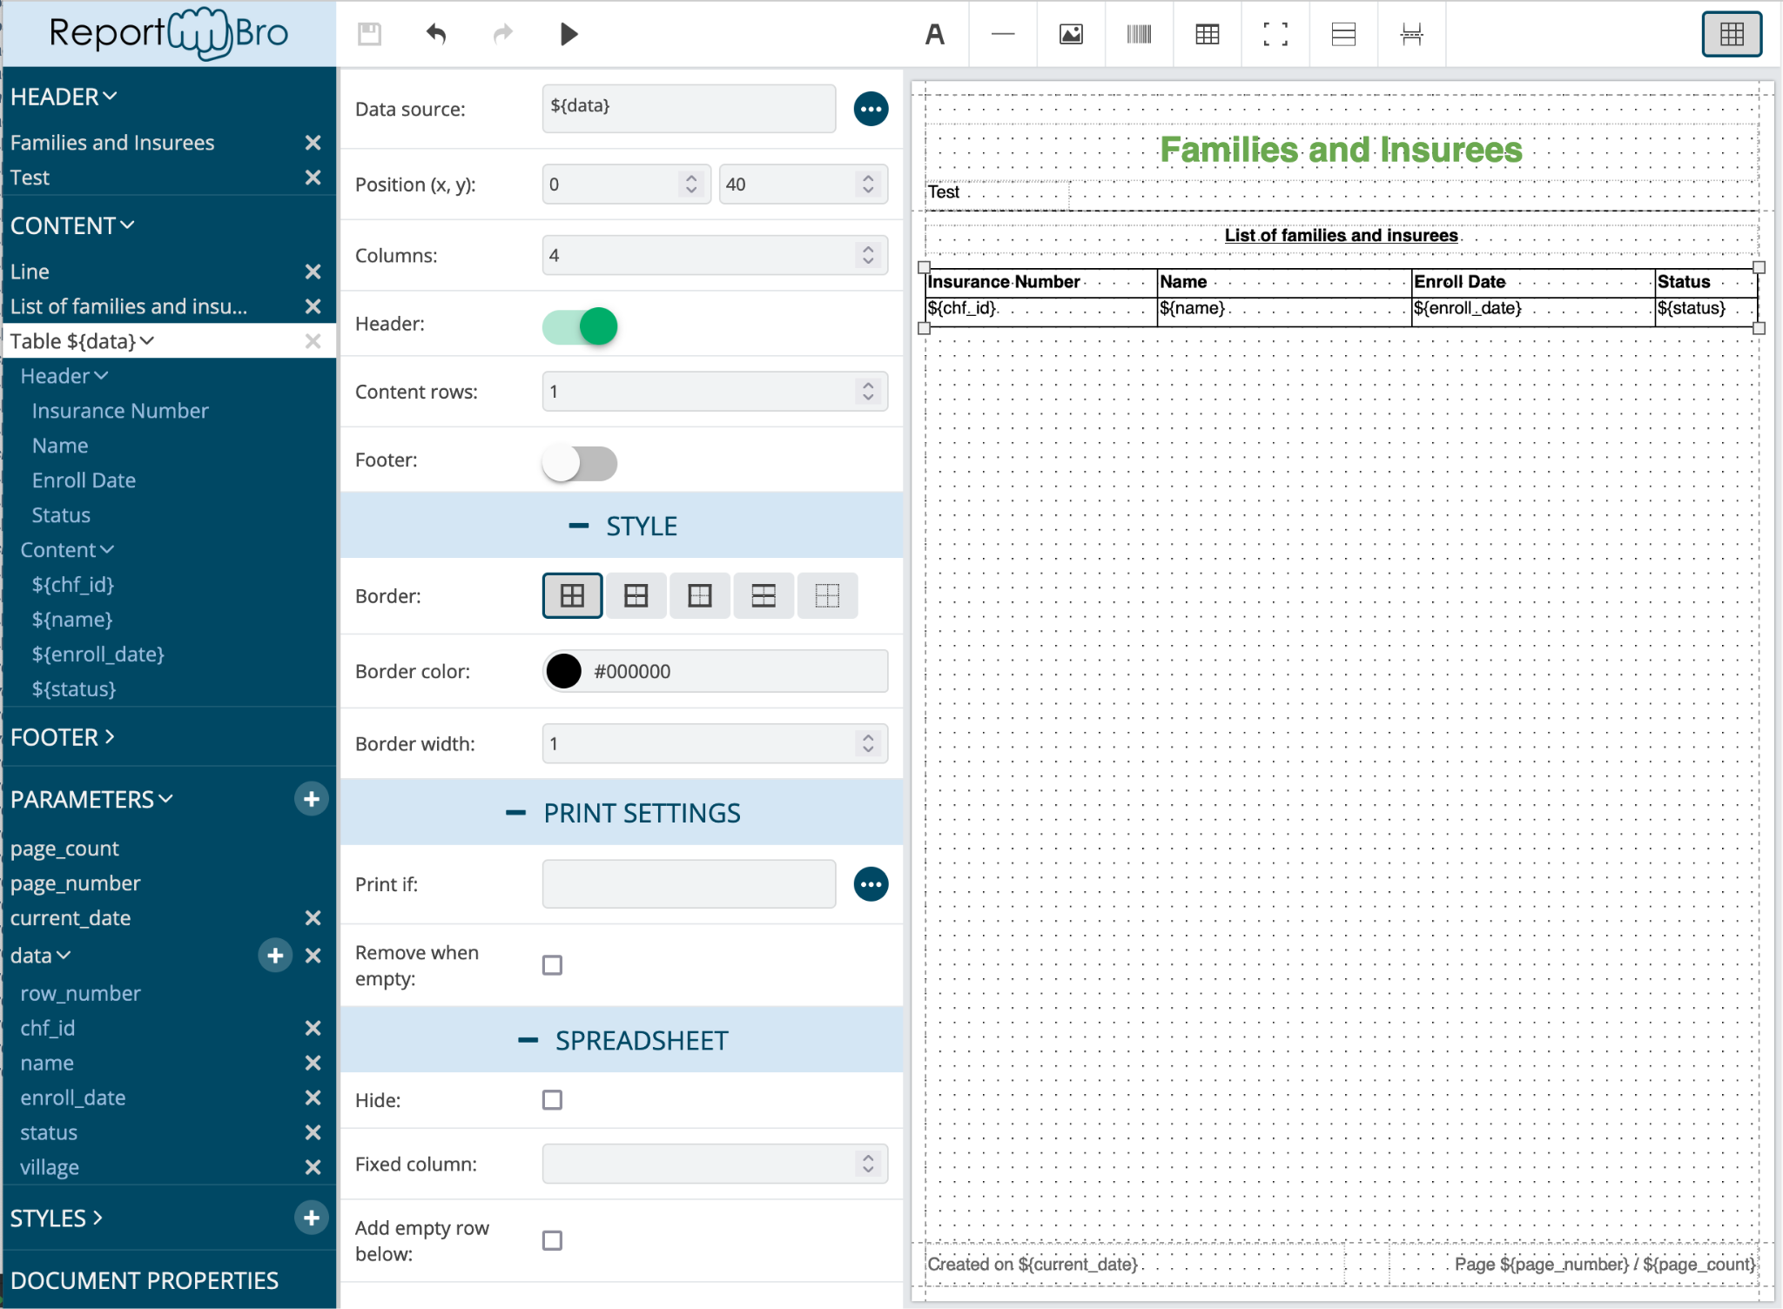

Slide 8
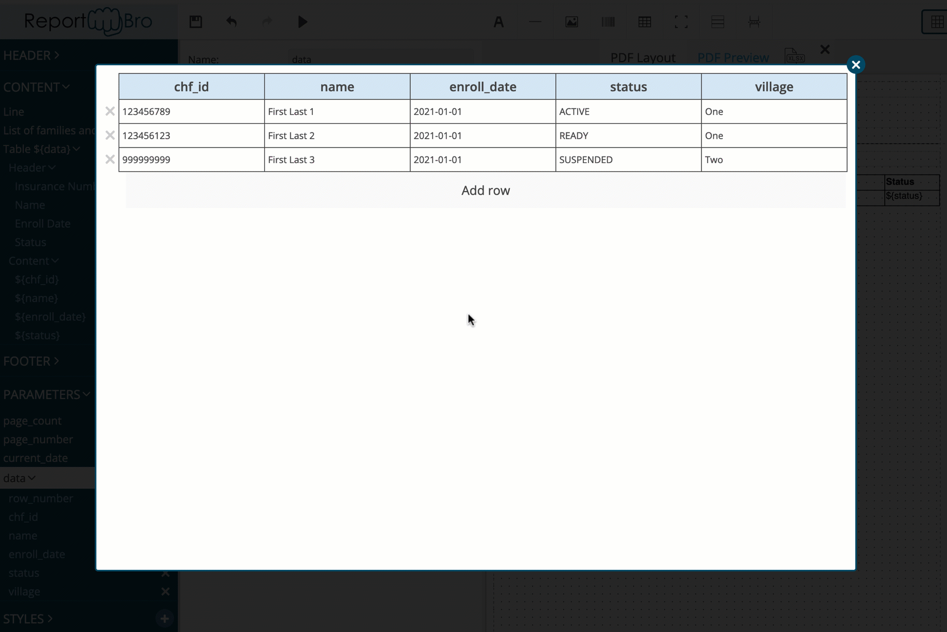

Slide 9
Reports are generated by URL
/api/report/<module>/<report_name>/<report_format>/?param=value
/api/report/claim/insuree_family_overview/xlsx/?location=1&date_from=2021-01-01
We chose not to specify parameters in the report description and to leave each frontend module expose a control to provide the necessary parameters.

Slide 10
JWT authentication changes
In the previous cycle, the JWT authentication was implemented in the frontend by handling the token in JS, storing it in Local Storage and adding it to every request.
This however wasn’t compatible with the reports nor the claim attachments upload.
We reverted to a Cookie-based mechanism, handled by the frontend itself.
This implied a rewrite of the JWT authentication method in the backend, which should stay compatible.

Slide 11
Roadmap

Slide 12
After the Report module
The report module will close the porting of legacy web app features to the modular architecture.
The month of February will be dedicated to implementing the small missing bits like the homepage and other missing screens, making a small package with a minimal version of the modular OpenIMIS and full end-to-end testing and verification of the software and improve/port as many reports as possible.
From there, the focus will be on migrating the database to PostgreSQL. Target is May 2022

Slide 13
openIMIS implementation

Slide 14
OpenIMIS implementation Niger
Updates:
Final online workshop took place on 1 Feb
Analysis of testing results and lessons learned
Next steps for openIMIS in Niger to be decided with Enabel HQ who is going there this week

Slide 15
Bluesquare team
Eric Darchis Lead Senior Dev
Quentin Gérôme Senior Dev
Christine Verstraete Health Financing Lead PM
Laure Pontis PM
General discussion and exchanges => openimis-implementers-committee@googlegroups.com openimis-developers-committee@googlegroups.com
Feedback on mocks/testing => Wiki https://openimis.atlassian.net/wiki/home
All other => PM (Christine and Laure) cverstraete@bluesquarehub.com lpontis@bluesquarehub.com

Slide 16
Thank you!

