Slide 1
openIMIS Functionality enchancement in Nepal
Claims Random Sampling
Beneficiary Mobile App
Self Enrollment

Slide 2
Random Sampling
Why?
To process pending claims in large volumes

Slide 3
Random Sampling Workflow

Slide 4
Beneficiary Mobile App
Features
Beneficiary can easily pay the fee through offline/online payment without visiting HIB
Can receive Notices from HIB
Can check available health services and claims
Can see near by Impaneled Health Facilities based on current location of user

Slide 5
Screen Shots

Slide 6
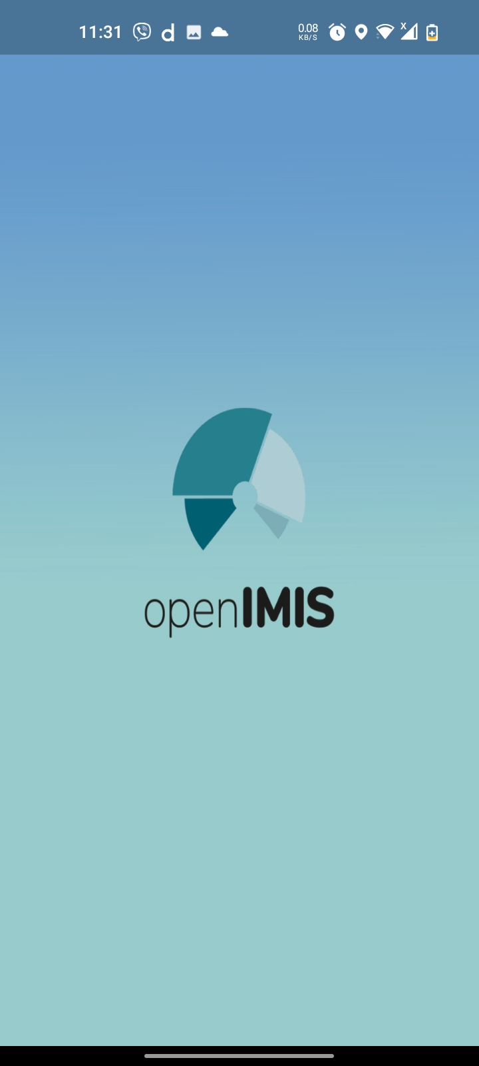
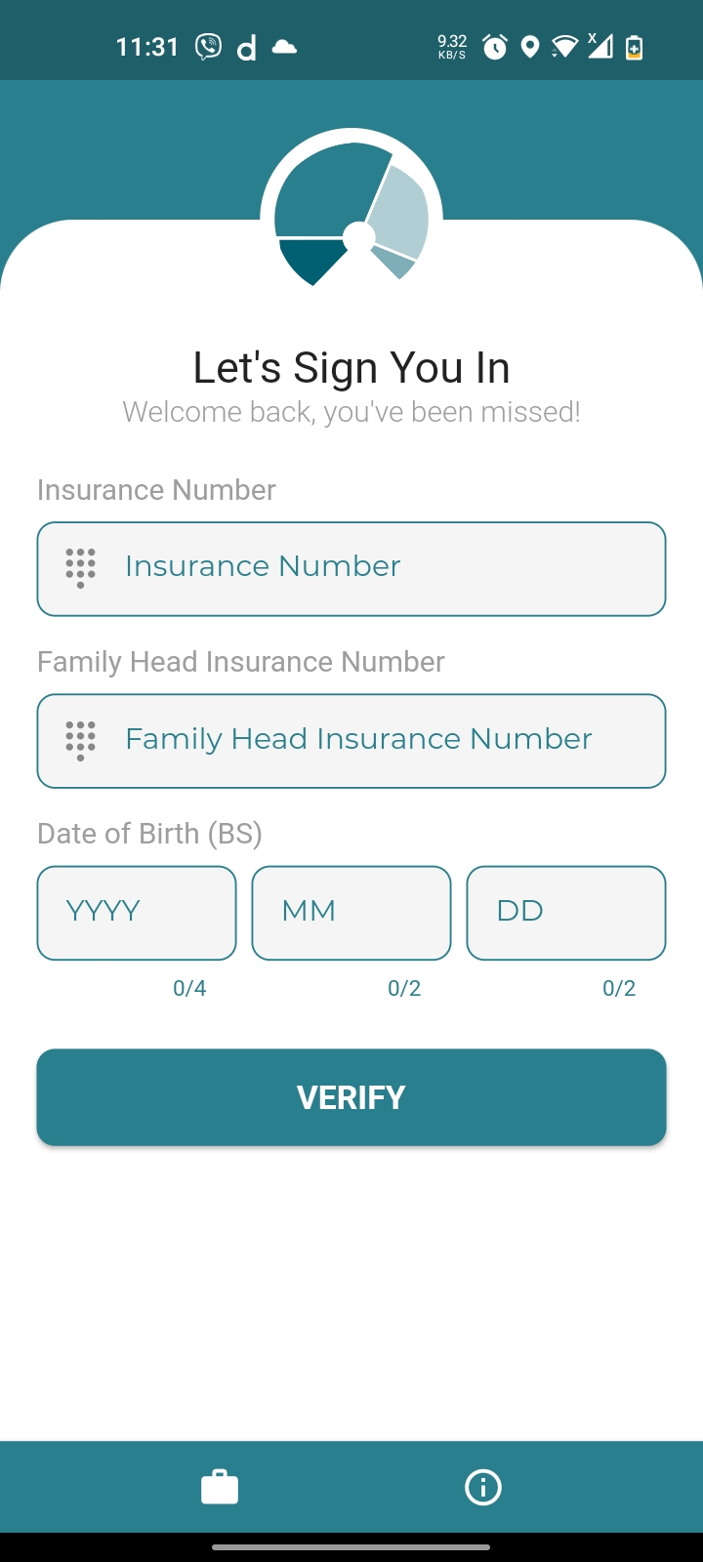
Loading Screen
Login Screen

Slide 7
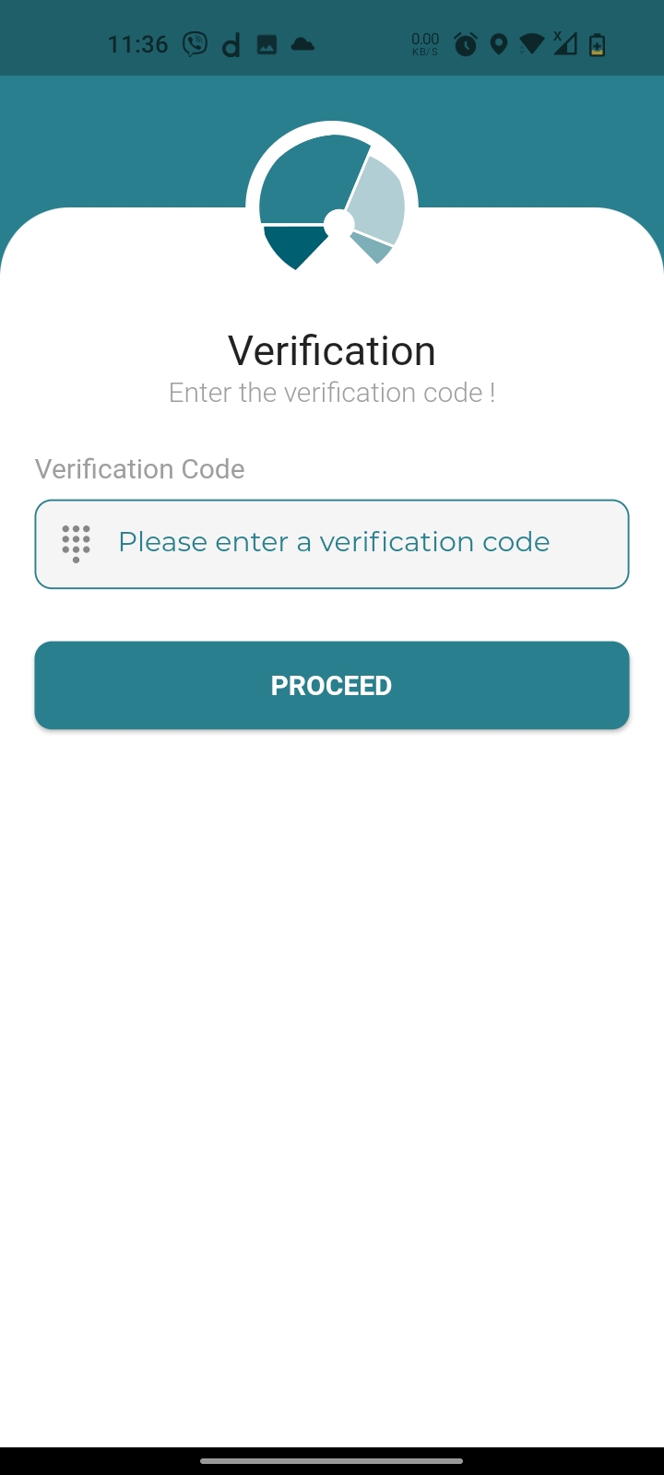
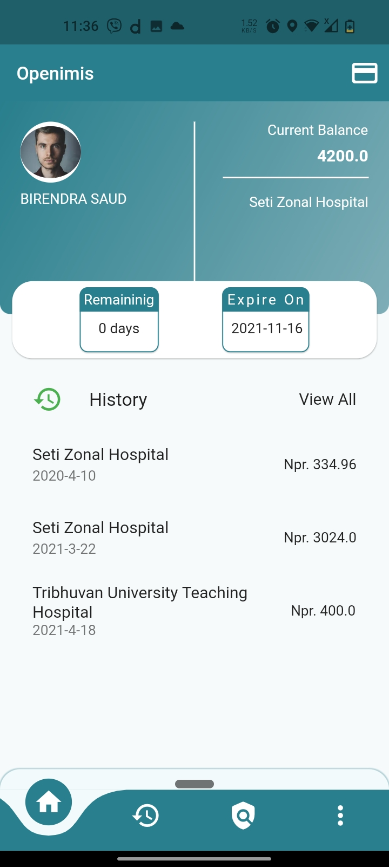
OTP Verification
Dashboard

Slide 8
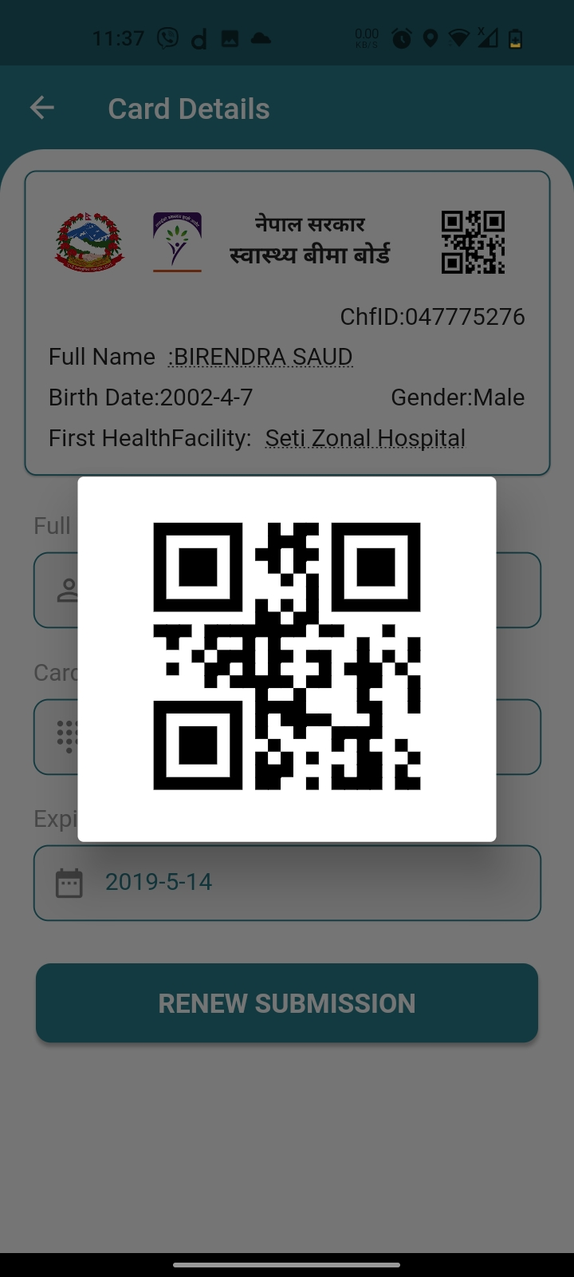
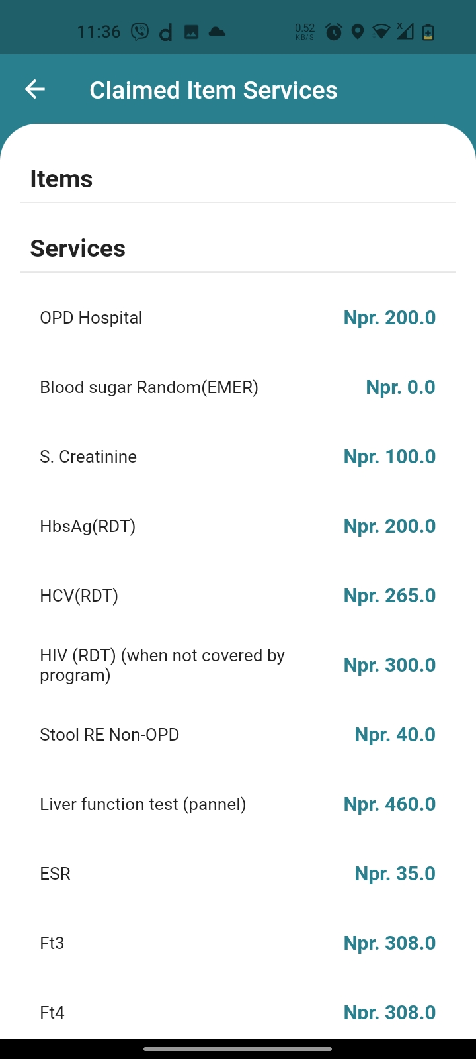
Show QR
Claimed Items

Slide 9
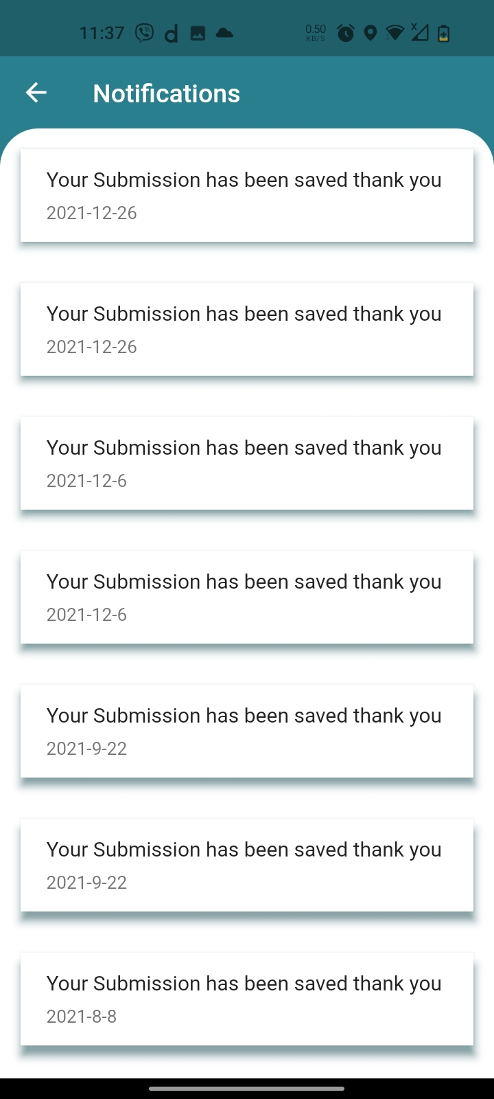
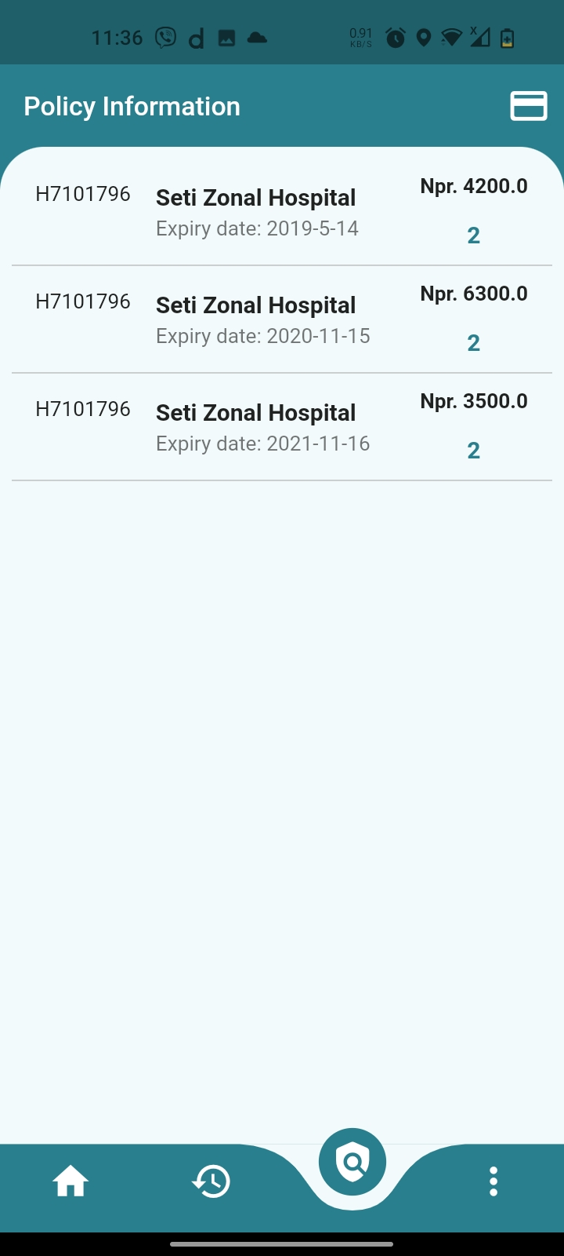
Notifications
Policy Information

Slide 10
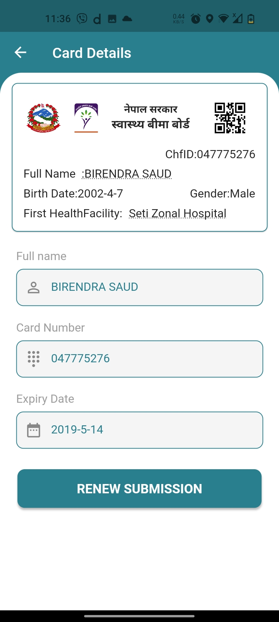
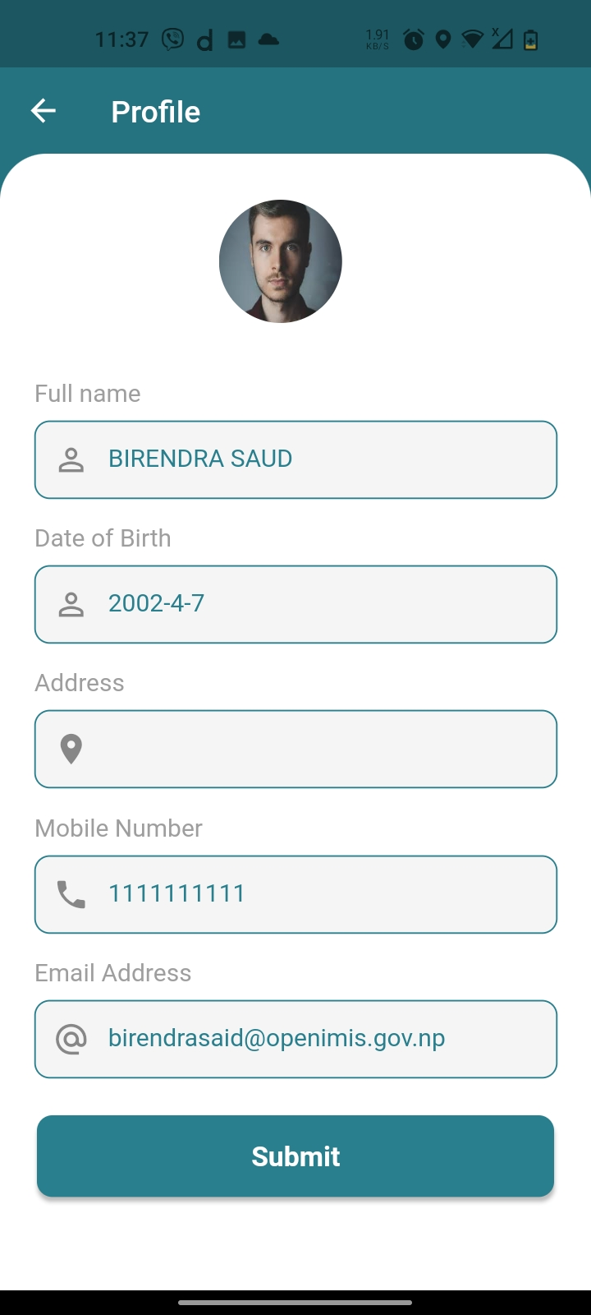
Policy Details
Edit Profile

Slide 11
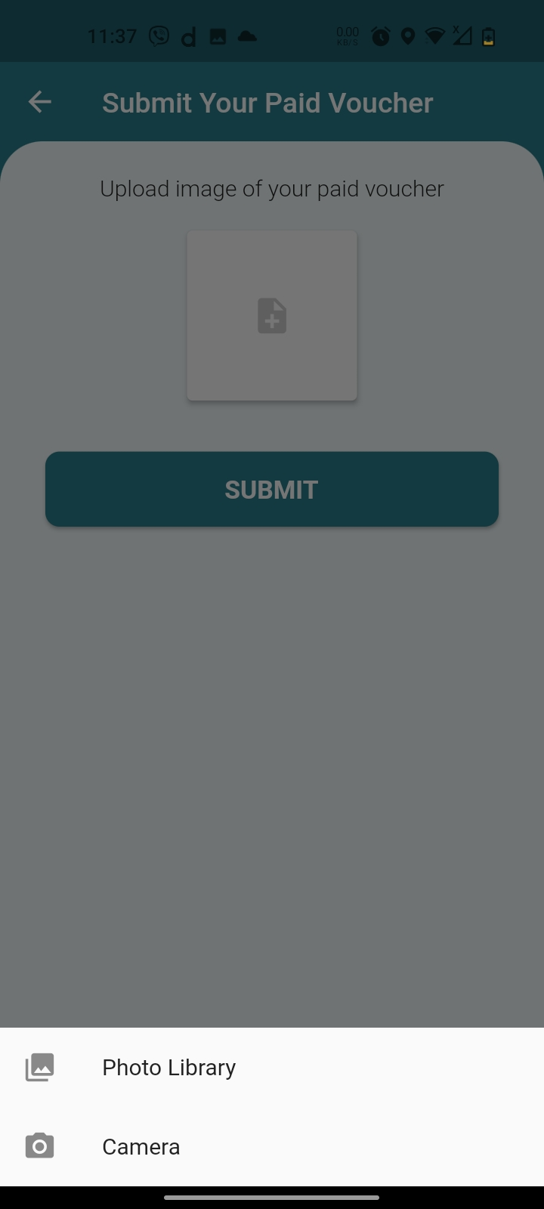
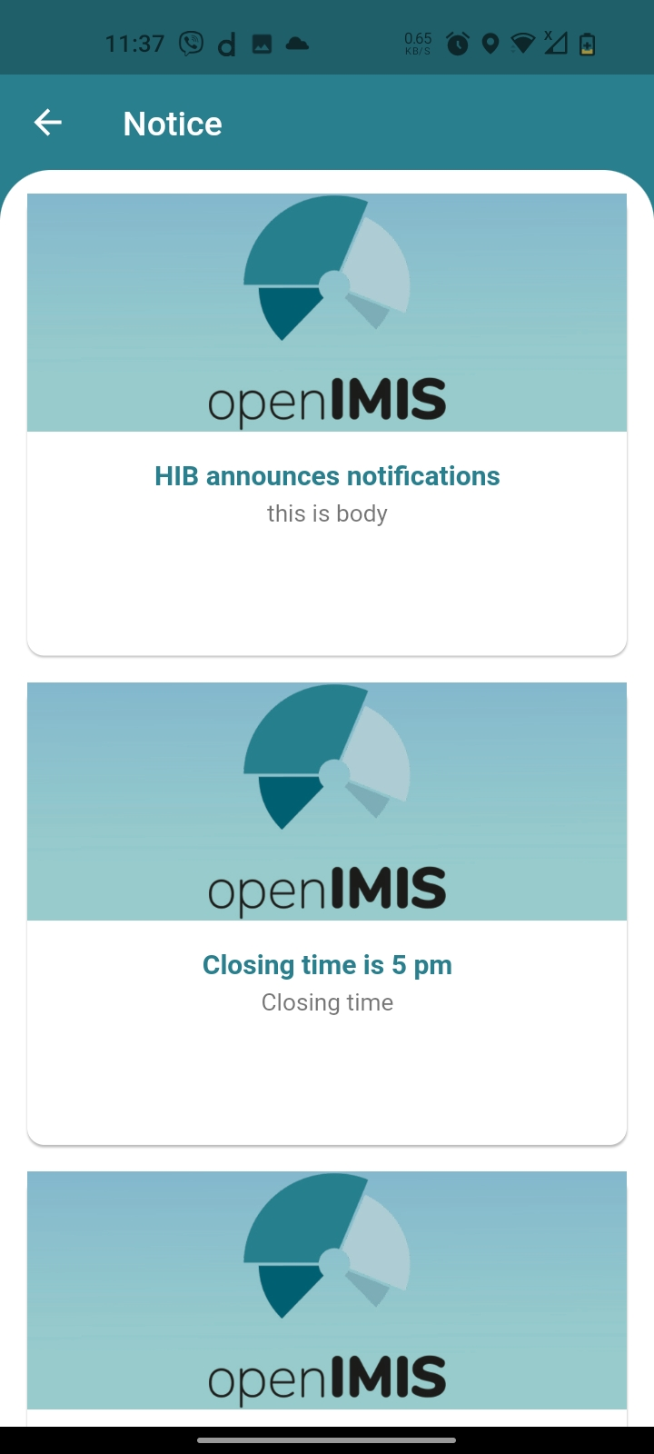
Upload Voucher
Notices

Slide 12
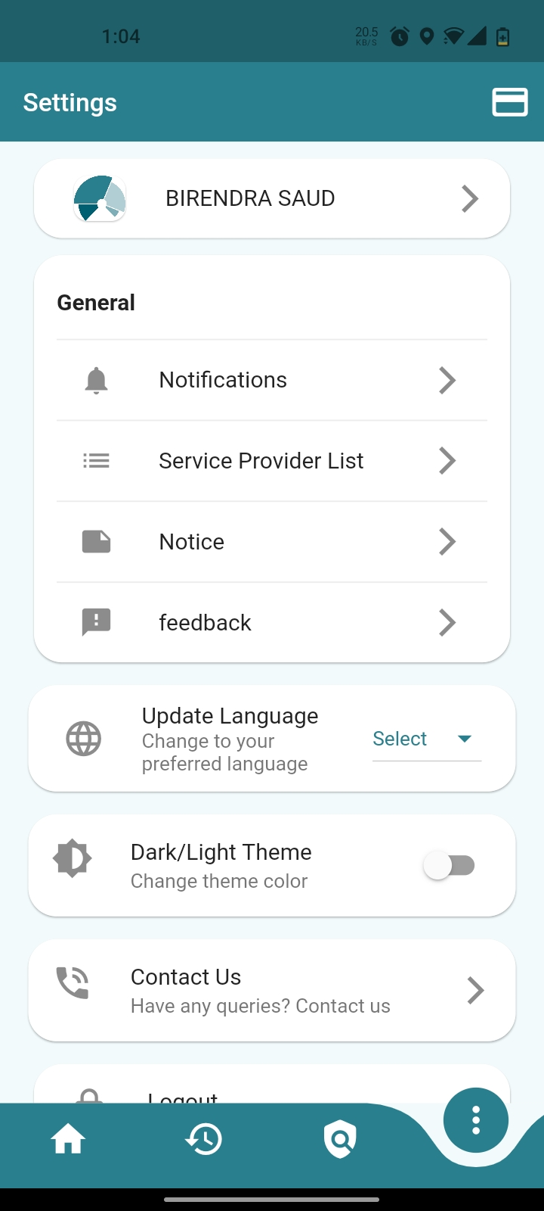
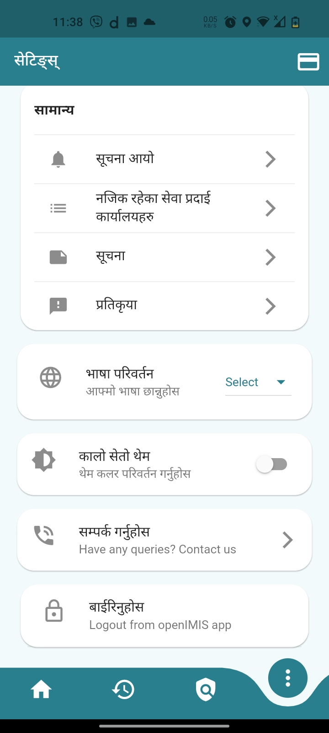
Settings EN
Settings NE

Slide 13
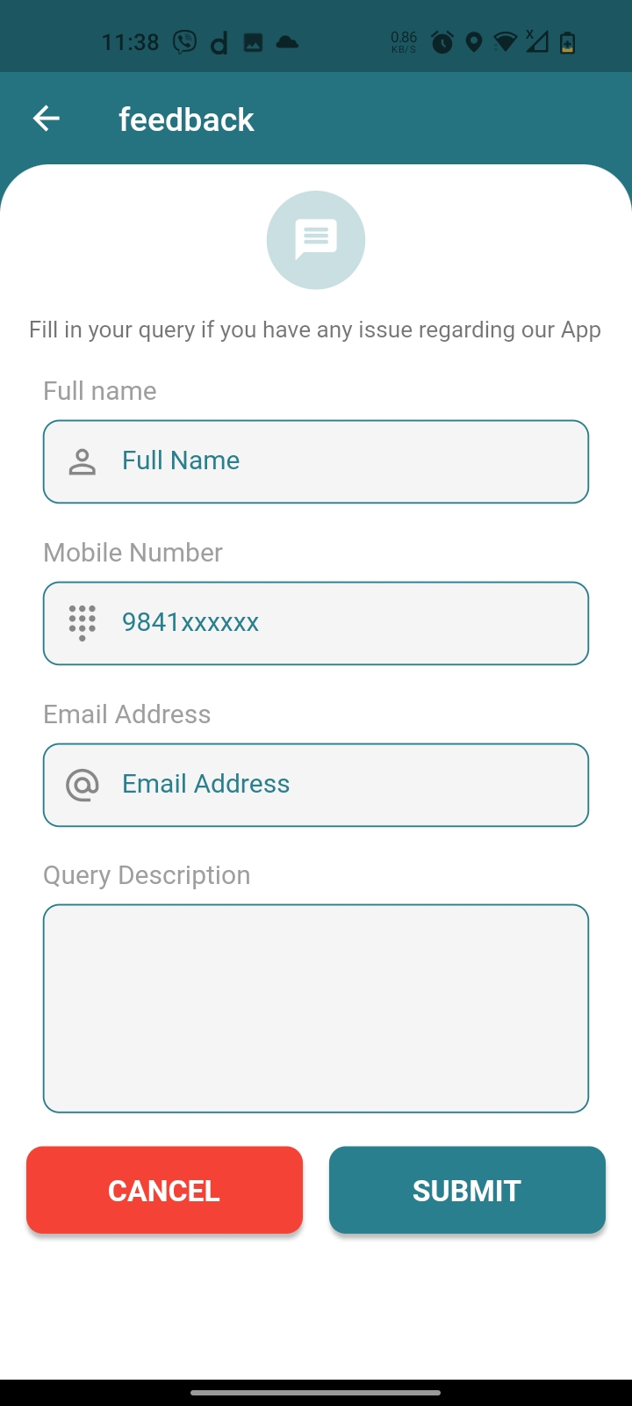
Submit Feedback

Slide 14
Self Enrollment Web App
Features
Beneficiary can easily Register themselves
Offline Payment/ Bank Voucher upload

Slide 15
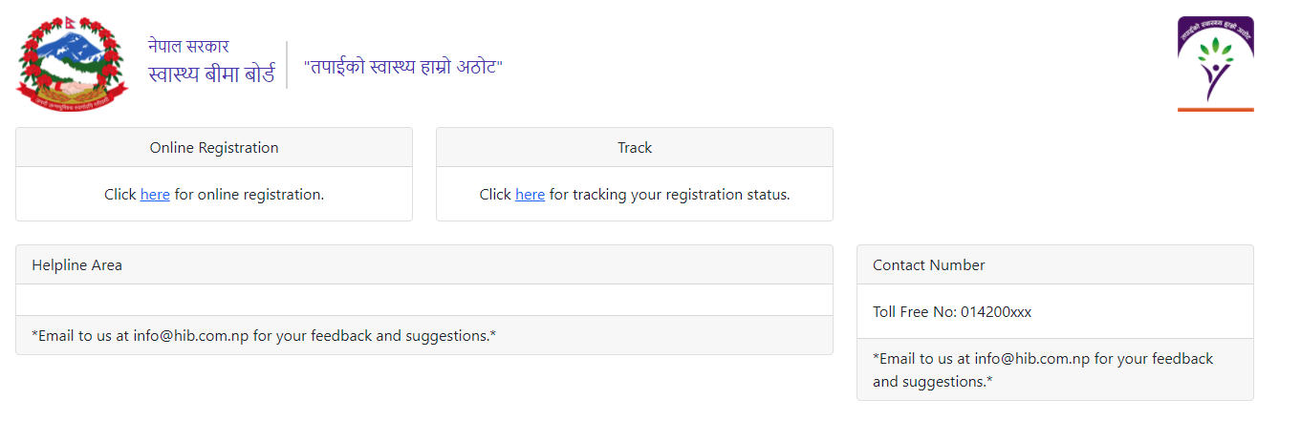
Home Page

Slide 16
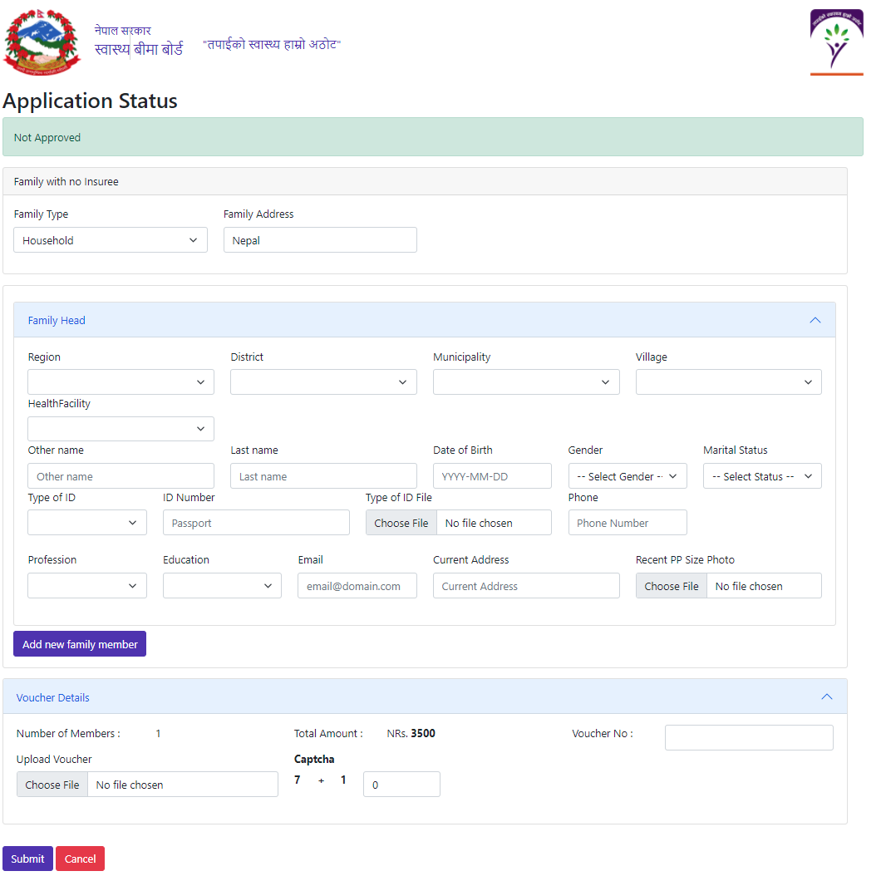
Online Registration
26.01.2022

Slide 17
Track Registration

Slide 18
Thank You !

