Slide 1
openIMIS Shelf Readiness
10 January 2021
Activity Report

Slide 2
WP1. openIMIS FHIR Module
Objectives (activities):
FHIR release four (R4) integration → 30.09.2021
Develop missing resources (ex. Contract, Enrolment Officer)
FHIR R4 extensions development → 30.09.2021
FHIR R4 extensions development (ex. insuree details)
openIMIS extensions development (ex. medication form and amount)
FHIR Authentication and Authorization → 30.06.2021
JWT authentication management
openIMIS FHIR Quality Assurance → 30.09.2021
Develop tests for the FHIR REST API
openIMIS FHIR module documentation → 31.12.2021
openIMIS FHIR IG
Document interoperability data exchange workflows

Slide 3
WP2. Packaging and Installation
Objectives (activities):
Docker package improvement → 30.06.2021
Publish Docker compose that don't need other files on the computer (using GitHub context)
Comply with Instant OpenHIE’s packaging/deployment strategy
Developer initialization script → 31.12.2021
facilitate the initialization of a ready to start openIMIS development environment

Slide 4
openIMIS FHIR module documentation
openIMIS FHIR R4 Implementation Guide (last build):
https://openimis.github.io/openimis_fhir_r4_ig
GitHub openIMIS FHIR R4 IG (source):
https://github.com/openimis/openimis_fhir_r4_ig
GitHub openIMIS FHIR R4 module (source):
https://github.com/openimis/openimis-be-api_fhir_r4_py
Profiling and IG tools:
SUSHI
IG Publisher
Python FHIR library:
FHIR® Resources (R4, STU3, DSTU2)

Slide 5
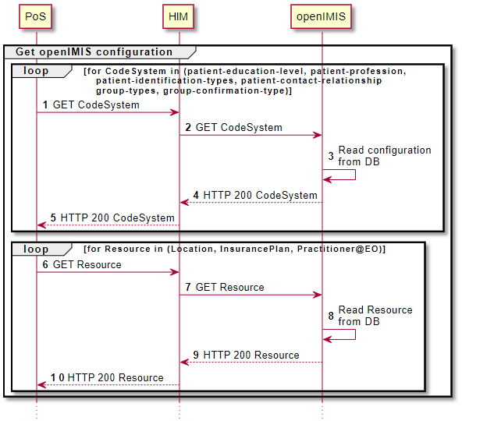
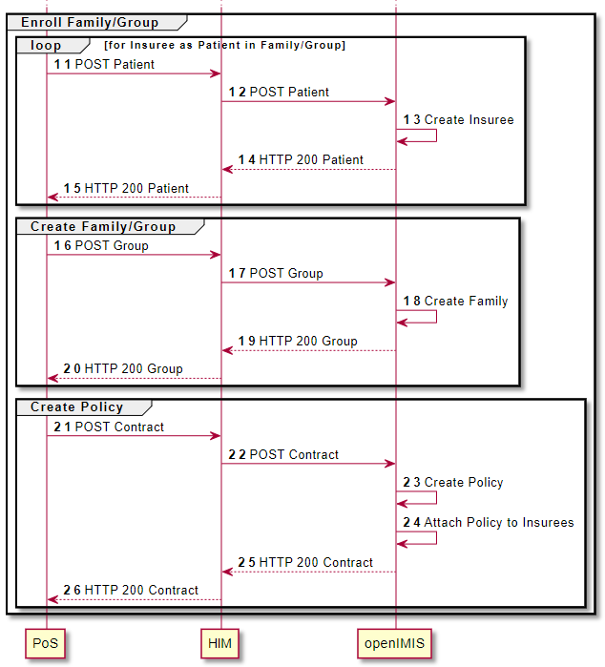
Workflows Enrollment
Link
2 steps:
Master Data synchronization
Enrollment data synchronization

Slide 6
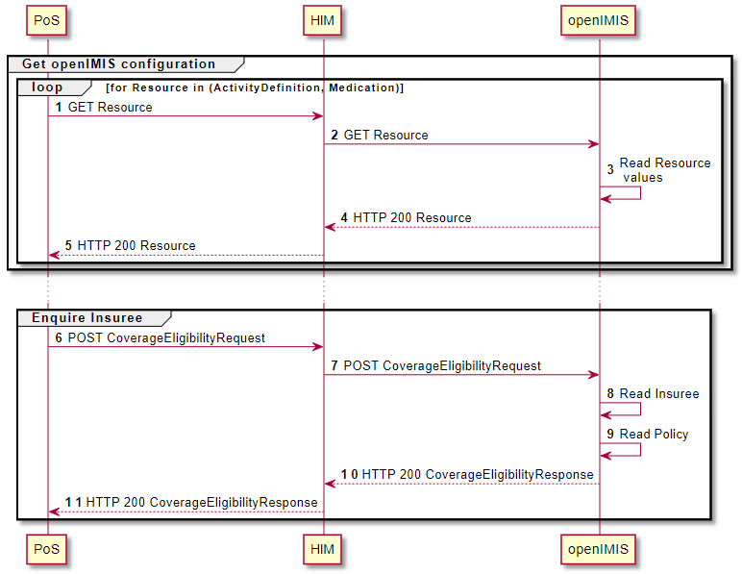
Workflows Enquire
Link
2 steps:
Master Data synchronization
Enquiring (per Service and/or Item)

Slide 7
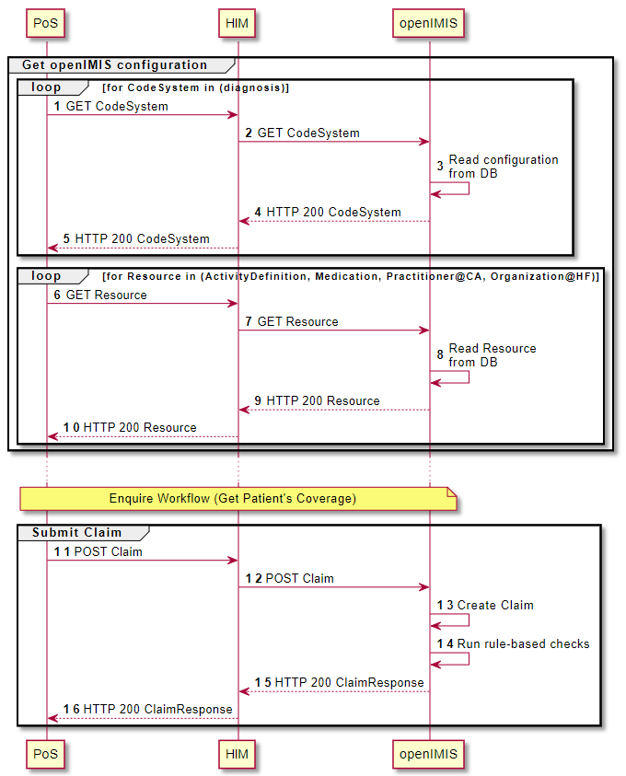
Workflows Claiming
Link
2 steps:
Master Data synchronization
Claims synchronization

Slide 8
Developer initialization script
BE Developer tools:
Create backend module skeleton in single command
Add GitHub files like workflows, gitignore
Fetch a module and install it from local directory
Fetch all modules and install them from local directories
Install modules from PyPI
Install all modules from PyPI
Create calculation backend module skeleton in single command
FE Developer tools:
Download from repository frontend module and build it locally in single command
Add github workflows files to the particular module
Fetch all modules and install them from local directories

Slide 9
openIMIS Shelf Readiness

