Slide 1
A tool for managing​ business processes in ​ Health and Social Protection
06 December 2021
Jean Brice Tetka

Slide 2
Outline
Introduction to openIMIS​
How can you use openIMIS?​
Catalytic Implementation Fund

Slide 3
Introduction to openIMIS
The success of health financing schemes depend on highly efficient implementation of multiple, complex business processes.​
Scheme operators in low- and middle-income countries struggle to achieve efficiencies in these schemes when they lack access to appropriate digital technologies.​
Build own IT system​
Buy commercial​
Use opensource ?

Slide 4
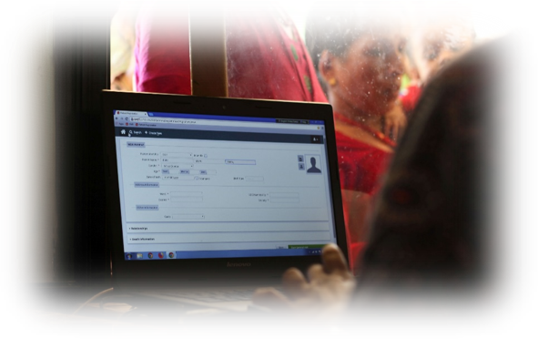
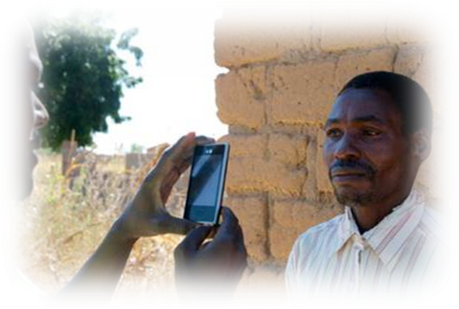
What is openIMIS?
openIMIS is an​
Open source software for manging health financing processes. It helps digitzing the link between patients, providers and payers for health care.​
It is supported by a​
community of developers, users and implementers​
With the joint mission to​
Increase and improve universal health coverage (UHC)​

Slide 5
Open Source !
COPYRIGHT​
(c) 2016-2018 Swiss Agency for Development and Cooperation (SDC)​
​
LICENCE​
GNU AGPL v3 License as published by the Free Software Foundation​
Free to use, modify, and redistribute

Slide 6
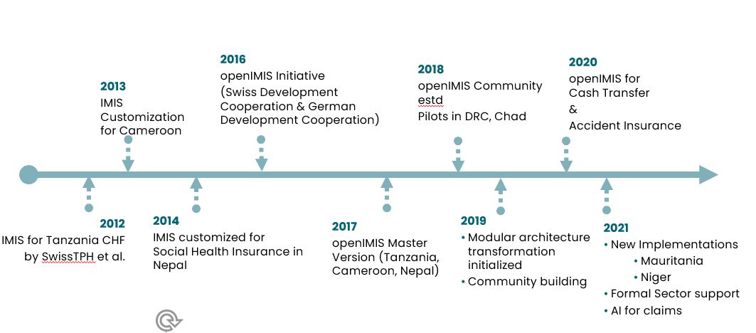
The History

Slide 7
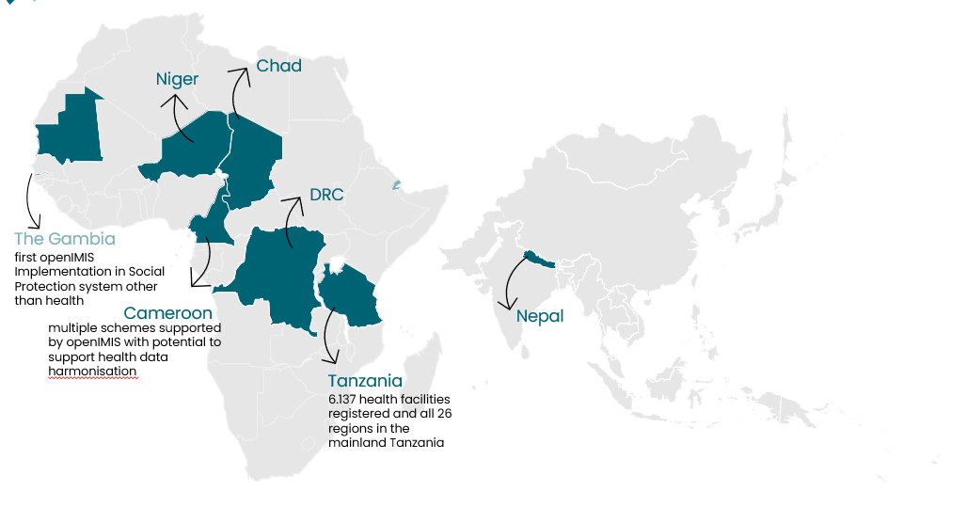
Where is openIMIS used?

Slide 8
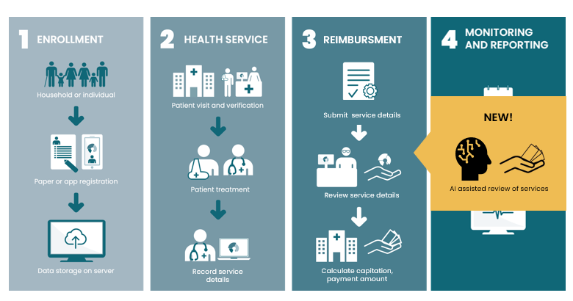
openIMIS Workflows

Slide 9
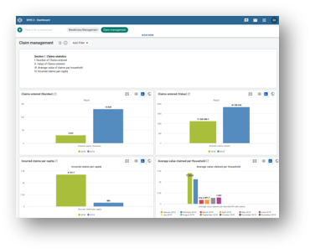
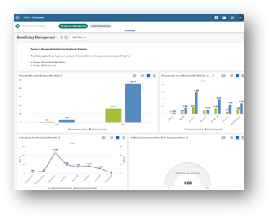
Interop example: DHIS2
openIMIS is capable of sending HL7 FHIR compatible data on:​
Beneficiaries​
Policies​
Claims​
Services​
Items​
in order to produce analytical dashboards in DHIS2
Standard Dashboards available for​
Beneficiary Management (~25 indicators)​
Claims Management (~50 indicators)​
Scheme performance (6 indicators)​
​Ability to customize/design dashboards according to need.

Slide 10
How can you use openIMIS?

Slide 11
Manage health insurance
​Formal sector schemes (employer/employee based)​
Informal sector (contribution based)​
Private insurance
Manage beneficiaries​
Record services and generate insurance claims​
Digital transmission of claims​
Review of claims​
​
Online/Offline functionality

Slide 12
Manage voucher schemes
Example: Voucher schemes for maternal care​
​
Register pregnant women​
Provide ‘digital vouchers’ for various ANC and Post-natal visits​
Record services provided​
Keep track of used vouchers​
​
Online/Offline functionality

Slide 13
Manage any process where you need to keep track of the diagnosis and services provided to patients
Uniquely identified patients
Capture diagnosis using ICD10
Record services & drugs provided to patient (including pricing information)
Analyze data extensively using DHIS2 platform

Slide 14
Beyond health: Cash Transfer Schemes
Example: Cash Transfer for COvID-19 in The Gambia
Register beneficiaries
Identify beneficiaries using unique ID
Keep track of ‘service’ provided - cash payment
Ensure no duplicate payments
Pre-defined cash payment values
Use Android app or web platform for recording data

Slide 15
Catalytic Implementation Fund

Slide 16
Catalytic Implementation Fund
openIMIS, the software and knowledge around it is free
Costs are incurred for an implementation
Hardware
Software customization
Training of users
The lack of funds to cover the initial implementation costs are a barrier for openIMIS up-take

Slide 17
CIF details
BMZ & SDC have jointly setup a Catalytic Implementation Fund for supporting openIMIS implementations in partner countries
Catalytic nature
Aimed to ‘start’ the implementation process
Not intended to be a continuous funding stream
Sustainability of use case is high priority
Partner Countries
BMZ/SDC development cooperation

Slide 18
Eligibility
Scheme operators
For health financing or other social protection schemes
Clear scheme definition
Legal and/or policy frameworks
Well defined Standard Operating Procedures
Funds could be used for
Software customization
Capacity Development
(limited) Equipment needs

Slide 19
The process
Scheme operator
Express interest to openIMIS Coordination desk
Work with CD to do a ‘pre-feasibility’
BMZ & SDC to review pre-feasibility results
Feasibility Study
Scope of support required
Resource needs
Modality of support
Approval
openIMIS coordination desk will facilitate the support provision

Slide 20
openIMIS tools
The service desk will provide you a platform to:
Ask questions
Request new features
Report bugs
The openIMIS wiki
All information related to openIMIS
Including work in progress
Contact us directly:
saurav.bhattarai@giz.de; konstanze.lang@giz.de; uwe.wahser@giz.de

Slide 21
THANK YOU !

Slide 22
contact@openimis.org
More information on openIMIS
Sign up for our newsletter at www.openIMIS.org
openIMIS wiki: wiki.openIMIS.org​
​
Source code: github.com/openimis
www.openIMIS.org
@openIMIS

