Slide 1
Payment Layer
Gumzo
6 December 2021

Slide 2
Status
Done:
Invoice and Bill BE module
Calculation rules: contribution, fee-for-service, capitation
FHIR R4: bill, invoice
Next:
Invoice and Bill FE module
Payment Plan module
Calculation rules: fees, commissions
FHIR R4 subscription and notification mechanism

Slide 3
Architecture

Slide 4
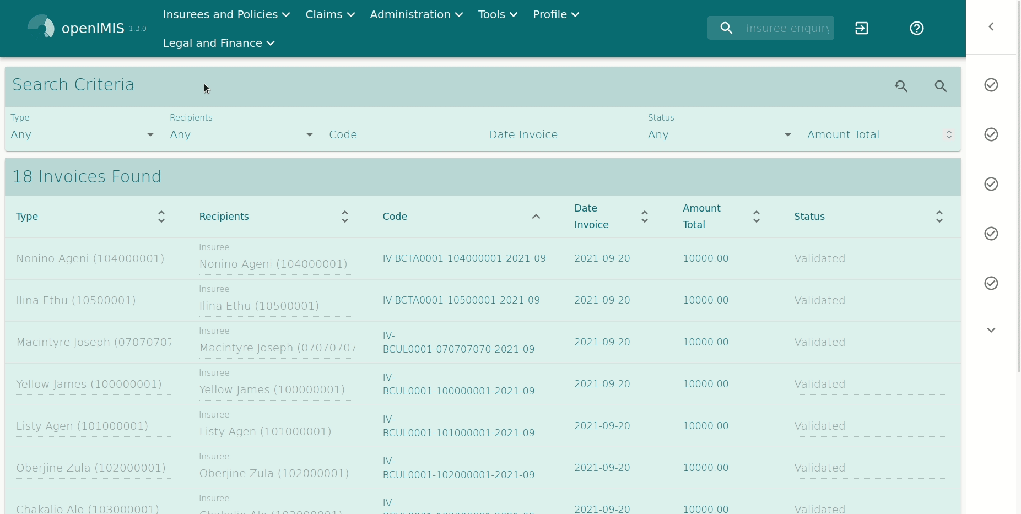
Frontend development

Slide 5
openIMIS Payment Layer

Slide 6
Calculations rules
Dedicated module to convert business object are using calculation rules
Calculation rules are «simple» modules that host business logic code
To be a calculation rule, a module needs to have a class that is based on the AbstractCalculationRule, and implements the mandatory methods and listen to few signals
Advantages:
Calculation rules can be selected with a FE picker
Calculation rules can add parameters to existing FE page (the page need to have a calculation contribution point)
Version control is defined
Objects can depend on calculation rules (the exact rule to be used will depend on the one installed) such as the contribution plan
In our case, the calculation rule would be linkable to contribution or payment* plan

