Slide 1
Payment Layer
Gumzo
8 November 2021

Slide 2
Status
Done:
Invoice and Bill BE module
Calculation rule for legacy contribution
Next:
Invoice and Bill FE module
Payment Plan module
Calculation rules for Claims, Capitation, Commissions
FHIR R4 resource mapping and development (similar to E0 developments)

Slide 3
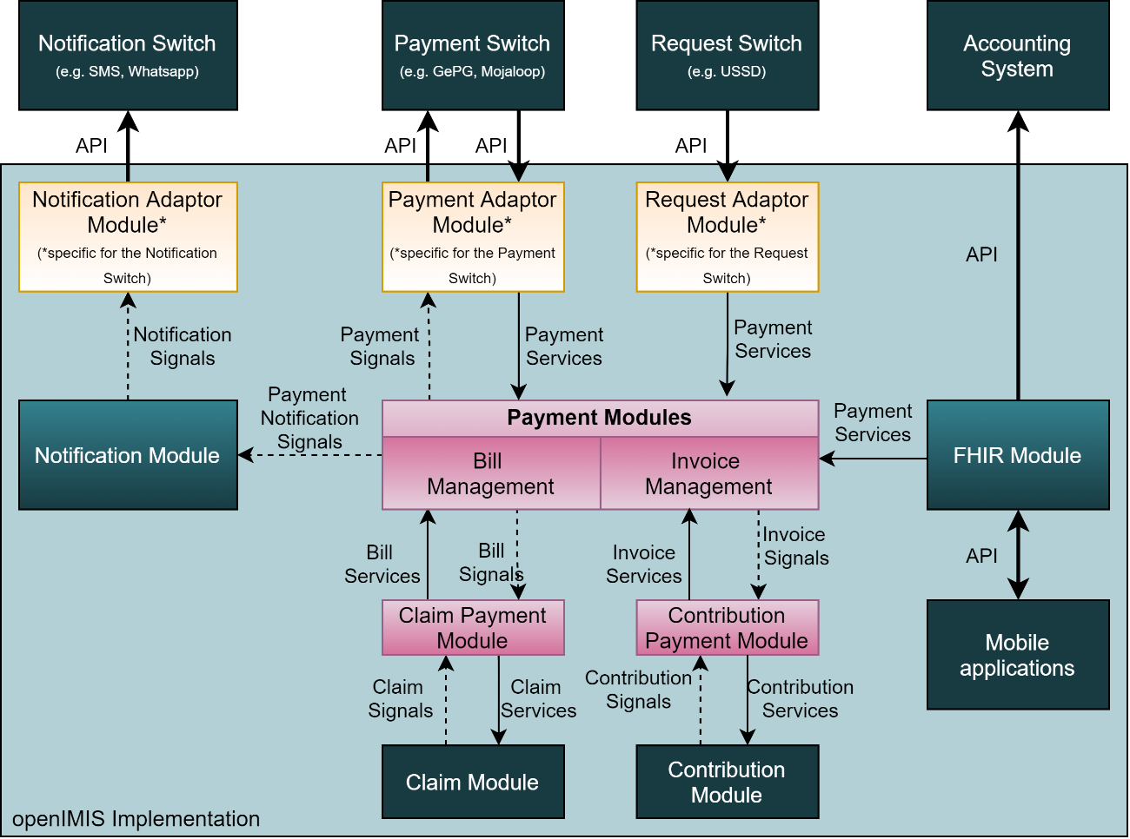
Architecture

Slide 4
Key principles
2 main resources «bill» and «invoice»
Act as abstraction layer for payments
Send signals so specific payments adaptors modules could act on business actions
Provide services that will act as business entry points for payments adaptor modules (and other modules)
Dedicated module to convert business object (claims, contributions, …) into bill and invoice
FHIR resources (to be defined)
Invoice
PaymentNotice

Slide 5
Calculations rules
Dedicated module to convert business object are using calculation rules
Calculation rules are «simple» modules that host business logic code
To be a calculation rule, a module needs to have a class that is based on the AbstractCalculationRule, and implements the mandatory methods and listen to few signals
Advantages:
Calculation rules can be selected with a FE picker
Calculation rules can add parameters to existing FE page (the page need to have a calculation contribution point)
Version control is defined
Objects can depend on calculation rules (the exact rule to be used will depend on the one installed) such as the contribution plan
In our case, the calculation rule would be linkable to contribution or payment* plan

Slide 6
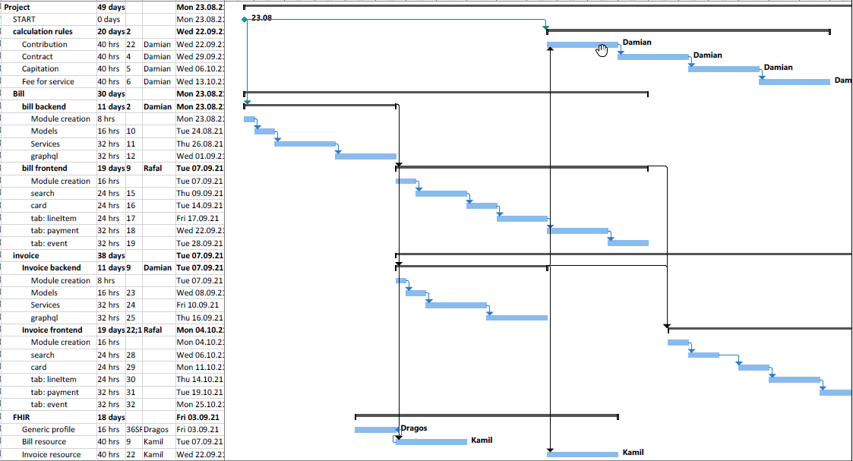
Tentative planning

Slide 7
Links
Calculation rules
Payment and accounts
Account payable - [inbound invoices] bill
Account receivable - [outbound] invoices
Payment plan
Calculation rules

