Slide 1
The FR Community in the openIMIS initiative 28.07.2021 Jean Brice Tetka

Slide 2
The goal of the FR Community
Move from a community of possible implementers to a community of confirmed implementers (ultimate goal)
Make the openIMIS knowledge available in French
Create a space for experience sharing
Build the capacity
Offer tailored support

Slide 3
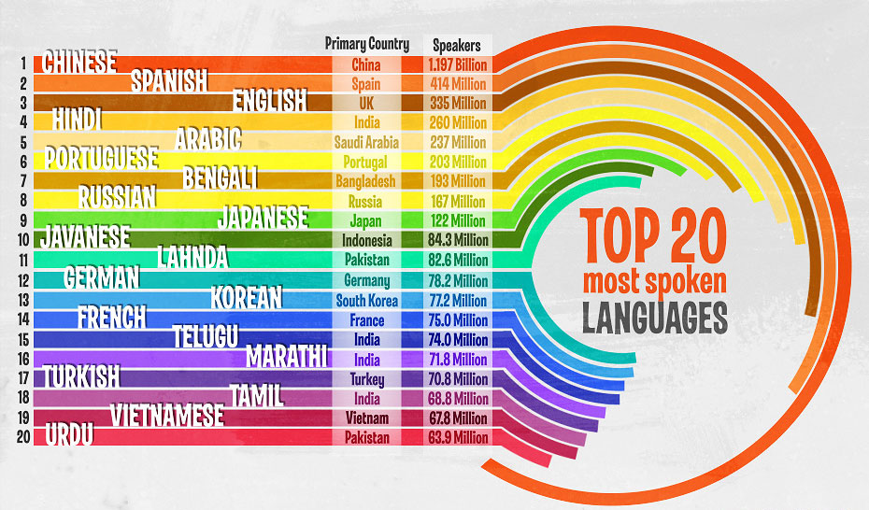
What if another language comes in?

Slide 4
Where to position the FR community on the governance structure?
Note: In openIMIS initiative we have Committee

Slide 5
THANK YOU !
More information on openIMIS
Signup for our newsletter at www.openIMIS.org
openIMIS wiki: wiki.openIMIS.org
Source code: github.com/openimis
Technical documentation: docs.openIMIS.org
www.openIMIS.org
@openIMIS

