Slide 1
openIMIS Shelf Readiness
5 July 2021
Activity Report

Slide 2
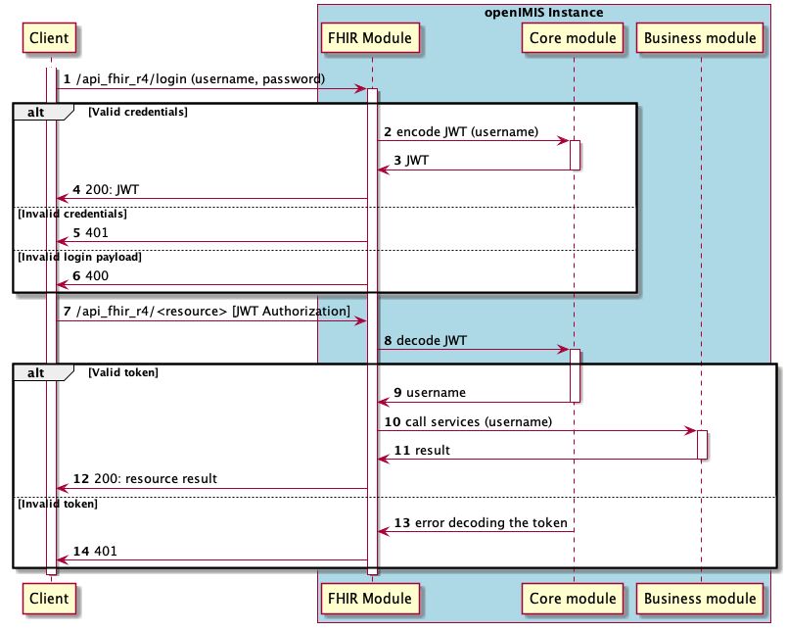
1.3 FHIR Authentication and Authorisation
openIMIS wiki page:
1.3 FHIR Authentication and Authorisation
GitHub FHIR R4 module:
https://github.com/openimis/openimis-be-api_fhir_r4_py
Developments:
FHIR R4 module manages the same JWT authentication mechanism as the new modular openIMIS
/login endpoint developed to receive the JWT from FHIR REST API
All other FHIR endpoints requires Authorization header with JWT bearer token
Added FHIR Authorisation based on User’s role and attached authorities
Missing authorities (permissions) in 8 openIMIS business modules (e.g Claim module) were added
Because authorization is also based on User’s configured locations, the FHIR module takes the query set from business modules

Slide 3
2.1 Docker package improvement
openIMIS wiki page:
2.1 Docker package improvement
GitHub openIMIS Docker:
https://github.com/openimis/openimis-dist_dkr
GitHub openIMIS Instant OpenHIE:
https://github.com/openimis/openimis-dist_instant_openhie
Developments:
openIMIS Docker package has been improved to allow User’s configuration from outside the repositories
Instant OpenHIE compliant Docker package has been developed reducing manual steps and allowing for easy configuration with other services
Communication started with Jembi to integrate the Instant OpenHIE compliant Docker package with the Instant OpenHIE GitHub repository

Slide 4
openIMIS Shelf Readiness

Slide 5
WP1. openIMIS FHIR Module
Objectives (activities):
FHIR release four (R4) integration → 30.09.2021
Develop missing resources (ex. Contract, Enrolment Officer)
FHIR R4 extensions development → 30.09.2021
FHIR R4 extensions development (ex. insuree details)
openIMIS extensions development (ex. medication form and amount)
FHIR Authentication and Authorization → 30.06.2021
JWT authentication management
openIMIS FHIR Quality Assurance → 30.09.2021
Develop tests for the FHIR REST API
openIMIS FHIR module documentation → 31.12.2021
openIMIS FHIR IG
Document interoperability data exchange workflows

Slide 6
WP2. Packaging and Installation
Objectives (activities):
Docker package improvement → 30.06.2021
Publish Docker compose that don't need other files on the computer (using GitHub context)
Comply with Instant OpenHIE’s packaging/deployment strategy
Developer initialization script → 31.12.2021
facilitate the initialization of a ready to start openIMIS development environment

Slide 7
Global architecture for mobile apps usecase

