Slide 1




AI-based Claim Categorization
openIMIS AI PartnerHack
21 June 2021

Slide 3
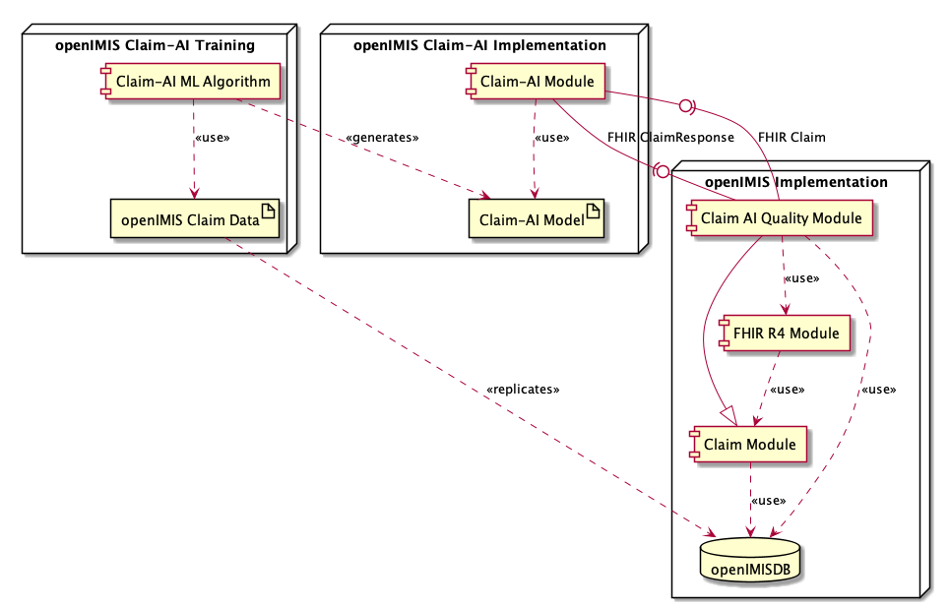
openIMIS Claim-AI Architecture

Slide 5
AI-based Claim Adjudication: Objective
Gathering
Data
Cleaning
Data
Data analysis
Evaluation metrics and acceptance criteria
Training and evaluating ML model
Claim-AI module development
Claim-AI Quality monitor module development
User acceptance testing
Develop and validate an AI-based claim categorization solution capable to:
  Set as accepted/rejected each items/services from all submitted claims (must have)
  Give a rejection reason for each rejected item/service (nice to have)
  Modify the values related to Approved Quantities and Prices for each rejected item/service (nice to have)
Secondary objectives:
  Flag claims containing rejected items/services to be reviewed by Medical Officers
  Allow to check the quality of the AI-based adjudication and to ‘fix’ the misclassified results
  Provide a misclassification report to support in the AI Model re-training decision
  Make the solution generic to be used by other insurance systems

Slide 6
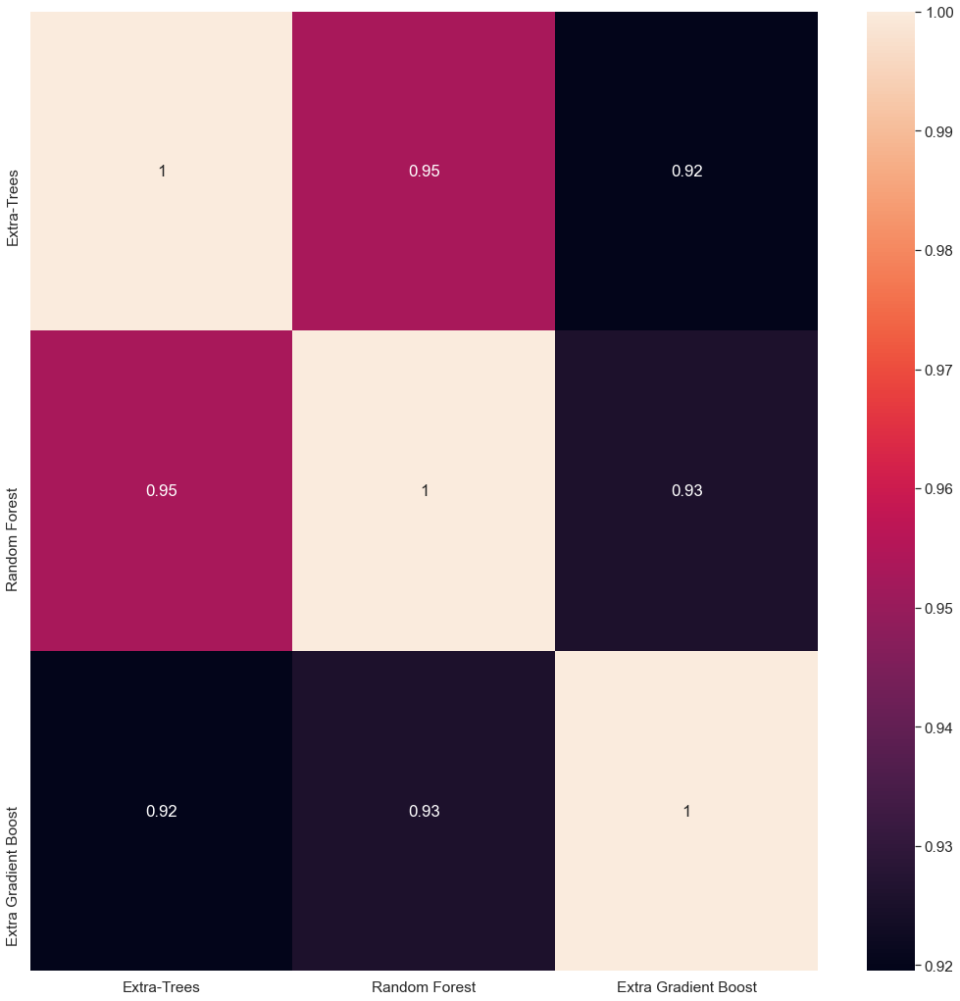
AI model training and evaluation
Gathering
Data
Cleaning
Data
Data analysis
Evaluation metrics and acceptance criteria
Training and evaluating ML model
Claim-AI module development
Claim-AI Quality monitor module development
User acceptance testing
Evaluated models:
Random Forest Classifier
Extra Trees Classifier
Extra Gradient Boost Classifier
Voting Classifier
Decision Trees Classifiers
K Neighbors Classifier
K Means
Deep Learning related techniques
Configurations tested:
random under-sampling
random over-sampling
different selection of features & aggregated features
different normalization methods
F1 Score > 0.6
Accuracy > 0.96

Slide 7
Gathering
Data
Cleaning
Data
Data analysis
Evaluation metrics and acceptance criteria
Training and evaluating ML model
Claim-AI module development
Claim-AI Quality monitor module development
User acceptance testing
From research to production
Gathering
Data
Cleaning
Data
Data analysis
Evaluation metrics and acceptance criteria
Training and evaluating ML model
Offline data
Cleaning data conditions
Normalization and categorization
    Best AI model
Gathering
Data
Cleaning
Data
Data preparation
AI Model execution
User acceptance testing
Online data

Slide 8
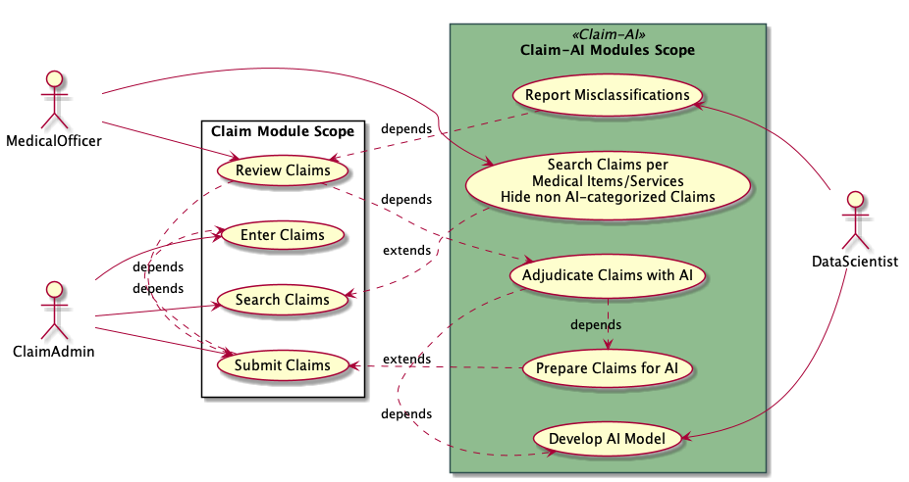
Claim-AI modules development
Gathering
Data
Cleaning
Data
Data analysis
Evaluation metrics and acceptance criteria
Training and evaluating ML model
Claim-AI module development
Claim-AI Quality monitor module development
User acceptance testing

Slide 9
Claim-AI module
Responsibilities
Gathering
Data
Cleaning
Data
Data analysis
Evaluation metrics and acceptance criteria
Training and evaluating ML model
Claim-AI module development
Claim-AI Quality monitor module development
User acceptance testing
Self containing module
Implements an FHIR-based API for Claim submission
Loads the AI Model files
Executes the AI Model to evaluate the submitted Claims

Slide 10
Claim-AI Quality module
Responsibilities
Gathering
Data
Cleaning
Data
Data analysis
Evaluation metrics and acceptance criteria
Training and evaluating ML model
Claim-AI module development
Claim-AI Quality monitor module development
User acceptance testing
Contributes to Claim Review Search with additional filters
Prepares the new submitted claims for AI categorisation
Pushes Claims to Claim-AI module on scheduled task and/or event-based activation
Updates Claims based on the response
Reports Claim adjudication misclassifications

Slide 11
  FHIR Claim input data for Claim-AI module
Gathering
Data
Cleaning
Data
Data analysis
Evaluation metrics and acceptance criteria
Training and evaluating ML model
Claim-AI module development
Claim-AI Quality monitor module development
User acceptance testing
Input data model: FHIR Claim
Output data model: FHIR ClaimResponse
Development of FHIR R4 module
FHIR Contained Resources are required to send all related data
Pagination
FHIR R4 Resource | openIMIS Database Tables | Entity
Claim | tblClaim tblClaim → tblClaimServices tblClaim → tblClaimItems | Claim
Claim → Condition | tblClaim → tblICDCodes | Diagnosis
Claim → HealthcareService | tblClaim → tblHF | Health Facility
Claim → Patient | tblClaim → tblInsurees tblClaim → tblInsurees → tblFamilies | Insuree
Claim → ActivityDefinition | tblClaim → tblClaimServices → tblServices | Medical Service
Claim → Medication | tblClaim → tblClaimItems→ tblItems | Medical Item
Claim → Practitioner | tblClaim → tblClaimAdmin | Claim Administrator

Slide 12
Product Value Chain
Per implementation (data scientist)
Gathering data
Clean data
Data analysis and visualization
Per implementation (automated)
Evaluation metrics and acceptance criteria
Training and evaluating ML model
Global Good
openIMIS Claim-AI module development
Claim-AI Quality module development
Per implementation (implementer)
Module user acceptance testing
Operations

Slide 13
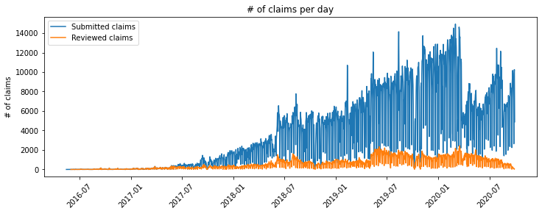
Next steps
Validation on last NHIB database
  Discovered a degradation of the AI Model performance cause by data drift
Data drift is caused by
  COVID situation: data distribution before and after is not the same
  Categorical field proportion more than 60%
Ways to improve
  Solve data drift issues by creating aggregated field → requires access to full DB, meaning a copy of the FHIR data on AI module implementation
  Improve label consistency

Slide 14







More information on openIMIS
Website: www.openIMIS.org (sign up for the newsletter!)
openIMIS wiki: wiki.openIMIS.org
Source code: github.com/openimis
Documentation: docs.openIMIS.org
Demo: demo.openIMIS.org
Contacts SwissTPH:
Dragos Dobre (dragos.dobre@swisstph.ch)
Simona Dobre (simona@dobre.fr)
Project links: openIMIS wiki: openimis.atlassian.net/wiki/spaces/OP/pages/1448542777
Claim-AI research: https://github.com/openimis/openimis-ai-research_py
Claim-AI module BE: https://github.com/openimis/openimis-be-claim_ai_py
Claim-AI Quality BE: github.com/openimis/openimis-be-claim_ai_quality_py
Claim-AI Quality FE: https://github.com/openimis/openimis-fe-claim_ai_quality_js
Thank you
Notes:
GIZ,

